Slide 1
Title Slide
FraudScope: Temporal Graph Learning for Financial Fraud Analysis
Agastya [35], Aamir [36], Taanshu [37], Aveel Lewis [38]
Course: DL Mini Project
Department of Artificial Intelligence and Machine Learning
St. Francis Institute of Technology (SFIT)
Guide: Joanne Gomes
T.E. Semester V, Academic Year 2026-27

Slide 2
Content
Literature Survey Summary Table
Research Gaps
Problem Statement and Objectives
Proposed System and Methodology
System Block Diagram
Dataset Description and Preprocessing
Deep Learning Model Architecture
Tools, Technologies and Environment
Implementation Details
Experimental Setup and Training
Results and Performance Evaluation
Comparison with Baseline / Existing Methods
Sample Outputs and Demonstration
Challenges and Limitations
Conclusion and Future Scope
References

Slide 3
Literature Survey Summary Table
Ref | Author | Problem | Dataset | Method | Limitation
[1] | Liu et al., 2020 | Neighbour inconsistency in GNN fraud detection | Four fraud datasets | GraphConsis: consistency-aware sampling + attention | Time evolution not studied
[2] | Liu et al., 2021 | Imbalanced fraud detection | Fraud graph benchmarks | PCGNN: label-balanced + neighbourhood sampling | No temporal behaviour
[3] | Tong & Shen, 2023 | Transaction fraud under imbalance | Financial transaction data | HHLNGNN: subgraphs, sampling, self-attention | Temporal change weakly modelled
[4] | Motie & Raahemi, 2024 | Review of GNN fraud detection | 33 studies, 5 databases | Systematic review | Little edge-level work
[5] | Wu & Chao, 2024 | Fraud detection with explanation | Supply-chain finance | Heterogeneous GNN + multitask learning | Not bank transactions
[6] | Olaniyan, 2025 | Financial fraud over time | Kaggle - Online Transaction Fraud Detection Datasets | Graph + temporal encoder + contrastive | Complex architecture
[7] | Faruq et al., 2026 | Fraud in transaction networks | Transaction networks | Temporal encoding + link prediction | Closest to our idea
[8] | Shi & Tang, 2026 | Cyber financial fraud, sparse labels | Cyber financial fraud | Spatio-temporal contrastive + uncertainty | Hard to reproduce

Slide 4
Research Gaps
Neighbour-mismatch and sampling methods (GraphConsis, PCGNN, HHLNGNN) do not model how relations evolve over time.
Imbalance is handled by sampling alone; it is unclear whether time adds signal beyond balancing.
Edge-level (transaction) and unsupervised detection are under-explored (2024 review).
Heterogeneous GNN explanations are domain-specific (supply-chain finance), not bank account transactions.
Temporal models (GTCT, STCGNN) are complex; Temporal and Relational GNN is closest to our idea.
Overall gap: early detection of evolving fraud, severe imbalance, leakage-free temporal evaluation and investigator-oriented explanation remain open.

Slide 5
Problem Statement and Objectives
Problem: fraud hides in relationships between accounts that change over time. Rule-based and tabular models treat each transaction in isolation and miss coordinated, evolving fraud rings; fraud is also rare, which skews labels.
Main objective: build a temporal graph learning system that gives a fraud risk score per account or transaction, updated as new events arrive.
Specific objectives:
  Build a temporal transaction graph (accounts = nodes, transactions = edges).
  Compare Random Forest, GraphSAGE and a temporal GNN.
  Evaluate leakage-free (train on past, test on future) using precision, recall, F1 and ROC-AUC.
  Explain each score with reasons and a suspicious-path graph.
Expected output: a 0 to 1 fraud risk score per account, with reasons and the suspicious subgraph, shown in a Streamlit dashboard.

Slide 6
Proposed System, Methodology and Novelty
Proposed solution: FraudScope, a temporal GNN-based fraud scoring and investigation system.
  Workflow: transaction data > preprocessing > graph creation > features > models > fraud score > evaluation > dashboard.
  Deep Learning: GraphSAGE and a temporal GNN learn from account relationships and transaction timing; trained with binary cross-entropy.
Novelty: lightweight temporal GNN compared against tabular and static GNN baselines, with early detection, leakage-free temporal evaluation and a suspicious-path explanation layer.
Rule engine and anomaly scoring from the FundTrace AI prototype (structuring, layering, round-tripping, dormant activation, fan-out, mule behaviour, velocity; Isolation Forest) support the risk reasons.

Slide 7
System Block Diagram
1. Transaction data
Public dataset +
synthetic fraud patterns
2. Preprocessing
Pandas: clean data,
map accounts to node IDs
3. Graph creation
Accounts = nodes,
transactions = edges
(NetworkX, PyG)
4. Features
Node, edge, time:
velocity, gaps, counts
8. Dashboard
Streamlit: risk score,
reasons, suspicious
graph
7. Evaluation
Train on past, test
on future; P, R, F1,
ROC-AUC
6. Fraud score
0 to 1 per account;
BCE loss
5. Models
Random Forest,
GraphSAGE, then
temporal GNN

Slide 8
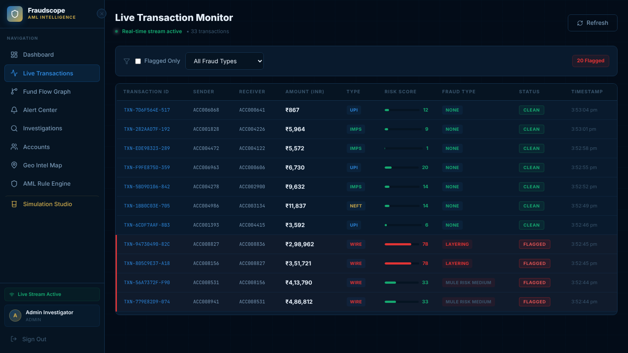
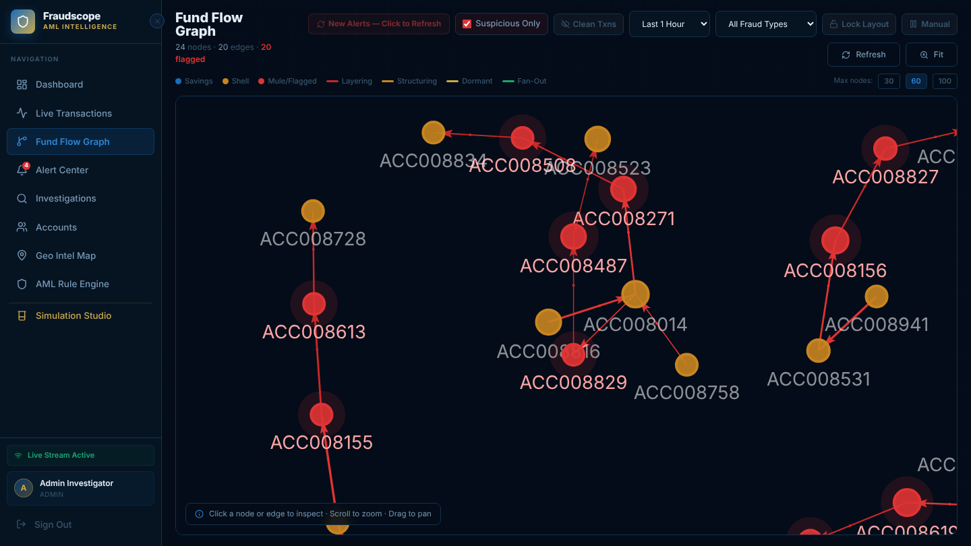
Dataset Description and Pre-processing
Dataset: synthetic transaction data following the FraudScope simulator patterns (30 days, 5,000 accounts, 97,831 transactions).
Samples and classes: binary (fraud / normal), highly imbalanced: 96,841 normal vs 990 fraud transactions (1.0%); 518 / 204 / 205 fraud accounts out of 5,000 in the train / validation / test windows.
Split: temporal, not random. Train on past, validate on a later window, test on the future (days 1-18 train, 19-24 validation, 25-30 test; 58,341 / 19,722 / 19,768 transactions).
Preprocessing: Pandas cleaning, account-to-node-ID mapping, graph construction (NetworkX, PyG); node, edge and time features such as velocity, time gaps and counts.
Challenges: class imbalance, label sparsity, temporal leakage.

Slide 9
Deep Learning Model Architecture
Models: Random Forest (tabular baseline), GraphSAGE (static GNN), temporal GNN (time encoding + edge attributes + message passing).
Input: node, edge and time features of the transaction graph. Output: fraud probability 0 to 1 per account.
Loss: binary cross-entropy. Layer sizes and dimensions: 2 message-passing layers, hidden size 64, 17 node features and 6 edge features plus an 8-dim time encoding, mean + max aggregation, 1 output logit (28,897 trainable parameters; GraphSAGE baseline 10,561).
Pretrained model: none, trained from scratch.
Modification: kept lightweight compared with GTCT and STCGNN so it can be reproduced at mini-project scale.
Input graph
(nodes, edges, time)
Time encoding +
edge features
GraphSAGE
message passing
Temporal GNN
layer
Sigmoid
fraud score

Slide 10
Tools, Technologies and Environment
Tools, technologies and environment used in the project
Component | Details to report
Programming language | Python 3.10+
DL framework | PyTorch Geometric (PyG) 2.8.1 on PyTorch 2.15.0
Development environment | Cloud Linux container, Python scripts (train.py, report.py)
Libraries | Pandas, NumPy, NetworkX, PyG, scikit-learn (Random Forest, Isolation Forest)
Hardware | CPU only: 4 cores, 15 GB RAM, no GPU
Dataset tools | Pandas (CSV load), NetworkX to PyG graph conversion
Interface / deployment | Streamlit dashboard (FraudScope); FundTrace AI prototype: React + Vite, Node.js/Express, Socket.io, FastAPI, MongoDB

Slide 11
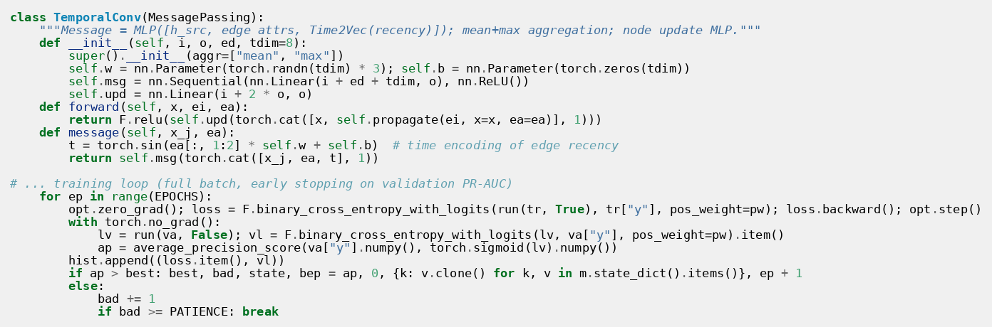
Implementation Details
Data loading and preprocessing: Pandas cleaning, account-to-node-ID mapping, graph built with NetworkX and PyG.
Features: velocity, time gaps, counts, amounts (node, edge and time level).
Models: Random Forest and GraphSAGE baselines, then a temporal GNN.
Loss and optimizer: binary cross-entropy (positive-class weighted); optimizer Adam.
Learning rate, batch size, epochs: learning rate 0.005, full-batch (one temporal graph of 5,000 nodes per window), up to 200 epochs with early stopping (patience 30).
Training and validation: train on past, validate and test on future transactions.
Inference: 0 to 1 fraud score per account, updated as new events arrive.
Interface: Streamlit dashboard with risk score, reasons and suspicious graph.

Slide 12
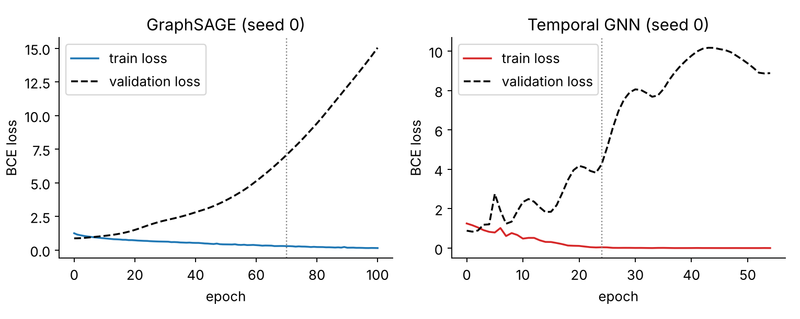
Experimental Setup and Training
Experiments: Random Forest vs GraphSAGE vs temporal GNN on the same temporal split.
Dataset sizes (train / validation / test): 58,341 / 19,722 / 19,768 transactions; 518 / 204 / 205 fraud accounts out of 5,000.
Hyperparameters: learning rate 0.005, hidden size 64, 2 layers, dropout 0.3, weight decay 0.001 (grid-searched on validation PR-AUC).
Epochs completed: Temporal GNN 52-55 (best epoch 22-25), GraphSAGE 97-109 (best epoch 67-79), over 3 seeds.
Training time and hardware: about 13 s (Temporal GNN) and 5 s (GraphSAGE) per run on a 4-core CPU, no GPU.
Imbalance handling and feature variants tested: positive-class weighted BCE and an F1-optimal threshold chosen on validation; mean-only vs mean + max aggregation (mean + max kept).
Metrics: precision, recall, F1, ROC-AUC (accuracy is not used because it misleads on 96,841 normal vs 990 fraud).

Slide 13
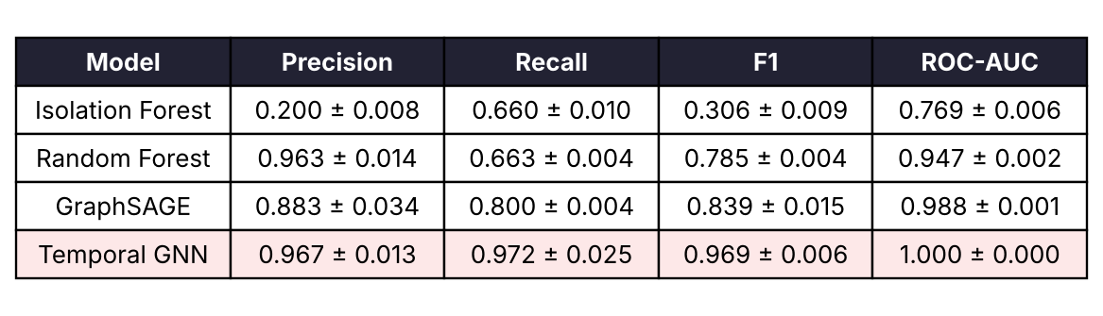
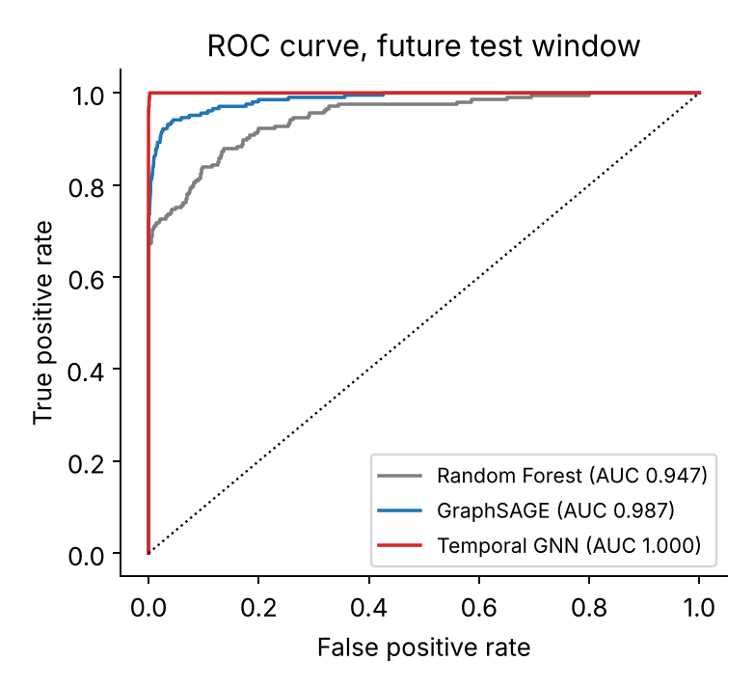
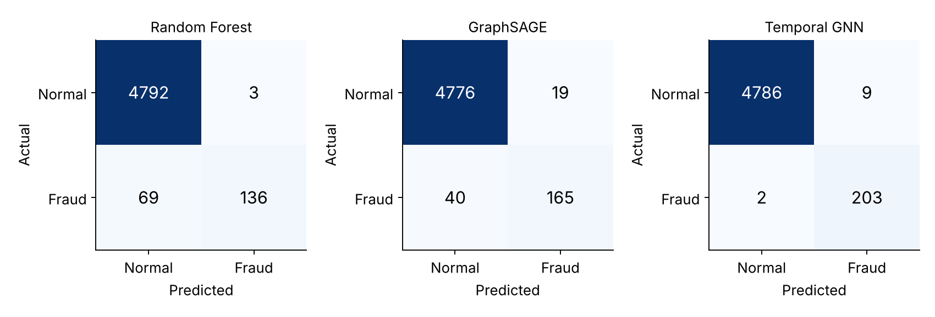
Results and Performance Evaluation
Metrics reported: precision, recall, F1 and ROC-AUC for each model on the future test set.

Slide 14
Comparison with Baseline / Existing Methods
Baselines: Random Forest (tabular) and GraphSAGE (static graph); Isolation Forest and rule-based detectors from FundTrace AI as non-deep reference.
Metrics: precision, recall, F1, ROC-AUC on the same leakage-free temporal split.
Question tested: does temporal behaviour beat tabular and static GNN baselines? Literature (GTCT ablation) suggests temporal encoders add recall and AUC. Outcome: on the future test window the Temporal GNN reached F1 0.969 and ROC-AUC 1.000, against 0.839 / 0.988 for GraphSAGE, 0.785 / 0.947 for Random Forest and 0.306 / 0.769 for Isolation Forest; recall rose to 0.972 from 0.800 and 0.663. Rule-based detectors were not scored separately. These are synthetic-data results.

Slide 15
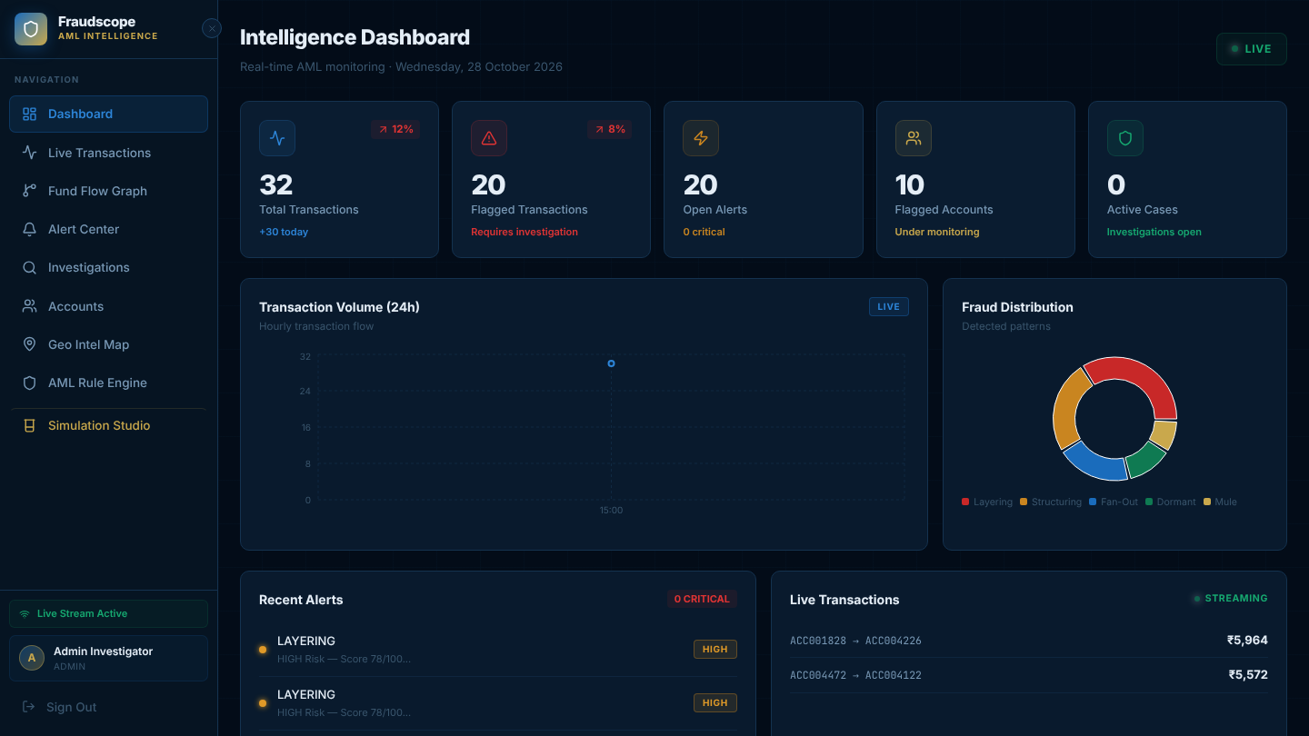
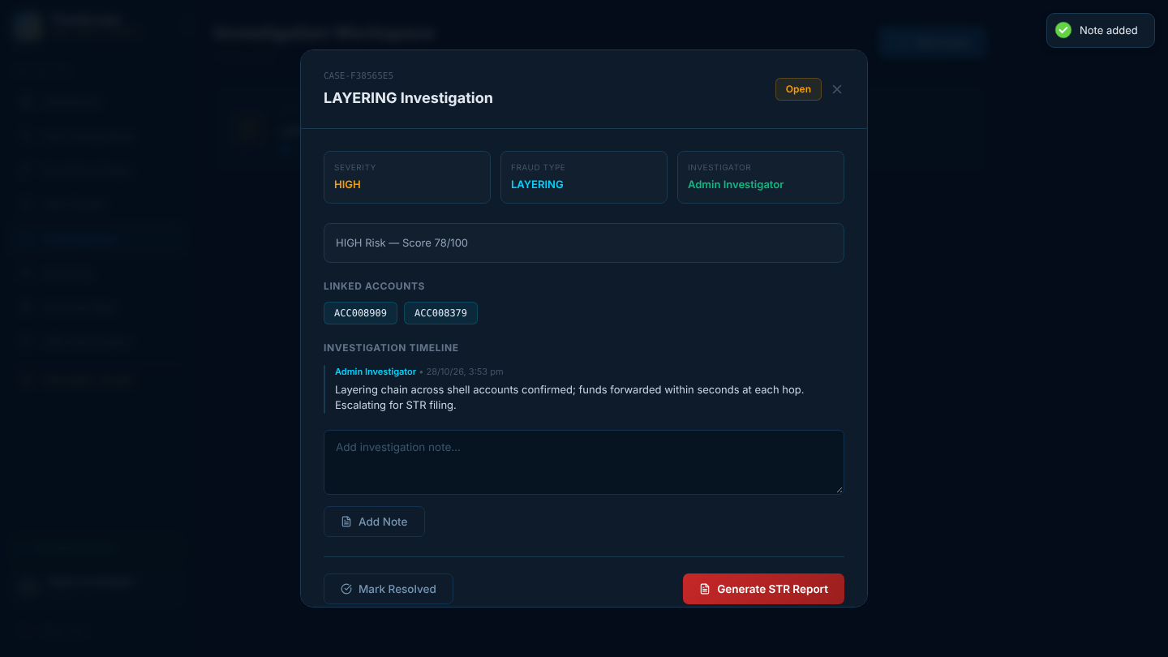
Sample Outputs and Demonstration
FundTrace AI demo: live transaction stream, alert "Layering chain detected - CRITICAL", animated red laundering path in the fund flow graph.
Case workspace with notes and one-click STR PDF report.

Slide 16
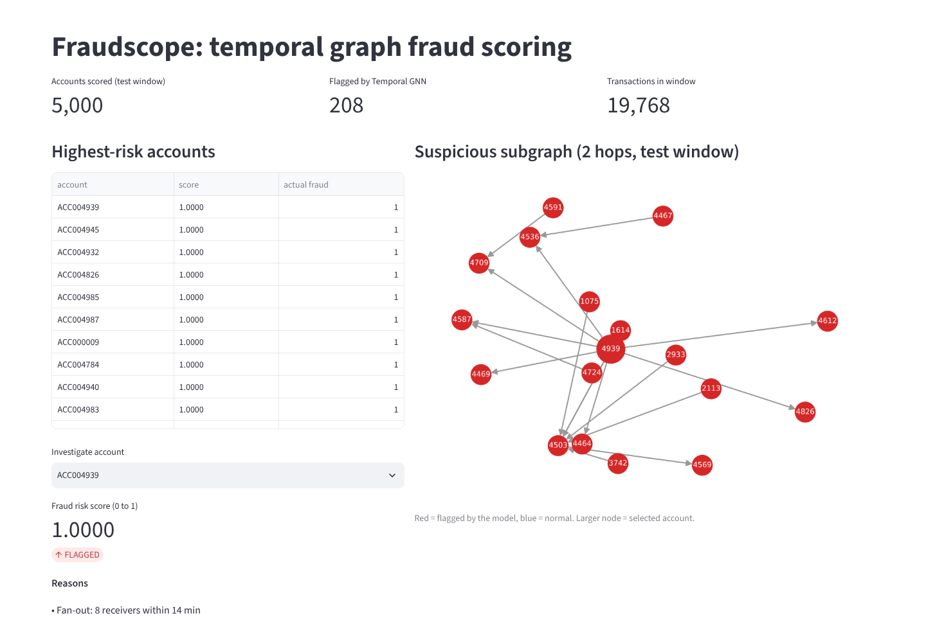
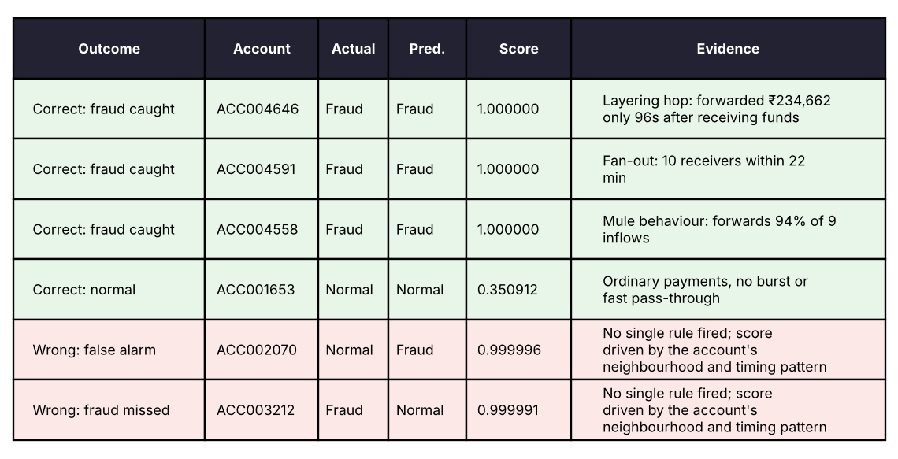
Sample Outputs and Demonstration
FraudScope dashboard: risk score, reasons and suspicious graph per account.
Correct and incorrect predictions.
Confusion matrix and plots.

Slide 17
Challenges and Limitations
Severe class imbalance: very few fraud labels, so accuracy misleads and precision / recall / F1 are needed.
Avoiding temporal leakage: strict past-to-future split instead of random split.
Limited real labelled fraud data, so synthetic fraud patterns were added.
Closest paper (Temporal and Relational GNNs) overlaps our idea, so novelty has to be specific; STCGNN and GTCT are complex to reproduce.

Slide 18
Conclusion and Future Scope
Conclusion
Implemented a temporal graph fraud scoring pipeline: transaction graph, features, Random Forest / GraphSAGE / temporal GNN, and a Streamlit dashboard.
Main results: Temporal GNN on the future test window: precision 0.967, recall 0.972, F1 0.969, ROC-AUC 1.000 (mean of 3 seeds, synthetic data).
Objectives met: all four on simulated data (temporal graph built, three models compared leakage-free, scores with reasons and subgraph in the dashboard); validation on real bank data remains.
Future scope
Early detection of evolving fraud and transaction-level (edge) fraud.
Uncertainty-aware risk scores.
Real-world validation and Neo4j for heavy graph workloads (FundTrace roadmap).
Additional features: integration with STR / FIU reporting.

Slide 19
References
[1] Liu, Dou, Yu, Deng, Peng, "GraphConsis: Alleviating the Inconsistency Problem of Applying GNN to Fraud Detection," ACM SIGIR, 2020.
[2] Y. Liu et al., "PCGNN: Pick and Choose, a GNN-based Imbalanced Learning Approach for Fraud Detection," The Web Conference, 2021.
[3] G. Tong, J. Shen, "Financial Transaction Fraud Detector Based on Imbalance Learning and GNN," Applied Soft Computing, 2023.
[4] S. Motie, B. Raahemi, "Financial Fraud Detection Using GNNs: A Systematic Review," Expert Systems with Applications, 2024.
[5] B. Wu, K.-M. Chao, "Heterogeneous GNNs for Fraud Detection and Explanation in Supply Chain Finance," Information Systems, 2024.
[6] J. Olaniyan, D. Olaniyan, "Graph-Temporal Contrastive Transformer for Financial Fraud Detection," Algorithms, 2025.
[7] M. O. Faruq et al., "Temporal and Relational GNNs for Fraud Detection in Transaction Networks," IEEE Open J. Computer Society, 2026.
[8] Y. Shi, M. Tang, "Uncertainty-aware Spatio-Temporal Contrastive GNN for Cyber Financial Fraud Detection," Scientific Reports, 2026.
[9] Tools: PyTorch Geometric, NetworkX, scikit-learn, Pandas, Streamlit; FundTrace AI prototype (React, Node.js, FastAPI); dataset synthetic transactions from ml-service/gnn/gen_data.py.

