Slide 1

Agro Favor
Ecommerce
Website

Slide 2

TEAM: Harshwardhan Shelar Kirti Dahake
GUIDE Name: Rupali Thorat Mam

Slide 3

Abstract
The system is implemented using a 3-tier approach, with a backend database, a middle tier of spring boot server application, and the react front end client accessed through web browser. Agro Favor uses multi-tier MVC architecture, server and client side scripting techniques, implementation technologies such as Java(OOP), Spring Boot, Hibernate, BOOTSTRAP, HTML5, CSS, ReactJS, relational databases (MySQL) etc.
Agro Favor is a web portal that will be used to generate farm related orders from customers and facilitate suppliers to supply those orders.

Slide 4
Introduction :
Rapid growth of agriculture industry is creating significant increase in demand for the agriculture products and machineries across the globe. The growing digitalization and rapidly spreading internet connectivity can enable farmers to access farm related services from their place and as per their need. To achieve sustainable growth within India’s agricultural industry there is need of simplifying the process of shopping of farming related products and equipment’s by farmers throughout the country. The quality of life of farmers throughout India can be improved by providing the technological infrastructure necessary to create the smarter future of farming.

Slide 5




Purpose
Organic
Product
Evergreen Foliage
Healthy Vegetables
To make farming materials more affordable and accessible - especially for those living in remote communities. We were founded on a dream to improve the quality of life for farmers in India, and a hope to make a sustainable and revolutionary change in the agriculture industry.

Slide 6
Scope
Agro Favor interacts with the database to get product information & display it to customer, allows customer to add product to the cart, view order details & place an order. It also provides suppliers their respective orders, delivery details and inform suppliers about stocks of a product. Secondary information like previous orders and cart details are also stored in the database for future retrieval.

Slide 7
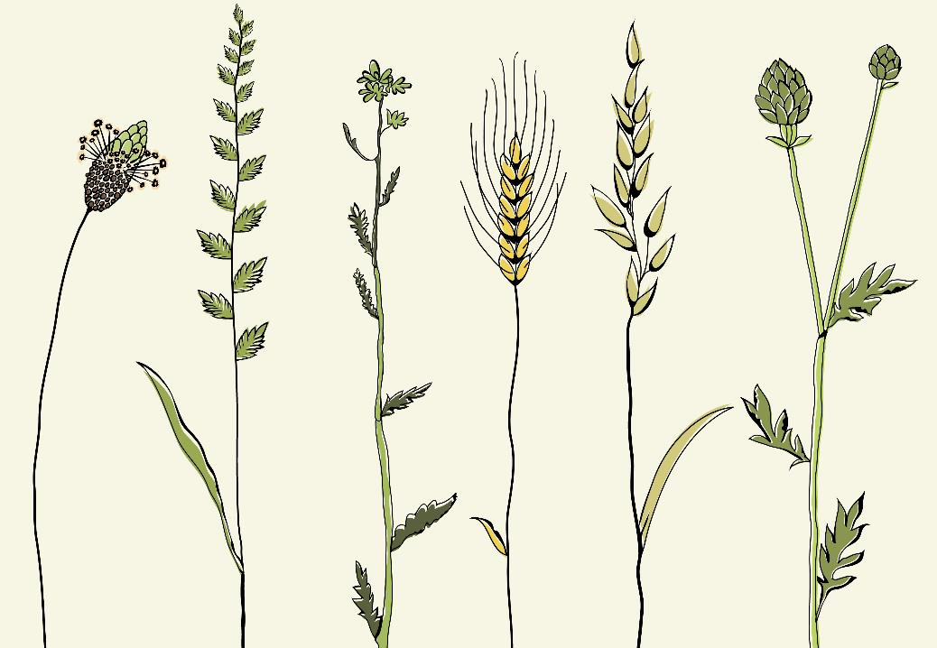
Features
Provide latest equipment for farming
Organic Farming Materials
Doorstep delivery
Assistance to farmer by renting heavy equipment
Easy return policy
Availability of the menu online 24x7

Slide 8
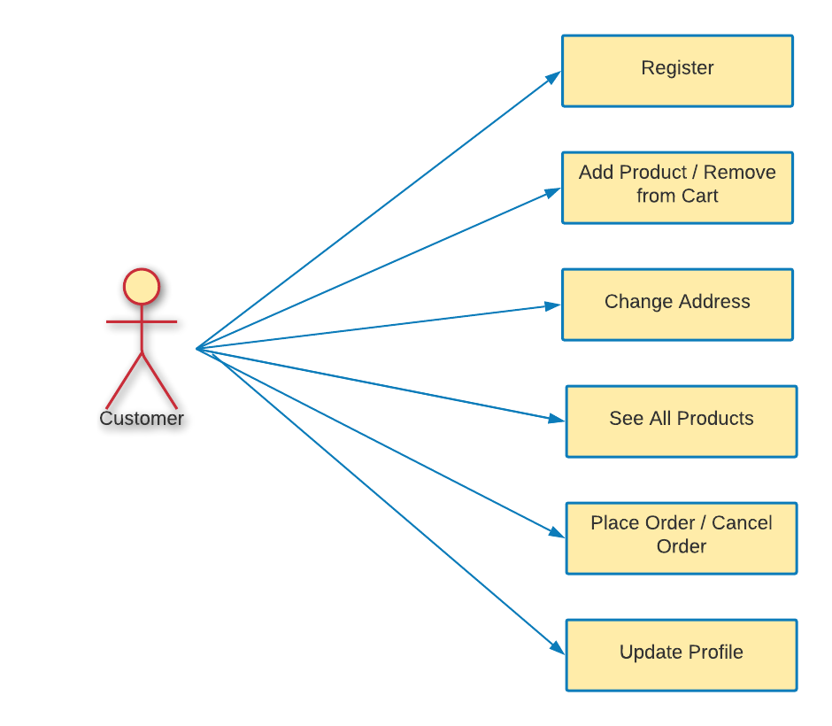
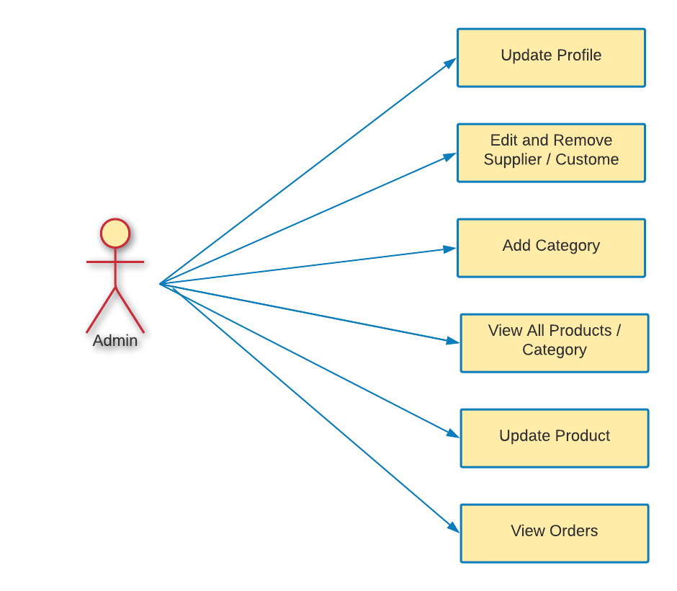
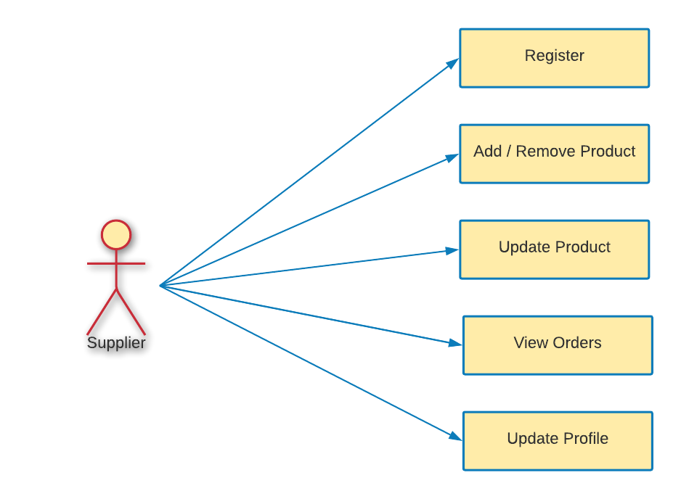
Functional Requirements (UML)

Slide 9
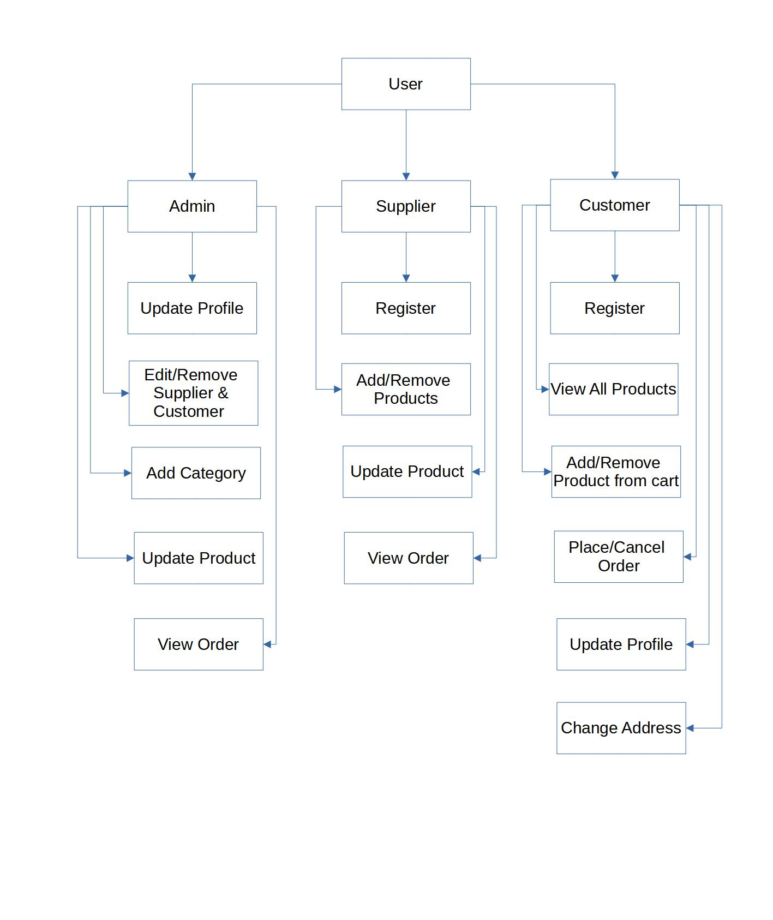
Functional Decomposition Diagram

Slide 10

Benefits
The rich variety of online websites makes customers do their wishes very quickly where this website helps to add products easily to cart for customers and Admin section also admin can manages the menu list of the User Interface where admin can the add new products to the list and also update the product list and also can delete the products which admin don’t want to keep it in a menu list this system will helps to user and admin to do a functions in a easy manner. This website will contains function such as add to cart, view menu, etc.

Slide 11



Competition

Slide 12




Links
AWS Link
http://3.141.195.17:3000/home
YouTube Link
https://youtu.be/gQKyiZSD9UY
GitLab Link
https://github.com/ImHarshwardhan/Agro_Favor

Slide 13
Conclusion
Agro favor is an E-Commerce platform which is not just about conducting business transactions via the Internet. Its impact will be far-reaching, and more prominent by aiding in growth of agriculture sector.
As companies and suppliers are gaining direct access to farmers, they can generate high profits with better customer reach and satisfaction. As more and more other companies will join into the initiative and more products/ services will be made available to farmers.
This new approach towards functional and farmer centric e-commerce platform will create entirely new economy and that will tremendously change lives of farmers and those dependent on agriculture for living.
It will reshape the competition in various industries, and facilitate farmers to get better farm products like seeds, fertilizers and machinery at low cost. Since more businesses are being held online resulting in higher overall development and emergence of a more innovative and advanced technology in agriculture sector.

Slide 14
References
Stack Overflow: https://stackoverflow.com/
GitHub: https://github.com/
Java Docs: https://docs.oracle.com/javase/8/docs/technotes/tools/windows/javadoc.html
Spring Boot Docs: https://docs.spring.io/spring-boot/docs/current/reference/htmlsingle/
Hibernate Docs: https://hibernate.org/orm/documentation/5.4/
ReactJS Docs: https://reactjs.org/docs/getting-started.html
Farmkart : https://farmkart.com/

Slide 15



Thank you
Contact us:
farmforever2020@gmail.com
http://3.19.32.190:3000/about

