Slide 1

Unit 7: Equilibrium
7.1 Intro to Equilibrium
7.2 Direction of Reversible Rxns
7.3 Rxn Quotient and the EQ Constant
7.4 Calculating the Equilibrium Constant
7.6 Properties of the Equilibrium Constant

Slide 2
Reversible Reactions and the Concept of Equilibrium
Some reactions can go both forward or in reverse. These are called reversible reactions.
A RATE can be calculated for both the forward reaction and the reverse reaction.
Chemical equilibrium occurs when a reaction and its reverse reaction proceed at the same RATE. As many molecules are being made as broken.

Slide 3
Chemical equilibrium
state where concentrations of products and reactants remain constant
equilibrium is dynamic (reaction is still happening)
any chemical reaction in a closed vessel will reach equilibrium
at equilibrium, forward reaction rate = reverse reaction rate
RATES are equal, CONCENTRATIONS are constant

Slide 4
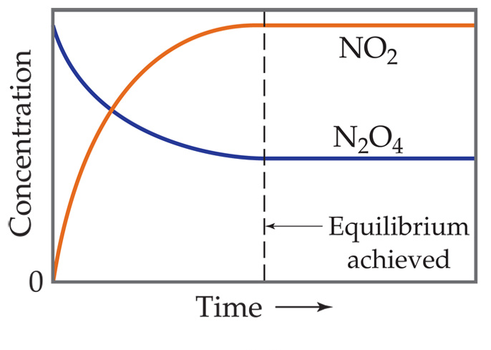

A System at Equilibrium
Once equilibrium is achieved, the amount of each reactant and product remains constant. (Not equal, but constant.)

Slide 5

The Reaction Quotient, Q
For the general reversible reaction:
the reaction quotient is expressed as:
PRODUCTS OVER REACTANTS
Q =
Q is the ratio of products to reactants and allows us to examine the reaction position, whether nearer the products or nearer the reactant.
What Q value could indicate a position near completion?

Slide 6
No liquids and solids allowed!
Because equilibrium depends on rates, the collision theory tells us that it only includes particles that can actually collide.
For this reason, the reaction quotient expressions only include gases or dissolved particles, and NOT liquids or solids.

Slide 7
Don’t worry about units….
The units for Q (and later K) depend on the reaction. They are usually not used.

Slide 8
Write the Q expression for the following reactions:
H₂ (g) + F₂ (g)⇄ 2HF (g)
2. Mg (s) + 2CuCl (aq) ⇄ 2Cu (s) + MgCl₂ (aq)
3. 2H₂0 (l) ⇄ 2H₂ (g) + O₂ (g)
4. Cl₂ (g) + 2Na (s) ⇄ 2NaCl (s)

Slide 9
The Equilibrium Expression (Law of Mass Action)
For the general at equilibrium reaction:
the equilibrium expression is ALWAYS PRODUCTS OVER REACTANTS:
K_{eq} =
K_{eq} is the equilibrium CONSTANT- the ratio of products to reactants when the system is at EQUILIBRIUM.
If a system IS at equilibrium, Q = K_{eq}. The forward and reverse rates are equal.
If a system is NOT at equilibrium, Q ≠ K_{eq}. The reaction will shift until Q=K_{eq}.

Slide 10
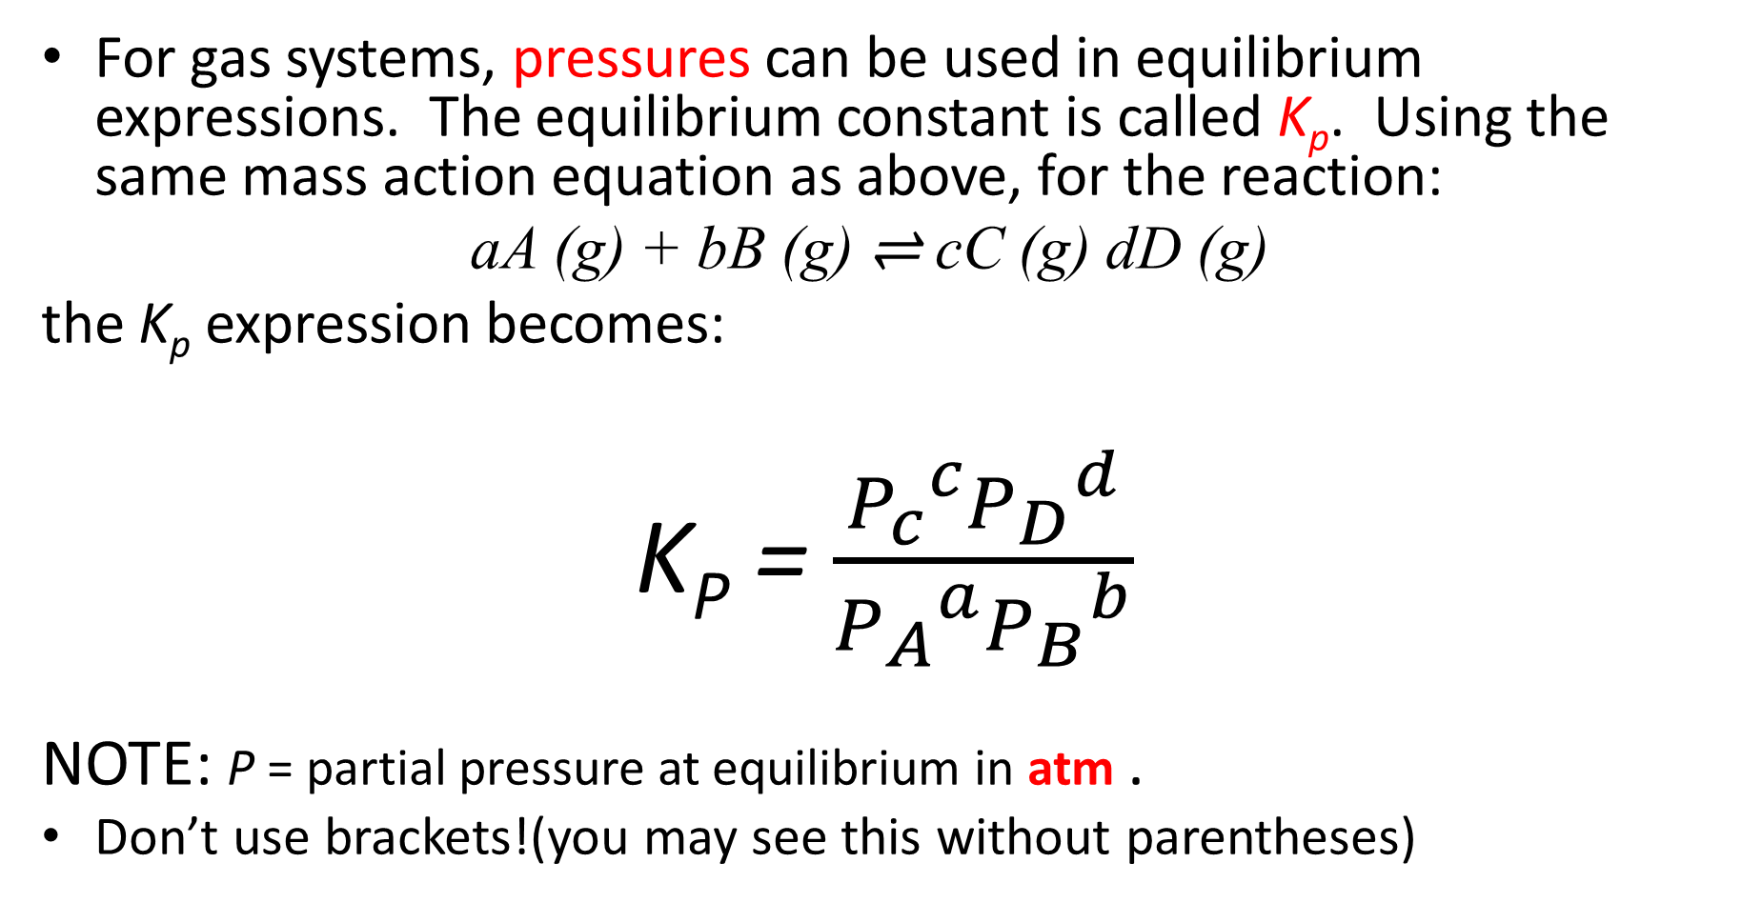
Gas Systems and Pressures in K
For gas systems, pressures can be used in equilibrium expressions. The equilibrium constant is called K_{p}. Using the same mass action equation as above, for the reaction:
aA (g) + bB (g) ⇌ cC (g) dD (g)
the K_{p} expression becomes:
K_{P} = $\frac{{P_{c}}^{c}{P_{D}}^{d}}{{P_{A}}^{a}{P_{B}}^{b}}$
NOTE: P = partial pressure at equilibrium in atm .
Don’t use brackets!(you may see this without parentheses)

Slide 11
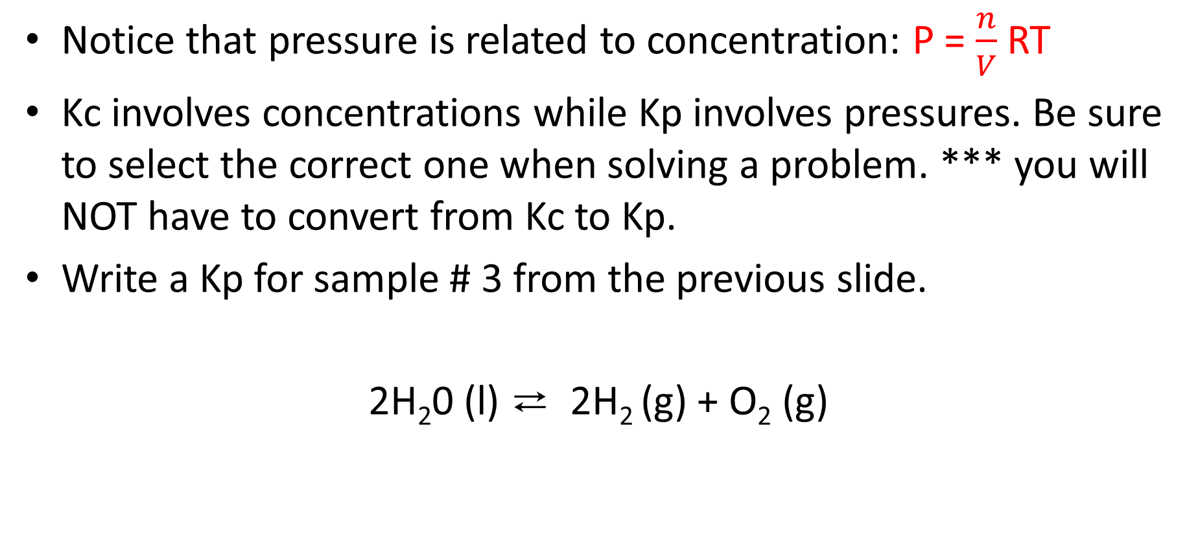
Kc or Kp?
Notice that pressure is related to concentration: P = $\frac{n}{V}$RT
Kc involves concentrations while Kp involves pressures. Be sure to select the correct one when solving a problem. *** you will NOT have to convert from Kc to Kp.
Write a Kp for sample # 3 from the previous slide.
2H₂0 (l) ⇄ 2H₂ (g) + O₂ (g)

Slide 12
K is a CONSTANT. This means that for a given reaction at a given temperature, the ratio of P/R at equilibrium will always be the same. For any reaction, K only changes with temperature (not with concentration or pressure).

Slide 13
Ex. Write an Equilibrium Expression 4 NH₃(g) + 7 O₂(g)  4 NO₂(g) + 6 H₂O(g) If we know equilibrium concentrations, we can calculate the equilibrium constant, K_{c}.

Slide 14
K changes with temperature (not with concentration or pressure).
A K value is only true for one reaction at one specific temperature.
Change the temperature and K will change.

Slide 15
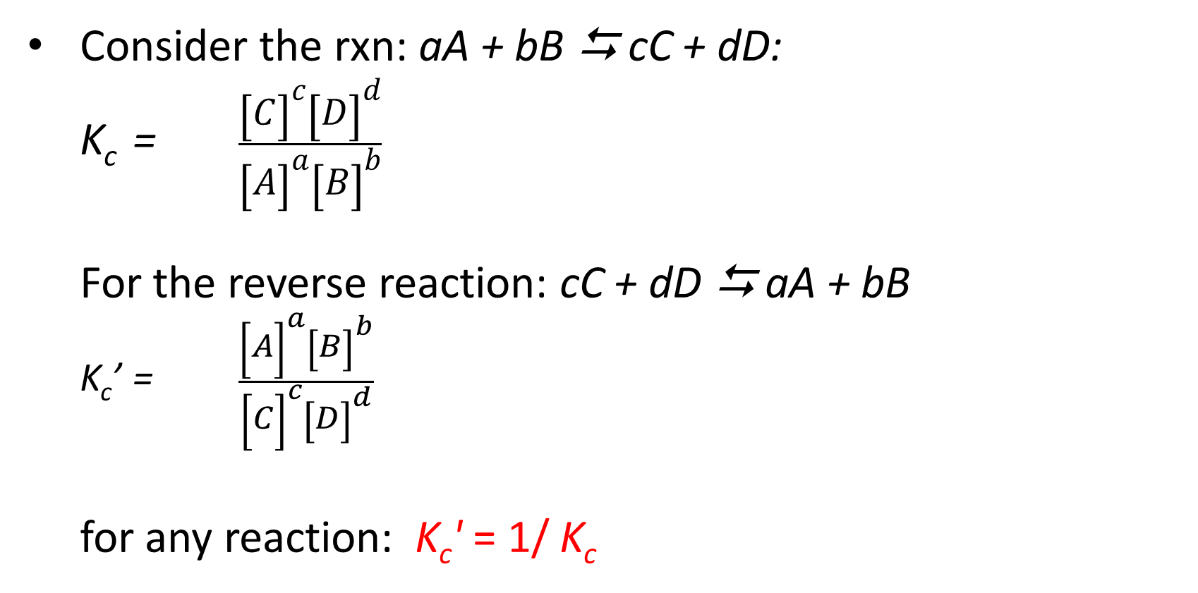
Consider the rxn: aA + bB  cC + dD: K_{c} = $\frac{{\left[C\right]}^{c}{\left[D\right]}^{d}}{{\left[A\right]}^{a}{\left[B\right]}^{b}}$ For the reverse reaction: cC + dD  aA + bB K_{c}’ = $\frac{{\left[A\right]}^{a}{\left[B\right]}^{b}}{{\left[C\right]}^{c}{\left[D\right]}^{d}}$ for any reaction: K_{c}' = 1/ K_{c}
Properties of the Equilibrium Constant

Slide 16
Practice
For the reaction: A  B, K_{eq} = 3.4
Write the expression for K_{eq.}
Write the reverse reaction, the corresponding equilibrium expression, and calculate its value.

Slide 17
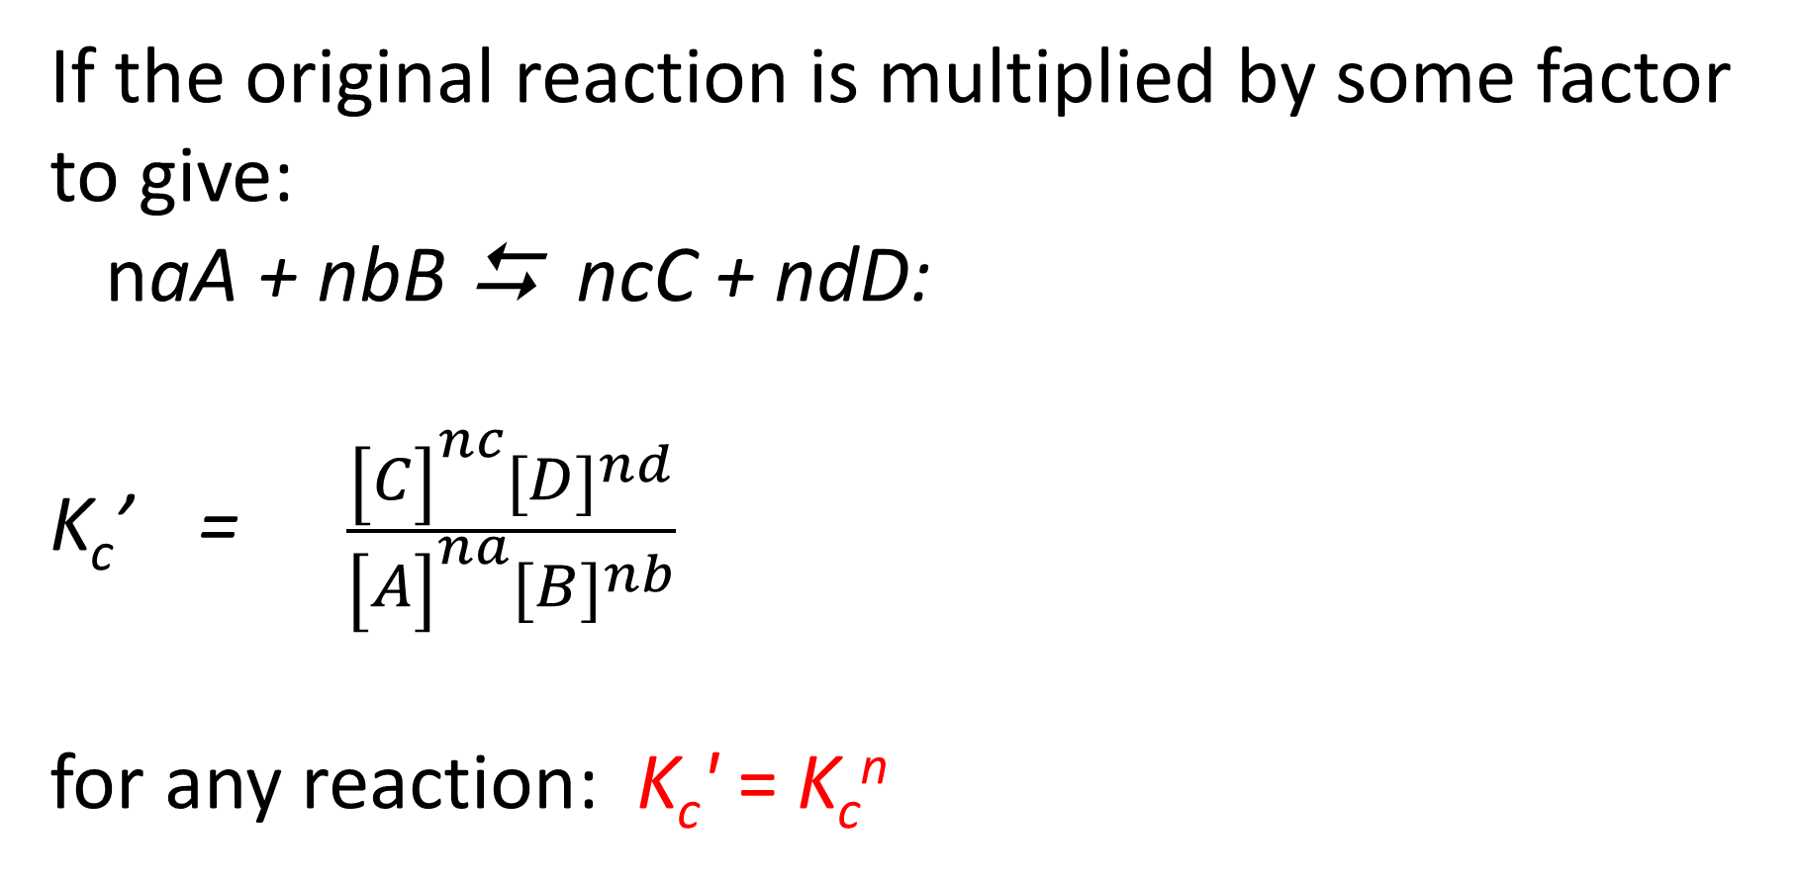
If the original reaction is multiplied by some factor to give: naA + nbB  ncC + ndD: K_{c}’ = $\frac{{\left[C\right]}^{nc}{\left[D\right]}^{nd}}{{\left[A\right]}^{na}{\left[B\right]}^{nb}}$ for any reaction: K_{c}' = K_{c}^{n}

Slide 18
Practice
For the reaction: A  B, K_{eq} = 3.4
For the reaction 2A  2B Write the corresponding equilibrium expression, and calculate its value.

Slide 19
For a 2-step reaction with K_{c1} and K_{c2} as K_{c} values for each step, the K_{c} for the overall reaction is K_{c} = K_{c1} × K_{c2}. Suppose that for reaction 1: A + B ⇄ C K₁ = 0.10 And that reaction 2: C + B ⇄ D K₂ = 4.5 What is the overall reaction? What is the value of K for the overall reaction?

Slide 20
Practice: For the reaction:
AgCl (aq)+ Na (s) ⇄ NaCl (aq) + Ag (s) , K = 5.7 x 10¹¹,
What is the equilibrium expression?
Calculate K for the reaction:
2AgCl (aq)+ 2Na (s) ⇄ 2NaCl (aq) + 2Ag (s)
Calculate K for the reaction:
NaCl (aq) + Ag (s) ⇄ AgCl (aq)+ Na (s)

Slide 21
Unit 7: Equilibrium
7.5 Magnitude of the Equilibrium Constant
7.8 Representations of Equilibrium

Slide 22
Determining if a reaction is at the Equilibrium Position
Every reversible reaction has an equilibrium constant, K that is temperature specific, in other words, if you change the temperature, you change K for that reaction
At equilibrium, Q = K
A Q value can be used to determine if a system is at equilibrium, and also what direction (forward or reverse) it will be shifting to reach equilibrium.
Q- “Questioning” whether system is at EQ. Use given concentrations to calculate a Q value using the K expression, and compare to the K.

Slide 23
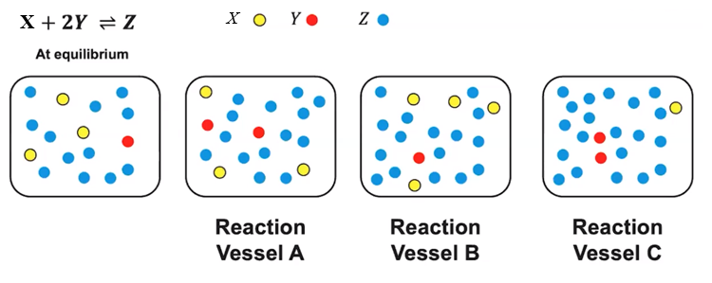
Which of the following systems are at equilibrium?

Slide 24
Using Q and K
Practice: For the synthesis of ammonia, the value of K is 6×10⁻² at 500ºC. In an experiment, 0.50 mol of N₂(g), 1.0×10⁻² mol of H₂(g), and 1.0×10⁻⁴ mol of NH₃(g) are mixed at 500ºC in a 1.0 L flask. In which direction will the system proceed to reach equilibrium?

Slide 25
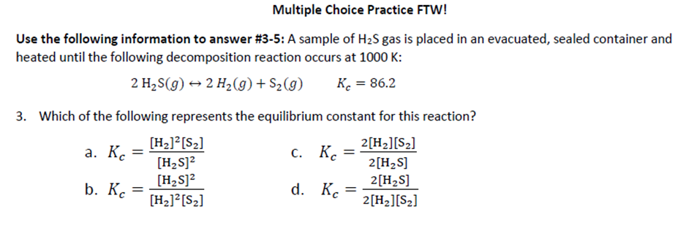
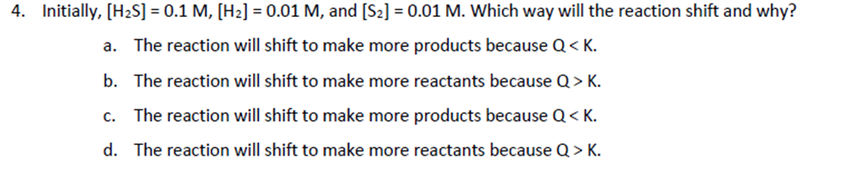

Slide 26
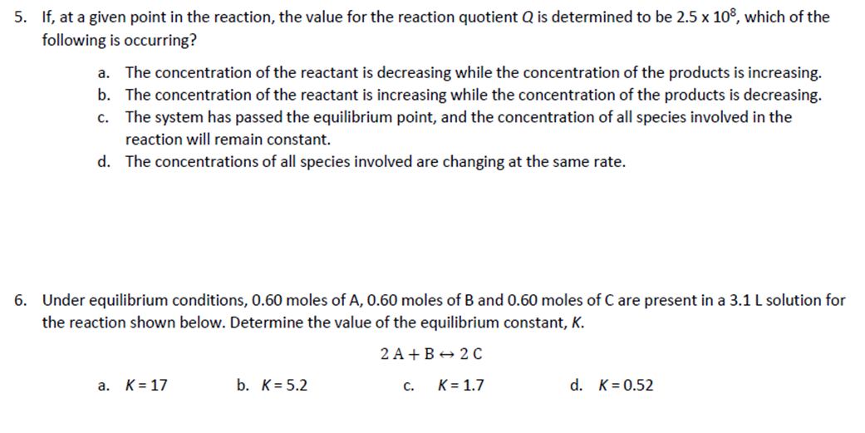

Slide 27
Consider: moles/liter must be used for aqueous systems, but they can also be used for gases
At a 298 K, a 3.0-L flask contains 2.4 mol of Cl₂ , 1.0 mol NOCl, and 4.5 x 10⁻³ mol NO. Calculate K_{eq} at this temperature for the following reaction (assuming the reaction is at equilibrium):
2 NOCl (g)⇄2 NO (g) + Cl₂ (g)
Write an equilibrium expression for the reaction and solve for the value of K_{c} at 298 K.
What does this K_{c} value tell us about the system at equilibrium?

Slide 28
Using K to find concentrations
The reaction: H₂ (g) + F₂ (g)⇄ 2HF (g) has an equilibrium constant of Kc = 16 at 400°C.
If the system at equilibrium was shown to have [H₂] = [F₂] = 1.0 M, What is the [HF]?
At 400°C, does this reaction favor the products or reactants? How do you know?

Slide 29
Suppose in another reaction of H₂, F₂, and HF, also at 400°C, we increase the concentration of reactants and when equilibrium was reestablished, the new [H₂]= [F₂] = 2.0 M.
What would be the [HF] under these circumstances?

Slide 30
Equilibrium position
Equilibrium position - a set of equilibrium concentrations that establish a ratio of products to reactants equal to the equilibrium constant. Can be visualized on a number line.
What is true when K=1? - The SIZE of the K value can tell you something about the reaction

Slide 31
For a reaction with K>1, this means that there are more PRODUCTS than REACTANTS at equilibrium. This reaction is said to ‘favor the products’ at equilibrium.
For a reaction with K<1, this means that there are more REACTANTS than PRODUCTS at equilibrium. This reaction is said to ‘favor the reactants’ at equilibrium.
Kinetic Control: The size of K and the time needed to reach equilibrium are not directly related. (example…. 2 Fe + 3 O₂ ⇌ Fe₂O₃)
K values of two reactions cannot always be directly compared because stoichiometry differences.

Slide 32
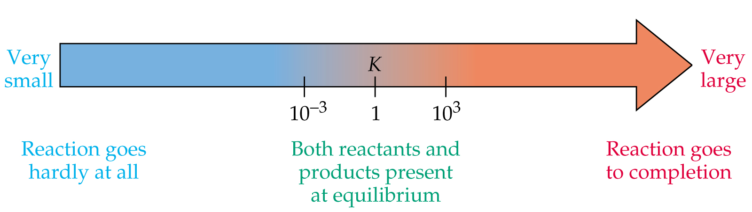
If the value for K is very small, reactants are present in great excess at equilibrium and the reaction hardly occurs at all.
If the value for K is very large, products are present in great excess at equilibrium, and the reaction is said to go to completion. (Remember that a large K does not necessarily mean the reaction is fast!)
Values for K in the range of 0.001 to 1000 describe reactions where reactants and products are both present in significant quantities at equilibrium.
The size of K determines how to analyze an equilibrium problem!

Slide 33
Consider the reaction 2NOCl(g)  2NO(g) + Cl₂(g) at 35ºC. Various amounts of NOCl(g), NO(g), and Cl₂(g) are mixed in a 10.0 L flask. After the system has reached equilibrium the concentrations are observed to be: [Cl₂] = 1.52 x 10⁻¹ M [NO] = 4.00 x 10⁻³ M [NOCl] = 3.96 x 10⁻¹ M a. Calculate the value of K for this system at 35ºC. b. What can we conclude about the reaction progress from the value of K?
Always set up the expression w/o numbers first!
= 1.55 × 10⁻⁵
Never use initial concentrations,
only equilibrium concentrations!

Slide 34
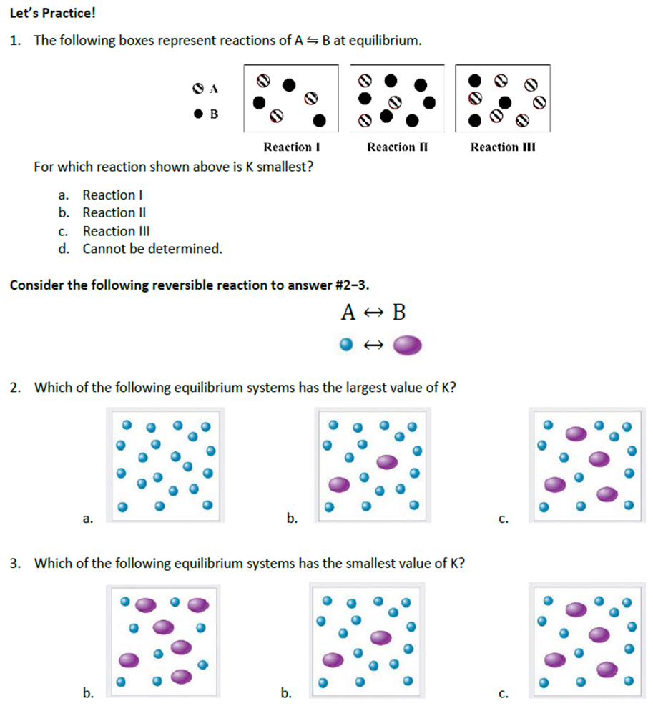

Slide 35
Unit 7: Equilibrium
7.9 Intro to LeChatlier’s Principle
7.10 LeChatlier and the Reaction Quotient, Q

Slide 36
Le Chatlier’s Principle
When a system is at equilibrium, K = Q.
If a stress is applied to a system at equilibrium making K ≠ Q, the system will shifts in the direction that relieves the stress and returns K = Q.
A stress is any kind of change in a system AT EQUILIBRIUM that upsets the equilibrium (makes K ≠ Q).
3 types of stress
Changes in concentration
Changes in Pressure-Volume
Changes in Temperature

Slide 37
STRESS: Changes in concentration
Consider the reaction at equilibrium: A (g) + B (g) ⇌ C(g)
Write an equilibrium expression:
At equilibrium, Q=K (1= original position)
An increase in concentration of a reactant will cause a increase/decrease in Q (2=stress shift), disturbing the equilibrium of the system. The system will shift forward/reverse to restore equilibrium (3=shift to new equilibrium). As a result, the concentration of the reactants increase/decrease and the concentration of the products increase/decrease.
Number line Representation:
Q
K

Slide 38
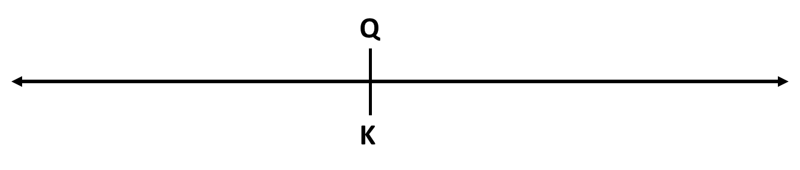
STRESS: Changes in concentration
Consider the reaction at equilibrium: A (g) + B (g) ⇌ C(g)
Write an equilibrium expression:
At equilibrium, Q=K
An increase in concentration of any product will cause Q to increase/decrease equilibrium to shift forward/reverse to increase/decrease the concentration of reactants and increase/decrease the concentration of the products.

Slide 39
STRESS: Changes in concentration
A (g) + B (g) ⇌ C(g)
A decrease in concentration (removal) of a reactant will cause Q to increase/decrease, causint the reaction to shift forward/reverse to restore equilibrium. . The system will shift forward/reverse to restore equilibrium. As a result, the concentration of the reactants increase/decrease and the concentration of the products increase/decrease.
An decrease in concentration of any product will cause Q to increase/decrease equilibrium to shift forward/reverse to increase/decrease the concentration of reactants and increase/decrease the concentration of the products.
OVERALL: A change in concentration of reactant or product will affect the value of Q, and not affect the value of K.

Slide 40
Sample Problem
Consider the reaction: N₂(g) + 3H₂(g) 2NH₃(g)
If the system is at equilibrium, what direction of shift will each action cause?
a. addition of N₂ b. addition of NH₃ c. addition of H₂ d. removal of NH₃

Slide 41
STRESS: Changes in pressure or volume- only gases affected
Changes in pressure only affect equilibrium systems having gaseous products and/or reactants. Increasing the pressure/decreasing the volume of a gaseous system will cause equilibrium to shift to the side with fewer gas particles. Decreasing the pressure/increasing the volume of a gaseous system will cause equilibrium to shift to the side with more gas particles.

Slide 42
If the system has the same number of moles of gas on each side, changes in pressure do not affect equilibrium. Adding an inert gas does not affect equilibrium since the partial pressures of the gases in the reaction are not affected. Changing pressure does not affect the value of the equilibrium constant.

Slide 43
Example: determine the direction of shift in response to each action
P₄(s) + 6Cl₂(g)  4PCl₃(l) a. increase container volume b. decrease container volume c. add argon gas Example: PCl₃(g) + Cl₂(g)  PCl₅(g) a. decrease container volume b. add helium gas Example: PCl₃(g) + 3NH₃(g)  P(NH₂)₃(g) + 3HCl(g) a. increase container volume

Slide 44
STRESS: Changes in temperature
Changes in temperature may easily be treated as changes in concentration if you think of heat as a product (exothermic rxn) or a reactant (endothermic rxn).
Example: B₂(g) + C₂(g) ⇄ 2BC (g) ∆H = +21kJ/mol
Is heat a reactant or product?

Slide 45
Exothermic reaction: R ⇄ P + ∆
An increase in temperature of an exothermic reaction will cause equilibrium to shift forward/reverse. K will decrease/increase.
A decrease in temperature of an exothermic reaction will cause equilibrium to shift forward/reverse. K will decrease/increase.
Endothermic reaction: R + ∆ ⇄ P
An increase in temperature of an endothermic reaction will cause equilibrium to shift forward/reverse. K will decrease/increase.
A decrease in temperature of an endothermic reaction will cause equilibrium to shift forward/reverse. K will decrease/increase.
For the reaction: B₂(g) + C₂(g) ⇄ 2BC (g) ∆H = +21kJ/mol, if the temperature is increased, the reaction will shift ____________________ and K will _________________

Slide 46
Example
Example: N₂(g) + 3H₂(g) ⇄ 2NH₃(g) ∆H = -21ºC
Is heat a reactant or product?
What happens if T increases? To the concentration of reactants? To concentration of products? To K?
What happens if T decreases? To the concentration of reactants? To concentration of products? To K?

Slide 47
Catalysts & equilibrium
With a catalyst, reactions reaches equilibrium quickly, but no change in the amount of product or the value of K.
In other words, catalyst make you reach equilibrium faster, but doesn’t stress the system

Slide 48
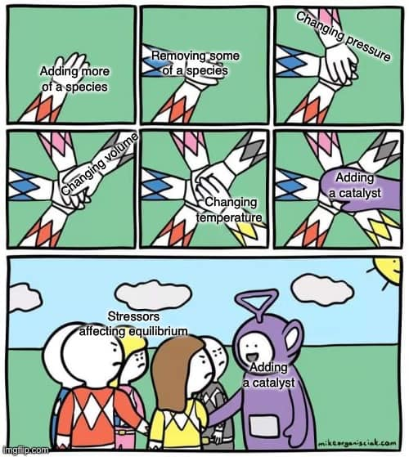

Slide 49
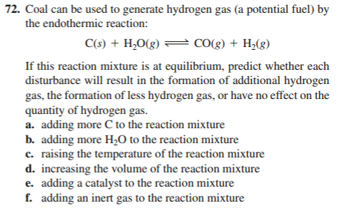
Which ONE affects K? How is K affected- increase or decrease?

Slide 50
Unit 7: Equilibrium
7.7 Calculating Equilibrium Concentrations

Slide 51
Review!
For the reaction:
2 NO₂ (g) ⇌ N₂O₄ (g), ΔH_{rxn} = -177 kJ/mol, and K_{p} = 0.785 at 387 K.
a) Write an expression for K_{p}.
b) If a previously evacuated reaction vessel was filled with 0.50 atm of NO₂ and 0.50 atm of N₂O_{4­}, is the system at equilibrium? If not, which way would the reaction shift to reach equilibrium?

Slide 52
2 NO₂ (g) ⇌ N₂O₄ (g) ΔH_{rxn} = -177 kJ/mol
NO₂ is brown while N₂O₄ is colorless. If the reaction is light brown at equilibrium, predict the direction of shift, and changes to the color of the reaction.
The reaction is heated
The gases are placed in the container half the size.
More N₂O₄ is added
Will the value of K increase or decrease when this reaction is cooled?

Slide 53
Equilibrium and RICE Tables
The stoichiometry of a chemical reaction and the associated K value, can be used to determine the concentrations of products or reactants for a reaction at equilibrium based on the initial values for the reacting species.
We can use a RICE Table to keep track of our reaction.
R- Reaction
I- Initial
C- Change
E- Equilibrium
What’s new about these RICE table:
E = Equilibrium Concentration ~OR~ Pressure in atm
There might be some of ALL the reactants and products left
Quantities are in mol/L (M) for Kc or atm for Kp, NOT moles

Slide 54
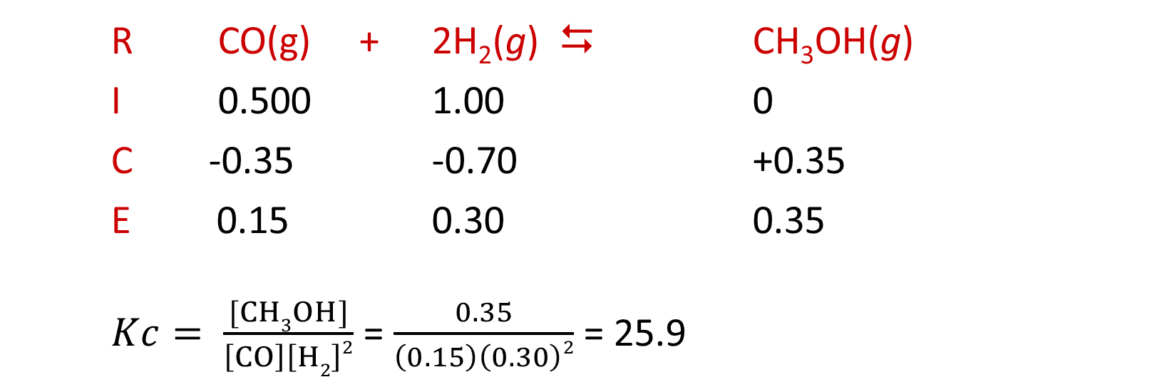
Given some initial and equilibrium data for a reaction, the value of K can be calculated. Consider the following reaction:
CO(g) + 2 H₂ (g) ⇌ CH₃OH (g)
A reaction mixture at 780 °C initially contains [CO] = 0.500 M and [H₂] = 1.00 M. At equilibrium, the CO concentration is found to be 0.15 M. Calculate the concentrations of all species at equilibrium. What is the value of the equilibrium constant? Does this reaction favor the reactants or the products?
R CO(g) + 2H₂(g)  CH₃OH(g)
I 0.500 1.00 0
C -0.35 -0.70 +0.35
E 0.15 0.30 0.35
$Kc= \frac{[CH3OH]}{\left[CO\right]\left[H2\right]2}$ = $\frac{0.35}{\left(0.15\right)\left(0.30\right)2}$ = 25.9

Slide 55
EXAMPLE: A rigid vessel at a temperature of 25ºC initially has a partial pressure of NO equal to 0.526 atm and a partial pressure of Br₂ equal to 0.329 atm. At equilibrium the partial pressure of Br₂ is 0.203 atm.
(a) Calculate K_{p} for the reaction: 2NO(g) + Br₂(g) ⇄ 2NOBr(g)
(b) Calculate the total pressure in the container once equilibrium has been established.

Slide 56
Using K to find Concentrations of Reactants and Products
Size of K and Reaction Position:
If a reaction has a very LARGE K value (K > 10⁵), the reaction is considered to leave negligible reactants at equilibrium, or the reaction goes TO COMPLETION.
If a reaction has a very small K value (K < 10⁻⁵), the reaction is considered to produce very few products at equilibrium. The tiny product concentrations can be calculated using an approximation for the amount of reaction.

Slide 57
STEPS FOR SOLVING EQUILIBRIUM PROBLEMS
Write a balanced equation.
Check the size of K! Will the reaction go to completion?
Set up the equilibrium expression. (No numbers yet!)
*** RARE STEP*** If you can't tell which way the reaction is going to shift, solve for Q. Don’t assume the reaction will shift forward!
Set up a RICE table that includes the equation, initial concentrations, changes in concentration in terms of x, and final concentrations.
Substitute these final concentrations into the equilibrium expression and solve for x.
Check your answer to make sure that it is logical!

Slide 58
Example: K is LARGE (>10⁵) Rxn goes to completion…. Solve as a normal STOICH problem! Remember to consider limiting reactants.
Consider the reaction: 2 NO (g) + O₂(g) ⇌ 2 NO₂
If K = 1.0 x 10²³ at 500°C, calculate the molarity of NO₂ produced when a solution that is 1.0 M NO and 0.25 M O₂ reacts.

Slide 59
Finding Equilibrium concentrations from initial data and K values
When we know that a reaction MUST proceed to the products, even in tiny amounts, we will use “x” to represent the change. Using the mole- mole ratio, then this might be change and be 2x or 3x etc.
We can then complete the equilibrium values in terms of “x”, and also apply an approximation for when x is very small (<5% of the initial value).

Slide 60
Small K values: The case of the vanishing x Useful when K is small
Practice: Finding Equilibrium Concentrations from Initial Concentrations and the Equilibrium Constant
Consider the reaction: N₂ (g) + O₂(g) ⇌ 2 NO Kc = 2.0 x 10⁻⁵ at 2000ºC
A reaction mixture initially contains [N₂] = 1.800 M and [O₂] = 1.500 M. Find the equilibrium concentrations of the reactants and product at this temperature.

Slide 61
The Vanishing x: Checking the Approximation and Refining as Necessary
When solving an equilibrium problem, some +x and -x values can be treated as negligible if it is less that 5% of the number that it was to be subtracted from or added to. If x is not negligible, the quadratic equation must be used. (Never the case on an AP test)
We can check our approximation by comparing the approximate value of x to the initial concentration. If the approximate value of x is less than 5% of the initial concentration, the approximation is valid.

Slide 62
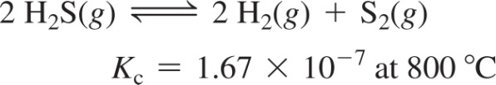
Consider the reaction for the decomposition of dihydrogen sulfide:
A 0.500 L reaction vessel initially contains 0.125 mol of H₂S at 800 °C. Find the equilibrium concentrations of H₂ and S₂.

Slide 63
What if x isn’t negligible??
The Perfect Square: if keeping “−x” is necessary, see if the problem is a perfect _____________ and thus easy to solve using algebra.
Example: Consider the reaction: H2(g) + I2(g) ⇌ 2 HI(g), Kp = 64 (at 25oC). A reaction mixture at 25°C initially
contains P_{H2} = P_{I2} = 0.20 atm. Find the equilibrium partial pressures of H₂, I₂, and HI.

Slide 64
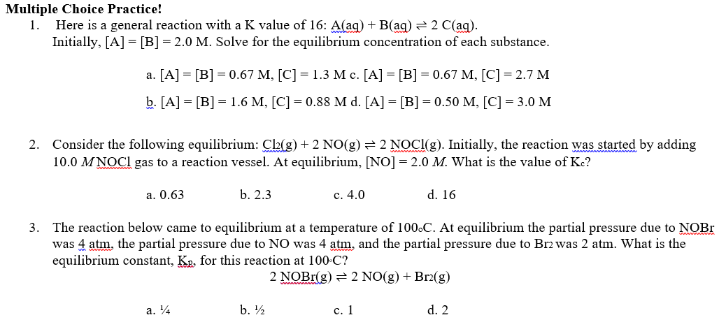
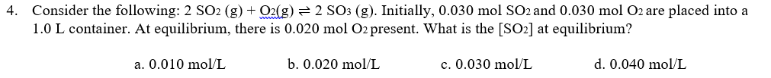

Slide 65
