Slide 1
6.1 Endo and Exothermic RXNs 6.2 Energy Diagrams 6.3 Heat Transfer and Thermal Equilibrium 6.4 Heat Capacity and Calorimetry
AP Chem Unit 6
THERMOCHEMISTRY

Slide 2
Review Time
Energy is required to break apart or separate particles that are attracted to one another (TTB- takes to break)
Energy is freed or released when bonds or attractive forces are formed (FTF- free to form)
EVERY chemical or physical process is some combination of breaking apart attractive interactions AND the formation of attractive forces and bonds.
Together, they determine the energy change for the reaction

Slide 3
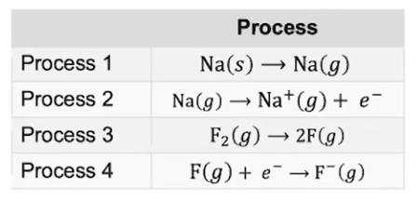
Consider the processes below. Which require energy and which free energy?
What do we call processes that require energy? Endothermic
What do we call processes that release energy? Exothermic

Slide 4
Exothermic- reaction which has an overall release of energy
energy flows out of the system (more FTF than TTB)
potential energy is changed to thermal energy
products have lower potential energy than reactants
2C₈H₁₈ + 25O₂ → 16CO₂ + 18H₂O + 5076 kJ
OR
2C₈H₁₈ + 25O₂ → 16CO₂ + 18H₂O ΔH= −5076 kJ/mol_{rxn}
Draw a reaction energy diagram that shows an
exothermic reaction:
Heat term is on the right
side of the equation.
For an exothermic reaction, ΔH is negative.

Slide 5
Endothermic- reaction which overall absorbs energy
energy flows into the system (More TTB than FTF)
thermal energy is changed into potential energy
products have higher PE than reactants
2C + 2H₂ + 52.3 kJ → C₂H₄
OR
2C + 2H₂ → C₂H₄ ΔH = +52.3 kJ/mol_{rxn}
Draw a reaction energy diagram that shows an
endothermic reaction:
Heat term is on the left
side of the equation.
For an endothermic
reaction, the ΔH is POSITIVE!

Slide 6
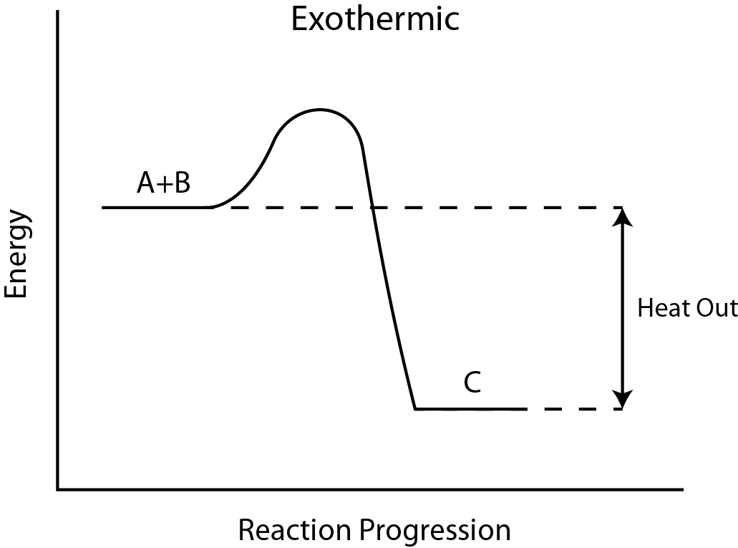
In terms of heat, exothermic reactions are energetically favorable

Slide 7
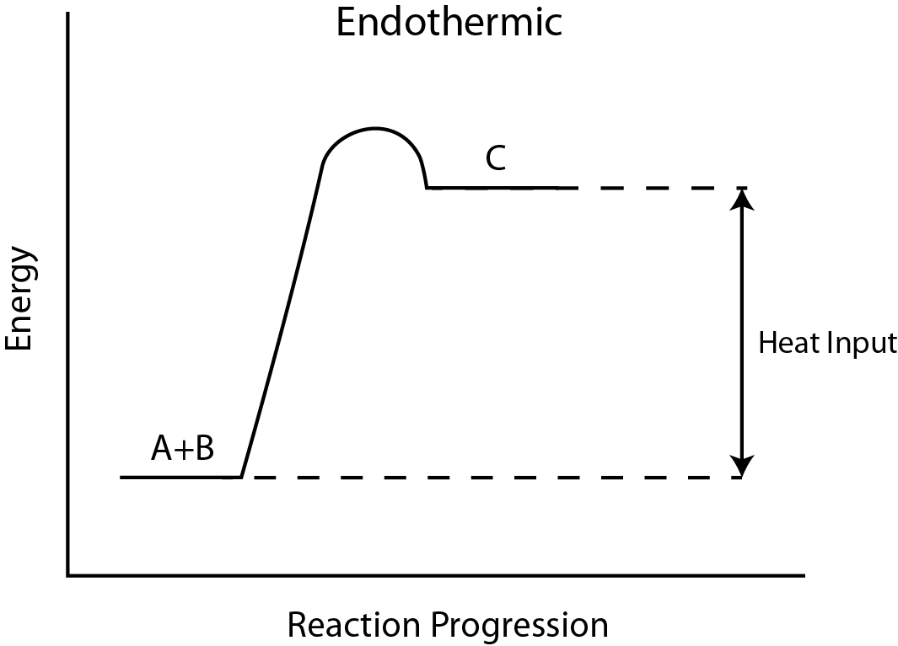
In terms of heat, endothermic reactions are energetically unfavorable

Slide 8
Energy- the capacity to do work or to produce heat 1st Law of Thermodynamics: Law of Conservation of Energy Energy can be converted from one form to another but it can be neither created nor destroyed. The total amount of energy in the universe is constant.

Slide 9
Energy Changes in Physical Processes
Heat is the transfer of thermal energy between two bodies. Also called ENTHALPY and has the symbol ΔH.
Temperature is a measure of the thermal energy on a molecular scale. Chemists think of energy as AVERAGE MOLECULAR KINETIC ENERGY
Temperature = Thermal Energy
90⁰C
40⁰C
greater thermal energy

Slide 10
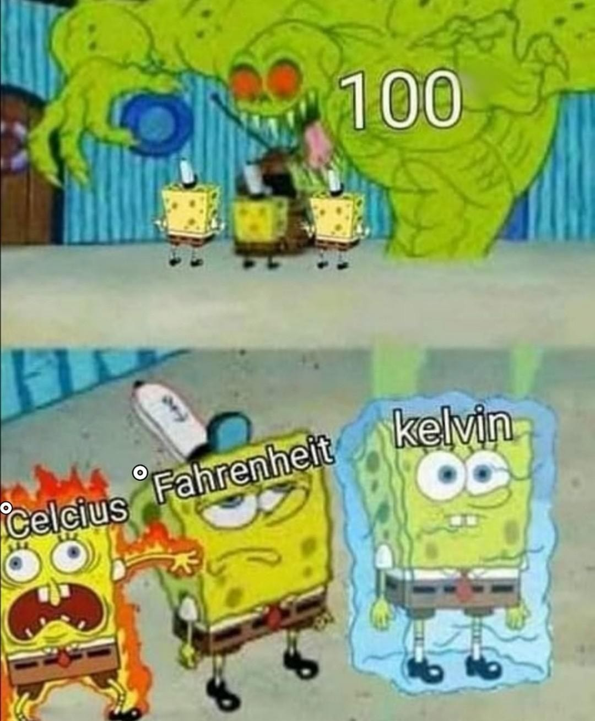

Slide 11
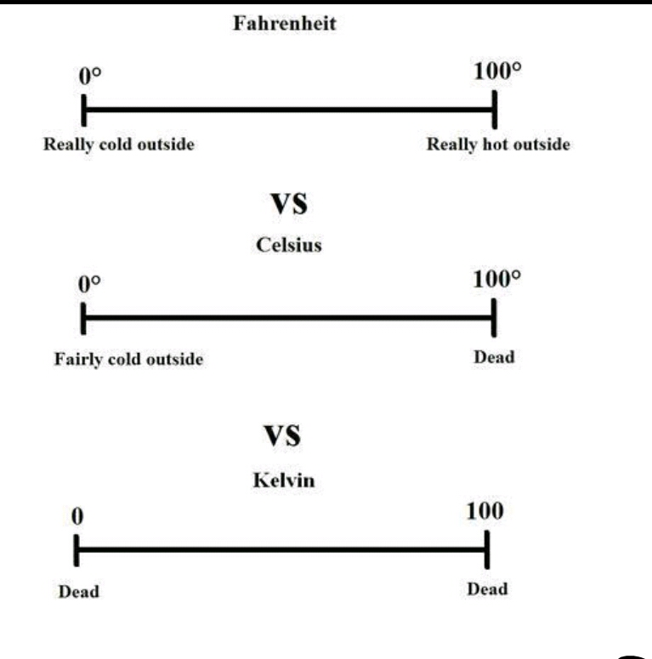

Slide 12
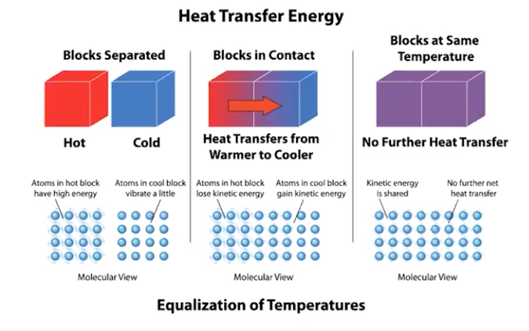
Heat transfer (q) occurs through molecular collisions which transfer KE (kinetic energy) from higher T molecules to lower T molecules
When all particles have the same average KE (temperature), thermal equilibrium is reached
For exothermic rxns, energy (q) is transferred out, and q <0
For endothermic rxns, energy (q) is transferred in , and q >0 ... but from or to where??

Slide 13
The system is our reaction. The surroundings are everything else. Together they make up the universe. Energy is transferred from one to another- either system to surroundings (exothermic) or surroundings to system (endothermic)
Understanding the Universe
Thermodynamic quantities always consist of a number and a sign (+ or −). The sign represents the systems point of view.

Slide 14
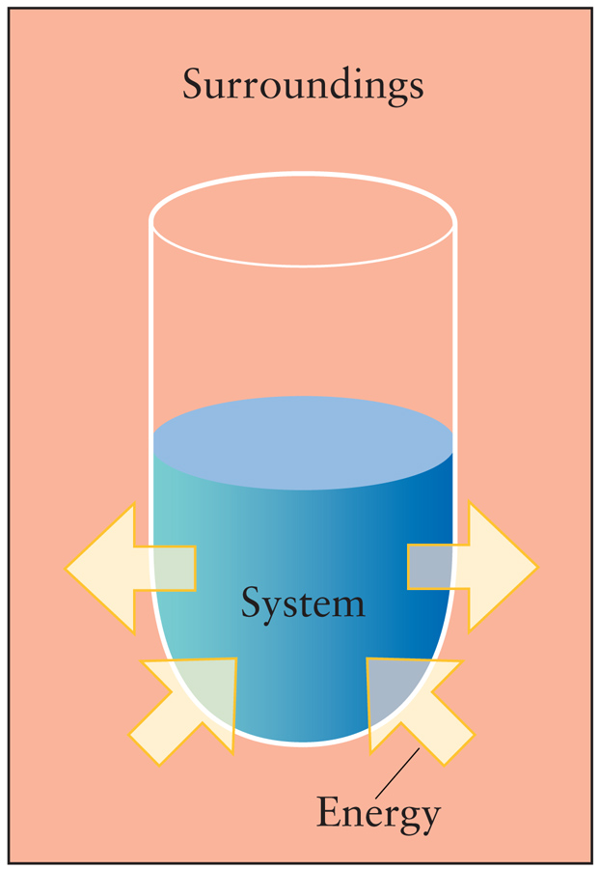
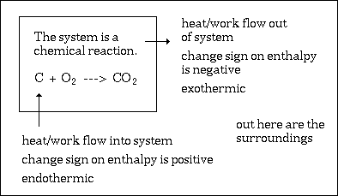
The system is our reaction. The surroundings are everything else.

Slide 15
Heat Transfer (either Released or Absorbed)
The heat released or absorbed by a process (q) can be calculated:
q=mCΔT
q = heat transferred
m = mass of body changing temperature
C = specific heat in J/g K or J/g°C
ΔT = (T_{f} – T_{i}) = change in temperature- always final - initial
The heat change of the system is equal and opposite to the heat change of the surroundings

Slide 16
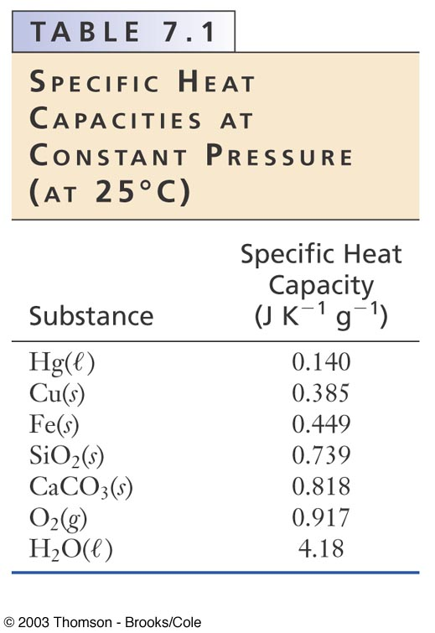
Specific Heat Capacity
C = J / (g) ºC
specific heat capacity of H₂O is 4.184J/g ºC
LARGE heat capacities = substances that do not conduct heat well but do hold higher heat per gram, low DT per J (water)
SMALL heat capacities = substances that do conduct heat well and holds lower heat per gram, high ΔT per J (metals)
Calculate the amount of energy needed to raise 35 g of water from 25°C to 37°C

Slide 17
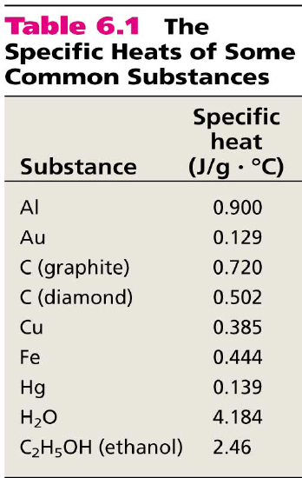
Practice
How much heat is given off when an 869 g iron bar cools from 94.0⁰C to 5.0⁰C?

Slide 18
Conservation of energy
Energy can neither be created nor destroyed, so the TOTAL energy change in the UNIVERSE for any process is ZERO!
q(universe)= q(system) + q (surroundings) = 0
q(system) + q (surroundings) = 0
q(system) = -q (surroundings)

Slide 19
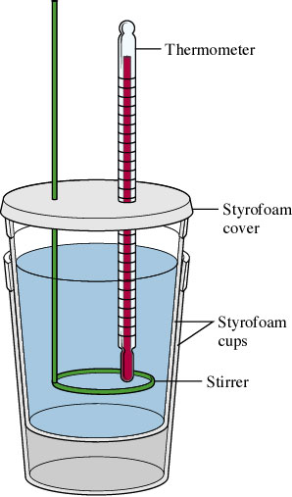
Calorimeter - insulated container of fluid (water) used for measuring the amount of heat absorbed or released in a process.
Energy released in a process (exothermic) is absorbed by the water (endothermic) and vice versa.
Careful measurement of temperature changes and mass of water allow us to calculate q, energy released or absorbed.
Because of conservation of energy,
q_{sys} = -q_{surr}

Slide 20
Practice Problem
A hot (81°C) piece of metal weighing 12 grams is dropped in a calorimeter holding 222 ml water. The water’s temperature rises from 22.0ºC to 24.5ºC. The specific heat (C) of water is 4.184 J/gºC.
What is the system? The surroundings?
How much energy did the water absorb?
What is the specific heat capacity of the metal?

Slide 21
6.5 Energy of Phase Change 6.6 Intro to Enthalpy of Rxn 6.9 Hess’ Law
AP Chem Unit 6
THERMOCHEMISTRY

Slide 22
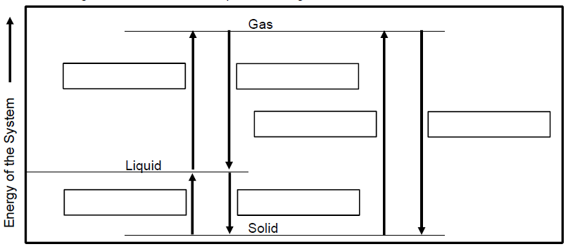
Heat Transfer and Phase Changes Label the diagram with the phase changes represented for each segment
Which phase changes are endothermic? Which are endothermic?
Explain why ΔH_{vap} tends to be larger than ΔH_{fus}.

Slide 23
Heat Transfer and Phase Changes
Heat of Vaporization = ΔH_{vap} = the heat required to change one mole of a substance from a liquid to a gas; units = Joules/mole = J/mol OR kJ/mol
n = moles
How do enthalpy of boiling and condensing compare:
ΔH_{boil} = + ΔH_{vap} · n H_{condens} = - ΔH_{vap} · n Equal and Opposite!
Heat of Fusion= ΔH_{fus} = heat required to change one mole substance from a solid to a liquid;
units = Joules/mole = J/mol OR kJ/mol
How do H of melting and freezing compare:
ΔH_{melt} = + ΔH_{fus} · n ΔH_{freeze} = - ΔH_{fus} · n Equal and Opposite!
Which phase changes are endothermic? Which are endothermic?
Define enthalpy of fusion and enthalpy of vaporization. What does the sign show?
Explain why ΔH_{vap} tends to be larger than ΔH_{fus}.

Slide 24
Practice
What is the energy change when 75.0 grams of molten tin turns to solid? (H_{f} = 7.03 kJ/mol)
ΔH_{freeze} = - ΔH_{fus} · n
n = 75.0g / 118.71 g/mol = 0.6318 mol
ΔH_{freeze} = - 7.03 · 0.6318 mol
ΔH_{freeze} = - 4.44 kJ

Slide 25
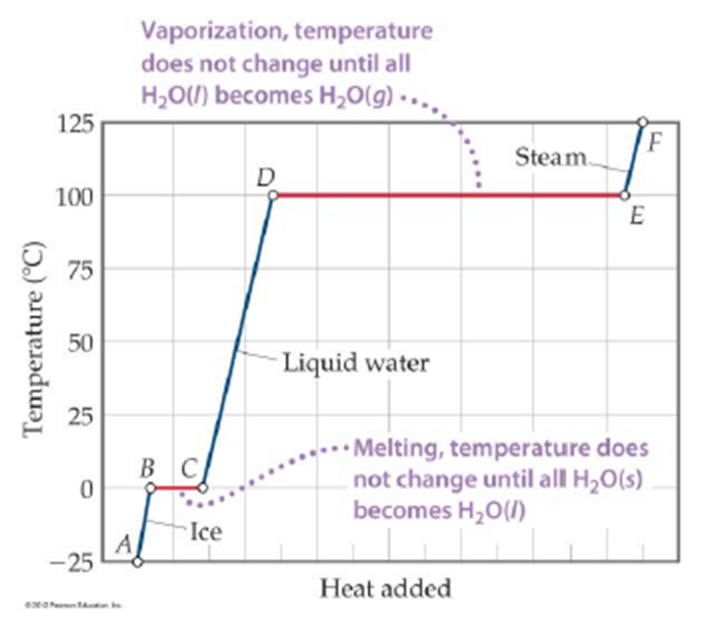
Identify the segments of this heating curve that would involve the equation:
q = m x C x ΔT
Identify the segments of this heating curve that would involve the equation:
ΔH = ΔH_{phase} n

Slide 26
How much heat is needed to raise the temperature of 32.0g of water from 9.0ºC to 104.0ºC?
[C_{p} (ice)= 2.06 J/gºC, C_{p} (water) = 4.184 J/gºC, C_{p} (steam) = 1.87 J/gºC, H_{f} (water) = 6.01 kJ/mol, H_{v}(water)=40.7 kJ/mol]
ΔH_{process}= heating liquid 9 - 100ºC + boiling water + heating gas from 100 - 109ºC
ΔH_{process}= segment CD + segment DE + segment EF
ΔH_{process}= q (liquid) + Δ H_{v} + q (gas)
q (liquid) = mCΔT = 32.0x4.184x(100-9) = 12183 Joules = 12.183 kJ
Δ H_{vap} = ΔH_{vap} n = 40.7 kJ/mol x (32.0g/18.02g/mol) = 72.27 kJ
q (gas) = mCΔT = 32.0x1.87x(104-100) = 239 Joules = 0.239 kJ
ΔH_{process}= 12.183 kJ + 72.27 kJ + 0.239 kJ
= 84.7 kJ

Slide 27
Reaction Enthalpy
Reaction Enthalpy or Heat of Reaction (ΔH_{rxn}) is used to quantify the heat flow into (or out of) a system in a process that occurs at constant pressure.
Δ H_{rxn} = ΔH (products) – ΔH (reactants)
Label on the reaction energy diagram below.
Heat of Reaction can be measured with a calorimeter

Slide 28
Molar Enthalpy (ΔH_{molrxn})
Calorimetry is the laboratory method of finding q, or heat transferred, for a chemical reaction, the heat involved in a physical change, or the specific heat of a substance.
q is an extensive quantity that depends on the amounts of substance used in the reaction. It cannot be compared unless standardized to a specific amount….. one mole.
Molar enthalpy = heat per mole of reactant
Can be calculated:
ΔH_{molrxn} = q_{sys} / moles of reactant
Why is it useful?
Comparable because it is an intensive property
Tabulated values can be applied to any amount

Slide 29
Calorimetry Problem
When a 1.5 g sample of KCl dissolves in 100.0 g of water in a calorimeter, the temperature drops from 22.1 ºC to 21.6 ºC.
Write an equation for the process.
Identify the system and the surroundings. (remember these are processes)
Calculate q, the heat transferred in the process.
Calculate ΔH_{rxn} for the dissolving process.

Slide 30
Practice: For the reaction 2Na + 2H₂O → 2NaOH + H₂ , ΔH = −368 kJ/mol_{rxn} Calculate the heat change that occurs when 3.5 g of Na reacts with excess water.
3.5g Na 1 mol Na 368 kJ =
23.0g Na 2 mol Na
ΔH = −28 kJ (or 28 kJ is released)

Slide 31
Practice: 4.00g of ammonium nitrate are added to 100.0 mL of water in a polystyrene cup. The water in the cup is initially at a temperature of 22.5°C and decreases to a temperature of 19.3°C. Determine the heat transferred in this reaction, then determine the enthalpy of solution of ammonium nitrate in kJ/mol. Assume that the heat absorbed or released by the calorimeter is negligible.
q_{sys} = -q_{surr} = -mCΔT
q = -104g(4.18J/gºC)(19.3 – 22.5)ºC = 1391J absorbed = 1.39 kJ
4.00g NH₄NO₃ x 1 mol NH₄NO₃ = 0.0500 mol
80.06g NH₄NO₃
1.39 kJ/0.0500 = 28 kJ/mol

Slide 32
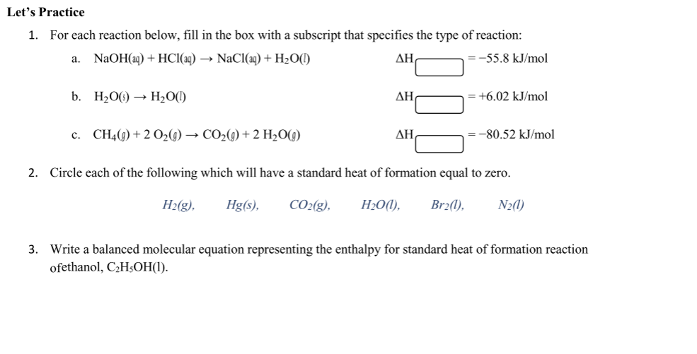

Slide 33
6.9 Hess’ Law 6.7 Bond Enthalpies 6.8 Energy of Formation (Big MAMA)
AP Chem Unit 6
THERMOCHEMISTRY

Slide 34
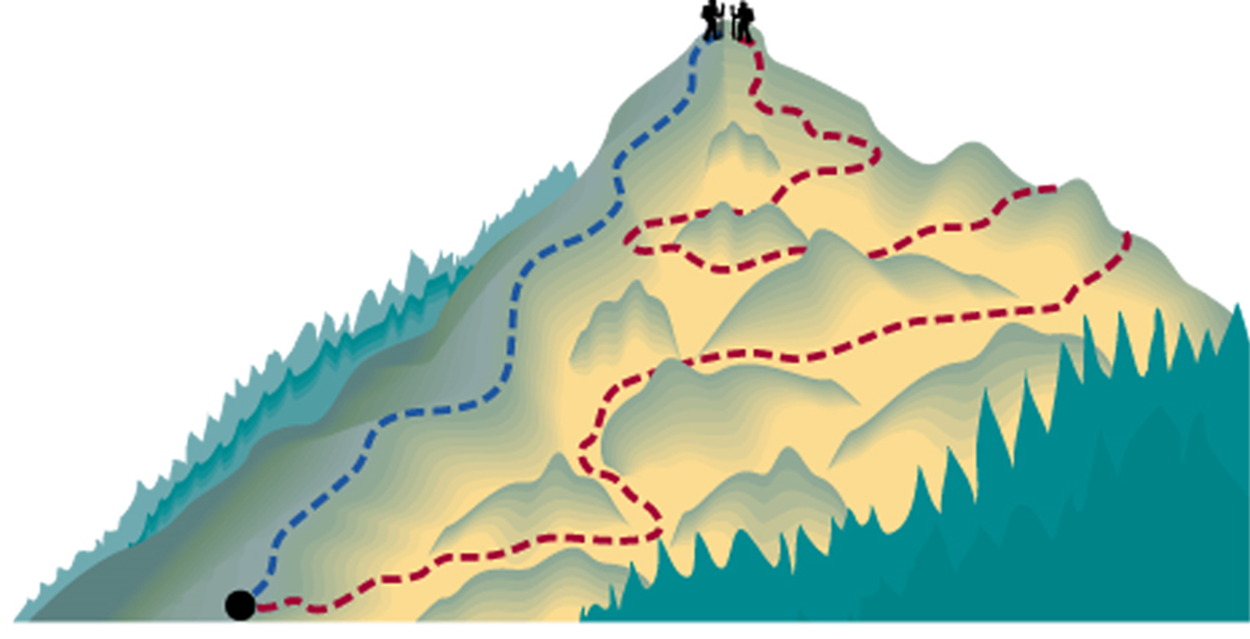
Enthalpy and Hess’ Law
Enthalpy of reaction is a state function: the change in enthalpy for any chemical reaction is constant, whether the reaction occurs in one step, or a series of steps.
Hess’ Law: The overall enthalpy change in a reaction is equal to the sum of the enthalpy changes for the individual steps in the process.
Energy of the climb of hiker 1 and hiker 2
is the same even though they took different paths.
The path doesn’t matter- the destination does.

Slide 35
In other words, if you perform the following series of reaction steps, with the associated heats of reaction:
A + B → C ΔH₁
C→ D + E ΔH₂
D + E → F ΔH₃
The sum of the heat from the collection of processes is THE SAME as the heat from the single step reaction
A + B → F.
For A + B → F, ΔH_{total} = ΔH₁ + ΔH₂ + ΔH₃
Helpful if ΔH₁, ΔH₂, and ΔH₃ are already tabulated values

Slide 36
Rules for applying Hess’ Law
If a reaction is reversed, the sign of ΔH is reversed.
If A → B ΔH₁
Then for B → A -ΔH₁
2. If the coefficients in a reaction are multiplied by an integer, the value of ΔH is multiplied by the same integer. If A → B ΔH₁
Then for aA → aB aΔH₁

Slide 37
Example:
Given:
C + O₂ → CO₂ ΔΗ = −393.5 kJ
CO + 1/2O₂ → CO₂ ΔΗ = −283.0 kJ
Find the heat of reaction for:
C + 1/2O₂ → CO
1
2

Slide 38
Practice: Given the following reactions and their respective enthalpy changes, calculate ΔH for the reaction: 2C + H₂→ C₂H_{2.} C₂H₂ + 5/2 O₂ → 2CO₂ + H₂O Δ H = −1299.6 kJ/mol_{rxn} C + O₂ → CO₂ ΔH = −393.5 kJ/mol_{rxn} H₂ + ½ O₂ → H₂O ΔH = −285.9 kJ /mol_{rxn}
2C + 2O₂ → 2 CO₂ ΔH = 2(−393.5) kJ/mol_{rxn}
H₂ + ½ O₂ → H₂O ΔH = −285.9 kJ/mol_{rxn}
2CO₂ + H₂O → C₂H₂ + 5/2 O₂ Δ H = +1299.6 kJ/mol_{rxn}
2C + H₂→ C₂H₂
Δ H = 226.7kJ/mol_{rxn}

Slide 39
Tabulated Enthalpy Values are true at the Standard State
ΔH° (delta H ‘naught’) – naught means ‘at standard state’
standard state allows for true comparison of values while keeping other conditions uniform (standard)
standard temperature is 25 °C
for gases, pressure is one atm
for a substance in solution, the concentration is one molar
for a pure substance in a condensed state (liquid or solid), the standard state is the pure liquid or solid (not a mixture).
for an element, the standard state is the phase in which the element exists under conditions of 1 atm and 25 °C.

Slide 40
Standard Heats of Formation Calculation- BIG MAMA
Standard enthalpy of formation, ΔH°_{f} - heat released or absorbed when one mole of a compound is formed by combination of its elements.
Every compound has a ΔHf. It is the amount of heat released or required to create that compound out of its base elements.
Examples:
Na + ½ Cl₂ → NaCl ΔH°_{f} = -410.9 kJ/mol
H₂ + ½ O₂ → H₂O ΔH°_{f} = -285.8 kJ/mol

Slide 41
Because of Hess’ Law, any reaction can be calculated by this sum:
ΔH_{rxn} = Σ ΔH°_{f} (products) – Σ ΔH°_{f} (reactants)
(Σ means “the sum of”)
Stuff you break apart (reactants) → Stuff you make (products)
So in words, this equation says: The amount of heat for a reaction (ΔH_{rxn}) is equal to the heat it takes to MAKE stuff (products) minus the heat it takes to break stuff up (reactants).

Slide 42
A few rules for this equation:
Pay attention to coefficients in your equation- if 2 moles of a compound are formed, the ΔH_{f} must be multiplied by 2!
The sign matters! Make sure you keep +’s positive and –’s negative. The more negative the value of ΔHº_{f}, the more stable the compound.
Note that ΔH_{f} for free elements is zero (0.00 kJ/mol). (Examples: C, Na, O₂, Cl₂)

Slide 43
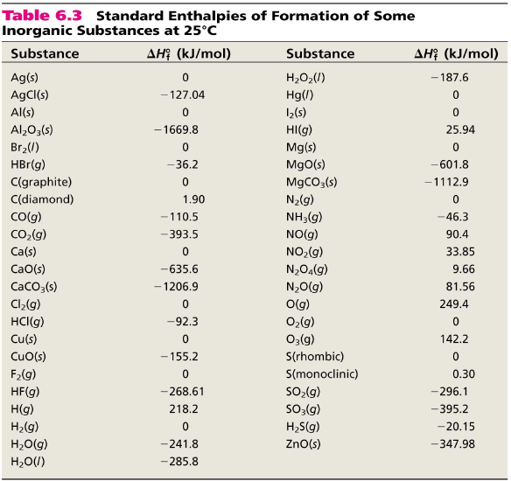
6.5

Slide 44
Calculate the heat of reaction of sulfur trioxide:
2 SO₂(g) + O₂(g) → 2 SO₃(g)
from the reference table: ΔH°_{f} SO₂(g) = -296.8 kJ/mol
ΔH°_{f} O₂(g) = 0.00 kJ/mol
ΔH°_{f} SO₃(g) = -395.7 kJ/mol
ΔH_{rxn} = Σ ΔH°_{f} (products) – Σ ΔH°_{f} (reactants)
= (2* -395.7 kJ/mol) – (2* -296.8 kJ/mol + 0.0)
= -197.8 kJ/mol

Slide 45
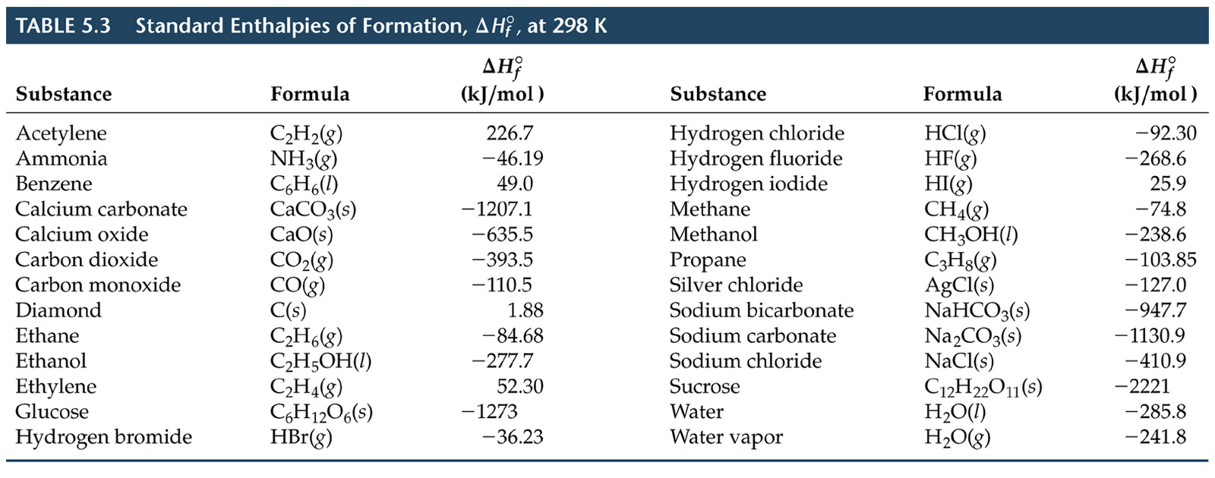
Calculate the heat of reaction:
C₃H₈(g) + 5O₂(g) → 3CO₂(g) + 4H₂O(l)

Slide 46
Calculate the heat of reaction:
C₃H₈(g) + 5O₂(g) → 3CO₂(g) + 4H₂O(l)
ΔH_{rxn} = Σ ΔH°_{f} (products) – Σ ΔH°_{f} (reactants)
= (3* -393.5 kJ/mol + 4 * 285.8 ) – (-103.8 kJ/mol + 5* 0.0)
= -2219.9 kJ/mol

Slide 47
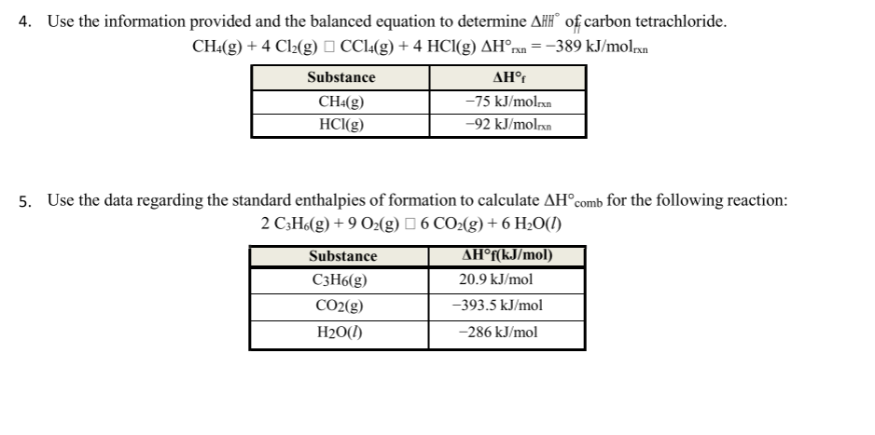

Slide 48
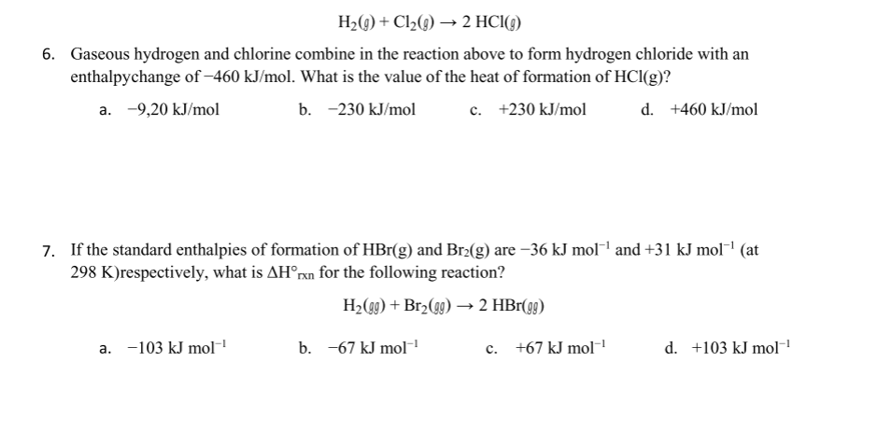

Slide 49
Enthalpy of Reaction from Bond Energies
Chemical reactions involve a combination of breaking bonds (always endothermic- TTB) and making new bonds (always exothermic- FTF).
The ΔH°_{reaction} can be estimated by comparing the cost of breaking old bonds to the income from making new bonds.
Bond Energy- The amount of energy it takes to break one mole of a specific bond in a compound.
Usually measured in the gas state
Bond breaking is always endothermic, so bond energies are positive values
The actual bond energy depends on the surrounding atoms and other factors, so average bond energies to estimate the ΔH_{rxn}.

Slide 50
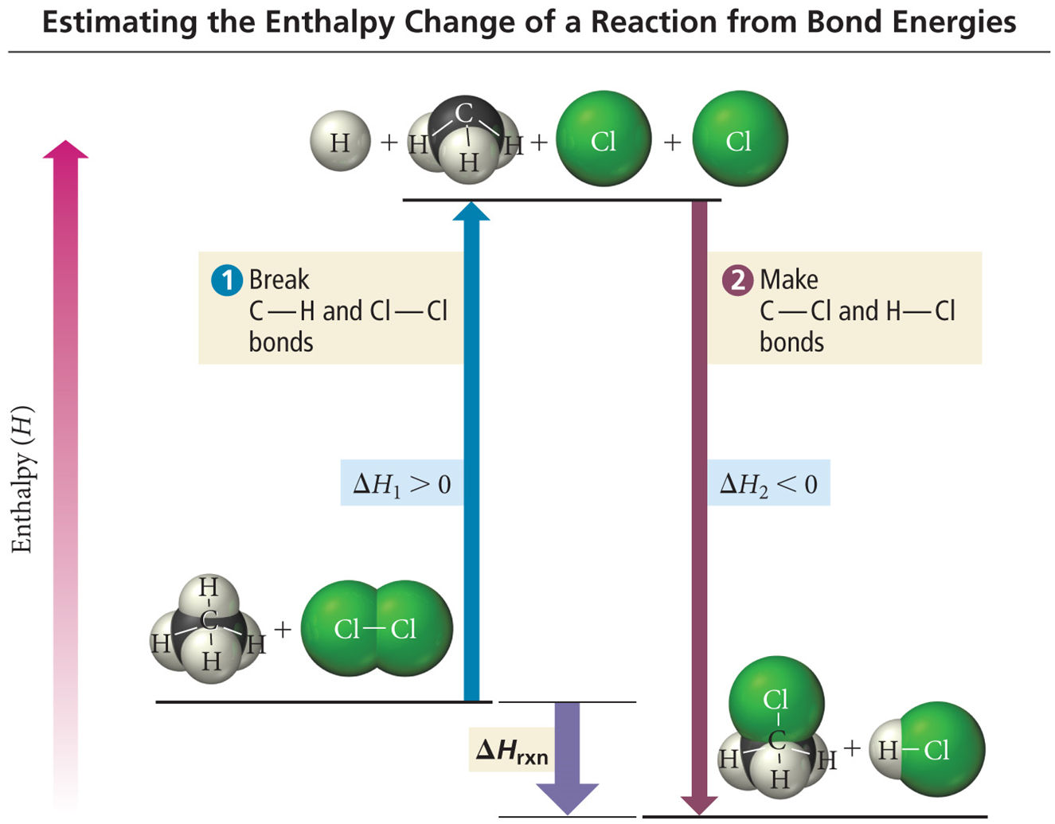
Using Bond Energies to Estimate ΔH°_{rxn}
Because bond energies are averages,
ΔH°_{rxn}is an estimate.
Works best when all reactants
and products in gas state
Bond breaking is endothermic,
ΔH(breaking) = +.
Bond making is exothermic,
ΔH(making) = −.
ΔH_{rxn} = ∑ (ΔH(bonds broken)) - ∑ (ΔH(bonds formed))

Slide 51
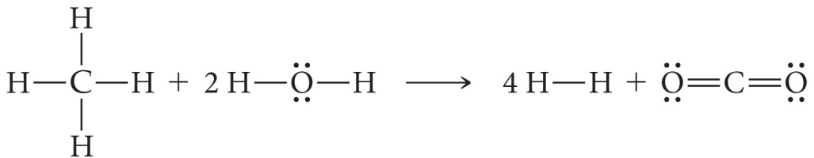
Calculating ΔH_{rxn} from Bond Energies
Hydrogen gas, a potential fuel, can be made by the reaction of methane gas and steam.
Use bond energies to calculate ΔH_{rxn} for this reaction.
Bond Energy Table found on p 410

Slide 52
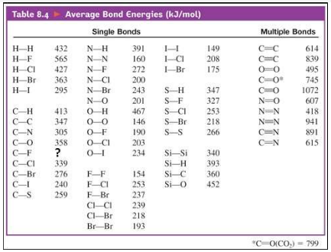

Slide 53
How do you know what to solve???
First: determine what you’re being asked to find: ΔH_{rxn} or something else?
Given? | Asked to find? | Use:
A lot of bond energies A reaction without ΔHrxn | ΔHrxn | Draw the Lewis structures. Use the following: ΔHrxn = bonds broken – bonds formed
A lot of heats of formation (ΔHf) A reaction without ΔHrxn | ΔHrxn | Big MAMA: ΔHrxn = ΣΔHf (products)− ΣΔHf (reactants)
Multiple reactions with ΔH A goal reaction without ΔHrxn | ΔHrxn | Hess’s Law! Rearrange the equations to make the goal equation, then combine your new ΔH’s (remember, what you do to an equation you must do to ΔH!)
info to calculate q (using mC∆T) Moles/grams of a chemical A CALORIMETER!!!!!! | ΔHrxn | ∆H_{rxn} = q/mol_{rxn}

Slide 54
What if it’s not ΔH_{rxn}? What if it is something else?
Given? | Asked to find? | Use:
A reaction with ΔHrxn Either: g or mol of a substance energy change (J or kJ) | Either: g or mol of a substance energy change (J or kJ) | Stoich! Don’t forget to convert between moles of your substance and molesrxn
A phase change (vaporizing, condensing, freezing or melting) ΔHvap or ΔHfus | Energy change (heat absorbed or released) | q = nΔH
A temperature change Mass or moles of a substance Heat capacity (J/gK) | Energy change (heat absorbed or released) | q=mCΔT

Slide 55
9.1 Intro to Entropy 9.2 Absolute Entropy and Entropy Change 9.3 Gibbs Free Energy and Thermodynamic Favorability 9.4 Thermodynamic and Kinetic Control
AP Chem Unit 6
THERMOCHEMISTRY
Chapter 17

Slide 56
Question….. Are all exothermic processes favorable? Are all endothermic processes unfavorable? Why do some processes naturally occur while others don’t?

Slide 57
Thermodynamic Favorability or “Spontaneity”
Processes are determined to be “thermodynamically favorable” (spontaneous) if they occur without outside intervention (such as being coupled to an outside energy source) -may be fast or slow- NOT determined by rate -depends on two factors- enthalpy (ΔH) and entropy (ΔS)

Slide 58

Entropy, S
the number of “microstates” in which a system can transfer energy
(kind of) measure of randomness or disorder
associated with probability (There are more ways for something to be disorganized than organized).
for a reaction, the CHANGE in entropy (ΔS) from products to reactants is very important.
an increase in entropy is thermodynamically favorable for a reaction

Slide 59
2nd Law of Thermodynamics
In any spontaneous process there is always an increase in the entropy of the universe.
The energy of the universe is constant but the entropy of the universe is increasing.
Therefore a process that shows an INCREASE in entropy (ΔS>0) is favored by nature.
3rd Law of Thermodynamics
As a system approaches 0 Kelvin (absolute zero), the entropy of that system approaches zero.

Slide 60
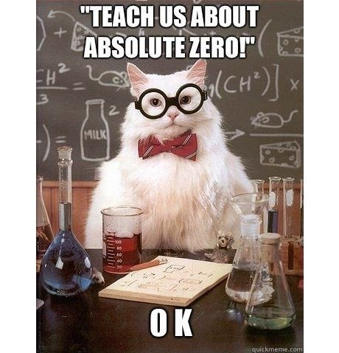

Slide 61


Slide 62


Slide 63
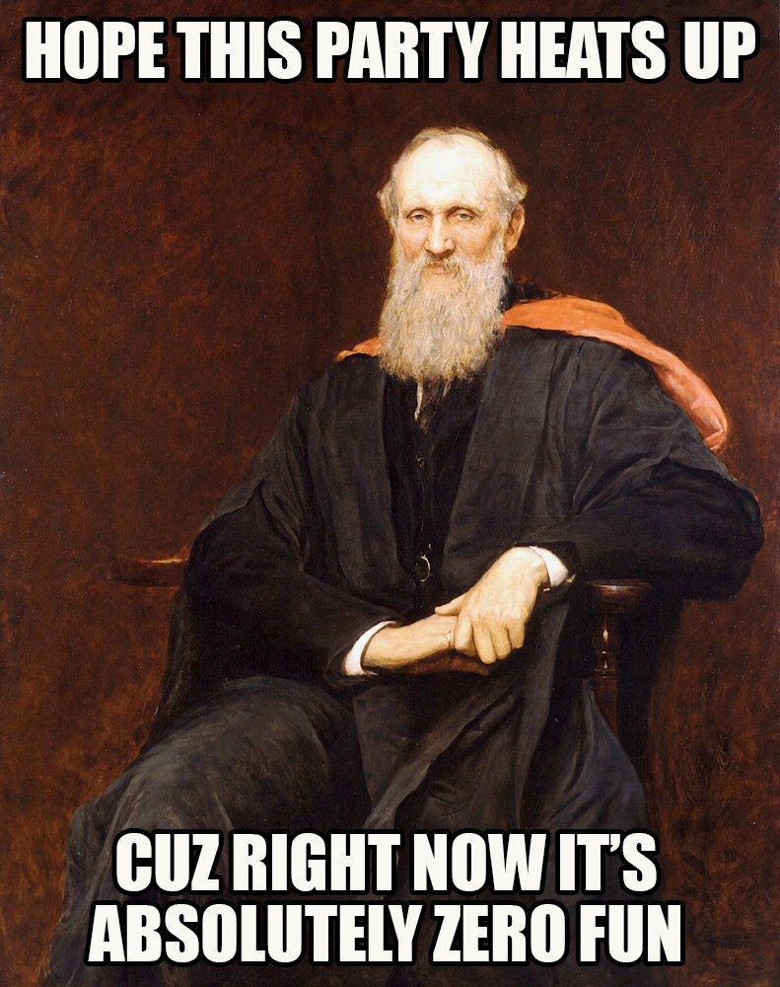

Slide 64
Change in Entropy, ΔS
For a process:
INCREASE in entropy is thermodynamically favorable and
DECREASE in entropy is thermodynamically unfavorable.
ΔS > 0, FAVORABLE (+ good!)
ΔS < 0, UNFAVORABLE(- bad!)
Notice that this is opposite sign convention from ΔH
(-ΔH good and +ΔH bad!)

Slide 65
Predicting Change in Entropy, ΔS
Phase: Gases have FAR more entropy than liquids, liquids have more entropy than solids
Entropy _______________ going from a solid to a liquid to a gas.
Entropy _______________ when solutions are formed.
Entropy _______________ with increasing temperature
Entropy usually _______________ in a reactions when more moles of product are formed. Exception?
A (s) → A (l)
MX (s) → MX (aq)
Q (290 K) → Q (350 K)
2H₂O (g) → 2H₂ (g) + O₂ (g)

Slide 66
Calculating ΔS
ΔS can be calculated using a formation equation much like “Big Mama”
ΔSº_{reaction} = ΣSº_{prod}- ΣSº_{react}
Important: ΔS is NOT zero for elements
ΔS values are much smaller than ΔS values and are tabulated in Joules/mol K instead of kilojoules/mol K. This will be important later!

Slide 67
Sample Problem
Ex. Given the following standard molar entropies, calculate ΔSº for the reaction: 2Al(s) + 3MgO(s) → 3Mg(s) + Al₂O₃(s)
Substance ΔSº value (J/mol K)
Al(s) 28.0 J/mol K
MgO(s) 27.0 J/mol
Mg(s) 33.0 J/mol K
Al₂O₃(s) 51.0 J/K
ΔSº = [3(33.0)+51.0] –[2(28.0) + 3(27.0)] = 13.0 J/K.mol_{rxn}

Slide 68
Thermodynamic Favorability and Free energy, ΔG
Thermodynamic Favorability is the combination of TWO factors:
Enthalpy (ΔH < 0 is favorable) and
Entropy (ΔS > 0 is favorable)
ΔG = ΔH - TΔS
ΔG, or Gibbs Free Energy- Free energy change is a measure of the thermodynamic favorability (spontaneity) of a reaction. It is the maximum work available from the system.
Determining the thermodynamic favorability of a reaction considers both enthalpy and entropy
This is called the Gibbs-Helmholtz equation… or the Big Grampa Eqn
***When working this, change ΔS from J to kJ***

Slide 69
Thermodynamic Favorability (Spontaneity) is determined by the SIGN of ΔG
A spontaneous (thermodynamically favored) reaction has a negative ΔG (ΔG<0).
A nonspontaneous (thermodynamically NOT favored) reaction has a positive ΔG (ΔG>0).
A reaction at equilibrium (forward and backward equally favored) has a ΔG=0.
Phase change is an example of a system at equilibrium- For example, when ice melts, ΔH > 0 (endothermic), ΔS > 0 and ΔG = 0 at 0°C.
Kinetic Control- a reaction that has a ΔG<0 is thermodynamically favorable, but the rate is not determined by ΔG. This means that it may proceed very slowly, like rusting of metal, or some radioactive decay. Both are spontaneous, but slow because they are under ‘kinetic control’

Slide 70
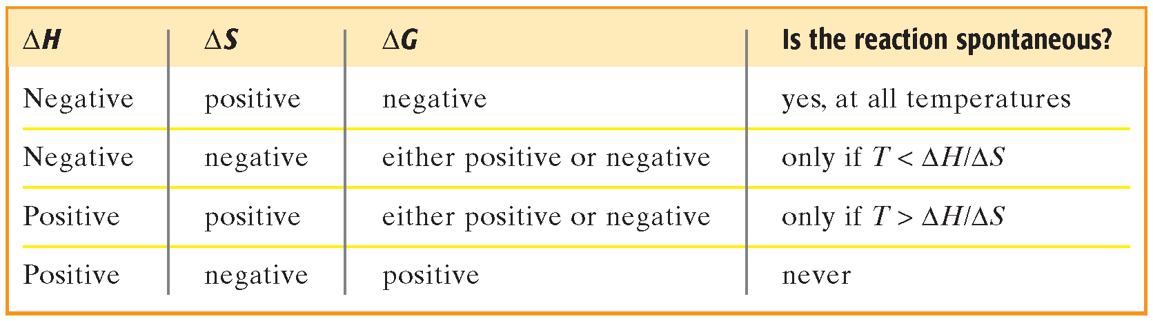
Predicting thermodynamic favorability using ΔG = ΔH -TΔS
What does spontaneous at all temperatures mean?
What does spontaneous at no temperatures mean?
What does spontaneous at high temperatures mean?
What does spontaneous at low temperatures mean?

Slide 71
Calculating using ΔG = ΔH -TΔS
Ex. For the given reaction and the following information, calculate ΔGº at 25ºC. 2PbO(s) + 2SO₂(g) → 2PbS(s) + 3O₂(g)
ΔHº (kJ/mol) ΔSº (J/molK) PbO(s) −218.0 70.0 SO₂(g) −297.0 248.0 PbS(s) −100.0 91.0 O₂(g) ----- 205.0
ΔHº = [2(-100.0)+3(0.0)] –[2(-218.0) + 2(-297.0)] = 830.0 kJ/mol_{rxn}
ΔSº = [2(91.0)+3(205.0)] –[2(70.0) + 2(248.0)]=161.0 J/K.mol_{rxn}= 0.161 kJ/K.mol_{rxn}
ΔG = ΔH -TΔS = 830.0 – (298) .0.161 = 782 kJ/mol
Spontaneous?
Spontaneous under any conditions?
NO, ΔG >0
Yes, High Temp

Slide 72
Calculating using ΔG = ΔH -TΔS
Ex. For the given reaction and the following information, calculate ΔGº at 25ºC. 2PbO(s) + 2SO₂(g) → 2PbS(s) + 3O₂(g)
ΔHº (kJ/mol) ΔSº (J/molK) PbO(s) −218.0 70.0 SO₂(g) −297.0 248.0 PbS(s) −100.0 91.0 O₂(g) ----- 205.0
ΔHº = [2(−100.0) + 3(0)]− [2(−218.0) + 2(−297.0)]= 830.0 kJ/mol_{rxn}
ΔSº = [2(91.0) + 3(205.0)] – [2(70.0)+2(248.0)] = 161.0 J/Kmol_{rxn}
ΔG= ΔH − T ΔS
ΔGº= 830.0−298(0.1610) = 782.0 kJ/mol_{rxn}

Slide 73
Calculating ΔG
ΔG° can also be calculated using a Big Mama equation. ΔG° =ΣΔG_{f}° (products) − Σ ΔG_{f}° (reactants) Note:
ΔG_{f}° for a free element in its standard state is zero.
These values are in kJ/mol

Slide 74
Sample Problem
Ex. Given the equation N₂O₄(g) → 2NO₂(g) and the following data, calculate ΔGº. Δ Gº_{f} for N₂O₄(g) = 97.82 kJ/mol Δ Gº_{f} for NO₂(g) = 51.30 kJ/mol
ΔGº = [2(51.30)] – [ 97.82]
= 4.78 kJ/mol_{rxn}

Slide 75
When ΔG = 0, system is a equilibrium
The equilibrium point occurs at the lowest value of free energy available to the reaction system. ΔG = G_{prod}-G_{react} = 0
***The most common example is a phase change!
Ex. Given for the reaction: Hg(l) → Hg(g)
ΔHº = 61.3 kJ/mol and ΔSº = 100.0 J/molK,
calculate the normal boiling point of Hg.
ΔGº =ΔHº −T ΔSº= 0 at phase change
0 = 61.3 –T(0.1000)
T = 613K or 340ºC

Slide 76
When ∆G is positive……
A reaction where ∆G > 0 will not occur independently. External sources of energy can be used to drive reactions with positive ∆G values. These are known as coupled reactions
Electricity may be used to cause a reaction to occur through electrolysis. We will look at this in our electrochemistry unit (Ch 18).
Light may be used (photoionization or absorption of photons (as in photosynthesis))
The reaction may be couple with another that has a very negative ∆G value, as in the conversion of ADP to ATP.

