Slide 1

Unit 7: Acids and Bases

Slide 2
Unit 7: Acids and Bases
8.1 Intro to Acids and Bases

Slide 3
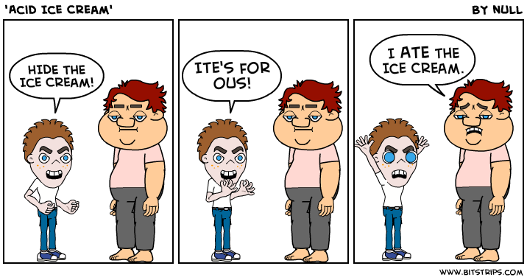
Review…. Naming Acids
Name it!
HBr
H₂CO₃
HClO
H₂S
Formula!
Phosphoric acid
Sulfurous acid
Hydroiodic acid
Acetic Acid

Slide 4
Arrhenius Acids and Bases
Recall that water, H₂O, can be thought of as
H⁺OH⁻
Define an acid and a base, according to the Arrhenius definition.
acid = a substance that produces excess H⁺ when dissolved in water
base = a substance that produces excess OH⁻ when dissolved in water
Write the products of each chemical reaction below, which involves the dissociation of each reactant into aqueous ions.
HCl (g) →
NaOH (s) →

Slide 5
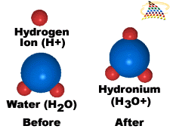
hydronium ion (H₃O⁺)- formed on reaction of a proton with a water molecule. H⁺ and H₃O⁺ are used interchangeably in most situations.

Slide 6
Definition of Acids and Bases: Brønsted-Lowry Acids and Bases
Brønsted-Lowry Acids and Bases – uses a partnership of acid and base to understand the transfer of a proton, H⁺, from the acid to the base.
Brønsted-Lowry Acid – particle that donates a proton to another particle (the base)
Brønsted-Lowry Base – particle that accepts a proton from another particle (the acid)

Slide 7
Brønsted-Lowry Acids and Bases
Write the formulas for the two products formed in these chemical reaction.
HCl(g) + H₂O(l) →
HCl behaves as an ____________ because it ______________ H+,
and water behaves a ___________ because it ______________ H+.
NH₃(aq) + H₂O(l) ⇌
NH₃ behaves as a ______________ because it ____________ H+,
and water behaves an _____________ because it ____________ H+.

Slide 8
Brønsted-Lowry Acids and Bases
A Brønsted-Lowry acid must have a hydrogen atom that it can lose as a positive ion (sometimes called the labile proton)
A Brønsted-Lowry base must have a lone pair that it can use to bind the H+ ion.
Water is an example of an amphiprotic substance. What does it mean to be amphiprotic? Can act either as an acid or a base.
Write an equation showing water acting as an amphoteric substance:
H₂O(l) + H₂O(l) ⇌

Slide 9
Brønsted-Lowry Acids and Bases
HA(aq) + H₂O(l)  H₃O⁺(aq) + A⁻(aq)
Acid Base Conjugate Conjugate Acid Base
The products of a B-L acid base reaction are often referred to as the conjugates of the reaction.
conjugate base- everything that remains of the acid molecule after a proton is lost conjugate acid- base plus a proton

Slide 10
Identify the conjugate bases of these substances.
Cl⁻
HCl HNO₃ NH₃ HC₂H₃O₂ CH₃NH₃⁺
NO₃⁻
NH₂⁻ (amide ion)
C₂H₃O₂⁻
CH₃NH₂ (methylamine)

Slide 11
Identify the conjugate acids of these substances.
HF
F⁻ NH₃ H₂O
NH₄⁺
H₃O⁺

Slide 12
For the following reactions, identify the acid, base, conjugate acid and conjugate base
NH₃ + H₃O⁺ ⇌ NH₄⁺ + H₂O
CH₃OH + NH₂⁻ ⇌ CH₃O⁻ + NH₃

Slide 13
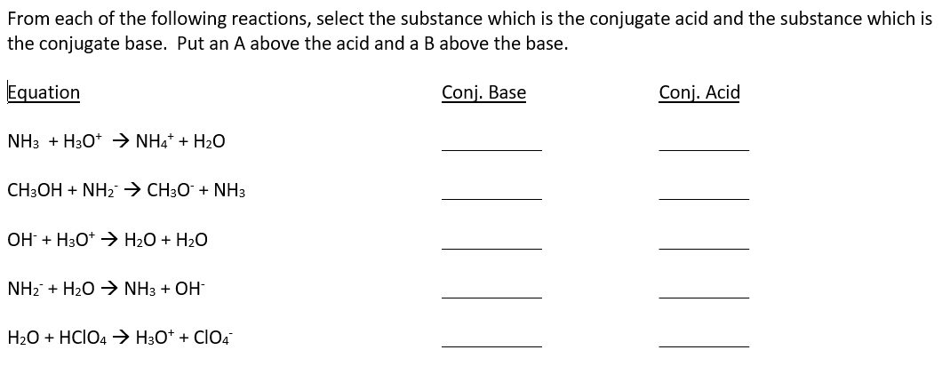

Slide 14
Strong and Weak Acids and Bases
Strong acid – LARGE K value, mostly dissociated substance. Write a dissociation reaction for the strong acid, HX:
HX + H₂O → H₃O⁺ + X⁻
- equilibrium lies far to the right
a strong acid yields a weak conjugate base (much weaker than H₂O)
Notice the single arrow! K > 10⁵
Weak acid- SMALL K value for dissociation, mostly undissociated
HA + H₂O ⇌ H₃O⁺ + A⁻
equilibrium lies far to the left
has a ‘significant’ conjugate base (stronger than water, but not a “strong” base) Notice the double arrow! K < 10⁻⁵

Slide 15
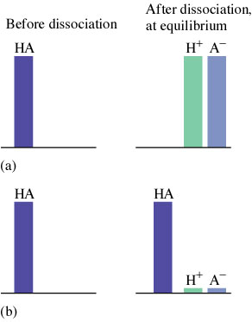

Slide 16

Sketch what five molecules of HF (weak) and five molecules of HCl
(strong) would look like in a beaker of water.
HF
HCl

Slide 17
Sketch what five molecules of HF (weak) and five molecules of HCl
(strong) would look like in a beaker of water.
HF
HCl

Slide 18
Unit 7: Acids and Bases
8.2 pH and pOH of Strong Acids and Bases

Slide 19
Reminder: Common strong acids -all completely dissociate! (Know these!)
Write the conjugate bases for the strong acids:
H₂SO₄ (sulfuric)
HCl (hydrochloric)
HNO₃ (nitric)
HClO₄ (perchloric)
HI (hydroiodic)
HBr (hydrobromic)

Slide 20
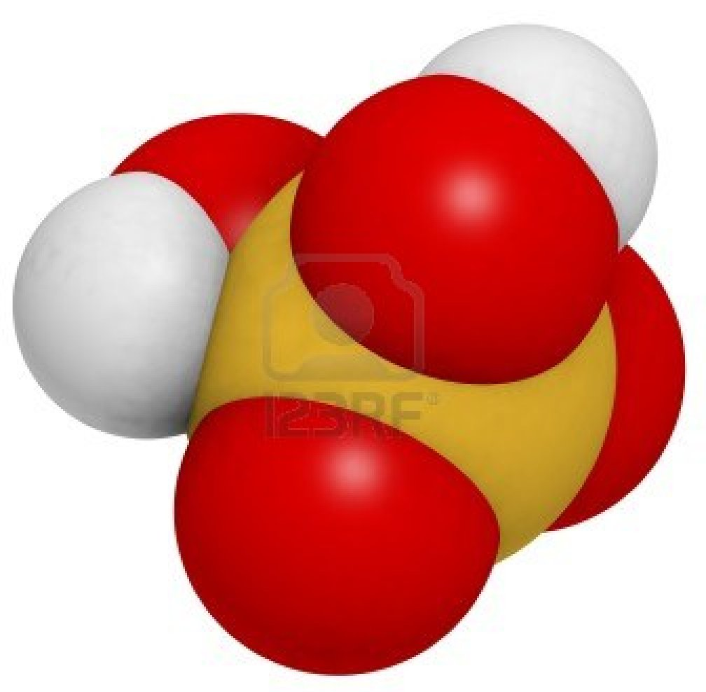
Sulfuric acid is a diprotic acid which means that it has two acidic protons. The first (H₂SO₄) is strong and the second (HSO₄⁻) is weak. Write equations for the first and second dissociations of sulfuric acid in water.

Slide 21
Strong Bases Completely Dissociate
The most common strong bases are the hydroxide compounds of the alkali metals, such as NaOH and KOH. Other strong bases include hydroxide compounds of the heavier alkaline earth metals, such as Ca(OH)₂, Sr(OH)₂, and Ba(OH)₂.
Write the dissociation for Ca(OH)₂. What do you notice about the [OH⁻] for the alkaline earth metal hydroxides?

Slide 22
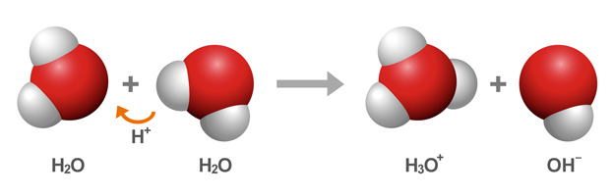
Autoionization of Water
H₂O + H₂O  H₃O⁺ + OH⁻ base acid conjugate conjugate acid base Write the K expression for the dissociation of water

Slide 23
Ion product constant for water (K_{w})
K_{w} = [H₃O⁺][OH⁻] At 25ºC, K_{w} = 1 × 10⁻¹⁴ because
[H⁺] = [OH⁻] = 1 × 10⁻⁷ M
This is a very important relationship that allows you to calculate [H+], [OH–], pH, and pOH.

Slide 24
More about K_{w}
No matter what an aqueous solution contains, at 25ºC,
[H⁺][OH⁻] = 1 × 10⁻¹⁴
Neutral solution [H⁺] = [OH⁻] and pH = 7 Acidic solution [H⁺] > [OH⁻] and pH < 7 Basic solution [H⁺] < [OH⁻] and pH > 7 K_{w} varies with temperature-this can affect the pH of pure water at different temperatures!

Slide 25
Calculating the pH of strong acids and bases
pH is defined as the negative logarithm (in base 10) of the concentration of H⁺ (or H₃O⁺).
pH = ─log[H⁺] or pH = ─log[H₃O⁺]
For example, the pH of a solution in which
[H⁺] = 1.0 x 10^{–7} = 7.00
Mathematically, this also means that concentration of H⁺ can be found from pH:
[H⁺] = 10^{-pH}

Slide 26
Significant figures in pH and other log values:
The number of decimal places in the log value should equal the number of significant digits in the original number (concentration).
Example: pH = 4.42 How many significant figures??
Calculate the pH of a solution where [H⁺] = 1.3 x 10⁻⁵ M

Slide 27
pH and pOH
In chemistry, we use the convention that the “negative log” of some quantity is labeled p(quantity). Therefore the concentration of hydroxide ions in solution is expressed in terms of the pOH. Similarly, pK_{w} = –log (K_{w}) = 14 at 25ºC .
You should also know that pH + pOH = 14 at 25ºC

Slide 28
pH, pOH and pK are logarithmic functions
pH and pOH are logarithmic functions. The pH changes by 1 for every power of 10 change in [H⁺]. pH decreases as [H⁺] increases.
A substance with a pH of 3.00 has ten times the [H⁺] as a substance with a pH of 4.00.

Slide 29
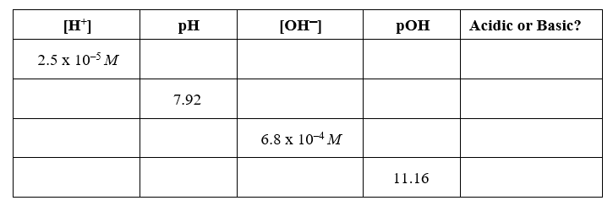
Practice

Slide 30
Calculating pH of Strong Acid Solutions
The pH of a solution of strong acid is simply calculated by taking the negative logarithm of concentration of a monoprotic strong acid.
For example, the pH of 0.1 M HCl is 1.0.
Caution: If the acid concentration is less than 1.0 × 10⁻⁷, the water becomes the important source of [H⁺] and the pH is 7.00. The pH of an acidic solution can not be greater than 7 at 25ºC!!!!!

Slide 31
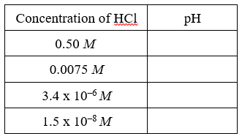
Practice:
With strong acids, the concentration of H+ in solution the same as the concentration of the acid itself. (This is not the case with weak acids) Calculate the pH for each of the following concentrations of hydrochloric acid. Remember that if the concentration of [H₃O+] has two sig figs, the pH will have 2 decimal places.

Slide 32
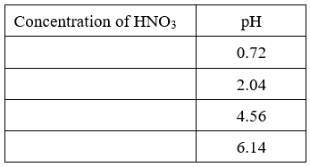
Calculate the concentration of nitric acid for each of the following solutions. Remember that if a pH has 2 decimal places, the concentration of [H₃O+] will have two sig figs.

Slide 33
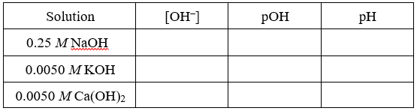
Fill in the missing information in the table below. Pay attention to the concentration of hydroxide in the last row of the table. [OH–] is not equal to 0.0050 M in 0.0050 M Ca(OH)₂.

Slide 34
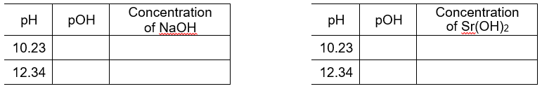
Fill in the missing information in the tables below. Remember that something extra should be done to convert from [OH–] into concentration of Sr(OH)₂.

Slide 35
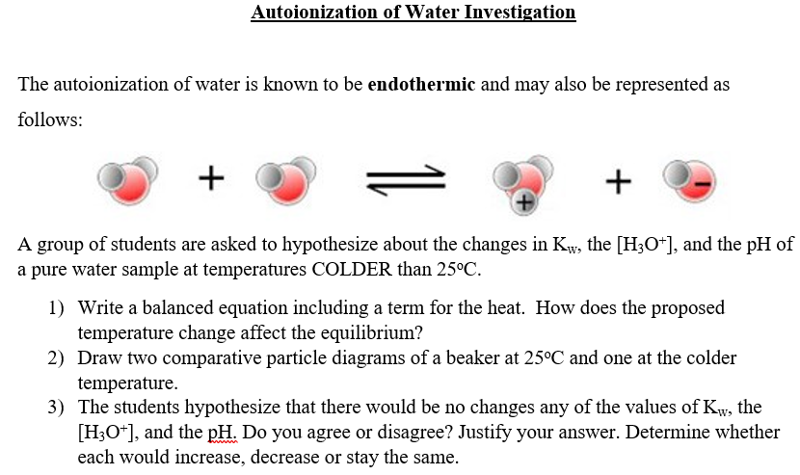

Slide 36
8.3 Weak Acid and Base Equilibria
Unit 7: Acids and Bases

Slide 37
Acid Dissociation Reaction
Write a dissociation reaction for HCl, a STRONG acid, in water. Write the dissociation constant.
Write a dissociation reaction for HCN, a WEAK acid, in water. Write the dissociation constant.

Slide 38
Acid dissociation constant (K_{a})
Equilibrium expressions and conditions are used to calculate concentrations of H⁺, conjugate bases, and remaning acids
The equilibrium expression for the dissociation of a weak acid is called the acid dissociation constant, or the K_{a}.
K_{a} = [H₃O⁺][A⁻] or K_{a} = [H⁺][A⁻] [HA] [HA]
Write the K_{a} expression for the weak acid, HCN.
Why isn’t water included in the K_{a} expression?

Slide 39
Calculating pH of Weak Acid Solutions
Calculating pH of weak acids involves setting up an equilibrium. Weak acids have SMALL K values, so an approximation for a small a can be used.
Always solve by:
Writing the equation,
Setting up the acid equilibrium expression (K_{a}),
Defining initial concentrations, changes, and equilibrium concentrations in terms of a,
Substituting values and variables into the K_{a} expression and solving for a, and
Using the a value to find the pH of the acid solution

Slide 40
Practice: Calculate the pH of a 0.100 M solution of acetic acid. The K_{a} of acetic acid is 1.8 × 10⁻⁵.

Slide 41
Reaction HC₂H₃O₂  H⁺ + C₂H₃O₂⁻
Initial 0.100 0 0
Change -x +x +x
Equilibrium 0.100- x x x
Often, the -x in a K_{a} expression
can be treated as negligible.
x = 1.34 × 10⁻³
Remember the 5% rule? Was the x negligible?

Slide 42
The question asked for the pH.
pH = −log [H⁺]
[H⁺] = x = 1.34×10⁻³
pH = −log 1.34×10⁻³
pH = 2.87
The answer has two significant figures because the K_{a} had only two significant figures. The answer is a reasonable pH for a solution of a weak acid.

Slide 43
Given the initial concentration and pH of a weak acid solution, the K_{a} can be calculated
Practice: A 0.100 M weak acid (HA) solution has a pH of 4.25. Find K_{a} for the acid.

Slide 44
Determination of the Percent Dissociation (or Ionization) of a Weak Acid
Percent Dissociation of a weak acid can be used to calculate pH, and vice versa
% dissociation = amount dissociated (mol/L) ×100 initial concentration (mol/L)
= final [H⁺] ×100 initial [HA]
For a weak acid, percent dissociation (or ionization) increases as the acid becomes more dilute (lower molarity). Equilibrium shifts to the right for lower molarities.

Slide 45
Practice: Calculate the percent dissociation of the 0.100 M weak acid (HA) solution with pH of 4.25 (from the last problem.)

Slide 46
pKa and pKb
Like pH and pOH, pKa and pKb express the values of Ka and Kb in a log function
where pKa = -log Ka and Ka = 10^{-pKa} and pKb = -log Kb and Kb = 10^{-pKb}
Also, an acid and it’s conjugate base show the following relationship:
K_{a} × K_{b} = K_{w} pKa + pKb = 14
The above relationship is also true for a base and it’s conjugate acid
Find the pKa of acetic acid, HC₂H₃O₂, whose Ka =1.8 × 10⁻⁵.
What is the pKb of the conjugate base, C₂H₃O₂⁻¹?
What is the Kb of C₂H₃O₂⁻¹?
How are the Ka and the Kb related?

Slide 47
Calculating pH of polyprotic acids
All polyprotic acids dissociate stepwise. Each dissociation has its own K_{a} value called K_{a1,} K_{a2} K_{a3}
As each H is removed, the remaining acid gets weaker and therefore has a smaller K_{a}. And as the negative charge on the acid increases it becomes more difficult to remove the positively charged proton.
Because the K_{a2} is much smaller than the K_{a1} value, we treat ANY weak acid species as if it loses only 1 H⁺ in significant quantities (only analyze the FIRST H+ removal)

Slide 48
Practice: Consider a 0.200 M H₂PO₄⁻¹ solution.
The pK_{a} of H₂PO₄⁻¹ is 7.20 at 25°C.
List all ions present in the solution.
Calculate the Ka of the acid.
Write a dissociation reaction and equilibrium expression.
Find the pH of the solution at 25°C.

Slide 49
Determination of the pH of a Mixture of Weak Acids
In a mixture of weak acids, only the acid with the largest K_{a} value will contribute an appreciable [H⁺]. Determine the pH based on this acid and ignore any others.

Slide 50
Analysis of weak bases
Weak bases (bases without OH⁻) react with water to produce a hydroxide ion. Common examples of weak bases are ammonia (NH₃), methylamine (CH₃NH₂), and ethylamine (C₂H₅NH₂).
The lone pair on N forms a bond with a H⁺. Most weak bases involve N.
The general form of the dissociation of a base in water:
B(aq) + H₂O(l)  BH⁺(aq) + OH⁻(aq) base acid conjugate conjugate acid base Practice: Write the equation for the dissociation of NH₃ in water

Slide 51
Base dissociation constant (K_{b})
The general form for the base dissociation constant is:
K_{b} = [BH⁺][OH⁻] and pKb = -log Kb
[B]
Practice: Write the K_{b} expression for the dissociation of NH₃ in water.

Slide 52
Analysis of pH of weak bases
Determination of the pH of a weak base is very similar to the determination of the pH of a weak acid. Follow the same steps. Remember, however, that b is the [OH⁻] and taking the negative log of x will give you the pOH and not the pH!
Practice: Calculate the [OH⁻] and the pH for a 15.0 M NH₃ solution. The K_{b} for NH₃ is 1.8×10⁻⁵.

Slide 53
Ex. Calculate the [OH⁻] and the pH for a 15.0 M NH₃ solution. The K_{b} for NH₃ is 1.8×10⁻⁵.
Reaction NH₃ + H₂O  NH₄⁺ + OH⁻
Initial 15.0 --- 0 0
Change −x --- +x +x
Equil 15.0−x --- x x
K_{b} = 1.8×10⁻⁵ = [NH₄⁺][OH⁻] = x² ≈ x²
[NH₃] 15.0−x 15.0
x = 1.6×10⁻² = [OH⁻]
pOH = −log 1.6×10⁻² = 1.78
pH = 14−1.78 = 12.22

Slide 54
Practice: Find the [OH⁻] and pH of a 0.100 M solution of pyridine, C₅H₅N. (pK_{b} = 8.85)
Write a Kb expression, and find Kb from pKb.
Find the [OH-] and pH.

Slide 55
Unit 7: Acids and Bases
8.4 Acid Base Reactions and Buffers

Slide 56
Remember: Weak Acids and Bases have significant conjugates
Because the conjugates of weak acids and bases are significant, their presence alone (without their partner) in water will cause the solution pH ≠ 7
Example: The salt NaCl₂O contains Cl₂O⁻, the conjugate base of HCl₂O. The presence of this conjugate base would make the solution basic according to the following reaction:
Cl₂O⁻ + H₂O ⇌ HCl₂O + OH⁻

Slide 57
Each of these salts contains a conjugate acid or base. Identify the significant conjugate acid or base, the partner, and hypothesize if a solution of salt would be acidic or basic or neutral.
Salt | Significant Ion | Partner | pH of salt solution? | Basic, Acidic or Neutral Salt?
NaCl₂O | Cl₂O⁻ (CB) | HCl₂O
NH₄Cl
NaNO₃
KC₂H₃O₂

Slide 58
Neutral Salts
Neutral Salts- Salts that are formed from the cation of a strong base and the anion from a strong acid form neutral solutions when dissolved in water. Ex. NaCl, KNO₃
The pH of these salts is always 7

Slide 59
Acidic Salts
Acid Salts- Salts that are formed from the conjugate acid of a weak base and the anion from a strong acid form acidic solutions when dissolved in water. Ex. NH₄Cl (notice the N atom!) Write the reaction of the significant conjugate in water:
The resulting solution will be ACIDIC because NH₄⁺ donates a proton from water
NH₄⁺ + H₂O  H₃O⁺ + NH₃

Slide 60
Basic Salts
Basic Salts- Salts that are formed from the conjugate base of a weak acid and the neutral cation form acidic solutions when dissolved in water. Ex. NaNO₂ Write the reaction of the significant conjugate in water:
The resulting solution will be BASIC because NO₂⁻ accepts a proton from water
NO₂⁻ + H₂O  OH⁻ + HNO₂

Slide 61
General Order of pH Strong Bases (SB) Weak Bases (WB) Basic Salts (BS) Neutral Salts (NS) Acidic Salts (AS) Weak Acids (WA) Strong Acids (SA) When asked to rank a mixture of compounds by pH, label each as shown above and then arrange them.
High pH
Low pH

Slide 62
Arrange the following 0.1 M solutions in order
of decreasing pH.
NaOH
NaCN
KCl
CH₃NH₂
H₃PO₄
NH₄NO₃
HBr
NaOH>CH₃NH₂>NaCN>KCl>NH₄NO₃>H₃PO₄> HBr

Slide 63
Determination of the pH of Salts
When determining the exact pH of salt solutions, we can find the K value of the significant conjugate from the K value of the weak partner. They are related with the equation:
K_{a} × K_{b} = K_{w} Also, pKa + pKb = 14 where pKa = -log Ka and pKb = -log Kb
K_{a} of a significant conjugate acid can be found from the K_{b} of the weak base partner.
K_{b} of a significant conjugate base can be found from the K_{a} of the weak acid partner.

Slide 64
K_{a} × K_{b} = K_{w} Also, pKa + pKb = 14
Practice: If NH₃ has a Kb value of 1.8x10⁻⁵, what is the K_{a} needed to analyze the salt NH₄Cl?

Slide 65
Practice: Calculate the pH of a 0.15 M solution of sodium acetate. The K_{a} of acetic acid is 1.8 x 10⁻⁵.
Reaction C₂H₃O₂⁻ + H₂O  HC₂H₃O₂ + OH⁻
Initial 0.15M ---- 0 0
Change −x +x +x
Equil. 0.15− x x x

Slide 66
[OH⁻] = 9.2×10⁻⁶
pOH = - log 9.2×10⁻⁶ = 5.04
pH = 14.00−5.04 = 8.96
The pH is slightly basic, which is reasonable for a basic salt

Slide 67
Find the pH of a 0.100 M CH₃NH₃Cl solution. The pKb for CH₃NH₂is 3.35.

Slide 68
HC₂H₃O₂ 1.8×10⁻⁵
HCN 6.2×10⁻¹⁰
HNO₂ 4.0×10⁻⁴
Given the K_{a} values for the acids above, rank these conjugate bases from weakest to strongest.
Cl⁻, C₂H₃O₂⁻, CN⁻, NO₂⁻
Cl⁻ < NO₂⁻ < C₂H₃O₂⁻ < CN⁻

Slide 69
Unit 7: Acids and Bases
8.6 Molecular Structure of Acids and Bases

Slide 70
Hydrohalic acids- Relative Acid Strength
Hydrohalic acids- H is attached to a halogen (HCl, HI, HBr, HF)
HF is the only weak hydrohalic acid. Although the H-F bond is very polar, the bond is so strong (due to the small F atom) that the acid does not completely dissociate.
The others (HCl, HBr, HI) have larger anions, and the larger the distance, the weaker the attraction between H⁺ and X⁻ weaker (Coulomb’s Law)
Of the hydrohalic acids, which is the strongest?

Slide 71

Relative Acid Strength
Oxyacids- most acids are oxyacids - acidic proton is attached to O Examples of weak oxyacids: H₃PO₄ (phosphoric) HNO₂ (nitrous) HOCl (hypochlorous)

Slide 72
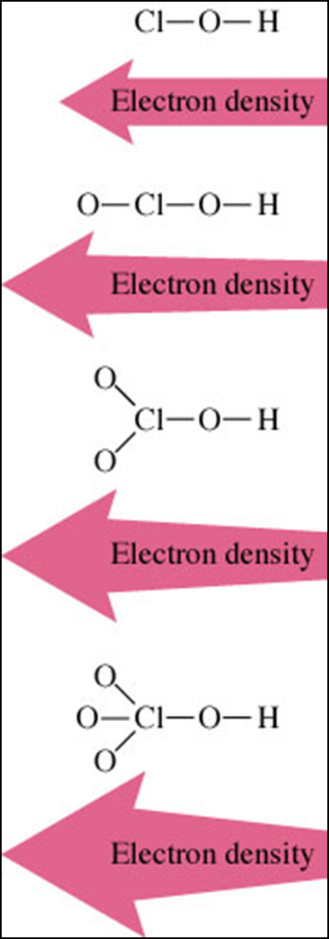
Oxyacid Relative Acid Strength- multiple O’s
In general, the more electron dense an anion is, the looser the H-A bond is, and the stronger the acid is.
Within a series, acid strength increases with increasing numbers of oxygen atoms. For example: HClO₄ > HClO₃ > HClO₂ > HClO
and H₂SO₄ > H₂SO₃ (Electronegative O draws electrons away from O-H bond)
Match the acid with the Ka
HIO₃ 2 x 10⁻¹¹
HIO 1.6 x 10⁻¹
HIO₂ 3.2 x 10⁻⁵

Slide 73
Oxyacid Relative Acid Strength- varying central atom
Acid strength increases with increasing electronegativity of oxyacids. Rank the acids with decreasing strength:
HOBr, HOCH₃, HOCl, HOI
HOCl > HOBr > HOI > HOCH₃

Slide 74
8.8 Properties of Buffers
8.9 Henderson
Hasselbalch Eqn
8.10 Buffer Capacity
Unit 7: Acids and Bases

Slide 75
Buffer Solutions and Common ion effect
The addition of a common ion to a solution of a weak acid makes the solution less acidic.
Example: Write the dissociation reaction for acetic acid:
Using the LeChatlier Principle, determine how the addition of NaC₂H₃O₂ causes the equilibrium to shift. Will the pH increase or decrease?

Slide 76
Buffer Solution
A buffer solution is made by combining a weak acid or base with a salt containing its conjugate.
When preparing a buffer, choose an acid whose pKa is close to the desired pH of the buffer solution.
Alternatively, the pKb of the base should be close to the pOH of the buffer solution.
These solutions are called buffers because they resist a change in pH when acid or base is added.

Slide 77
Which combinations of compounds can make a buffer solution?
HCHO₂ and NaCHO₂
HCl and NaCl
CH₃NH₂ and CH₃NH₃Cl
NH₃ and NaOH
100 mL 1.0 M HF and 50 ml 1.0 M NaOH
100 mL 1.0 M CH₃NH₂ and 50 ml 1.0 M HNO₃

Slide 78
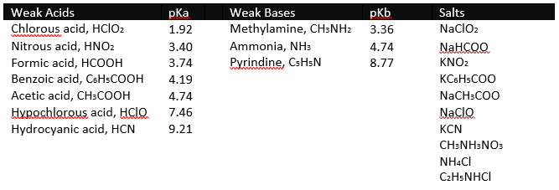
You have been asked to prepare 500.0 mL of buffer solution at pH 4.00. A student has suggested using ammonia, NH₃, and ammonium chloride, NH₄Cl, to prepare the buffer. Explain why this is NOT an appropriate choice to prepare the buffer.
From the table above, what would be the best combination to prepare the buffer?

Slide 79
Buffer solutions resist pH change by reaction with strong acid or base
Example: Consider a mixture of HC₂H₃O₂ and NaC₂H₃O₂ Write an equation for the addition of strong acid… hint, which component will it react with? (Easiest way to show a strong acid is to use H+):
H⁺ + C₂H₃O₂⁻ → HC₂H₃O₂ Write an equation for the addition of strong base … hint, which component will it react with? (Easiest way to show a strong acid is to use OH⁻):
OH ⁻ + HC₂H₃O₂ →H₂O + C₂H₃O₂ ⁻
Notice the one-way arrows. When a strong acid or base is added,the reaction is driven to completion.

Slide 80
Consider an NH₃/NH₄⁺ buffer system
Write an equation for the addition of strong acid to the system
NH₃ + H⁺ → NH₄⁺
Write an equation for the addition of strong base to the system
NH₄⁺ + OH⁻ → NH₃ + H₂O

Slide 81
Buffer capacity
The amount of acid or base that can be absorbed by a buffer system without a significant change in pH. In order to have a large buffer capacity, a solution should have large concentrations of both buffer components.
Which has a larger capacity:
0.10 M HF/0.10 M NaF, pKa 3.14
0.01 M HClO₂/ 0.01 M KClO₂ pka 1.95

Slide 82
Calculating the pH of a Buffer System
One way to calculate the pH of a buffer system is with the Henderson-Hasselbach equation. pH = pK_{a} + log [base] [acid] pH = pK_{a} + log [A⁻] [HA]

Slide 83
Creating Buffers
For a particular buffering system all solutions that have the same ratio of [A⁻]/[HA] have the same pH.
Optimum buffering occurs when [HA] = [A⁻] and the pK_{a} of the weak acid used should be as close as possible to the desired pH of the buffer system.
Formic acid (HCHO₂) has a pK_{a} = 3.74. Calculate the pH of a buffer that is 0.25 M HCHO₂ and 0.25 M NaCHO₂.
Notice that whenever [HA] = [A⁻] , pH = pKa!

Slide 84
Hints for Solving Buffer Problems: 1. Determine major species involved initially. 2. If chemical reaction occurs(Is there a strong acid or strong base?), write equation and solve stoichiometry in moles, then change to molarity. 3. Write equilibrium equation. 4. Set up equilibrium expression (K_{a} or K_{b}). 5. Solve. 6. Check logic of answer.

Slide 85
Ex. A solution is 0.120 M in acetic acid and 0.0900 M in sodium acetate. Calculate the [H⁺] at equilibrium. The K_{a} of acetic acid is 1.8×10⁻⁵.
Rxn HC₂H₃O₂  H⁺ + C₂H₃O₂⁻
Initial 0.120 0 0.0900
Change −x +x +x
Equil. 0.120−x x 0.0900 + x
K_{a} = x (0.0900 + x) ≈ x (0.0900) = 1.8 × 10⁻⁵ 0.120 −x 0.120
x = 2.4×10⁻⁵ M
[H⁺] = 2.4×10⁻⁵

Slide 86
Now solve using H-H equation:Ex. A solution is 0.120 M in acetic acid and 0.0900 M in sodium acetate. Calculate the [H⁺] at equilibrium. The K_{a} of acetic acid is 1.8×10⁻⁵.
Using the Henderson-Hasselbach equation: pK_{a} = −log 1.8×10⁻⁵ = 4.74 pH = 4.74 + log (0.0900/0.120) = 4.62 [H⁺] = 10^{(−4.62)} = 2.4×10⁻⁵

Slide 87
Calculate the pH of a solution that is 0.250 M in HCN and 0.170 M in KCN. For HCN, K_{a} = 4.9 × 10^{–10}.
Use either the equilibrium approach and the Henderson–Hasselbach approach.

Slide 88
Calculate the pH of a solution that is 0.250 M in HCN and 0.170 M in KCN. For HCN, K_{a} = 4.9 × 10^{–10}.
Use either the equilibrium approach and the Henderson–Hasselbach approach.
Follow up: A strong base is added to the buffer solution.
Write an equation showing the addition of the base to the buffer. Predict whether the pH will increase, decrease or stay the same.

Slide 89
8.5 Acid Base Titrations
8.7 pH and pKa
Unit 7: Acids and Bases

Slide 90
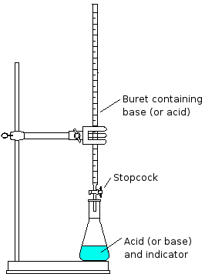
Acid-Base Titrations

Slide 91
Neutralization Rxns
Predict the products, determine if pH <7, >7, =7 at completion (careful! Notice the arrow! Acid + Base has a LARGE K value!):
NaOH + HCl →
NaOH + H₂SO₄ →
NH₃ + HI →
KOH + HC₂H₃O₂ →
NaOH + H₃PO₄ →

Slide 92
Titrant and Analyte
titrant-solution of known concentration (in buret)
The titrant is added to a solution of unknown concentration (analyte) until the substance being analyzed is just consumed (stoichiometric point or equivalence point).
The equivalence point is where the moles of titrant is just enough to completely neutralize the moles of analyte
In a titration, the data collected can include initial and final volume of the titrant, molarity of the titrant, and the volume of the analyte.

Slide 93
Practice: The titration of 25.00 mL of acid HA was performed with a 0.550 M solution of NaOH. The buret initially read 1.25 mL and showed a final volume of 24.76 mL.
What is the titrant and what is the analyte?
Calculate the concentration of the acid.

Slide 94
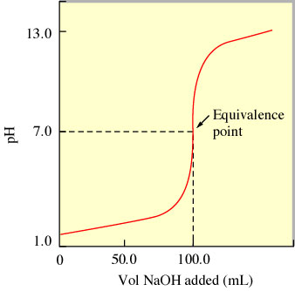
The progress of a Neutralization Reaction is commonly charted on a pH or Titration Curve
pH or titration curve -plot of pH as a function of the amount of titrant added.
The x axis represents mL of titrant added
The y axis represents pH of the solution
The equivalence point is the center of the steepest section of the curve

Slide 95
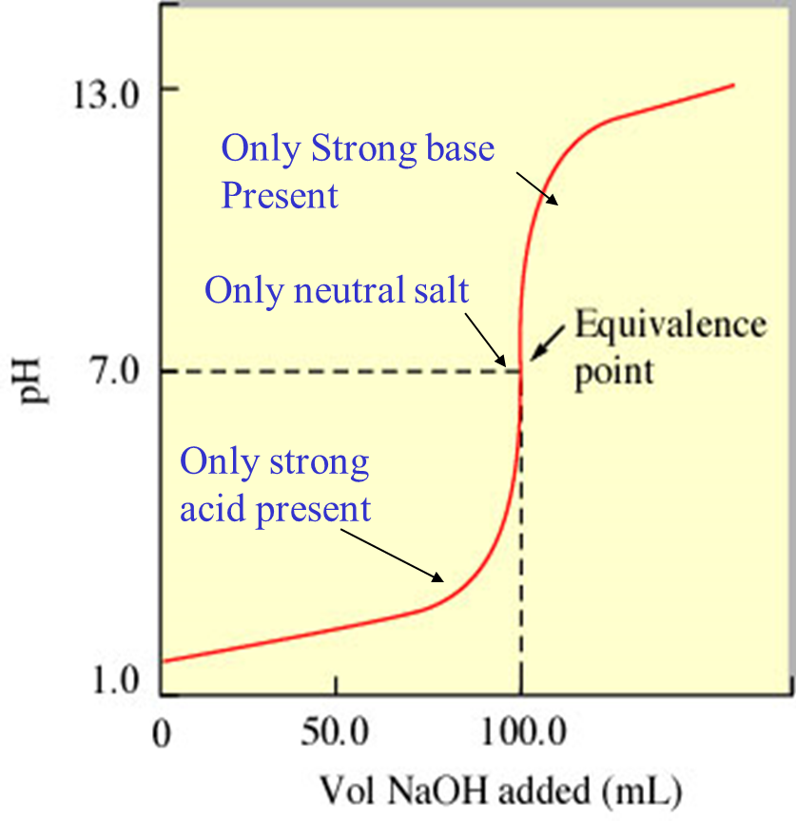
Simplest Curve: Strong acid-strong base
Simple reaction H⁺ + OH⁻ → H₂O
The pH is easy to calculate because all reactions go to completion.
At the equivalence point, the solution is neutral, pH is 7.

Slide 96
The pH Curve for the Titration of 50.0 mL of HNO₃ with 0.100 M NaOH
Write a reaction for the titration:
What is the pH at the equivalence point? Why? (no significant conjugates left)
Using the equivalence point data, calculate the molarity of the acid.
Only Strong base Present
Only neutral salt
Only strong acid present

Slide 97
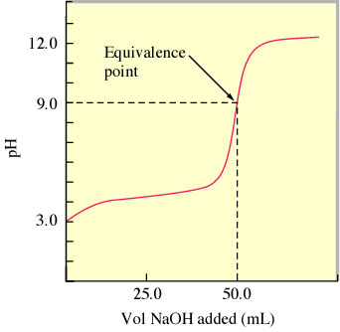
Weak acid - strong base
HA + OH⁻ → H₂O + A⁻
When titrating a weak acid with a strong base, there are several important points:
Initial pH- What species are present at this point? How would we find the pH?
Because the solution has only weak acid (dominant species), pH can be determined using the Ka, like any weak acid.
Equivalence Point- What species are present at this point? At the equivalence, the conjugate base of the weak acid is dominant species. That’s why the pH is >7. The exact pH can be calculated like a basic salt.
Easiest way to tell this is a weak acid titration?
~pH at Equivalence point is BASIC!!!

Slide 98
Weak acid - strong base
HA + OH⁻ → H₂O + A⁻
When titrating a weak acid with a strong base, there are several important points: Half Equivalence Point:
What is meant by ‘half’?
HALF of the titrant has been added. For this curve, it occurs at ½ (50 mL) = 25.00 mL
At halfway to the equivalence point:
50% of the acid remains and 50% of the conjugate base is present
Therefore, pH = pK_{a} at half equivalence point!
pKa can be determined from a titration curve in this way, and vice versa
½ WA=SB
[HA]=[A⁻] ½ eq pt
pH = pK_{a}
What is the pKa of this weak acid?
~4.2

Slide 99
Other points of interest:
Buffer Zone: between about 12 mL to 37 mL on this graph- surrounds the ½ equivalence point- both HA and A⁻ are present in large enough quantities that buffering occurs- pH changes very little
Beyond the Equivalence Point: all acid is neutralized, only strong base remains, pH is found by excess moles of base present
SB = WA
Basic salt
K_{b}
SB>WA
pOH = -log [SB]
WA>SB
[HA]=[A⁻] ½ eq pt
pH = pK_{a}
WA only
K_{a}
WA > SB
Buffer zone begins
WA >SB
Buffer Zone Ends

Slide 100
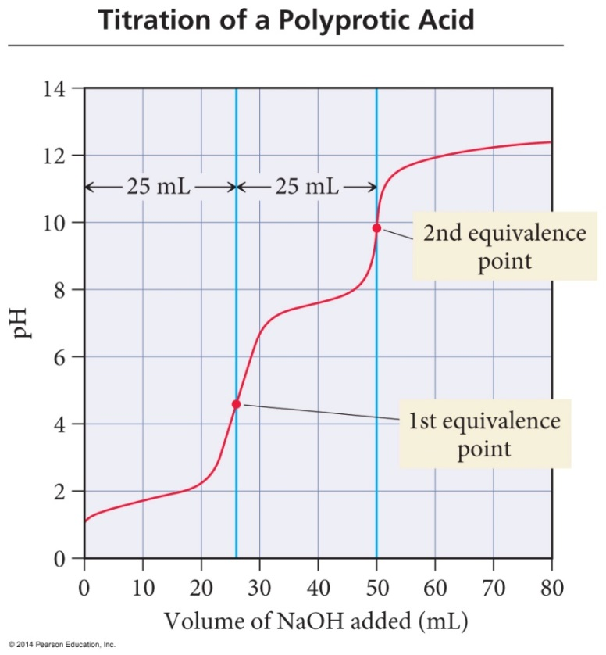
Titration of a Polyprotic Acid
If K_{a1} >> K_{a2}, there will be two equivalence points in the titration.
Graph has a ‘zigzag’ pattern
The closer the K_{a}’s are to each other, the less distinguishable the equivalence points are.
Notice that it takes equal amounts of moles to reach each equivalence point
Titration of 25.0 mL of 0.100 M H₂SO₃ with 0.100 M NaOH

Slide 101
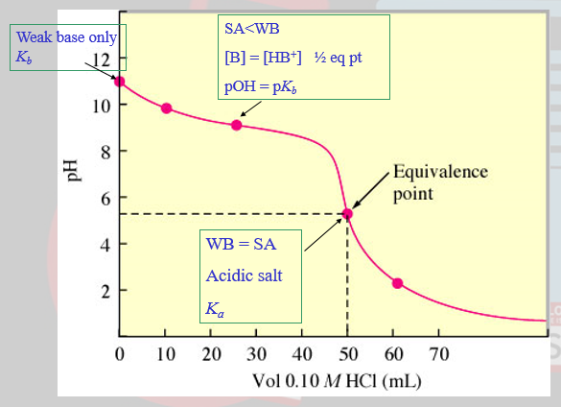
Weak base - Strong acid Titration
B + H₃O⁺ → BH⁺ + H₂O
Before the equivalence point, a weak base equilibria exists.
At ½ equivalence point pOH = pKb
At equivalence point, the conjugate acid causes the solution to have a pH < 7
Circle the buffer zone
Easiest way to tell this is a weak base titration?
~Initial pH is >7!
~pH at Equivalence point is ACIDIC!!!

Slide 102
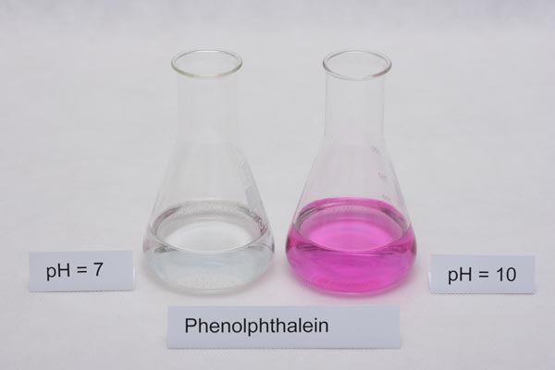
Indicators
Indicators are usually weak acids, HIn. They have one color in their acidic (HIn) form and another color in their basic (In⁻) form.
H⁺ + In⁻ ⇌ HIn ~OR~ HIn + OH⁻ ⇌ H₂O + In⁻
A very common indicator, phenolphthalein, is colorless in its HIn form and pink in its In⁻ form. It changes color in the range of pH 8-10.

Slide 103
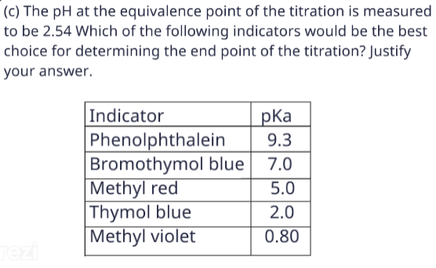
Choosing an indicator
The useful range of an indicator is usually the indicator pK_{a} ±1 (the buffering region).
When choosing an indicator, determine the pH at the equivalence point of the titration and then choose an indicator with a pK_{a} close to that.

Slide 104


