Slide 1
PS C:\> IIS:
“Posh-IIS”: How Powershell can help you configure IIS

Slide 2
Matt Ash
[twitter | github].com/ashmatthew
matthew.a.ash@gmail.com

Slide 3
Disclaimer
Does NOT include JavaScript

Slide 4
You & IIS Automation
Notes:
Use Powershell?
Familiar with IIS powershell capabilities?
Using any automation tools for IIS configuration?
What tools?

Slide 5
Me & IIS Automation
Notes:
Build Systems & MSDeploy
Led to Octopus
Led to Octopus Deploy Library
Led to analyzing and fixing Library step templates
Led to expanding to local setup of applications
Ultimately began my infatuation with site/application deployment automation

Slide 6
The Plan
IIS Review
Manual Configuration
Commandlets
Demo
What Next?

Slide 7
The Goals
Function ConfigureIIS { CreateApplicationPool x2 CreateWebsite CreateApplication CreateVirtualDirectory x2 }

Slide 8
IIS Review

Slide 9
Application Pool
one or more worker processes, configured with common settings that serve requests to one or more applications
Child of IIS server

Slide 10
Web Site
container for web applications, and you can access it through one or more unique bindings
assigned to application pool
Child of IIS server

Slide 11
Binding
combination of an IP address, a port, and the optional host headers on which HTTP.sys listens for requests
Child of a Web Site

Slide 12
Web Application
grouping of files that delivers content or provides services over protocols, such as HTTP
assigned to application pool
Child of Web Site

Slide 13
Virtual Directory
directory name (also referred to as path) that you specify and map to a physical directory on a local or remote server
Child of Web Site or Application

Slide 14
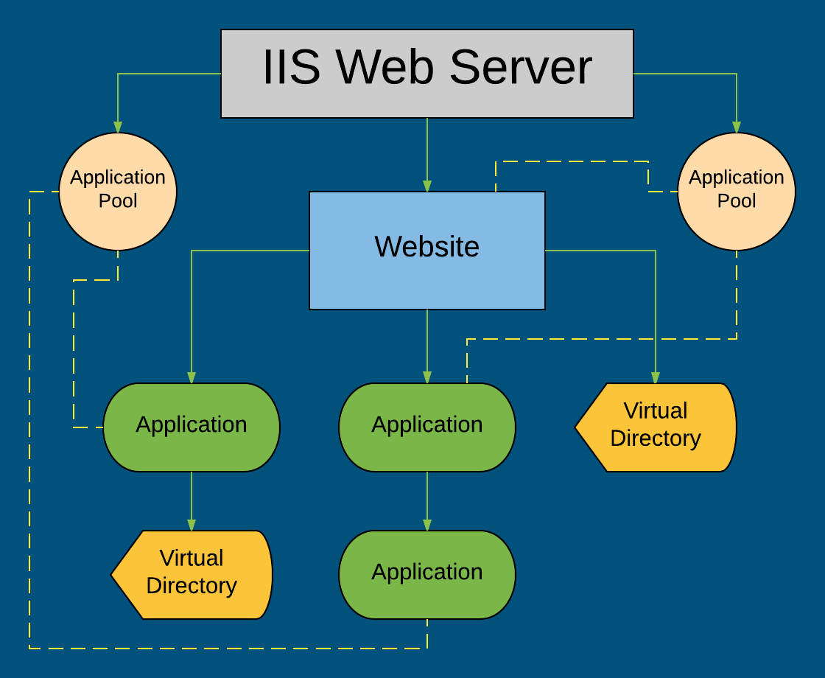

Slide 15
Manual Configuration

Slide 16
WebAdministration Commandlets and IIS Drive
https://technet.microsoft.com/en-us/library/ee790599.aspx

Slide 17
What about IISAdministration Commandlets?
Windows Server 2016 & Windows 10

Slide 18
WebAdministration Module
Commandlets
i.e.: Get-Website
Great for basics
Returns ConfigurationElement (typically) - NOT first class objects
Access individual properties through .Attributes[“AttributeName”].Value
IIS Drive
IIS:\
Allows for more advanced configuration reads/updates
NOT supported in IISAdministration module
You’ll likely end up using a combination of both

Slide 19
PowerShell

Slide 20
What Next?

Slide 21
What Next?
Folder Watcher
Octopus Deploy
DSC
...

Slide 22
Resources
Microsoft
Lots more commandlets
Octopus Library
Review step templates to see example usages of commandlets as used within Octopus deployments
PowerShell and IIS: 20 Practical Examples
Octopus blog post that demonstrates a lot of simple examples, not specific to Octopus

Slide 23
Slides & Code
https://github.com/ashmatthew/Presentations/tree/master/Posh-IIS

Slide 24
PS IIS:\> exit

