Slide 1
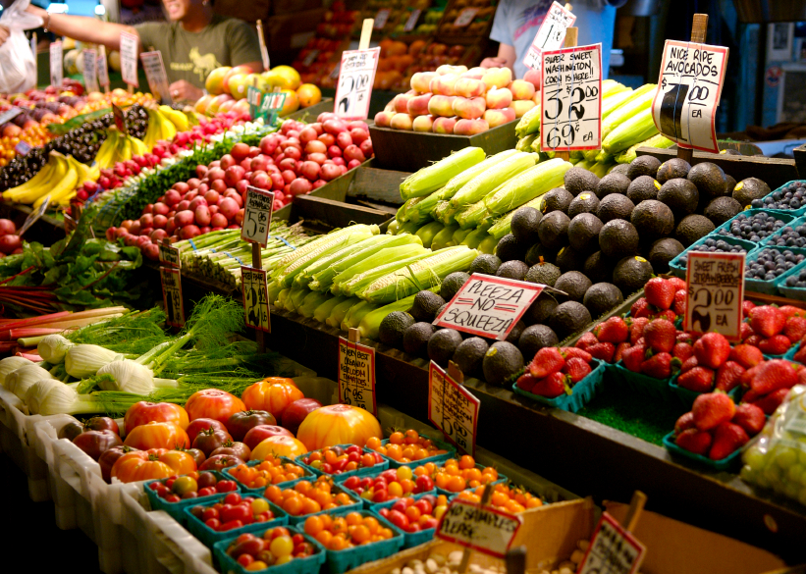
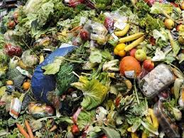
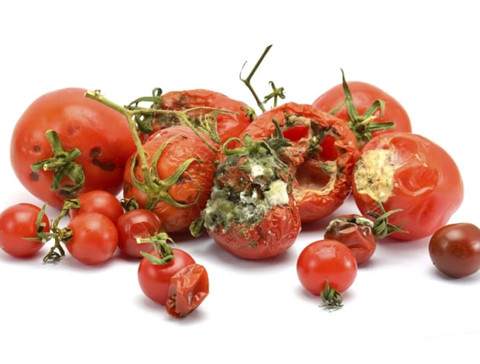
Did you know…
Why?

Slide 2
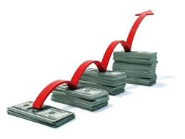


Slide 3

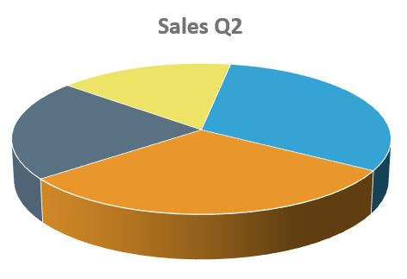
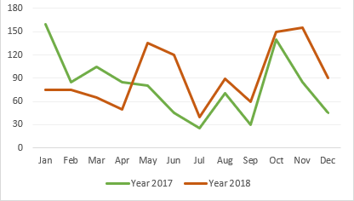
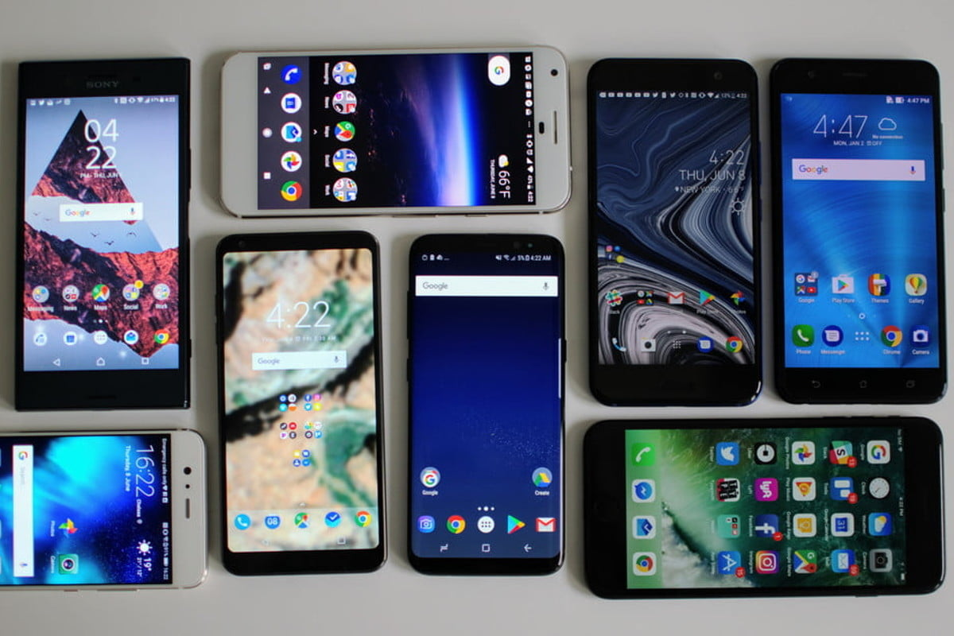
Imagine if stallholders can...
Using only….

Slide 4

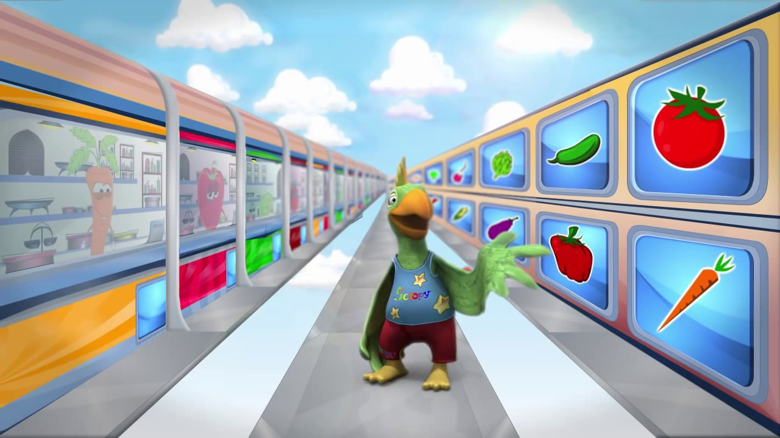
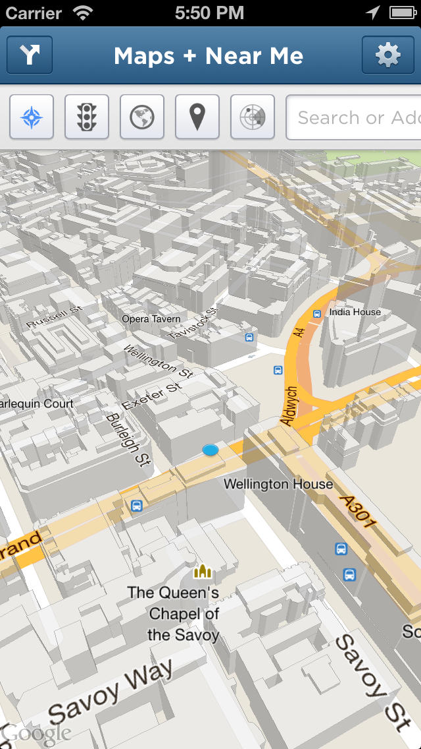
Imagine If...

Slide 5
Suki
Decrease produce wastage by increasing sales.

Slide 6
Produce Waste
Profit

Slide 7
Produce Waste
Profit

Slide 8
Produce Waste
Profit

Slide 9
How to end?

