Slide 1
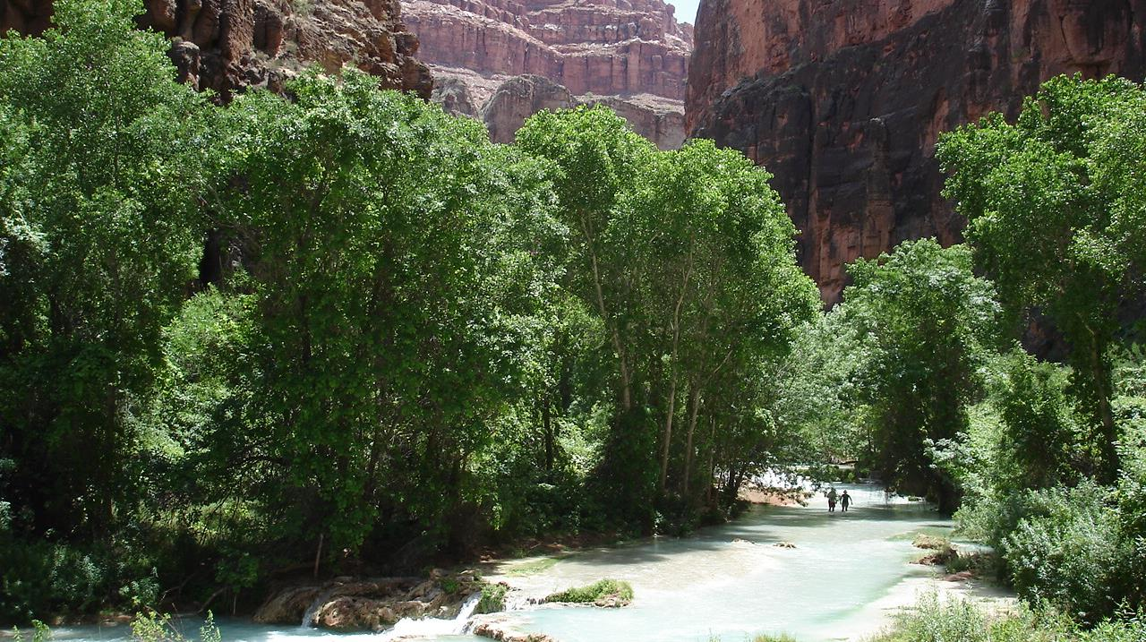
Adventure Travel

Slide 2
Why Travel With Us?
Adventurous Trips
Comfortable Lodging
Affordable Prices
Family Friendly
Incredible Fun!

Slide 3
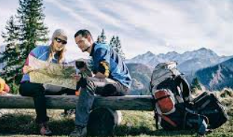
Backpacking Trips
Trails range from easy scenic hikes to canyoneering in the backcountry. We provide opportunities for all to experience the beauty and solitude of a backpacking adventure.

Slide 4
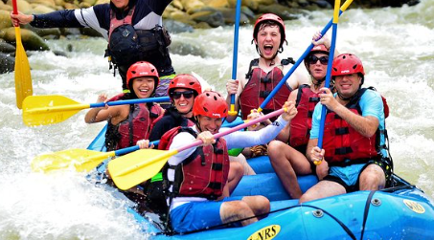
River Rafting
Prefer the “Wet & Wild”? We offer thrilling white water raft trips.
Choice of ½ day or full day trips
Lunch provided
Transportation to/from lodging

Slide 5
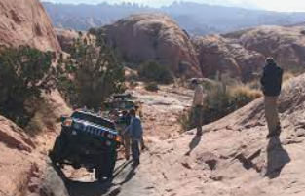
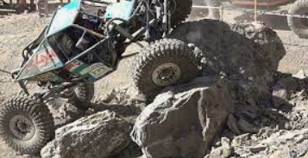
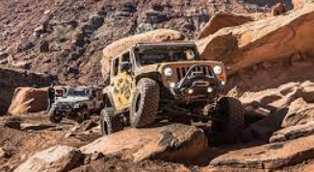
Our RockCrawling adventures …
… are incredible fun!!!

Slide 6
Nearby Loging
Campgrounds
Hostel
Bed and Breakfast
Motels/Hotels

Slide 7
Other Adventures …
Mountain Biking
Horseback Riding
Canyoneering
Wildlife Photography

