Slide 1
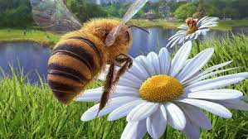
Beekeeping
Notes:
Attribute: Image obtained from https://pixabay.com/en/bee-honey-bee-apis-insect-garden-1575219/.

Slide 2
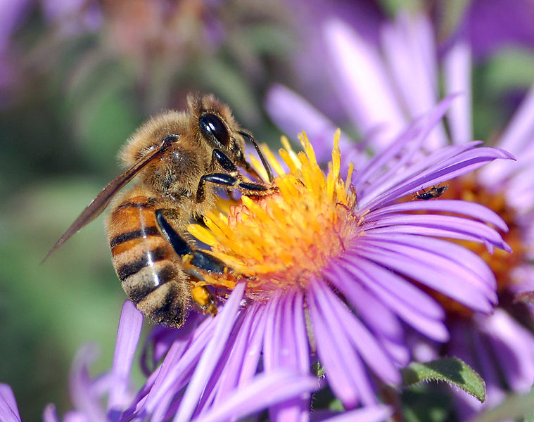
The Honeybee
Ancient people kept bees and harvested honey.
The bee is a member of the insect order Hymenoptera.
Social insects that that create nests called “hives”.
Honeybees pollinate ¼ of all fruit eaten by humans.
Notes:
Attribute: Image obtained from https://commons.wikimedia.org/wiki/File:European_honey_bee_extracts_nectar.jpg.

Slide 3
Why Do People Keep Bees?
Honey
Stores forever and never spoils
Sweeter than sugar
Raw honey can reduce allergy symptoms.
Wax is used for a variety of products such as candles, cosmetics, protectants, lubricants, and many others.
Pollination - gardens, orchards, flowers, and other crops.
“Sting Therapy” in a treatment for arthritis & other joint ailments.
To Help the World Preserve the Honey Bee!

Slide 4
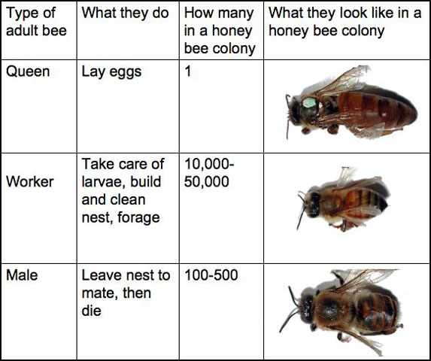
Honey Bee Genders
Notes:
Point out the green dot on the queen… Talk about how the workers have different roles (scout, guard, coroner, nursery, forager, etc).

Slide 5
Gender Facts
A Queen
Can live 3-5 years and can lay as many as 1,500 eggs / day
Flies only a couple of times in her life
Worker bees
Typically live 90 days in spring/summer; up to 120 days in winter
Will travel 3 to 6 miles to find pollen & nectar
Drone bees
Only purpose is to mate with the queen. They die after mating. If they don’t mate, they get kicked out of the colony in the Fall.
Do not have a stinger
Did you know honey bees are NOT native to the US?

Slide 6
What Do You Need To Start?
Honey Bees
Protective clothing
Various “tools” (smoker, hive tool, honey extractor)
Some place for the bees to live (“a hive box”)
A location to put your hive
Your time & labor

