Slide 1
^{The} Candy shop
“Specializing in Custom Flavors”

Slide 2
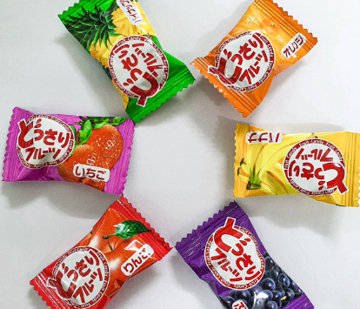
Our mission statement
The Candy Shop’s mission is to be one of the finest producers of unique quality Candy in the industry, while modeling excellence in how to treat employees and consumers.
Mission
“We will create any flavor Candy the customer requests!”
Notes:
Attribute: The image "ice-cream-sunday.gif" was obtained from http://www.culinaryschools.org/clipart/dessert/

Slide 3
Our most popular flavors

Slide 4
Popular flavor Orders

Slide 5

Make You Own Flavors
Have you ever wanted a candy flavor no one makes? Like, Jalapeno? Or, Rhubarb? How about a simple combination of popular flavors that are difficult to find, such as peanut butter and pecans?
The Candy Shop specializes in creating unique flavors. We also combine popular flavors in ways you can’t possibly imagine!
Notes:
Attribute: The images "ice-cream-cone.gif" was obtained from http://www.culinaryschools.org/clipart/dessert/

Slide 6
How to order
Need a special flavor for a special party next week? We can do it! Most of our flavors can be created and available for pickup in just 72 hours. Rush orders are also possible and can be picked up in only 24 hours for an additional fee.
Consult Our Flavor Specialist
Submit Your Order
Taste Test a Sample
We Produce Your Candy
Pickup Your Order

