Slide 1
How to Start a Certification Program

Slide 2

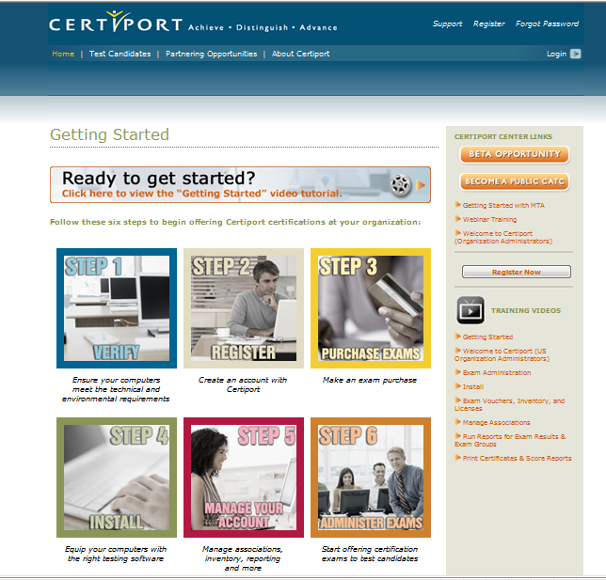
Register an Authorized Testing Center
Acquire required desktop software
Acquire a good textbook
Purchase exams or a site license
Certify your teachers
Register an Authorized Testing Center
Visit www.certiport.com and click the button, “Register a Testing Center”.
Follow the steps to complete the application form .
A representative will call you to activate your testing center.

Slide 3
5 basic steps
Register an Authorized Testing Center
Acquire required desktop software
Acquire a textbook & practice test
Purchase certification exams
Certify your teachers

Slide 4

Register an Authorized Testing Center
Acquire required desktop software
Acquire a good textbook
Purchase exams or a site license
Certify your teachers
Acquire the required desktop software
With the exception of Microsoft Office, all exams are delivered online, so do not require the industry software; however you will need the software to teach skills and prepare students.

Slide 5




Register an Authorized Testing Center
Acquire required desktop software
Acquire a good textbook
Purchase exams or a site license
Certify your teachers
Acquire a good textbook & practice test
Whenever possible, choose a textbook displaying the “Authorized Courseware” seal of approval!
Authorized Courseware in the form of DVDs and textbooks are published by numerous vendors.
Study guides are also available for many industry certification exams, many are even FREE!
The key to passing any certification exam is an excellent practice test. GMetrix practice tests are the best!
Notes:
Discuss textbook options and the advantage of using GMetrix practice tests.

Slide 6

Register an Authorized Testing Center
Acquire required desktop software
Acquire a good textbook
Purchase exams or a site license
Certify your teachers
Purchase certification exams
At least one exam will be needed per certification candidate. More will be needed for retake attempts.
Site licenses are also available to academic institutions for most certifications.

Slide 7

Register an Authorized Testing Center
Acquire required desktop software
Acquire a good textbook
Purchase exams or a site license
Certify your teachers
Certify your teachers
Recommend the teacher become certified and take the exam several times to become familiar with the skills expected.

