Slide 1
Custom Construction
“If you can dream it, we can build it.”

Slide 2
Mission Statement
To construct sheds, barns, outbuildings, and other storage facilities customized to the customers’ needs.
For more information, visit our website Custom Construction.

Slide 3
Custom Buildings
Send us a sketch of your building and let our engineers design the specifications and plans.
After you approve the specifications and plans, we will cut the materials, assemble them into a “kit” and deliver it to your building site.
You can either put the kit together yourself, or we can provide the labor – your choice!

Slide 4
How Our Service Works
Send Us Your Floorplan
Our Engineers Will Design a Building Plan
We Manufacture Your Kit from the Plan
The Kit is Delivered to Your Site
Either You (or We) Assemble the Kit

Slide 5
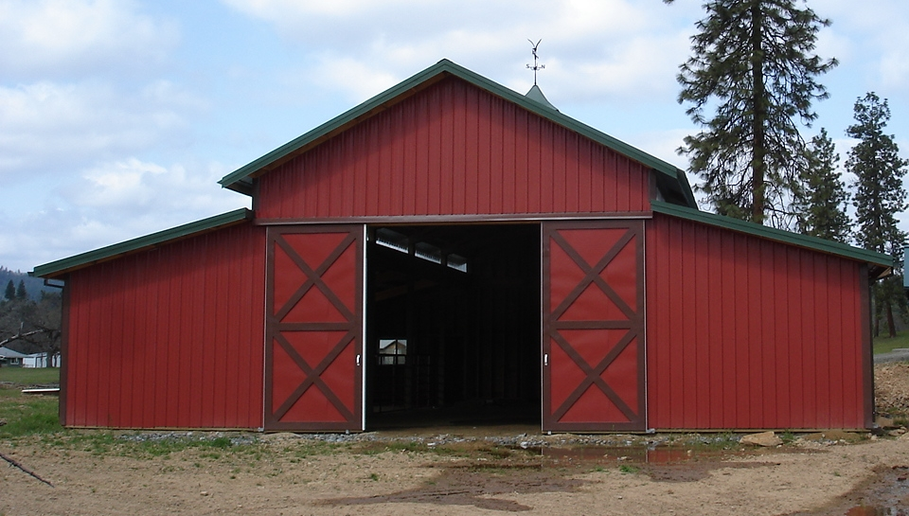
Satisfied Customers!

