Slide 1

Fishing Adventures
Laketown, Oregon

Slide 2
Another Summer is Gone …
Summer was a huge success at our lake this year:
10% more tourists than last year
12% increase in fish caught
60% return visitors

Slide 3
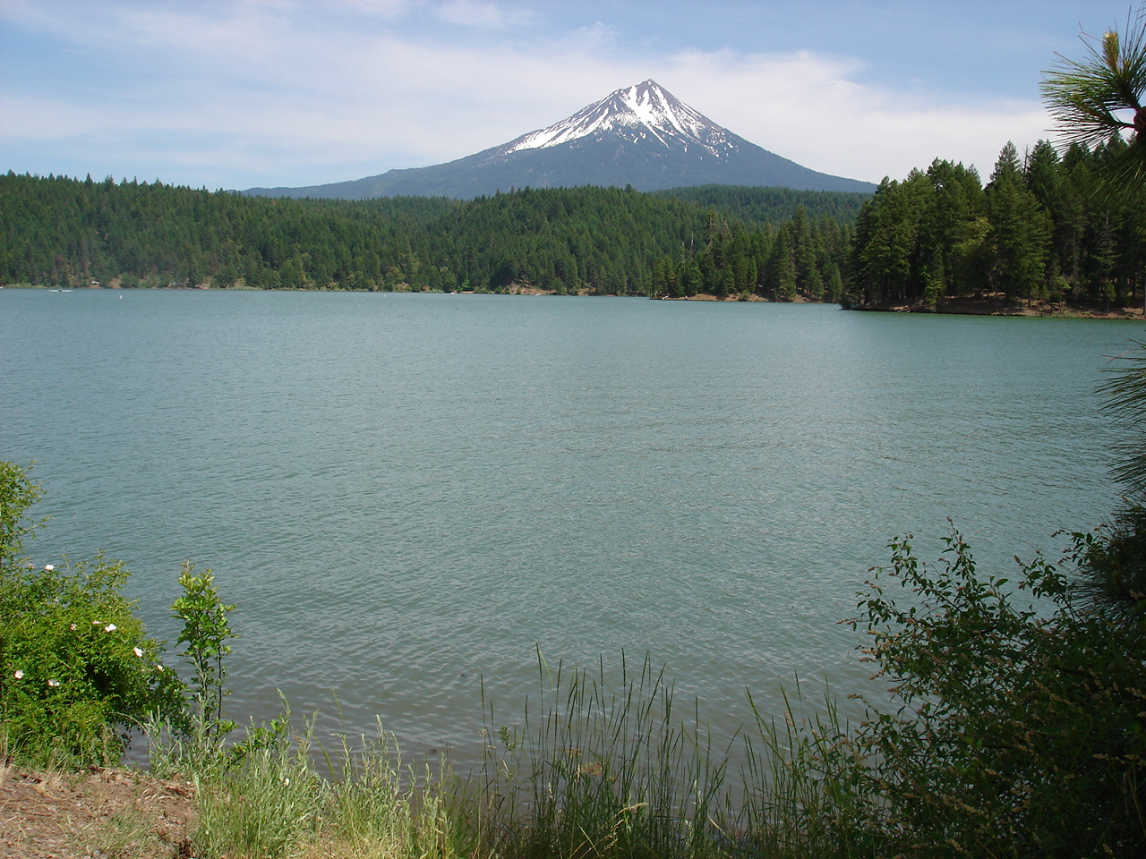
Fishing Derby Success!
Aquaculture Workshop - Approximately 30 high school and college students attended.
Kids Fishing Day - 75 fifth grade students participated.
Oregon Department of Fish and Wildlife released approximately 1,000 legal sized trout for participants to catch.
Raised approximately $60,000.00 for local fish enhancement.

Slide 4
Fishing is Good All Seasons
Month | High | Low | Water
January | 30 | 20 | 35
February | 32 | 26 | 35
March | 48 | 30 | 40
April | 65 | 46 | 50
May | 75 | 53 | 55
June | 85 | 62 | 60
July | 90 | 71 | 70
August | 92 | 69 | 70
September | 81 | 60 | 65
October | 65 | 46 | 55
November | 48 | 30 | 40
December | 32 | 22 | 35
Weather is beautiful all year and the water at the lake is surprisingly warm for most of seasons due to a few hot springs that feed into the lake. Even during the winter when the lake freezes on top, the temperature below the surface keeps fish active.
Don't let cold weather at home scare you away, because fishing on our lake is fabulous all year!

Slide 5
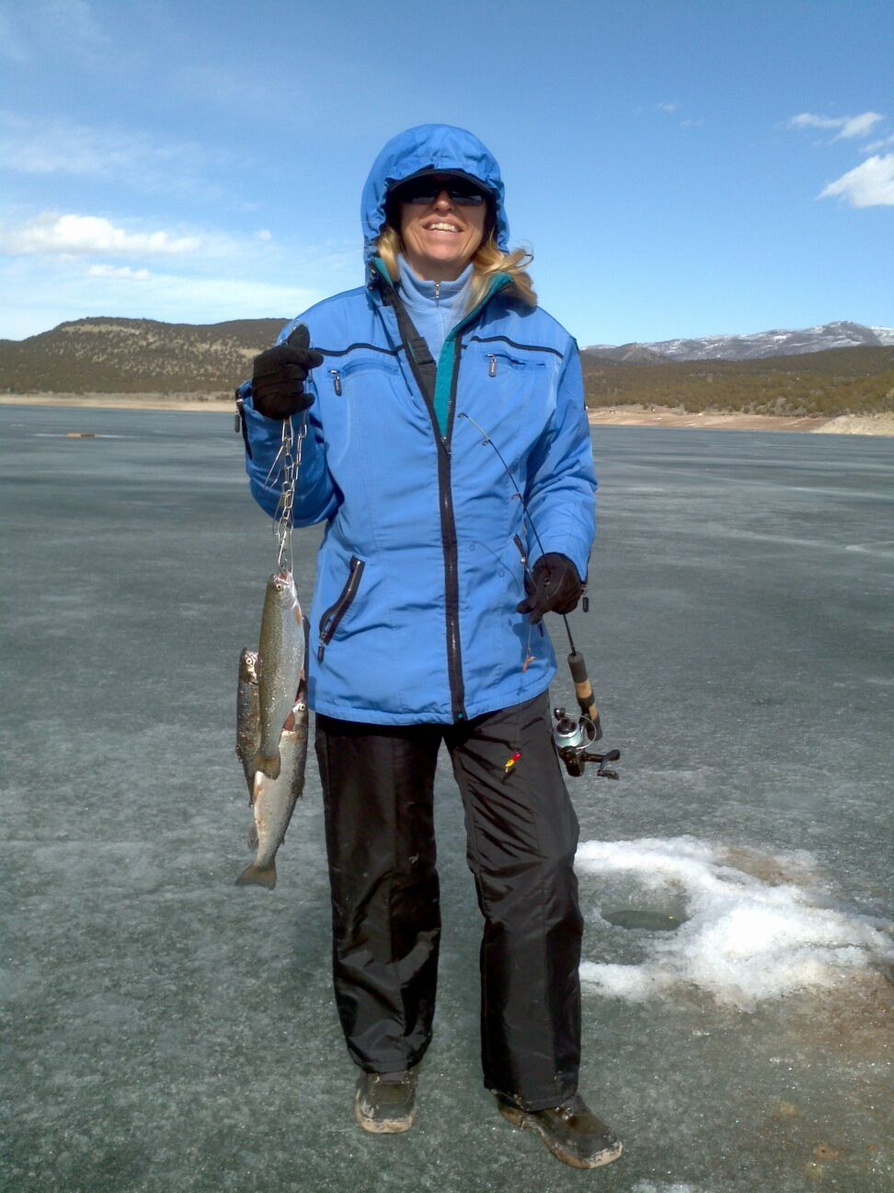
Winter is Coming!
Don’t forget. We offer excellent ice fishing for the truly committed angler. Start planning your trip today!

Slide 6
Ready to Go Fishing?
Book an Adventure
Pack Your Gear
Catch a Fish!

