Slide 1

Desert Lake Vacations

Slide 2
Types of Vacations
Camping
Houseboats
Condos/Hotels

Slide 3
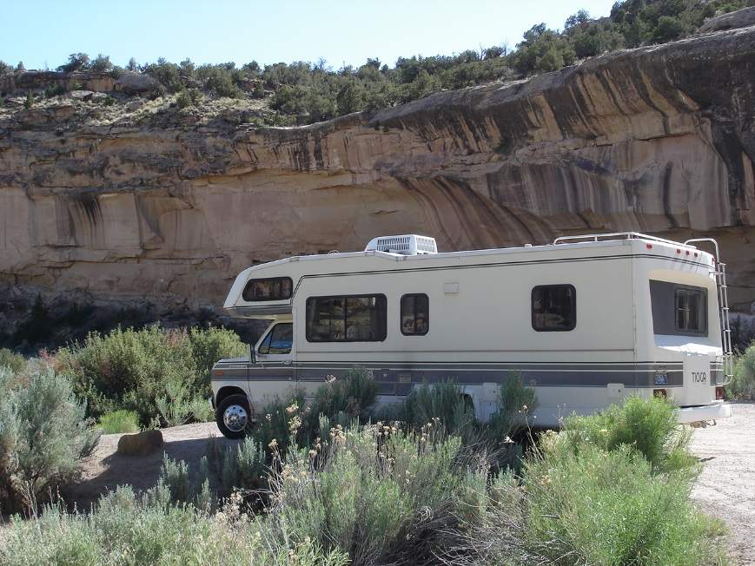
Camping
Jack Rabbit Flats – 50 tent sites
Lake View Campground – 62 tent and RV sites
Big Rock – 47 RV sites with full hookups

Slide 4
Why Rent a Houseboat?
Affordable compared to hotel vacations.
Luxurious compared to camping.
Options to rent toys (i.e., boats, jet skis).

Slide 5
Condos and Hotels
Condos
Hotels
Hostel
Luxury accommodations with kitchens, living rooms, and separate bedrooms.
Affordable accommodations with refrigerators and microwaves.
Inexpensive bunkbeds with shared bathrooms and access to kitchen.

Slide 6
Sample Equipment
Chart 1. Rental Wakeboards

Slide 7
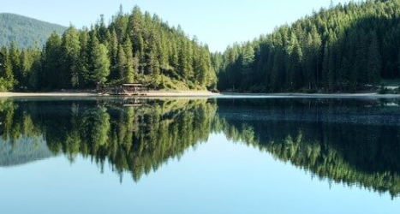
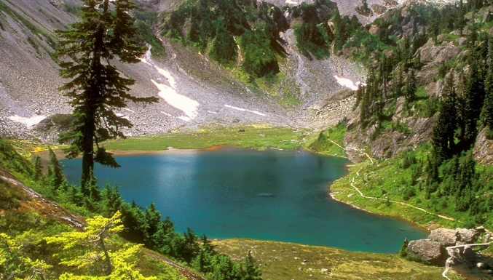
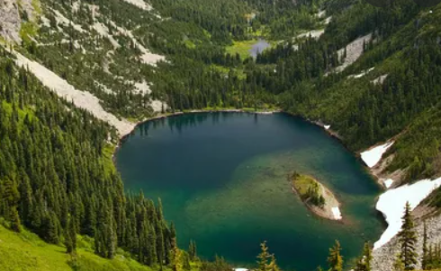
Planning
Book a houseboat
Pack your bag
Have fun

