Slide 1
Networking Essentials

Slide 2
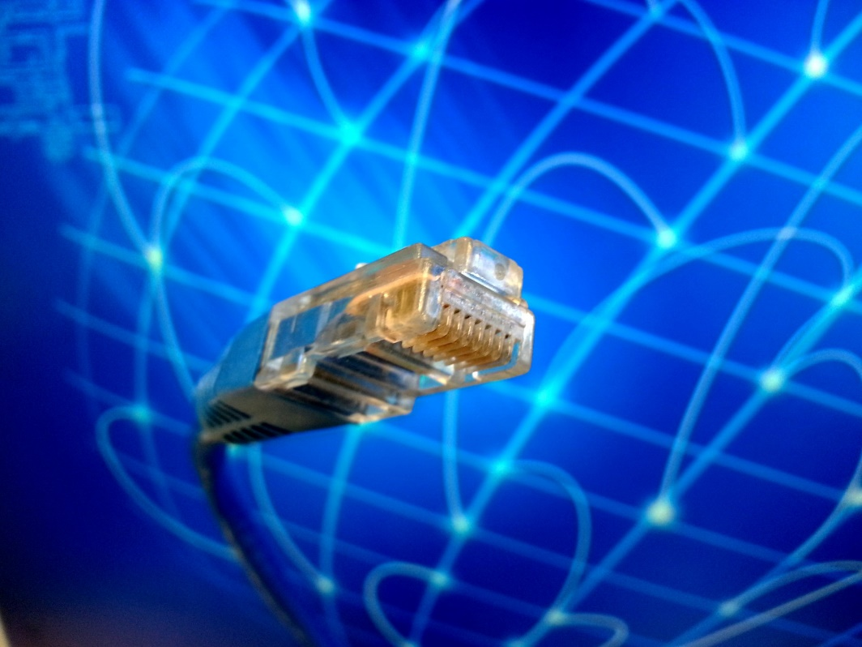
Important Terminology
ISP – Internet Service Provider
LAN – Local Area Network
WAN – Wide Area Network
IP Address – A numerical address that corresponds to your computer’s location on a network.
Router – A device that passes network traffic bath and forth.
DNS – Domain Name System; converts domain names to IP Addresses.

Slide 3

Capture the Future

Slide 4
Wireless Data Speeds

Slide 5
Example Network Values
Type | Example
IPv4 Address | 192.168.1.66
IPv6 Address | Fe80::799d:c72:b925%11
Subnet Mask | 255.255.255.0
Physical Address | 68-5D-43-66-0B-0C

Slide 6
What is a Network?
A computer network or data network is a telecommunications network which allows computers to exchange data. In computer networks, networked computing devices exchange data with each other using a data link. The connections between nodes are established using either cable media or wireless media. The best-known computer network is the Internet.
Internet
Router
Switch
Firewall
Wireless
LAN
Servers
Computer
Game Console
Smart TV
Laptop
Mobile Device

