Slide 1

10th Annual police auction
Summary Report

Slide 2
Unclaimed Property
Each year the Police Department recovers hundreds of stolen items. Many are unclaimed by their owners.
Any item unclaimed after 12 months is sold at our annual auction.
This is a list of the items sold this year.
Item Description | Total Sales
Appliances (Large) | $ 2,299.00
Appliances (Small) | $ 840.00
Bicycles (child) | $ 1,230.00
Bicycles (youth) | $ 5,458.00
Bicycles (adult) | $ 9,400.00
Desktop Computers | $ 18,900.00
Laptop Computers | $ 20,090.00
Tablet Computers | $ 1,775.00
Televisions | $ 8,675.00
Miscellaneous | $ 2,585.00

Slide 3


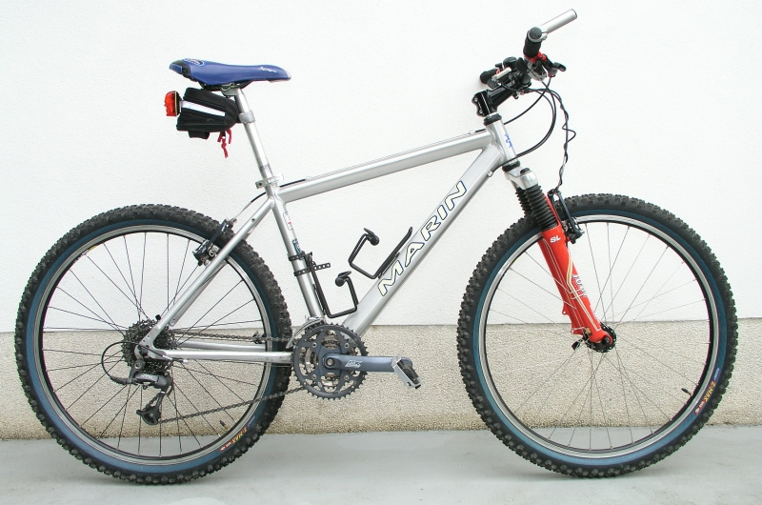
Popular items

Slide 4
Processing steps
Evidence
Items are impounded upon arrest
Held as evidence to use in court
Claims
After court, items are released for claim by owner
Efforts made to identify and contact owner
Auction
Items not claimed in 12 months sent to auction
Items not sold at auction are donated to charity

Slide 5
Advertising
Mail
Television News
Email
Social Media
Other suggestions?

