Slide 1
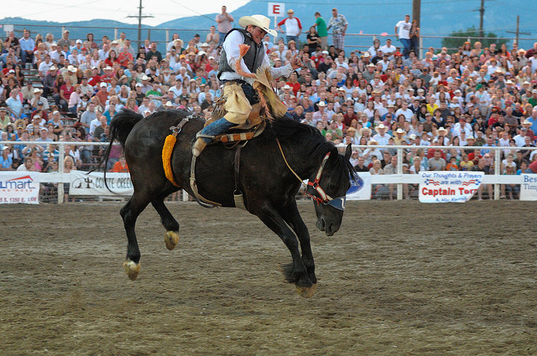
Guide to Rodeo
The Original American Sport

Slide 2
The birth of rodeo
What is Rodeo? – a sport of riding and roping contests derived from the skills of the American cowboy developed during the 19th century for work in the open-range cattle industry. Today, rodeo competitions are held in the United States, Canada, Mexico, and South America.
First Annual Rodeo - Prescott, Arizona Territory, July 4, 1888.
Professional Rodeo Cowboys Association (PRCA) – is the governing body of professional rodeo competitions.
Today’s largest annual rodeos and their starting years: Cheyenne Frontier Days (1897), Oregon’s Pendleton Round-Up (1910), the Calgary Stampede (1912), and the Las Vegas National Finals Rodeo (1985).

Slide 3
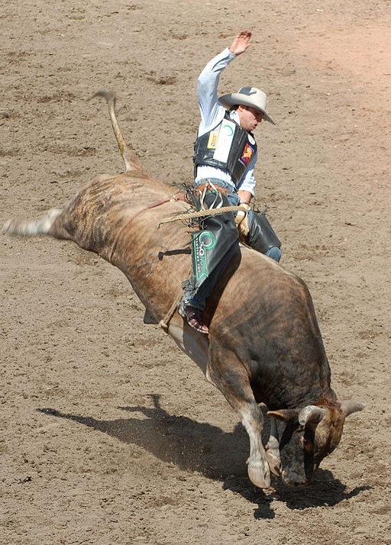
The “World Records” of Rodeo
Rough Stock Events: 2 to 4 judges award a combined score (50% animal / 50% rider) = 100 pts maximum
Bareback Bronc Riding = 94 pts by Will Lowe (2003)
Saddle Bronc Riding = 95 pts by Glen O'Neill (1996)
Bull Riding = 100 pts by Wade Leslie (1991)
Timed Events:
Steer Wrestling = 2.4 secs by Carl Deaton (1976)
Team Roping = 3.5 secs by Blaine Linaweaver and Jory Levy (2001)
Tie-down Roping = 6.3 secs by Ricky Canton (2005)
Barrel Racing = 13.52 by Brandie Halls (2006)

Slide 4
rough stock event

Slide 5
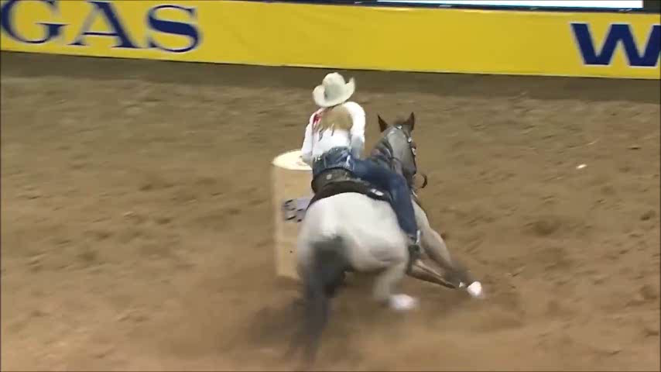
Timed Events keep you in suspense!

Slide 6
qualifying
Obtain a 1-yr. Permit from PRCA
“Card Holder” competes at PRCA rodeos to accrue award money
Top 15 money winners each year are invited to compete at NFR

Slide 7
NFR Average Ticket prices

