Slide 1

Discover Scuba
An Underwater Experience

Slide 2

Experience Scuba Diving
Have you ever wondered what it is like to breathe underwater ? If you want to find out, join us for a unique experience.
Learn the Basics of Scuba Diving
How to use Scuba Equipment
Breathe Underwater for the first time
Explore the Underwater World

Slide 3
Enrollment Prerequisites
Must be at least 10 years old
Complete a Medical Questionnaire
Provide your own swim wear and towel
Pay $75

Slide 4
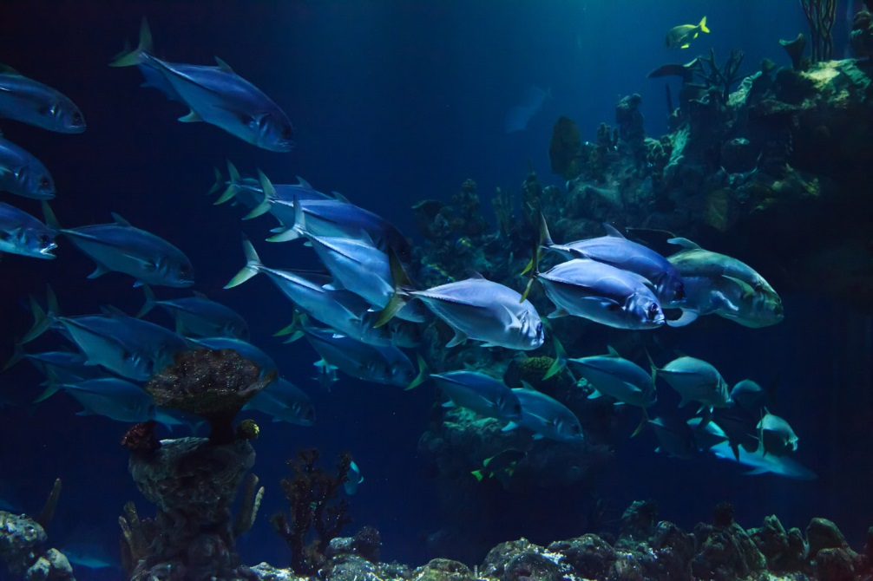
The Course
Theory – classroom session to teach basic scuba diving rules
Skills – taught in our swimming pool
Ocean Dive – apply both the theory and skills exploring the reef in front of our dive store!

Slide 5
Choose from Six Class Times!
Choose a Day | Group A 8am – 11am | Group B 2pm – 5pm
Saturday | 20 | 20
Wednesday | 10 | 10
Friday | 10 | 10
Saturdays (accommodate up to 20 divers)
Wednesdays and Fridays
(limited to 10 divers)

