Slide 1

Smartphones

Slide 2
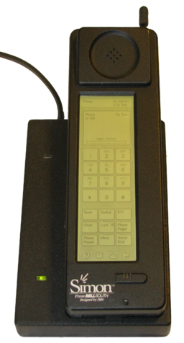
The First Smartphone
In 1993, International Business Machines introduced the first Smartphone called the IBM Simon.
The IBM Simon was the first phone that incorporated voice and data services into one package. The device even had a touchscreen to dial phone numbers.
It was the size of a brick, huge and heavy. The original retail price was $899.

Slide 3

Smartphones Today
Smartphones have come a long way since 1993. Today, most smartphones combine the functions of phone, calendar, organizer, messenger, camera, and entertainment system.

Slide 4
Objects

Slide 5
Popular Features
Waterproofing
Removable Batteries
Expandable Storage (SD Cards)
Cameras (Front and Back)
Dual SIMS
Biometric Security (Fingerprint Scan, Retinol Scan)
Folding Displays
Today’s smartphones are very “smart”!

Slide 6
Future Smartphones

