Slide 1
Application Framework Spring Framework
Overview
Prepared by: Piotr Kosmowski
Submitted on: 15.04.2014
Version: 1.0

Slide 2

Agenda
Motivation
Inversionof Control
Spring basis
XML way
Annotation way
Testing

Slide 3
Motivation
Why Spring appeared?
What problem solves?

Slide 4
Motivation Writing enterprise applications
Enterprise applications requires special mechanisms like:
Transactions
Security
Scalabity
Concurency
Messaging
Remote control
Persistence

Slide 5
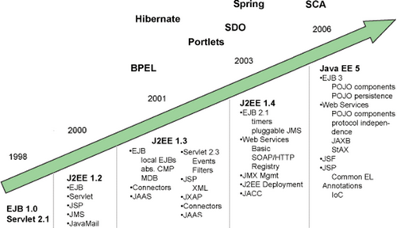
Motivation Writing enterprise applications
Before Spring Framework Enterprise :
environment polluted logic
requires Application Server
different servers (open, commercial)
they differently implement specification
very complicated
many XML files with configuration
unclear workflow
hard to write unit tests
very weak Time To Market

Slide 6
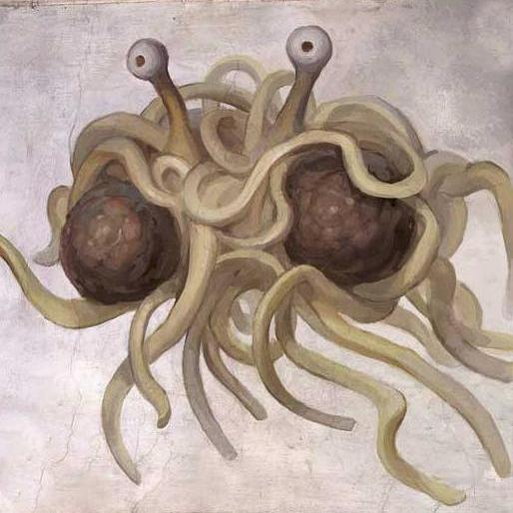
Motivation Got problem?

Slide 7

Motivation Hard time for enterprise developers
Rod Johnson between 1997 and 2002 was dealing with J2EE applications as a consultant. He identified many problems during his career and described them in his book "Expert One-on-One J2EE Design and Development".
He published there analysis of the problems with the code that implements framework Interface21 which was demonstrating how to solve those problems. This framework we would call today injection container.
"Expert One-on-One J2EE Design and Development" - Rod Johnson, Jurgen Hoeller
(2002)

Slide 8
Motivation How to write good software?
Clean code
Object Oriented
High cohesion
DRY - dont't repeat yourself (code reuse)
SoC - separation of concerns
SOLID principles
S (SRP) - Single responsibility principle
O (OCP) - Open/closed principle
L (LSP) - Liskov substitution principle
I (ISP) - Interface segregation principle
D (DIP) - Dependency inversion principle

Slide 9
Inversion of Control
What is that?
How solves problems?
What implementations exists?

Slide 10
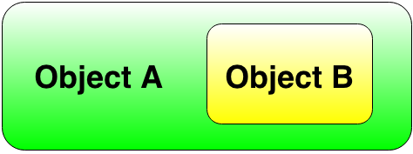
Dependency Injection What is dependency?
We are talking about dependency when one object relates on another one.
public class A{
private B objB;
public A {
this.objB = new B();
}
}

Slide 11
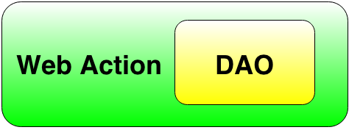
Dependency Injection What is dependency?
Web Action may need Data Access Object (DAO) to retrieve or save data to Data Base. Data Base actions is hidden in the DAO object (encapsulated).
public class DisplayActiveUsersWebAction{
protected UsersDAO usersDAO = new UsersDAO();
}
Above Web Action object instantiates dependent UsersDao object itself, which means that it satisfies its own dependency. In other words it configures itself.

Slide 12
Inversion of Control motivation What's wrong with direct constructor calls?
public interface BillingService {
Receipt chargeOrder(PizzaOrder order, CreditCard creditCard);
}
public class RealBillingService implements BillingService {
public Receipt chargeOrder(PizzaOrder order, CreditCard creditCard) {
CreditCardProcessor creditCardProcessor = new PaypalCreditCardProcessor();
TransactionLog transactionLog = new DatabaseTransactionLog();
ChargeResult result = creditCardProcessor.charge(creditCard, order.getAmount());
transactionLog.logChargeResult(result);
...
}
}

Slide 13
Inversion of Control motivation What's wrong with direct constructor calls?
This code poses problems for modularity and testability. In fact this code is not testable because of the following reasons:
If PaypalCreditCardProcessr or DatabaseTransactionLog has any dependencies like DatabaseConnection or RemoteTransactionArchiverWebService they will create them as well.
If we would like to test RealBillingService with unit tests the PaypalCreditCardProcessor will be created and we would perform operations on the real card creditCardProcessor. It means that we will the code will charge a real credit card during testing! In the tests we should operate on a FakeCreditCardProcessor.
When using other providers like VisaCreditCardProcessor for CreditCardProcessor or BitCoinTransactionLog for TransactionLog will require code changes in the RealBillingService.
It's also awkward to test what happens when the charge is declined or when the service is unavailable.
This method often leads to Spaghetti Monster code

Slide 14
Inversion of Control
The problem is that those dependencies are created directly by the RealBillingService. Instead the ready to use objects should be prepared externally and be delivered to the object that operates on them.
This object delivery from external place is called Inversion of Control as control over the object creation has been inverted.
IoC is sometimes facetiously referred to as the
"Hollywood Principle: Don't call us, we'll call you".

Slide 15
Inversion of Control
There are few implementations of Inversion of Control:
Factory pattern
Service locator pattern
Contextualized lookup
Template method design pattern
Strategy design pattern
Dependency injection
A constructor injection
Parameter injection
A setter injection
An interface injection

Slide 16
Inversion of Control Factory
A simple factory uses static methods to obtain implementation of the given class:
CreditCardProcessor creditCardProcessor = CreditCardProcessorFactory.getInstance();
TransactionLog transactionLog = TransactionLogFactory.getInstance();
public class CreditCardProcessorFactory {
private static CreditCardProcessor instance;
public static void setInstance(CreditCardProcessor creditCardProcessor) {
instance = creditCardProcessor;
}
public static CreditCardProcessor getInstance() {
if (instance == null) {
return new SquareCreditCardProcessor();
}
return instance;
}
}

Slide 17
Inversion of Control Factory
The code is testable now, however it is still clumsy as:
A global variable holds the mock implementation
need to be careful about setting it up and tearing it down.
could cause problems for other tests if initialization fails
prevents from running multiple tests in parallel.
All the static member variables are kept on the special area on heap memory - Permanent Generation which can cause some memory and Garbage Collector issues.
The dependencies are hidden in the code.
If we add a dependency on a CreditCardFraudTracker, we have to re-run the tests to find out which ones will break.
If forget to initialize a factory for a production service, we don't find out until a charge is attempted.
As the application grows, babysitting factories becomes a growing drain on productivity.

Slide 18
Inversion of Control Dependency Injection
The core principal is to separate behavior from dependency resolution.
In the example, the RealBillingService is not responsible for looking up the TransactionLog and CreditCardProcessor.
Instead, they're passed via constructor or setter.

Slide 19
Inversion of Control Dependency Injection
Constructor injection:
public class RealBillingService implements BillingService {
private final CreditCardProcessor creditCardProcessor;
private final TransactionLog transactionLog;
public RealBillingService(CreditCardProcessor creditCardProcessor,
TransactionLog transactionLog) {
this.creditCardProcessor = creditCardProcessor;
this.transactionLog = transactionLog;
}
...
}
public static void main(String[] args) {
CreditCardProcessor creditCardProcessor = new PaypalCreditCardProcessor();
TransactionLog transactionLog = new DatabaseTransactionLog();
BillingService billingService
= new RealBillingService(creditCardProcessor, transactionLog);
...
}

Slide 20
Inversion of Control Dependency Injection
Modifier injection (setter):
public class RealBillingService implements BillingService {
private final CreditCardProcessor creditCardProcessor;
private final TransactionLog transactionLog;
public void setCreditCardProcessor(CreditCardProcessor creditCardProcessor){
this.creditCardProcessor = creditCardProcessor;
}
public void setCreditCardProcessor(TransactionLog transactionLog){
this.transactionLog = transactionLog;
}
public static void main(String[] args) {
CreditCardProcessor creditCardProcessor = new PaypalCreditCardProcessor();
TransactionLog transactionLog = new DatabaseTransactionLog();
BillingService billingService = new RealBillingService();
billigService.setCreditCardProcessor(creditCardProcessor);
billigService.setTransactionLog(transactionLog);
...
}

Slide 21
Inversion of Control Dependency Injection
Dependency Injection design pattern requires that all child dependencies must be resolved / instantiated before injection to the object:
+RealBillingService (BillingService)
| |
| +PaypalCreditCardProcessor (CreditCardProcessor)
| |
| +PaypalWebService
|
+DatabaseTransactionLog (TransactionLog)
|
+DatabaseAccess
When dependencies graph is getting bigger it is worth to use some kind of framework to manage its dependencies configuration.

Slide 22
Inversion of Control Dependency Injection
Code now:
Is much more readable
Is much better fragmented and decoupled
Is much more cohesive
Is much better encapsulated
Has better responsibility, is reusable
Is better testable
Has explicit dependencies
Can be easier documented
Maintainability

Slide 23
Inversion of Control Dependency Injection
OK but seriously why, real life purposes?
Many folks don't realize that your dependencies chain can become nested, and it quickly becomes unwieldy to wire them up manually. Even with factories, the duplication of your code is just not worth it.
The most valuable benefit of using an IoC container is that you can have a configuration switch in one place which lets you change between, say, test mode and production mode.
Centralize the configuration of your dependencies.
Plugability: with DI you can inject dependency into the code without explicitly knowing how the functionality is actually working. For example: your class might get a ILog interface injected so that it can write logs. Since the class works with the ILog interface, it would be possible to implement a FileLog, MemoryLog or a DatabaseLog & inject this into your class. Any of these implementation will work fine as long as they implement the ILog interface

Slide 24
Inversion of Control Dependency Injection
DI frameworks:
Spring Framework
Guice
Pico Container
Weld (CDI)

Slide 25
Spring - basis
Construction
Bean Factory
Application Context
Configuration

Slide 26

Spring Framework
Versions:
Spring 1.0 – 2004
Spring 2.0 – 2006
Spring 2.5 – 2007
Spring 3.0 – 2009
Spring 3.1 - 2011
Spring 3.2 - 2013
Spring 4.0 - 2013
Very stable and frequent release plan.

Slide 27
Spring Framework Mission
The main aim is to simplifying application development.
Spring support application development on all levels / layers
There are many modules and extensions with other popular frameworks eg.
Struts, JSF, WebWork
Hibernate, TopLink, JPA
JDBC, JTA
Spring doesn't competete with other solutions and technologies which are good. Instead of that it supports theirs integration.
Spring doesn't forces to be installed on the application server, it doesn't forces speciality API to be used.
Spring is easy to be used
Spring enhances developers productivity
Spring supports in writing high quality software
Spring supports in writing testable code

Slide 28
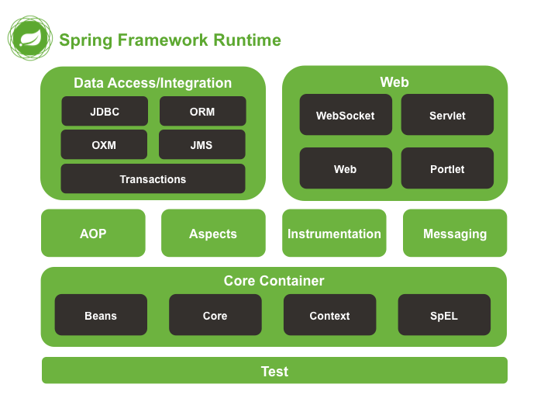
Spring Framework Construction

Slide 29
Inversion of Control container
Central to the Spring Framework is its Inversion of Control (IoC) container, which provides a consistent means of configuring and managing Java objects using reflection.
The container is responsible for managing object lifecycles of specific objects:
creating these objects,
configuring these objects by wiring them together,
calling their initialization methods.

Slide 30
Inversion of Control container Motivation
Simple application configuration:
public static void main(String[] args){
//object creation
BillingService billingService = new BillingService();
PaymentProcessor cardProcessor = new PaymentProcessor();
TransactionLog transactionLog = new TransactionLog();
//configuring these objects by wiring them together
billingService.setCardProcessor(cardProcessor);
billingService.setTransactionLog(transactionLog);
//calling their initialization methods
billingService.registerBillingServiceToCreditCardVendor();
}
Hit me!!!

Slide 31
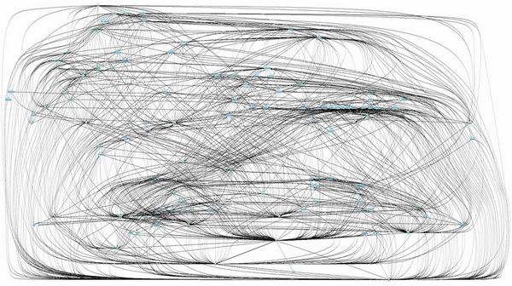
Inversion of Control container Motivation

Slide 32
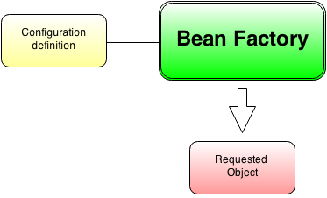
Inversion of Control container Bean Factory
Bean Factory is a core element of the Spring Inversion of Control container that creates requested objects and resolves dependencies by the given configuration:

Slide 33
Inversion of Control container Bean Factory
Initialization:
//create Inversion of Control container
DefaultListableBeanFactory beanFactory = new DefaultListableBeanFactory();
//create configuration and populate Inversion of Control container with it
XmlBeanDefinitionReader reader = new XmlBeanDefinitionReader(beanFactory);
reader.loadBeanDefinitions(new ClassPathResource("spring-configuration.xml"));
XML configuration:
<?xml version="1.0" encoding="UTF-8"?>
<beans xmlns="http://www.springframework.org/schema/beans"
xmlns:xsi="http://www.w3.org/2001/XMLSchema-instance"
xsi:schemaLocation="http://www.springframework.org/schema/beans
http://www.springframework.org/schema/beans/spring-beans.xsd">
<bean id="ruleBillingService" class="com.github.kospiotr.hellospring.BillingService"/>
</beans>

Slide 34
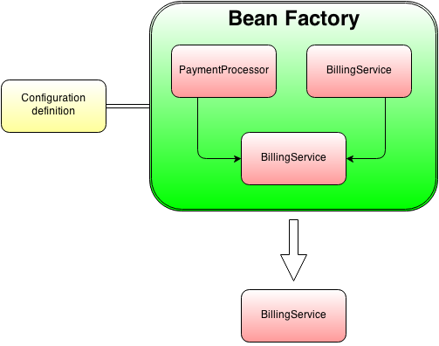
Inversion of Control container Bean Factory
The Bean Factory creates objects (Factory pattern).
If the object require dependency it searches them in the registry (Lookup pattern) and
inject them to the object (Dependency Injection pattern).
If not found – repeat recursive (recursive lookup).

Slide 35
Inversion of Control container Bean Factory
Objects can be obtained by means of either dependency lookup or dependency injection.
Dependency lookup is a pattern where a caller
asks the container object for an object with a
specific name or of a specific type.
Dependency injection is a pattern
where the container passes objects by name to
other objects, via either constructors, properties,
or factory methods.

Slide 36
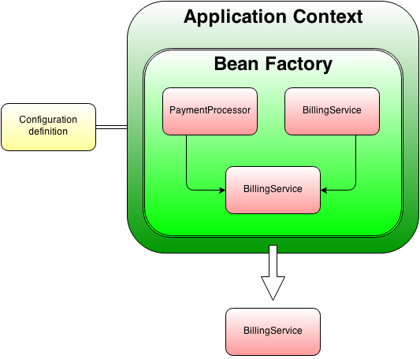
Inversion of Control container Application Context
ApplicationContext extends BeanFactory and adds some extra features to it.
Bean Factory
Bean instantiation/wiring
Application Context
Bean instantiation/wiring
Automatic BeanPostProcessor registration
Automatic BeanFactoryPostProcessor registration
Convenient MessageSource access (for i18n)
ApplicationEvent publication

Slide 37
Inversion of Control container Application Context
Then initialization and configuration changes (simplifies):
//create Inversion of Control container
//create configuration and populate Inversion of Control container with it
ApplicationContext applicationContext = new ClassPathXmlApplicationContext("spring-configuration.xml");
//requesting bean from the container by the id
BillingService billingService = applicationContext.getBean("ruleBillingService", BillingService.class);
billingService.charge(100);
And additionally we have extra features with minimal overhead.

Slide 38

Inversion of Control container Configuration
The container can be configured by loading XML files or detecting specific Java annotations on configuration classes.
These data sources contain the bean definitions which provide the information required to create the beans.
XML way
Java way

Slide 39
Inversion of Control container Configuration – XML way
Configuration:
<?xml version="1.0" encoding="UTF-8"?>
<beans xmlns="http://www.springframework.org/schema/beans"
xmlns:xsi="http://www.w3.org/2001/XMLSchema-instance"
xsi:schemaLocation="http://www.springframework.org/schema/beans
http://www.springframework.org/schema/beans/spring-beans.xsd">
<bean id="ruleBillingService" class="com.github.kospiotr.hellospring.BillingService"/>
</beans>
Initialization:
ApplicationContext applicationContext = new
ClassPathXmlApplicationContext("main.xml","common.xml","rest.xml");

Slide 40
Inversion of Control container Configuration – Java way
Configuration:
@Configuration
public class AppConfig {
@Bean(name = "ruleBillingService")
public BillingService billingServiceBean() {
return new BillingService();
}
}
Initialization:
ApplicationContext applicationContext = new
AnnotationConfigApplicationContext(AppConfig.class);

Slide 41
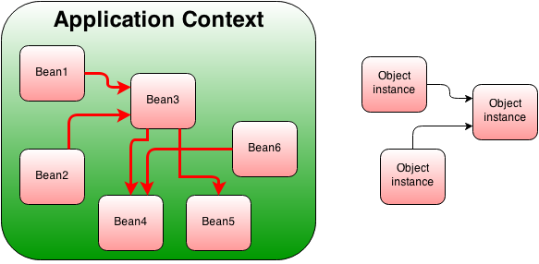
Inversion of Control container Beans
Objects created by the container (BeanFactory or ApplicationContext) are also called managed objects or beans.
Only managed objects can be controlled by Spring (injecting dependencies, lifecycle management).

Slide 42
Spring XML-based container configuration
Object management
Dependency Injection
Container Extension Points

Slide 43
XML-based container configuration Object management – Bean declaration and retrieving
Bean declaration:
<bean id="bean1" class="com.github.kospiotr.spring.BillingService"/>
<bean id="bean2" class="com.github.kospiotr.spring.BillingService"/>
Retrieving beans from the context:
By id:
BillingService billingService = (BillingService)applicationContext.getBean("bean1");
Obtaining bean by type (if unique bean class is defined in configuration):
BillingService billingService = applicationContext.getBean(BillingService.class);
If multiple beans with given class declared:
Map<String, BillingService> billingService =
applicationContext.getBeansOfType(BillingService.class);

Slide 44
XML-based container configuration Object management – Bean Alias
Bean alias (the bean can have more ids thanks to aliases):
<bean id="ruleBillingService" class="com.github.kospiotr.spring.BillingService"/>
<alias name="ruleBillingService" alias="service"/>
The bean can have more ids thanks to aliases.
Obtaining bean by alias is achieved in a same way as by id:
BillingService service = applicationContext.getBean("service", BillingService.class);

Slide 45
XML-based container configuration Object management – Factory Methods
Static Factory method:
<bean id="ruleBillingService„
class="com.github.kospiotr.spring.BillingServiceStaticFactory"
factory-method="createBillingService"/>
Non static Factory method:
<bean id="ruleBillingServiceFactory„
class="com.github.kospiotr.spring.BillingServiceFactory"/>
<bean id="ruleBillingService„
factory-bean="ruleBillingServiceFactory"
factory-method="createBillingService"/>

Slide 46
XML-based container configuration Object management – Scopes
Basic scopes:
singleton - (default) scopes a single bean definition to a single object instance per Spring IoC container.
prototype - scopes a single bean definition to any number of object instances.
Only valid in the context of a web-aware Spring ApplicationContext:
request - scopes a single bean to the lifecycle of a single HTTP request
session - scopes a single bean definition to the lifecycle of a HTTP Session.
global - session Scopes a single bean definition to the lifecycle of a global HTTP Session. Typically only valid when used in a portlet context.

Slide 47
XML-based container configuration Object management – Scopes
public BillingService() {
System.out.println("Constructed BillingService");
}
ApplicationContext ct = new ClassPathXmlApplicationContext("spring.xml");
ct.getBean(BillingService.class);
ct.getBean(BillingService.class);
ct.getBean(BillingService.class);
Singleton:
<bean id="ruleBillingService"
class="com.github.kospiotr.spring.BillingService"
scope="singleton"/>
> Constructed BillingService
Prototype:
<bean id="ruleBillingService"
class="com.github.kospiotr.spring.BillingService"
scope="prototype"/>
> Constructed BillingService
> Constructed BillingService
> Constructed BillingService

Slide 48
XML-based container configuration Object management – Lifecycle
Spring helps to mange the lifecycle of the objects. It is possible to perform actions:
after object has been initialized (after all properties has been set up),
before it will be destroyed (when context goes down).
There are 3 methods how it can be achieved by Spring:
In the configuration
By implementing interfaces
By marking methods with annotations

Slide 49
XML-based container configuration Object management – Lifecycle
Configuration driven:
<bean id="ruleBillingService" class="com.github.kospiotr.spring.BillingService"
init-method="init" destroy-method="cleanUp"/>
Class:
public class BillingService {
public BillingService() {
System.out.println("Constructed BillingService");
}
public void init() {
System.out.println("BillingService initialized");
}
public void cleanUp() {
System.out.println("BillingService clean up");
}
}

Slide 50
XML-based container configuration Object management – Lifecycle
Interface driven:
<bean id="ruleBillingService"
class="com.github.kospiotr.spring.BillingServiceLifecycleAware"/>
Class:
public class BillingServiceLifecycleAware implements InitializingBean, DisposableBean {
public BillingServiceLifecycleAware() {
System.out.println("Constructed BillingService");
}
public void afterPropertiesSet() throws Exception {
System.out.println("BillingService initialized");
}
public void destroy() throws Exception {
System.out.println("BillingService destroyed");
}
}

Slide 51
XML-based container configuration Object management – Lifecycle
Example application:
ApplicationContext ct = new ClassPathXmlApplicationContext("spring.xml");
BillingService service1 = applicationContext.getBean(BillingService.class);
//forces context to shut down
((ConfigurableApplicationContext) applicationContext).close();
Will result in:
> Constructed BillingService
> BillingService initialized
> BillingService clean up
Interfaces will tight coupled your code to Spring and annotations bind the code with JSR-330.

Slide 52
XML-based container configuration Dependency Injection – with values
Simple values:
<property name="sampleString" value="TestingString"/>
<property name="sampleIntiger" value="100"/>
<property name="sampleDouble" value="99.99"/>
List value:
Set value:
<property name="sampleList">
<list>
<value>pechorin@hero.org</value>
<value>raskolnikov@slums.org</value>
<value>stavrogin@gov.org</value>
<value>porfiry@gov.org</value>
</list>
</property>
<property name="sampleSet">
<set>
<value>pechorin@hero.org</value>
<value>raskolnikov@slums.org</value>
<value>stavrogin@gov.org</value>
<value>porfiry@gov.org</value>
</set>
</property>

Slide 53
XML-based container configuration Dependency Injection – with other beans
Inner bean:
<bean id="billingService1" class="com.github.kospiotr.spring.BillingService">
<property name="creditCardProcessor">
<bean id="creditCardProcessor„ class="com.github.kospiotr.spring.CreditCardProcessor"/>
</property>
<property name="transactionLogger">
<bean id="transactionLogger" class="com.github.kospiotr.spring.TransactionLogger"/>
</property>
</bean>
By reference:
<bean id="creditCardProcessor" class="com.github.kospiotr.spring.CreditCardProcessor"/>
<bean id="transactionLogger" class="com.github.kospiotr.spring.TransactionLogger"/>
<bean id="billingService1" class="com.github.kospiotr.spring.BillingService">
<property name="creditCardProcessor" ref="creditCardProcessor"/>
<property name="transactionLogger" ref="transactionLogger"/>
</bean>

Slide 54
XML-based container configuration Dependency Injection – injecting methods
Setter based dependency injection - is accomplished by the container calling setter methods on your beans after invoking a no-argument constructor or no-argument static factory method to instantiate bean.
<bean id="creditCardProcessor" class="com.github.kospiotr.spring.CreditCardProcessor"/>
<bean id="transactionLogger" class="com.github.kospiotr.spring.TransactionLogger"/>
<bean id="billingService" class="com.github.kospiotr.spring.BillingService">
<property name="creditCardProcessor" ref="creditCardProcessor"/>
<property name="transactionLogger" ref="transactionLogger"/>
</bean>

Slide 55
XML-based container configuration Dependency Injection – injecting methods
Constructor based dependency injection - is accomplished when the container invokes a class constructor with a number of arguments, each representing a dependency on other class.
<bean id="creditCardProcessor" class="com.github.kospiotr.spring.CreditCardProcessor"/>
<bean id="transactionLogger" class="com.github.kospiotr.spring.TransactionLogger"/>
<bean id="billingService" class="com.github.kospiotr.spring.BillingService">
<constructor-arg name="creditCardProcessor" ref="creditCardProcessor"/>
<constructor-arg name="transactionLogger" ref="transactionLogger"/>
</bean>

Slide 56
XML-based container configuration Dependency Injection – autowiring
By default beans must be configured for wiring manually. There is mechanism which allows for doing this automatically – autowiring.
Beans can be autowired in 3 ways:
no autowiring - manual wiring
byName – autowiring by property name
byType – autowiring by the dependency type (must be unique)
constructor - similar to byType, but type applies to constructor arguments

Slide 57
XML-based container configuration Dependency Injection – autowiring
byName example:
<bean id="creditCardProcessor" class="com.github.kospiotr.spring.CreditCardProcessor"/>
<bean id="transactionLogger" class="com.github.kospiotr.spring.TransactionLogger"/>
<bean id="billingService1"
class="com.github.kospiotr.spring.BillingService"
autowire="byName"/>
byType example:
<bean id="cp" class="com.github.kospiotr.spring.CreditCardProcessor"/>
<bean id="tl" class="com.github.kospiotr.spring.TransactionLogger"/>
<bean id="billingService1"
class="com.github.kospiotr.spring.BillingService"
autowire="byType"/>

Slide 58
XML-based container configuration Container Extension Points
BeanPostProcessor - interface that defines callback methods that can provide own (or override the container’s default) instantiation logic, dependency-resolution logic, after the Spring container finishes instantiating, configuring, and initializing a bean.
BeanFactoryPostProcessor – similar to above but operates on the bean configuration metadata; that is, the Spring IoC container allows a BeanFactoryPostProcessor to read the configuration metadata and potentially change it before the container instantiates any beans other than BeanFactoryPostProcessors
Many core functionalities of ApplicationContext are implemented with BPP and BFPP. Like autowiring and annotation based configuration.

Slide 59
XML-based container configuration Container Extension Points
Placeholders - You use the PropertyPlaceholderConfigurer to externalize property values from a bean definition in a separate file using the standard Java Properties format.
<bean id="payment1" class="com.github.kospiotr.spring.Payment">
<property name="paymentTitle" value="${paymentTitle1}"/>
<property name="accountFrom" value="${accountFrom1}"/>
<property name="accountTo" value="${accountTo1}"/>
<property name="amount" value="${amount1}"/>
</bean>
<bean class="org.springframework.beans.factory.config.PropertyPlaceholderConfigurer">
<property name="locations" value="classpath:config.properties"/>
</bean>
paymentTitle1=Pizza Payment
accountFrom1=12345
accountTo1=54321
amount1=100

Slide 60
Spring Annotation-based container configuration
Dependency Injection
Lifecycle
Component scanning

Slide 61
Annotation-based container configuration Configuration
An alternative to XML setups is provided by annotation-based configuration which rely on the bytecode metadata for wiring up components instead of angle-bracket declarations.
Instead of using XML to describe a bean wiring, the developer moves the configuration into the component class itself by using annotations on the relevant class, method, or field declaration.
To be able to use annotations you need to add to the configuration following directive:
<context:annotation-config/>

Slide 62
Annotation-based container configuration Dependency Injection - autowiring
Spring has mechanism for automated wiring objects called autowiring. It reduces need of explicit wiring and boilerplate code.
Components might be tied by following annotations: @Autowired, @Resource, @Inject. Great detailed explanation what is the difference can be found in the article.
Configuration doesn't contains information about component wiring:
<context:annotation-config/>
<bean id="billingService" class="com.github.kospiotr.spring.BillingService"/>
<bean id="creditCardProcessor" class="com.github.kospiotr.spring.CreditCardProcessor"/>
<bean id="transactionLogger" class="com.github.kospiotr.spring.TransactionLogger"/>

Slide 63
Annotation-based container configuration Dependency Injection - autowiring
@Inject and @Autowired
Matches by Type
Restricts by Qualifiers (@Named or custom Qualifier annotation)
Matches by Name
Can mark field, setter or constructor.
@Inject
public BillingServiceAutowireConstructor(CreditCardProcessor creditCardProcessor, TransactionLogger transactionLogger) {
this.creditCardProcessor = creditCardProcessor;
this.transactionLogger = transactionLogger;
}

Slide 64
Annotation-based container configuration Dependency Injection - autowiring
@Inject and @Autowired
Matches by Type
Restricts by Qualifiers (@Named or custom Qualifier annotation)
Matches by Name
Can mark field, setter or constructor.
@Inject
public BillingServiceAutowireConstructor(CreditCardProcessor creditCardProcessor, TransactionLogger transactionLogger) {
this.creditCardProcessor = creditCardProcessor;
this.transactionLogger = transactionLogger;
}
@Autowired is Spring's own (legacy) annotation. @Inject is part of a new Java technology called CDI that defines a standard for dependency injection similar to Spring.

Slide 65
Annotation-based container configuration Dependency Injection - autowiring
@Resource
Matches by property Name
Matches by Type
Restricts by Qualifiers (ignored if match is found by name)
Can mark field or setter.
@Resource(name = "creditCardProcessor1")
public void setCreditCardProcessor(CreditCardProcessor creditCardProcessor) {
this.creditCardProcessor = creditCardProcessor;
}
<bean id="billingService" class="com.github.kospiotr.spring.BillingService"/>
<bean id="creditCardProcessor1„ class="com.github.kospiotr.spring.CreditCardProcessor"/>
<bean id="creditCardProcessor2" class="com.github.kospiotr.spring.CreditCardProcessor"/>
Optionally takes a name attribute, and by default Spring interprets that value as the bean name to be injected

Slide 66
Annotation-based container configuration Dependency Injection - autowiring
When using @Inject or @Autowire annotations and wiring by type or by name is not possible @Named or @Qualifier might be used:
<bean id="billingService" class="com.github.kospiotr.spring.BillingService"/>
<bean id="creditCardProcessor1" class="com.github.kospiotr.spring.CreditCardProcessor"/>
<bean id="creditCardProcessor2" class="com.github.kospiotr.spring.CreditCardProcessor"/>
@Inject
@Named("creditCardProcessor1")
public void setCreditCardProcessor(CreditCardProcessor creditCardProcessor) {
this.creditCardProcessor = creditCardProcessor;
}

Slide 67
Annotation-based container configuration Lifecycle
Lifecycle callback can be also be implemented via @PostConstruct and @PreDestroy annotations:
public class BillingServiceJsr330LifecycleAware {
public BillingServiceJsr330LifecycleAware() {
System.out.println("Constructed BillingService");
}
@PostConstruct
public void afterPropertiesSet() {
System.out.println("BillingService initialized");
}
@PreDestroy
public void destroy() {
System.out.println("BillingService destroyed");
}
}

Slide 68
Annotation-based container configuration Component scanning
Candidate components are classes that match against a filter criteria and have a corresponding bean definition registered with the container. This removes the need to use XML to perform bean registration, instead you can use annotations.
To be able to use annotated classes you need to perform scanning them on Spring bootstrap. The scanning is being configured as follow:
<?xml version="1.0" encoding="UTF-8"?>
<beans xmlns="http://www.springframework.org/schema/beans"
xmlns:xsi="http://www.w3.org/2001/XMLSchema-instance"
xmlns:context="http://www.springframework.org/schema/context"
xsi:schemaLocation="http://www.springframework.org/schema/beans
http://www.springframework.org/schema/beans/spring-beans.xsd
http://www.springframework.org/schema/context
http://www.springframework.org/schema/context/spring-context.xsd">
<context:component-scan base-package="com.github.kospiotr.spring"/>
</beans>

Slide 69
Annotation-based container configuration Component scanning
Components might be marked with following stereotype annotations:
@Service - Annotate all your service classes with @Service. All your business logic will be in Service classes.
@Repository - Annotate all your DAO classes with @Repository. All your database access logic should be in DAO classes.
@Component - Annotate your other components (for example REST resource classes) with component stereotype.
@Named - Standarized @Component annotation.

Slide 70
Annotation-based container configuration Component scanning
@Component
public class BillingService {
@Inject
private CreditCardProcessor creditCardProcessor;
@Inject
private TransactionLogger transactionLogger;
...
}
@Component is a generic stereotype for any Spring-managed component. @Repository, @Service, and @Controller are specializations of @Component for more specific use cases, for example, in the persistence, service, and presentation layers, respectively

Slide 71
Spring Testing

Slide 72
Testing Integration tests
Annotation @RunWith(SpringJUnit4ClassRunner.class) makes test class as a manageable component. It allows to inject components.
@ContextConfiguration allows to load existing configuration(XML, JavaConfig)
@RunWith(SpringJUnit4ClassRunner.class)
@ContextConfiguration({"/spring-configuration.xml"})
public class BillingServiceTest {
@Inject
BillingService billingService;
@Test
public void shouldNotProcessPaymentWithNegativeAmount() {
Payment payment = new Payment("Test", "123", "321", -10);
boolean result = billingService.processPayment(payment);
assertFalse(result);
}

Slide 73
actual version: kospiotr.github.io/wiki/spring-framework.html code samples: github.com/kospiotr/spring-classes me: github.com/kospiotr

Slide 74
ANY QUESTIONS?

