Slide 1
K/V Store System Using a Variant of Paxos Made Moderately Complex
Kaiwen Wang, Zihao Wu

Slide 2
Part 1
Introduction
01
Task
Distributed key-value store system using Paxos protocol
02
Goal
A system that can remain consistency when partition happens
03
Exactly once & Paxos Protocol with stable leader
Design

Slide 3
Part 2
Objectives
Exactly once
01
Use exactly once semantic to minimize the number of messages
Data consistency
02
Partition resistance
Majority agreement on each decision
03
Garbage collection
Delete stale slots to save memory space
Need all agreements on garbage slots
04
Server recovery
Server falls behind due to network partition
Need to know all decisions during the partition

Slide 4
Part 3
Basic Paxos
Three roles
Replica
Store the identical log as other replicas do
Leader
Spawn a scout to contend for active leader as soon as the last scout failed.
Spawn a commander to propose a proposal to all acceptors for a specific slot in the log.
Acceptor
Make agreements on active leader and each slot.

Slide 5
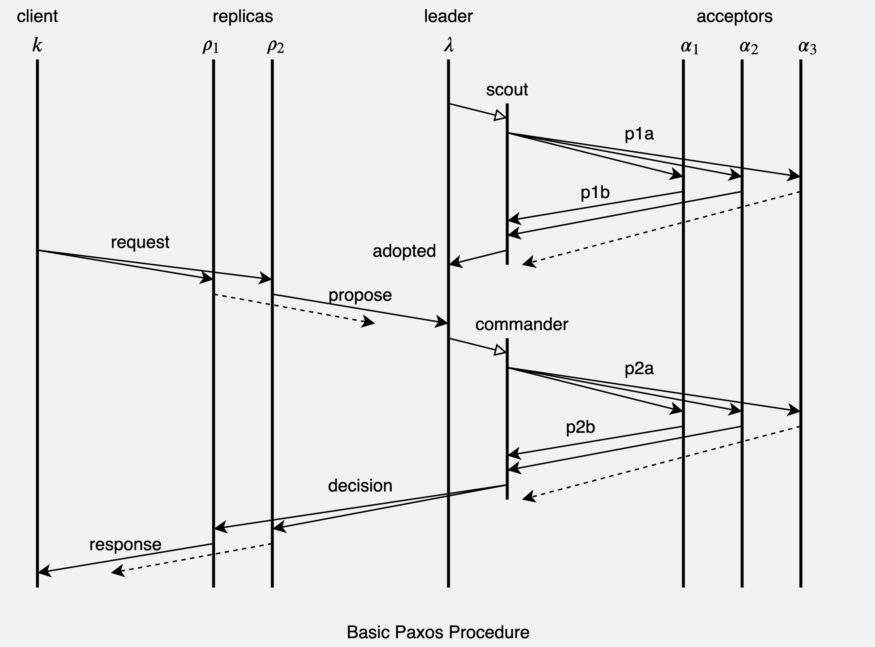
Part 3
Basic Paxos
Two context flows
Phase 1
Leader election phase
Phase 2
Proposal agreement phase

Slide 6
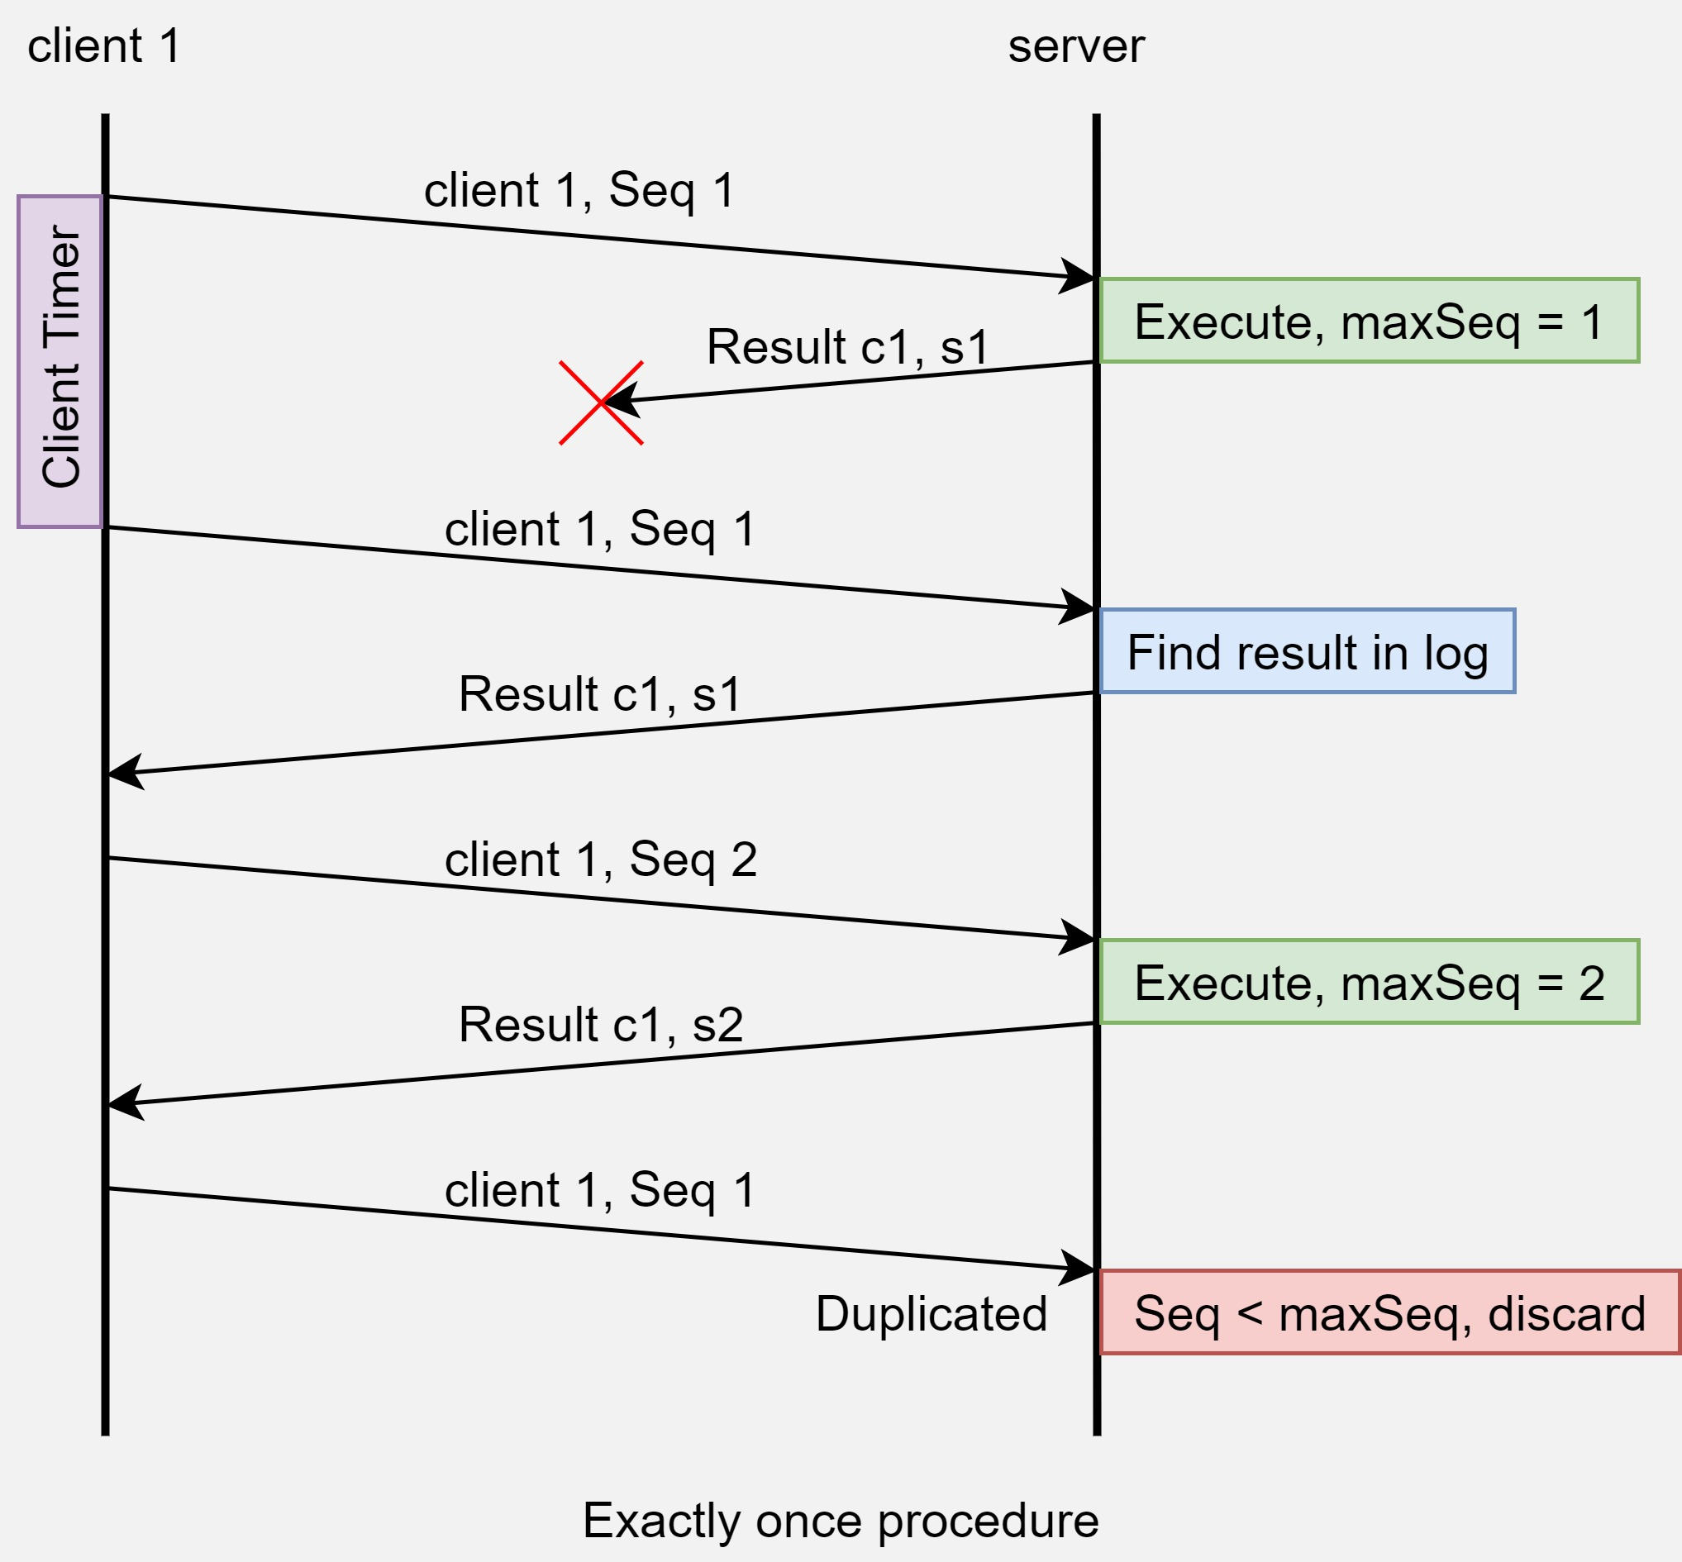
Part 4
Exactly once
Store the client ID and its largest sequence number.
Discard messages which sequence number is lower than the greatest received.
Ensure the application will not execute the same command twice.

Slide 7
Part 5
Stable leader
Basic Paxos
Once a leader is preempted, it will start phase 1 to compete for next leader immediately
Cost redundant messages
Our approach
When a leader is preempted, it won’t spawn a new scout to contend for active leader
Instead, stay inactive and serve as a follower
Use Heartbeat/Ping message to make sure leader survive

Slide 8
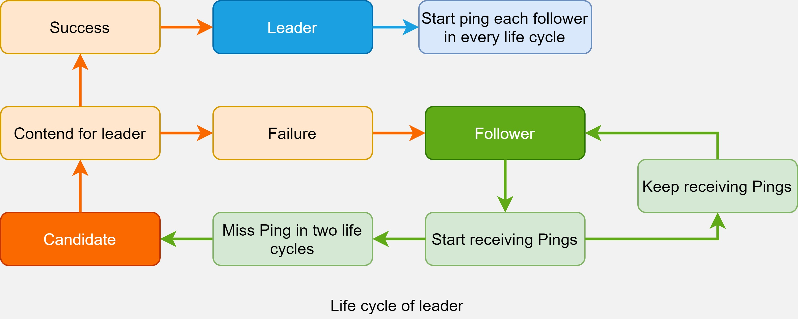
Part 5
Stable leader
Leader will stay inactive until it notices the current leader is unreachable

Slide 9
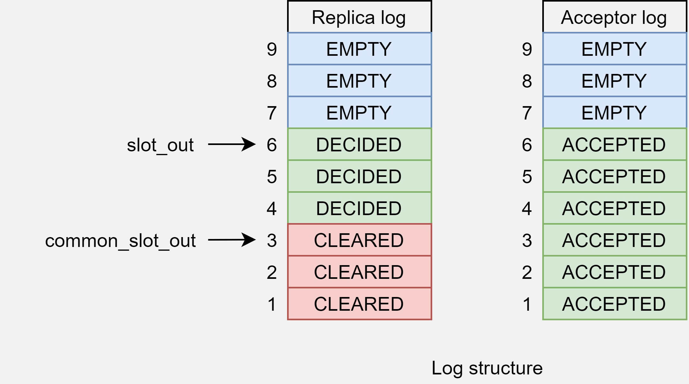
Part 6
Log structure
Four Status
EMPTY
This slot has not been proposed for any decision
ACCEPTED
This slot is proposed to a leader, can be in decided or undecided both status
DECIDED
The proposal in this slot has gained majority agreements of all acceptors
CLEARED
All replicas have executed this decision and all replicas know about it
slot_out: The executed slot known by the replica itself
common_slot_out: All replicas have executed this slot including slots before this slot

Slide 10
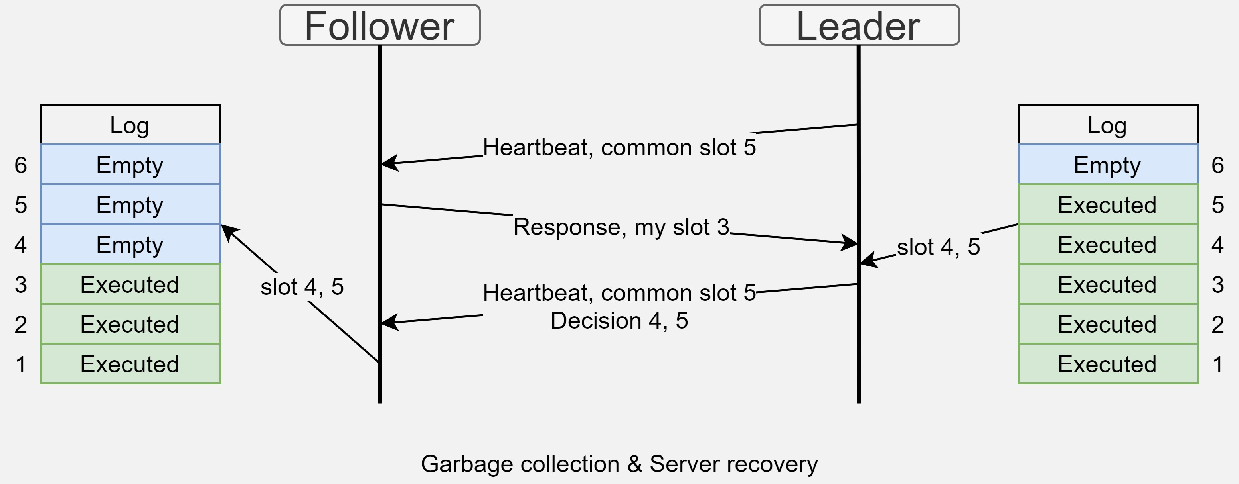
Part 7
Garbage collection & Server recovery
Heartbeat message & response
Piggybacking the slot info with it
One server falls behind, system stops
Catch up with the latest decisions within Heartbeat

Slide 11
Part 8
Results and Conclusion
Test set is provided by Dslabs framework covering common combinations of situations that a distributed system may encounter.
The tests include single/multiple client(s)/server(s), network partitions, partition heals, concurrent operations etc. Also, the test set will test how many messages the system sends per request to evaluate the message redundancy. Our system uses about 60 messages per request.
The test system asserts the invariants on different tests to find out whether our system violates certain rules, such as consistency, linearizability, availability, and the state of each slot in the log about whether it is accepted by majority.
The framework basically is a I/O automata. It will treat all messages and timer as a I/O event to achieve serializability for each server. It will also memorize every state of each server and client as a node. The node is a state which stores all internal states, on-flying messages, triggered timer in the background. This can help us evaluate the system redundancy in message transmission, timer settings or whether the lagging replicas can recovery on time.

Slide 12
References
Van Renesse, Robbert, and Deniz Altinbuken. "Paxos made moderately complex." ACM Computing Surveys (CSUR) 47, no. 3 (2015): 1-36
Lamport, Leslie. "Paxos made simple." ACM Sigact News 32, no. 4 (2001): 18-25.
Robbert van Renesse, D.A., 2018 [Online] Available at:
http://paxos.systems/index.html

Slide 13
Thank you!
Kaiwen Wang

