Slide 1

Door Lock Monitoring System
Victoria

Slide 2
Problem Statement
Monitoring many doors manually can be difficult, especially in:
Schools
Libraries
Other large facilities

Slide 3
Use Cases
View current door status
Manually change modes
Update expected door status
Compare door status
View event log
Reset system
3

Slide 4
Key Features
JavaFX application
Expected vs. current door status comparison
Event log
Color coordinated issues/safe results
Reset option
Mode switching for different scenarios
Editable door names
Custom mode creation

Slide 5

Roadmap
Growth Oriented

Slide 6
Future Thinking
Hardware based current status detection
Automatic Mode detection
Direct lock/unlock commands sent from software
Different security profiles
Automatic alters
Dashboard GUI Expansion
Database storage for logs, doors and modes
Audit log
Possible Future Roadmap
Q1
Research & Planning
Q2
Hardware Integration
Q3
User Roles & Security
Q4
Database & Audit log
6

Slide 7
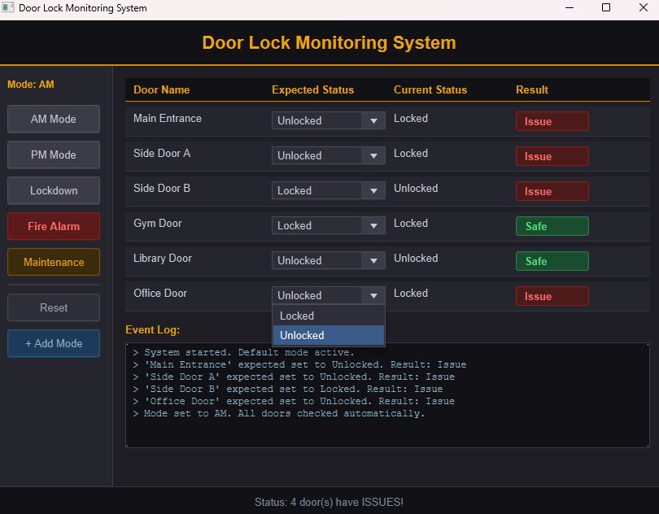
7

Slide 8
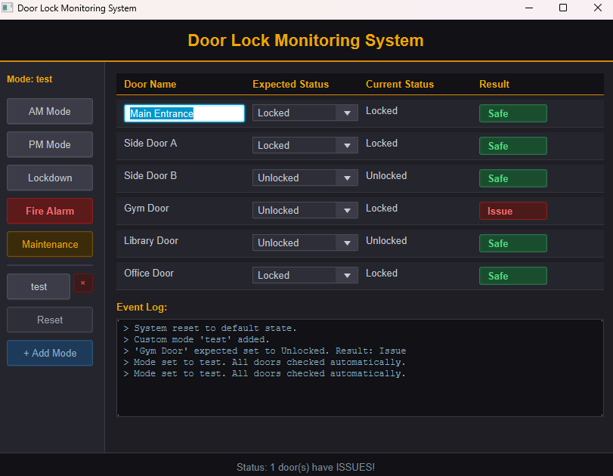
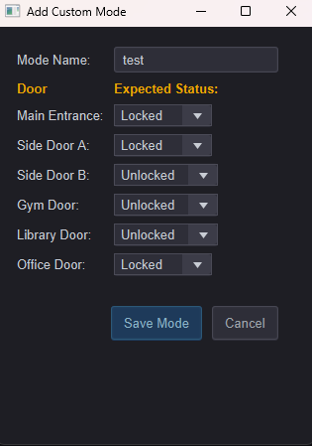
8

Slide 9
Thank you

