Slide 1
亮度對比度
Bright
Contrast

Slide 2
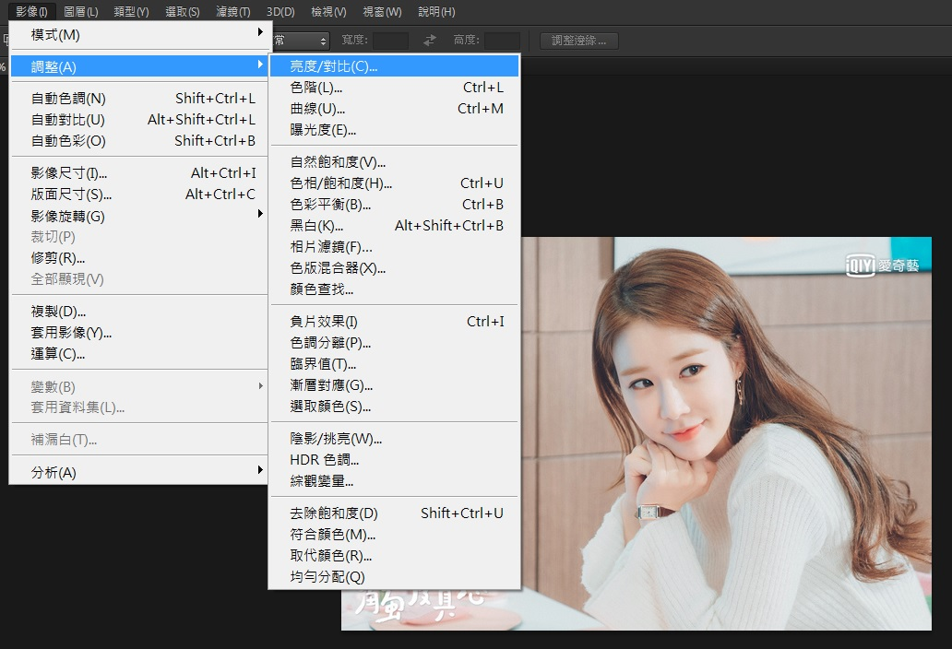
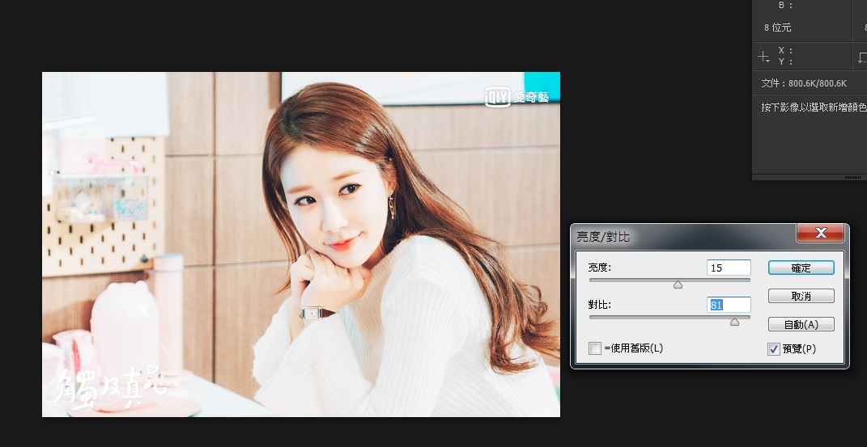

Slide 3
Bright/Contrast
亮度滑桿值=parseInt(亮度滑桿值);
對比滑桿值=parseInt(對比滑桿值);
對比滑桿值=對比滑桿值/100;
for()
{
紅= 127.5+(紅-127.5)*(1+對比滑桿值)+亮度滑桿值
綠= 127.5+(綠-127.5)*(1+對比滑桿值)+亮度滑桿值
藍= 127.5+(藍-127.5)*(1+對比滑桿值)+亮度滑桿值
}

Slide 4
HTML
<input type="range" id="r1" value="0" min="-150" max="150" onChange="rangepro()">
<input type="text" id="btxt" value="0" onChange="textpro()">
<input type="range" id="r2" value="0" min="-50" max="100" onChange="rangepro()">
JavaScript
function loadimg()
{
i1.src = fileReader.result;
r1.value=r2.value=btxt.value=ctxt.value=0;
}
function rangepro()
{
btxt.value=r1.value;
BrightContrast(r1.value);
}
function textpro()
{
r1.value=btxt.value;
BrightContrast(btxt.value);
}
function BrightContrast(bvalue)
{
}

Slide 5
CSS
input[type="range"]{
-webkit-appearance: none; /* Override default CSS styles */
width:200px;
height: 15px;
outline: none; /* Remove outline */
}
input[type="text"]{
width:35px;
height:10px;
}
#r1{
background:linear-gradient(to right,hsl(0,50%,0%),hsl(0,50%,100%));
}
#r2{
background:linear-gradient(to right,hsl(90,0%,50%),hsl(90,100%,50%));
}

Slide 6

HW

Slide 7
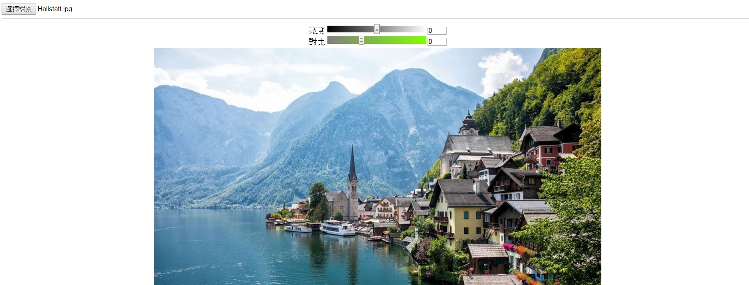
table{
margin:0 auto;
}
td{
text-align:center;
}

Slide 8
