Slide 1
Image Filtering
Smoothing

Slide 2
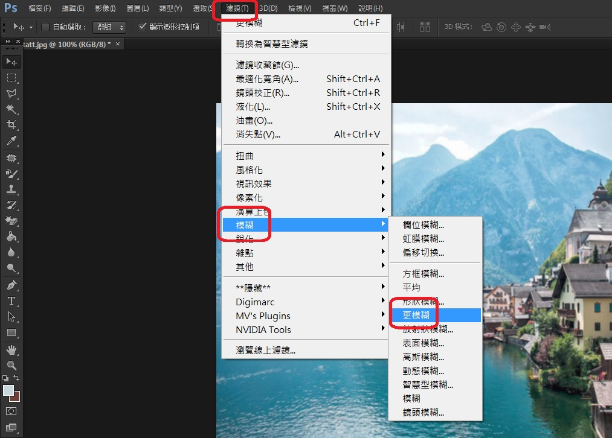

Slide 3
Noise Removal (Image Smoothing)
An image may be "dirty" (with dots, speckles)
Noise removal:
To remove speckles/dots on an image
Can be removed by taking mean or median values of neighboring pixels (e.g. 3x3 window)
Equivalent to low-pass filtering
Problem with low-pass filtering
May blur edges

Slide 4
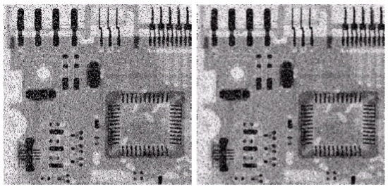

Slide 5
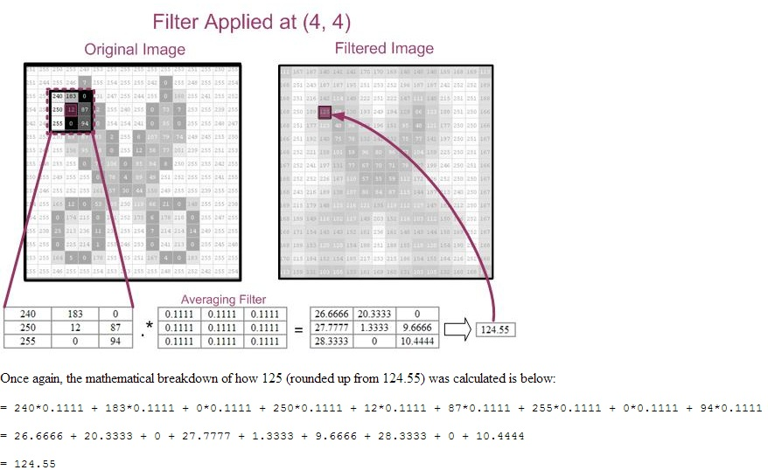

Slide 6
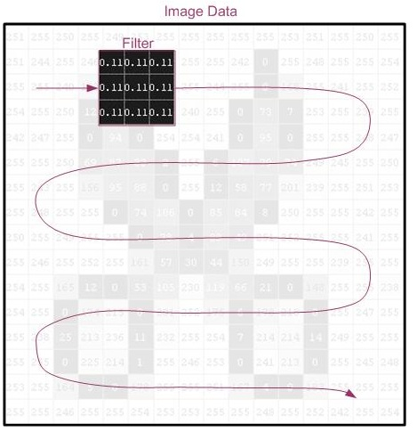

Slide 7
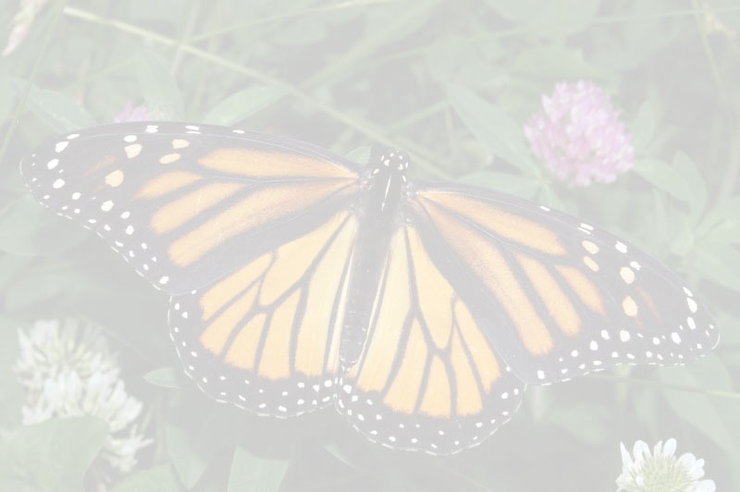
(0, 0) |  |  | (0, w-1)
 | (1, 1)
(h-1, 0) |  |  | (h-1, w-1)
 | (1, 1)
left=x-1; 如果 left <0, 則 left=0
right=x+1; 如果 right >w-1, 則 right = w-1
up=y-1; 如果 up <0, 則 up=0
down=y+1; 如果 down>h-1, 則 down= h-1
var smoothpx=(rgbimg[up][left]+rgbimg[up][x]+rgbimg[up][right]+
rgbimg[y][left]+rgbimg[y][x]+rgbimg[y][right]+ rgbimg[down][left]+rgbimg[down][x]+rgbimg[down][right])/9;

Slide 8
(0, 0) | (0, 1) | (0, 2) | (0, 3)
(1, 0) | (1, 1) | (1, 2) | (1, 3)
(2, 0) | (2, 1) | (2, 2) | (2, 3)
(3, 0) | (3, 1) | (3, 2) | (3, 3)
(0, 0) = imgData.data[0]
(0, 1) = imgData.data[4]
(0, 2) = imgData.data[8]
(y, x) = imgData.data[i]
i=y*4*i1.width+4*x;
(2, 1) = imgData.data[36]
(0,0)
(0,1)
(0,2)
0 | 1 | 2 | 3 | 4 | 5 | 6 | 7 | 8 | 9 | 10 | 11 | 12
imgData.data[0]
imgData.data[4]
imgData.data[8]

Slide 9
function process()
{
var r=[];
for(var y=0;y<i1.height;y++)
{
r[y]=[];
for(var x=0;x<i1.width;x++)
{
i=y*4*i1.width+4*x;
r[y][x]=imgData.data[i]; //紅
}
}
for(var y=0;y<i1.height;y++)
{
for(var x=0;x<i1.width;x++)
{
i=y*4*i1.width+4*x;
imgData.data[i]=smoothing(r,y,x);
}
}
}
function smoothing(rgbimg,y,x)
{
計算 rgbimg[y] [x] 的模糊值 smoothpx
return smoothpx;
}

Slide 10
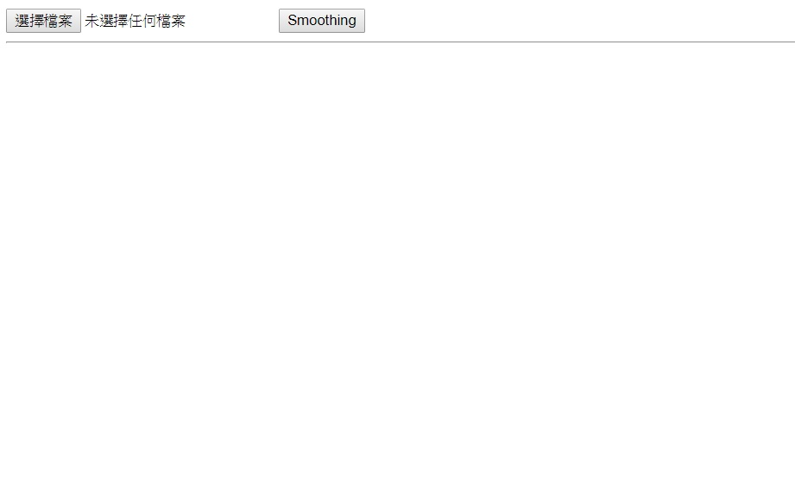
HW

Slide 11
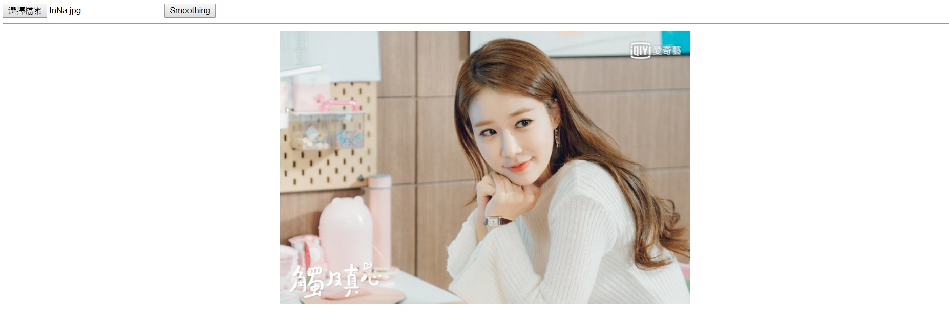

Slide 12

<td><img ></td>
<td style="width:5px"></td>
<td><canvas></canvas></td>

