Slide 1
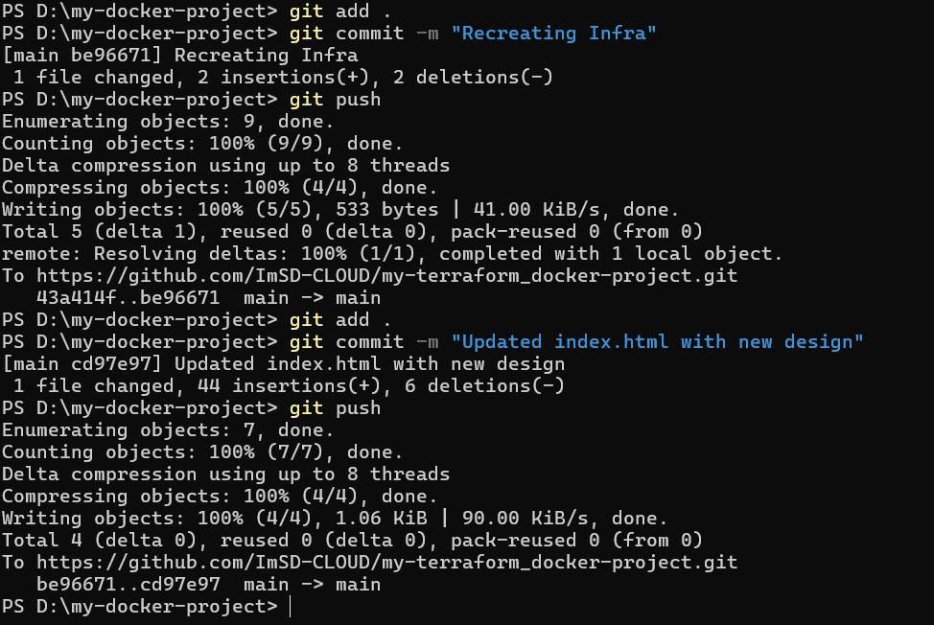
Pushing code changes to GitHub

Slide 2
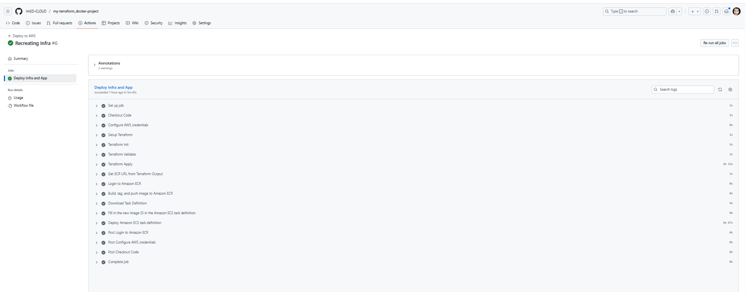
GitHub Actions workflow running upon code change

Slide 3
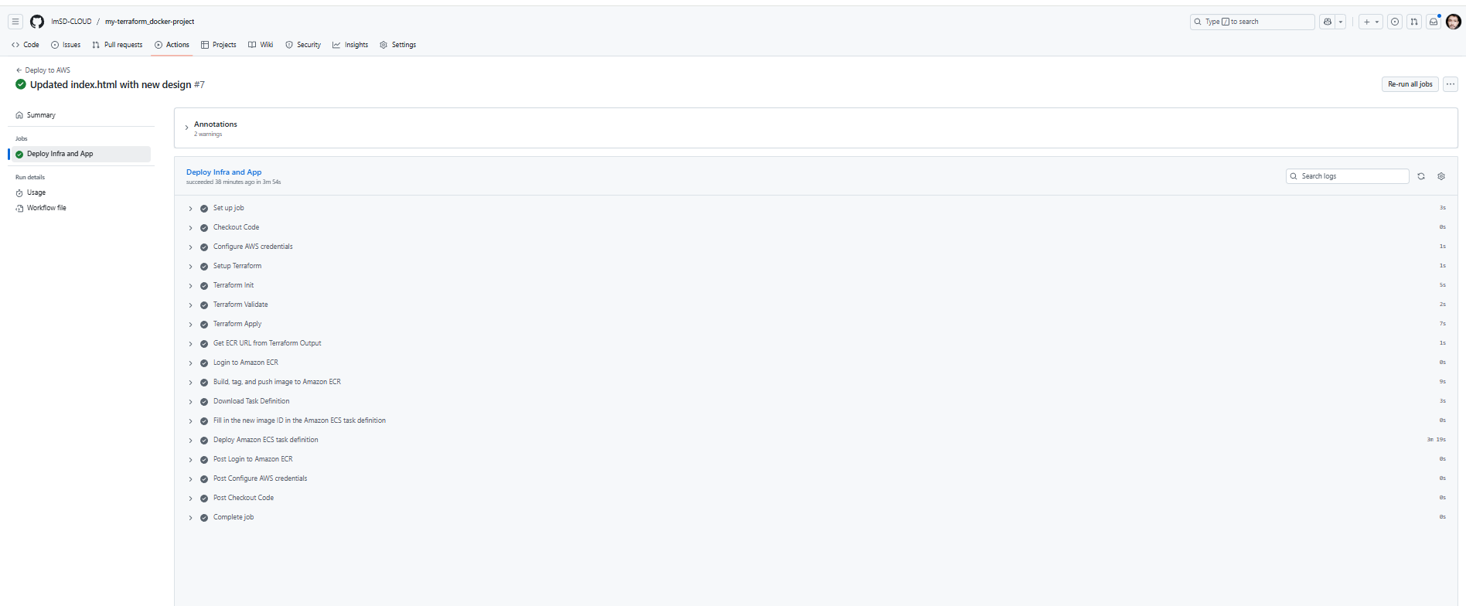
GitHub Actions workflow running upon code change

Slide 4
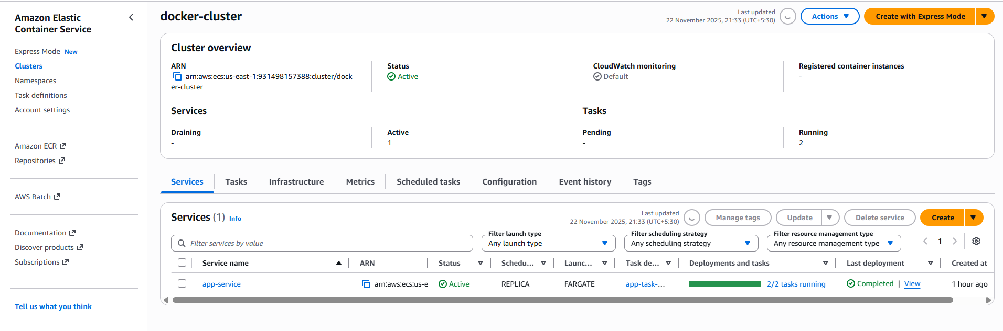
Docker cluster created and tasks are running

Slide 5
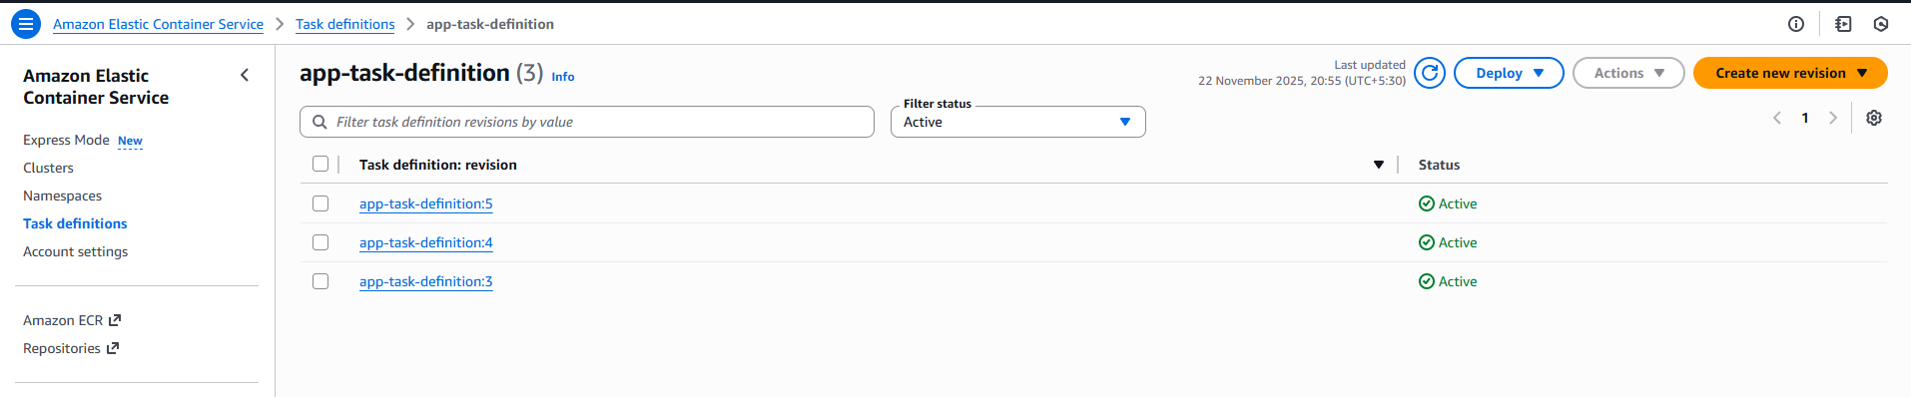
Task definitions are available

Slide 6
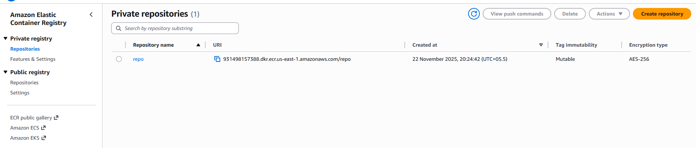
Docker repository has been created on ECR

Slide 7
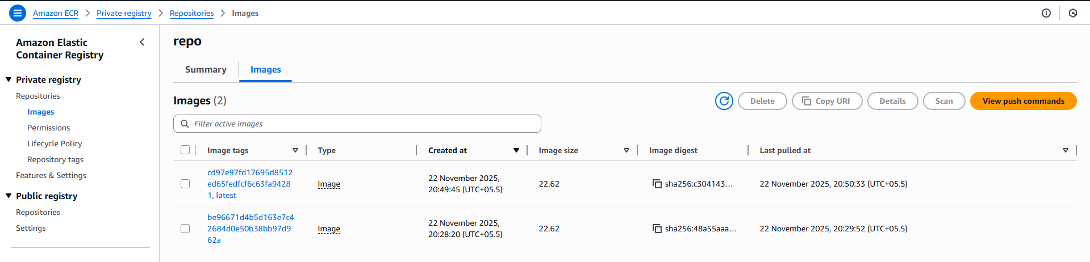
Dockerfile images are available inside the repository

Slide 8
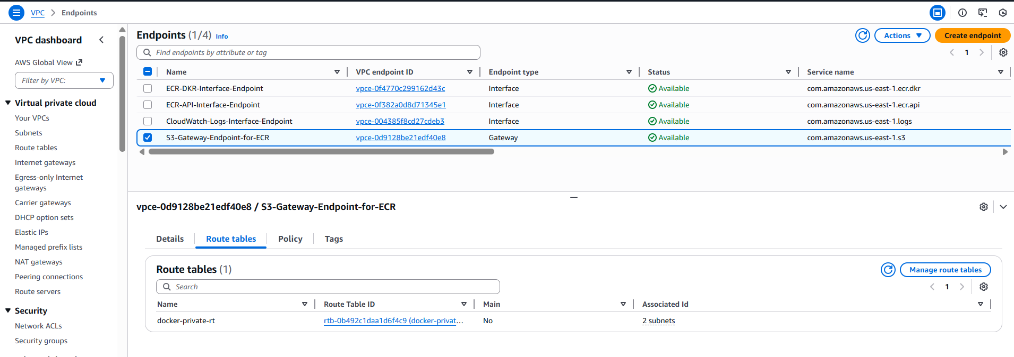
All the 4 VPC Endpoints have been created successfully

Slide 9
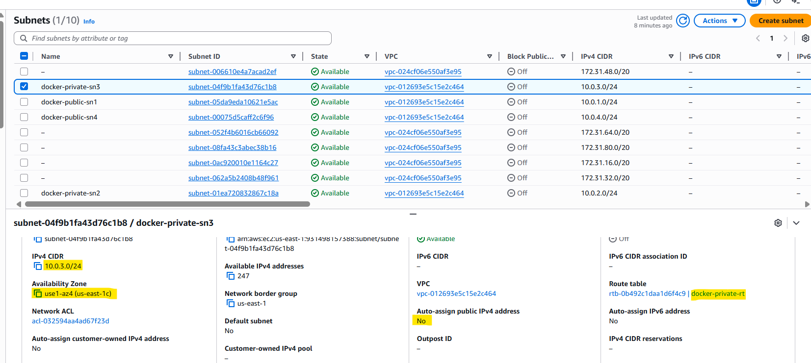
First private subnet for ECS tasks

Slide 10
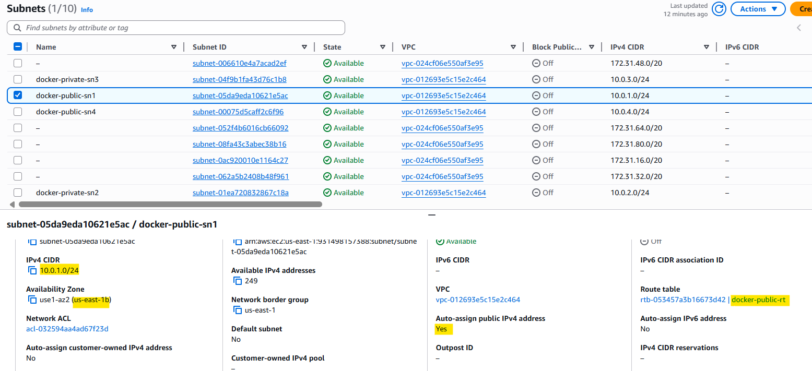
First public subnet for Application Load Balancer

Slide 11
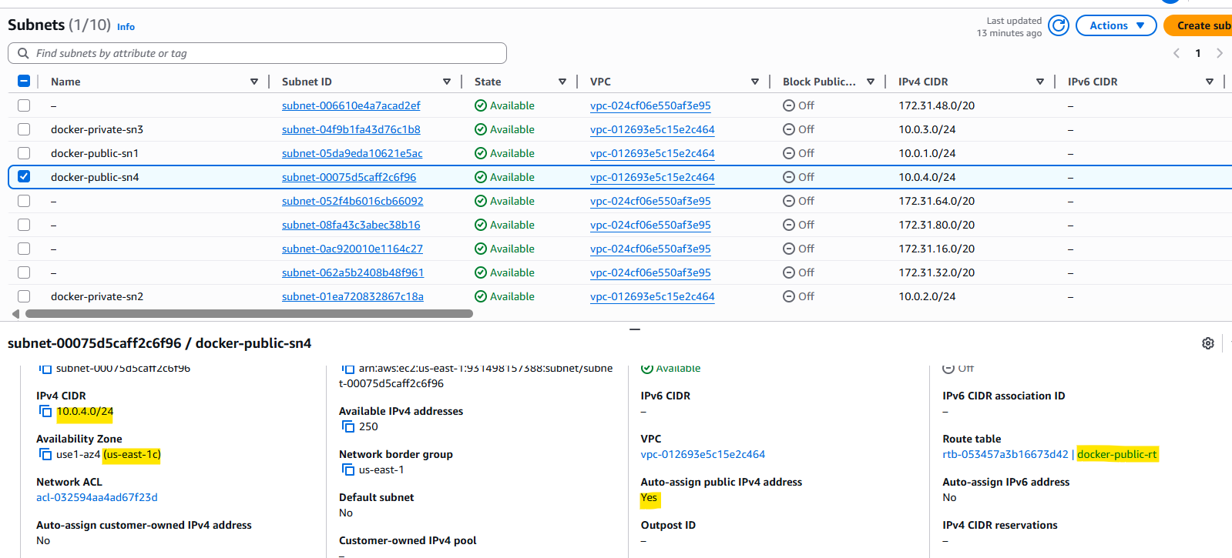
Second public subnet for Application Load Balancer

Slide 12
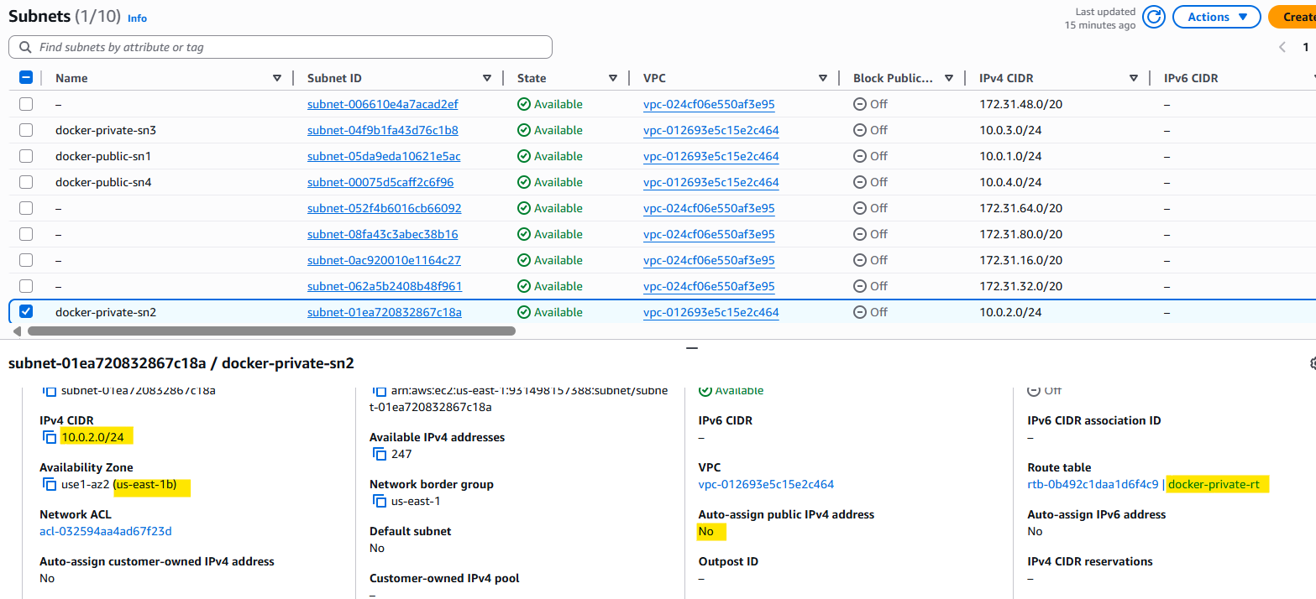
Second private subnet for ECS tasks

Slide 13
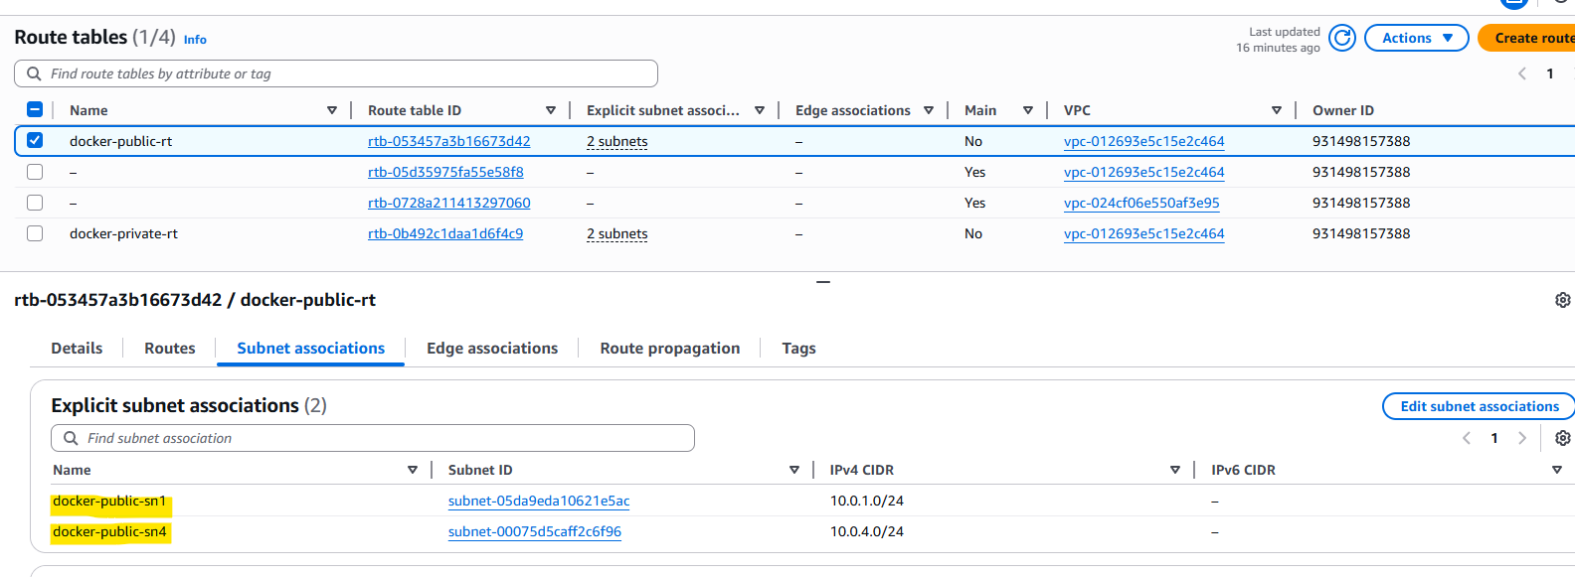
Public route table for Internet Gateway and Public Subnets

Slide 14
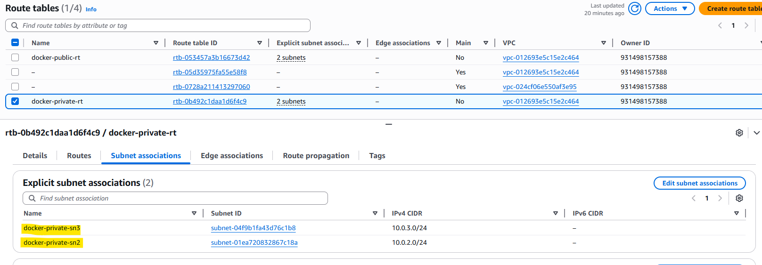
Private route table for NAT Gateway and Private Subnets

Slide 15
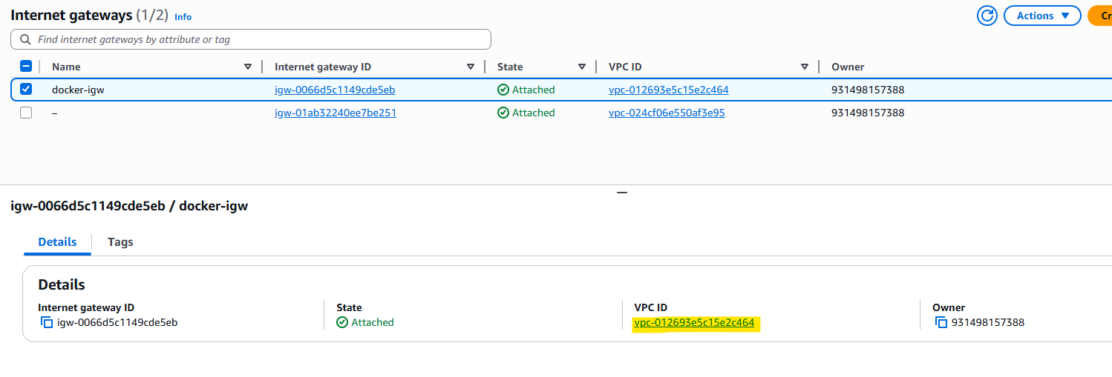
Internet Gateway

Slide 16
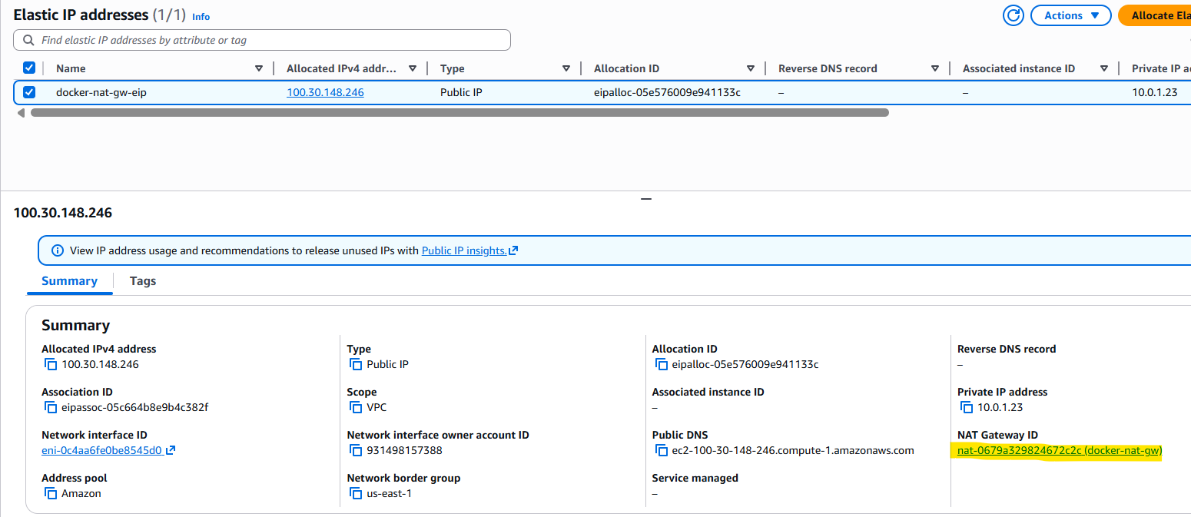
Elastic IP for NAT Gateway

Slide 17
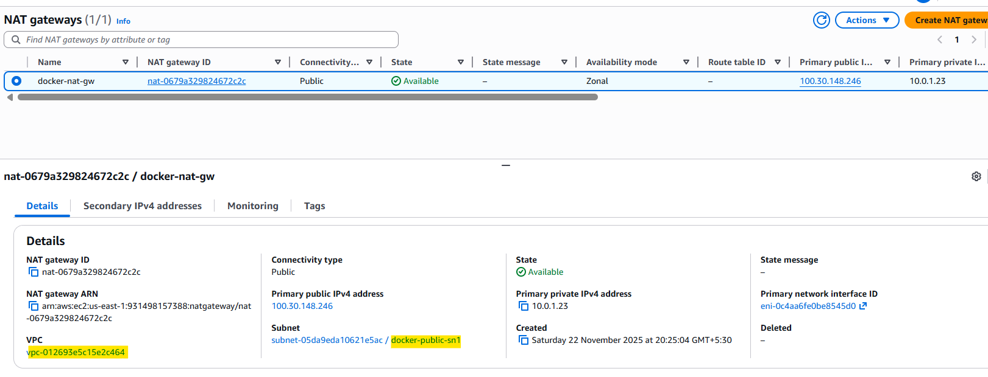
NAT Gateway

Slide 18
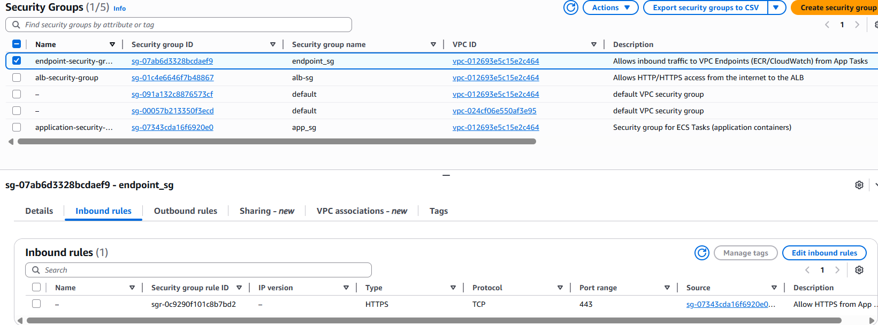
Endpoint Security Group for VPC Endpoints

Slide 19
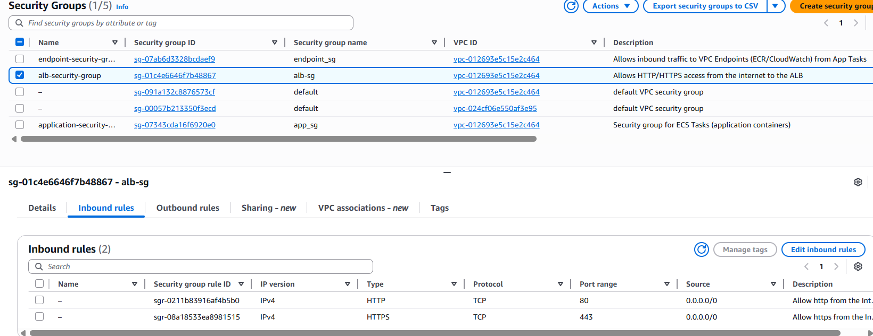
ALB Security Group for Application Load Balancer

Slide 20
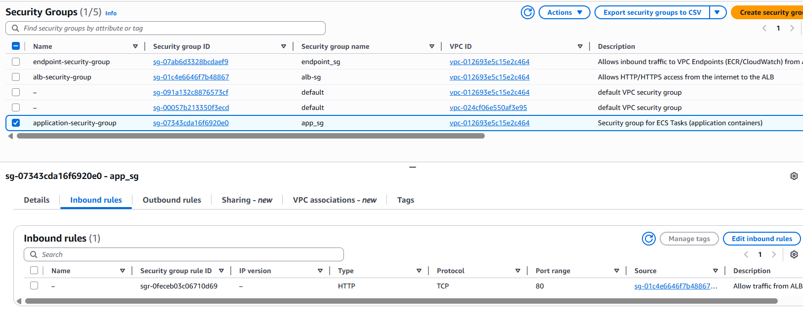
Application Security Group for tasks running on ECS

Slide 21
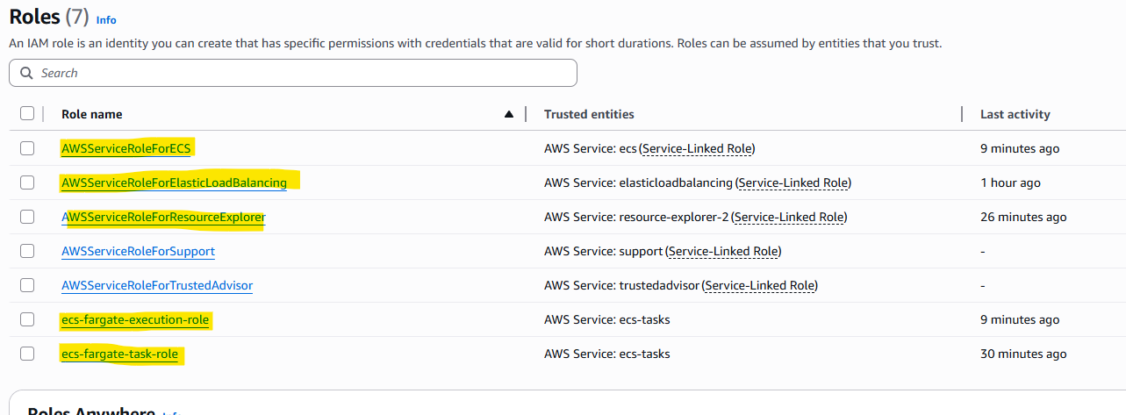
IAM Roles

Slide 22
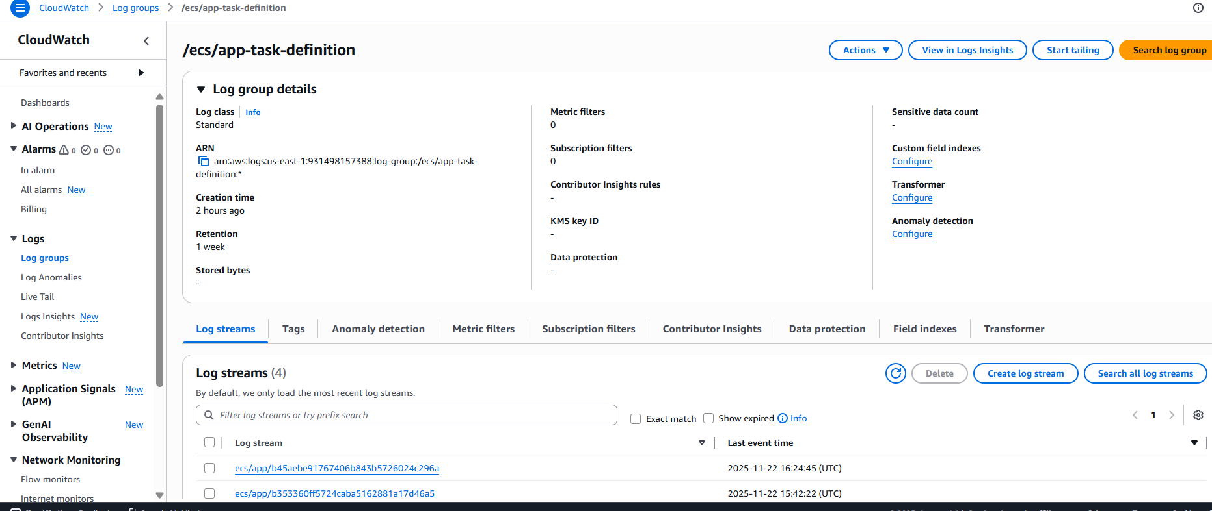
CloudWatch Log Group for tasks

Slide 23
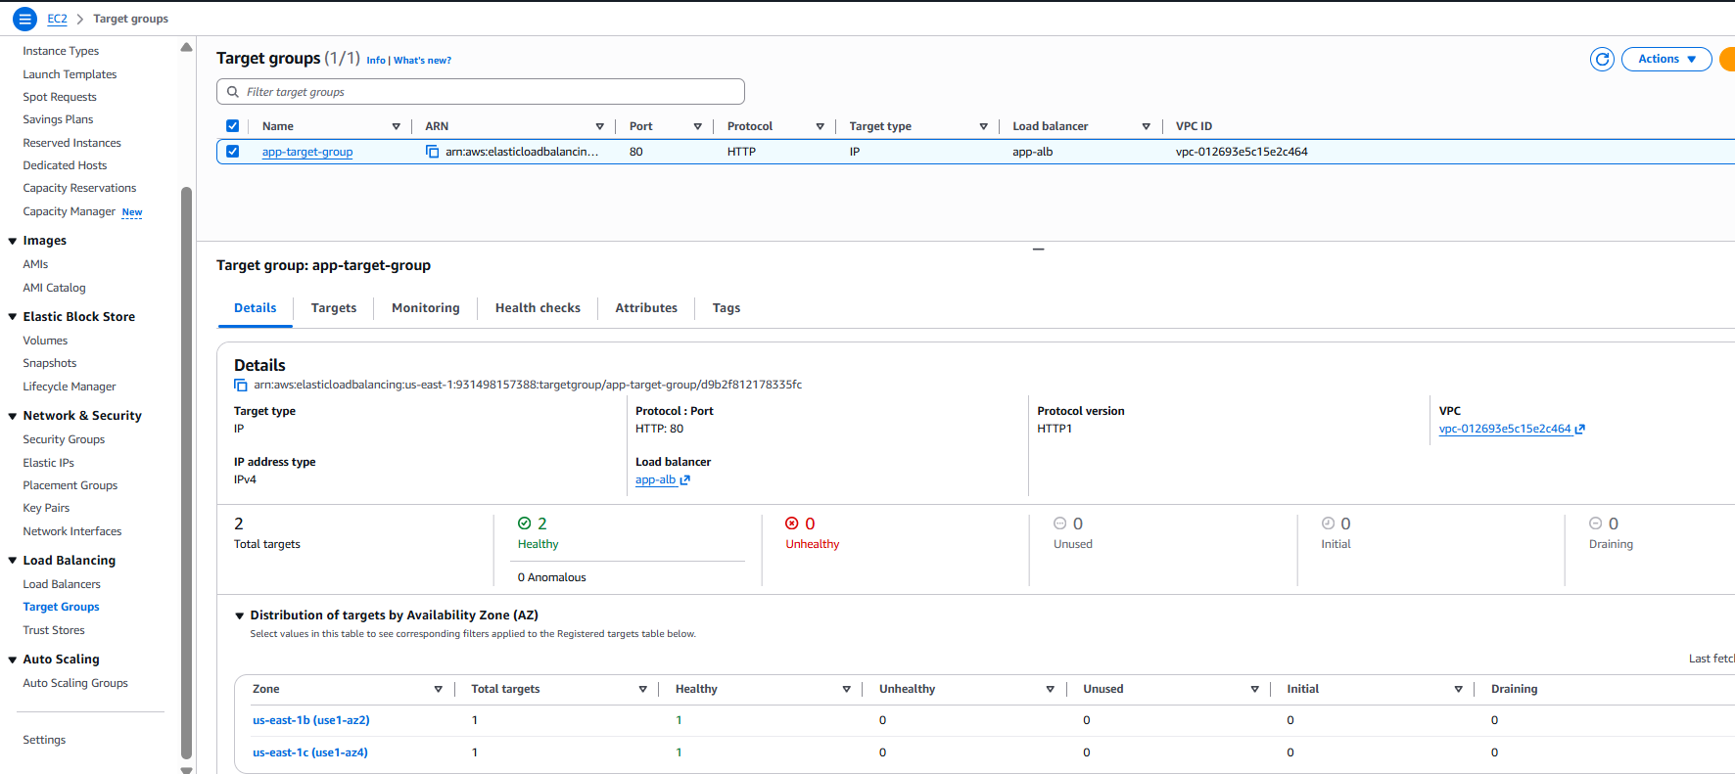
Target Group associated with Load Balancer

Slide 24
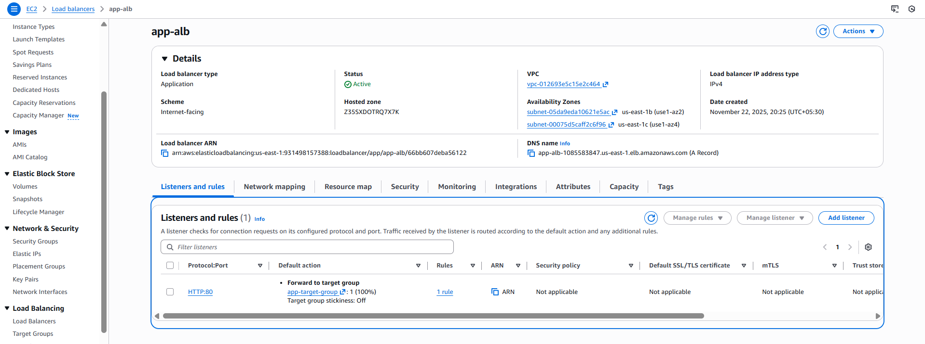
Application Load Balancer

Slide 25
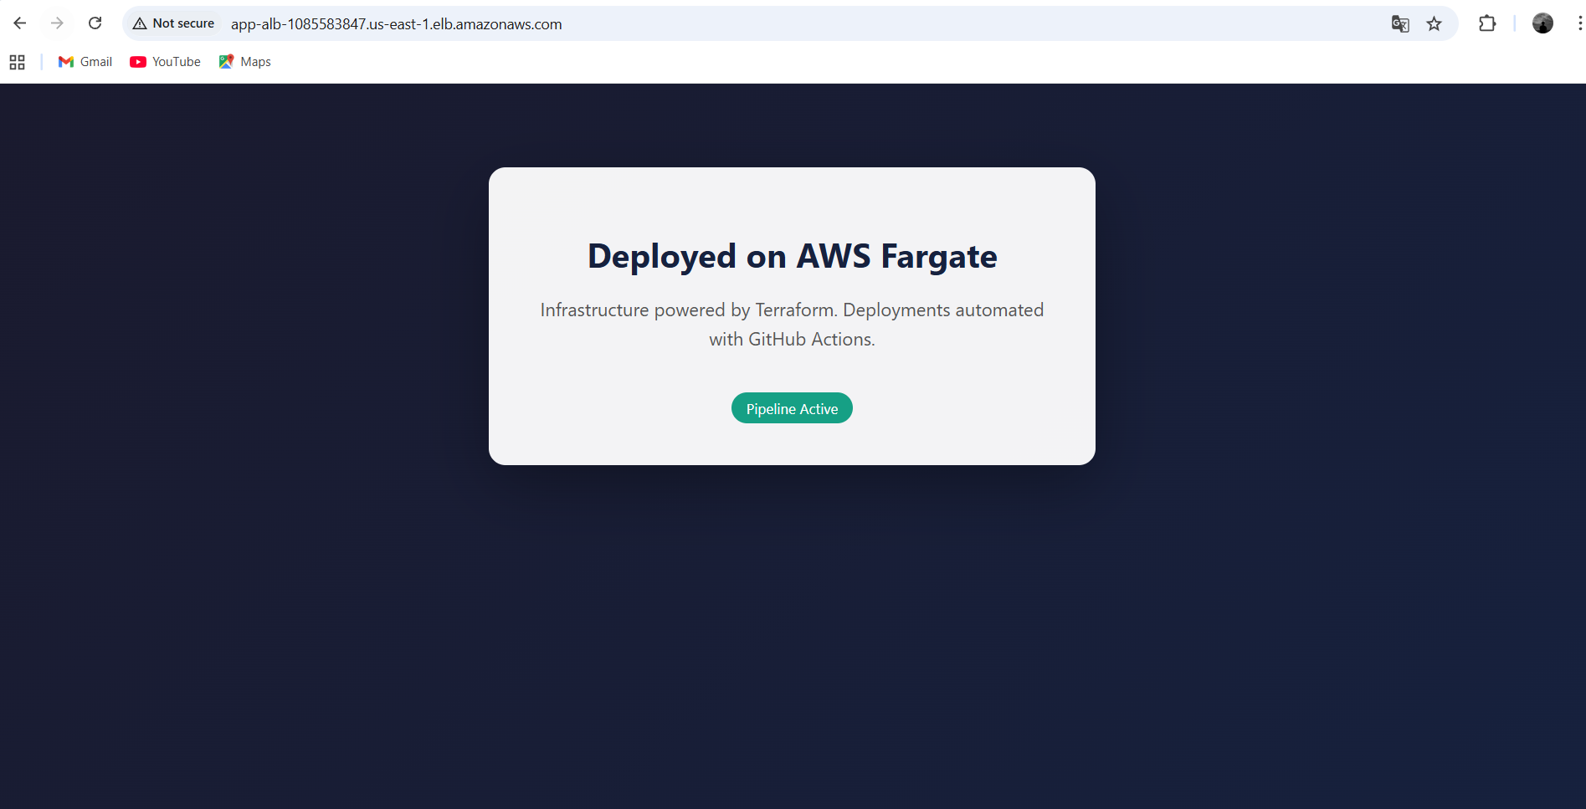
Application successfully deployed and accessible on the web

Slide 26


