Slide 1
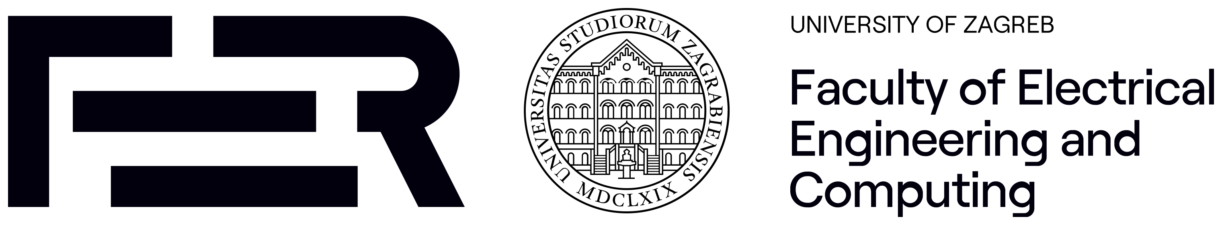
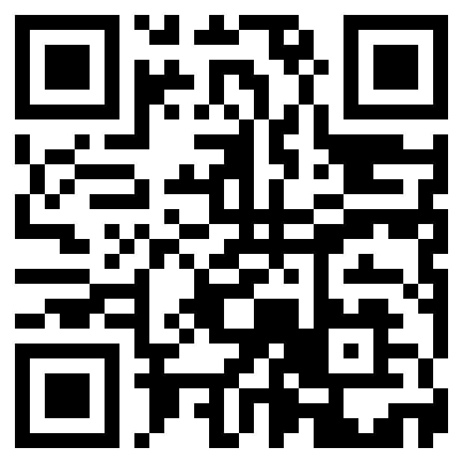

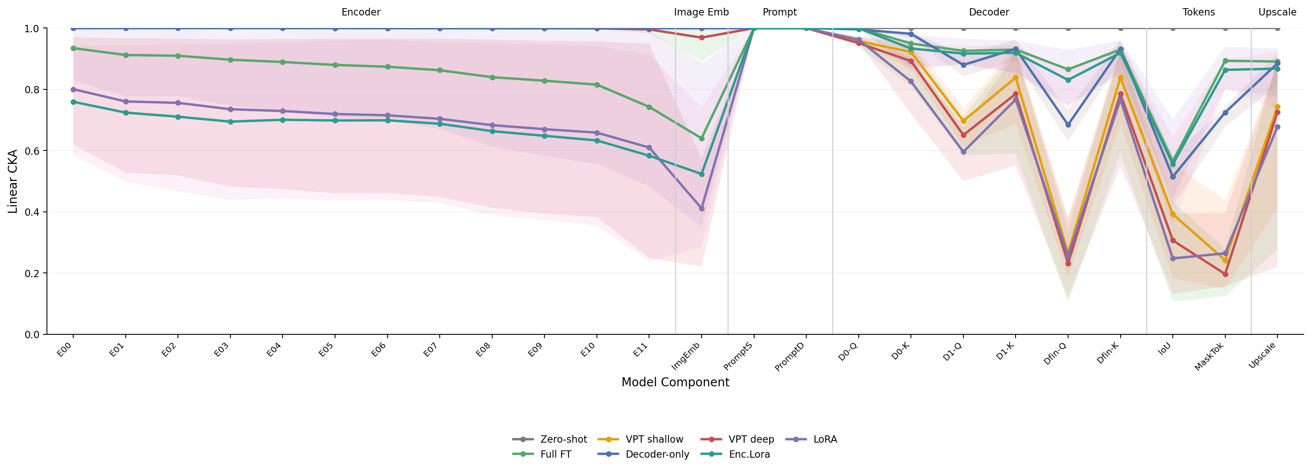
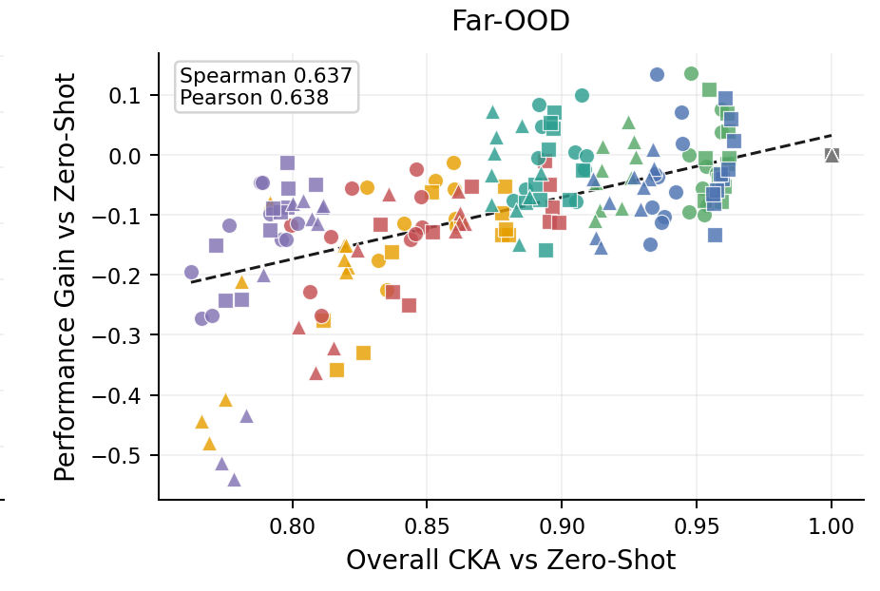
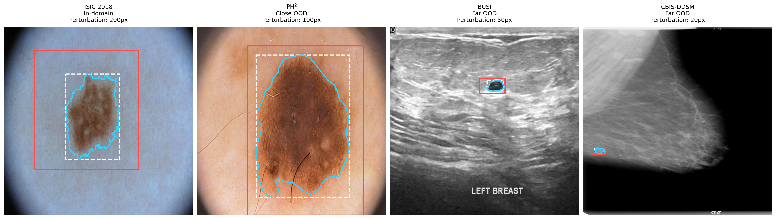
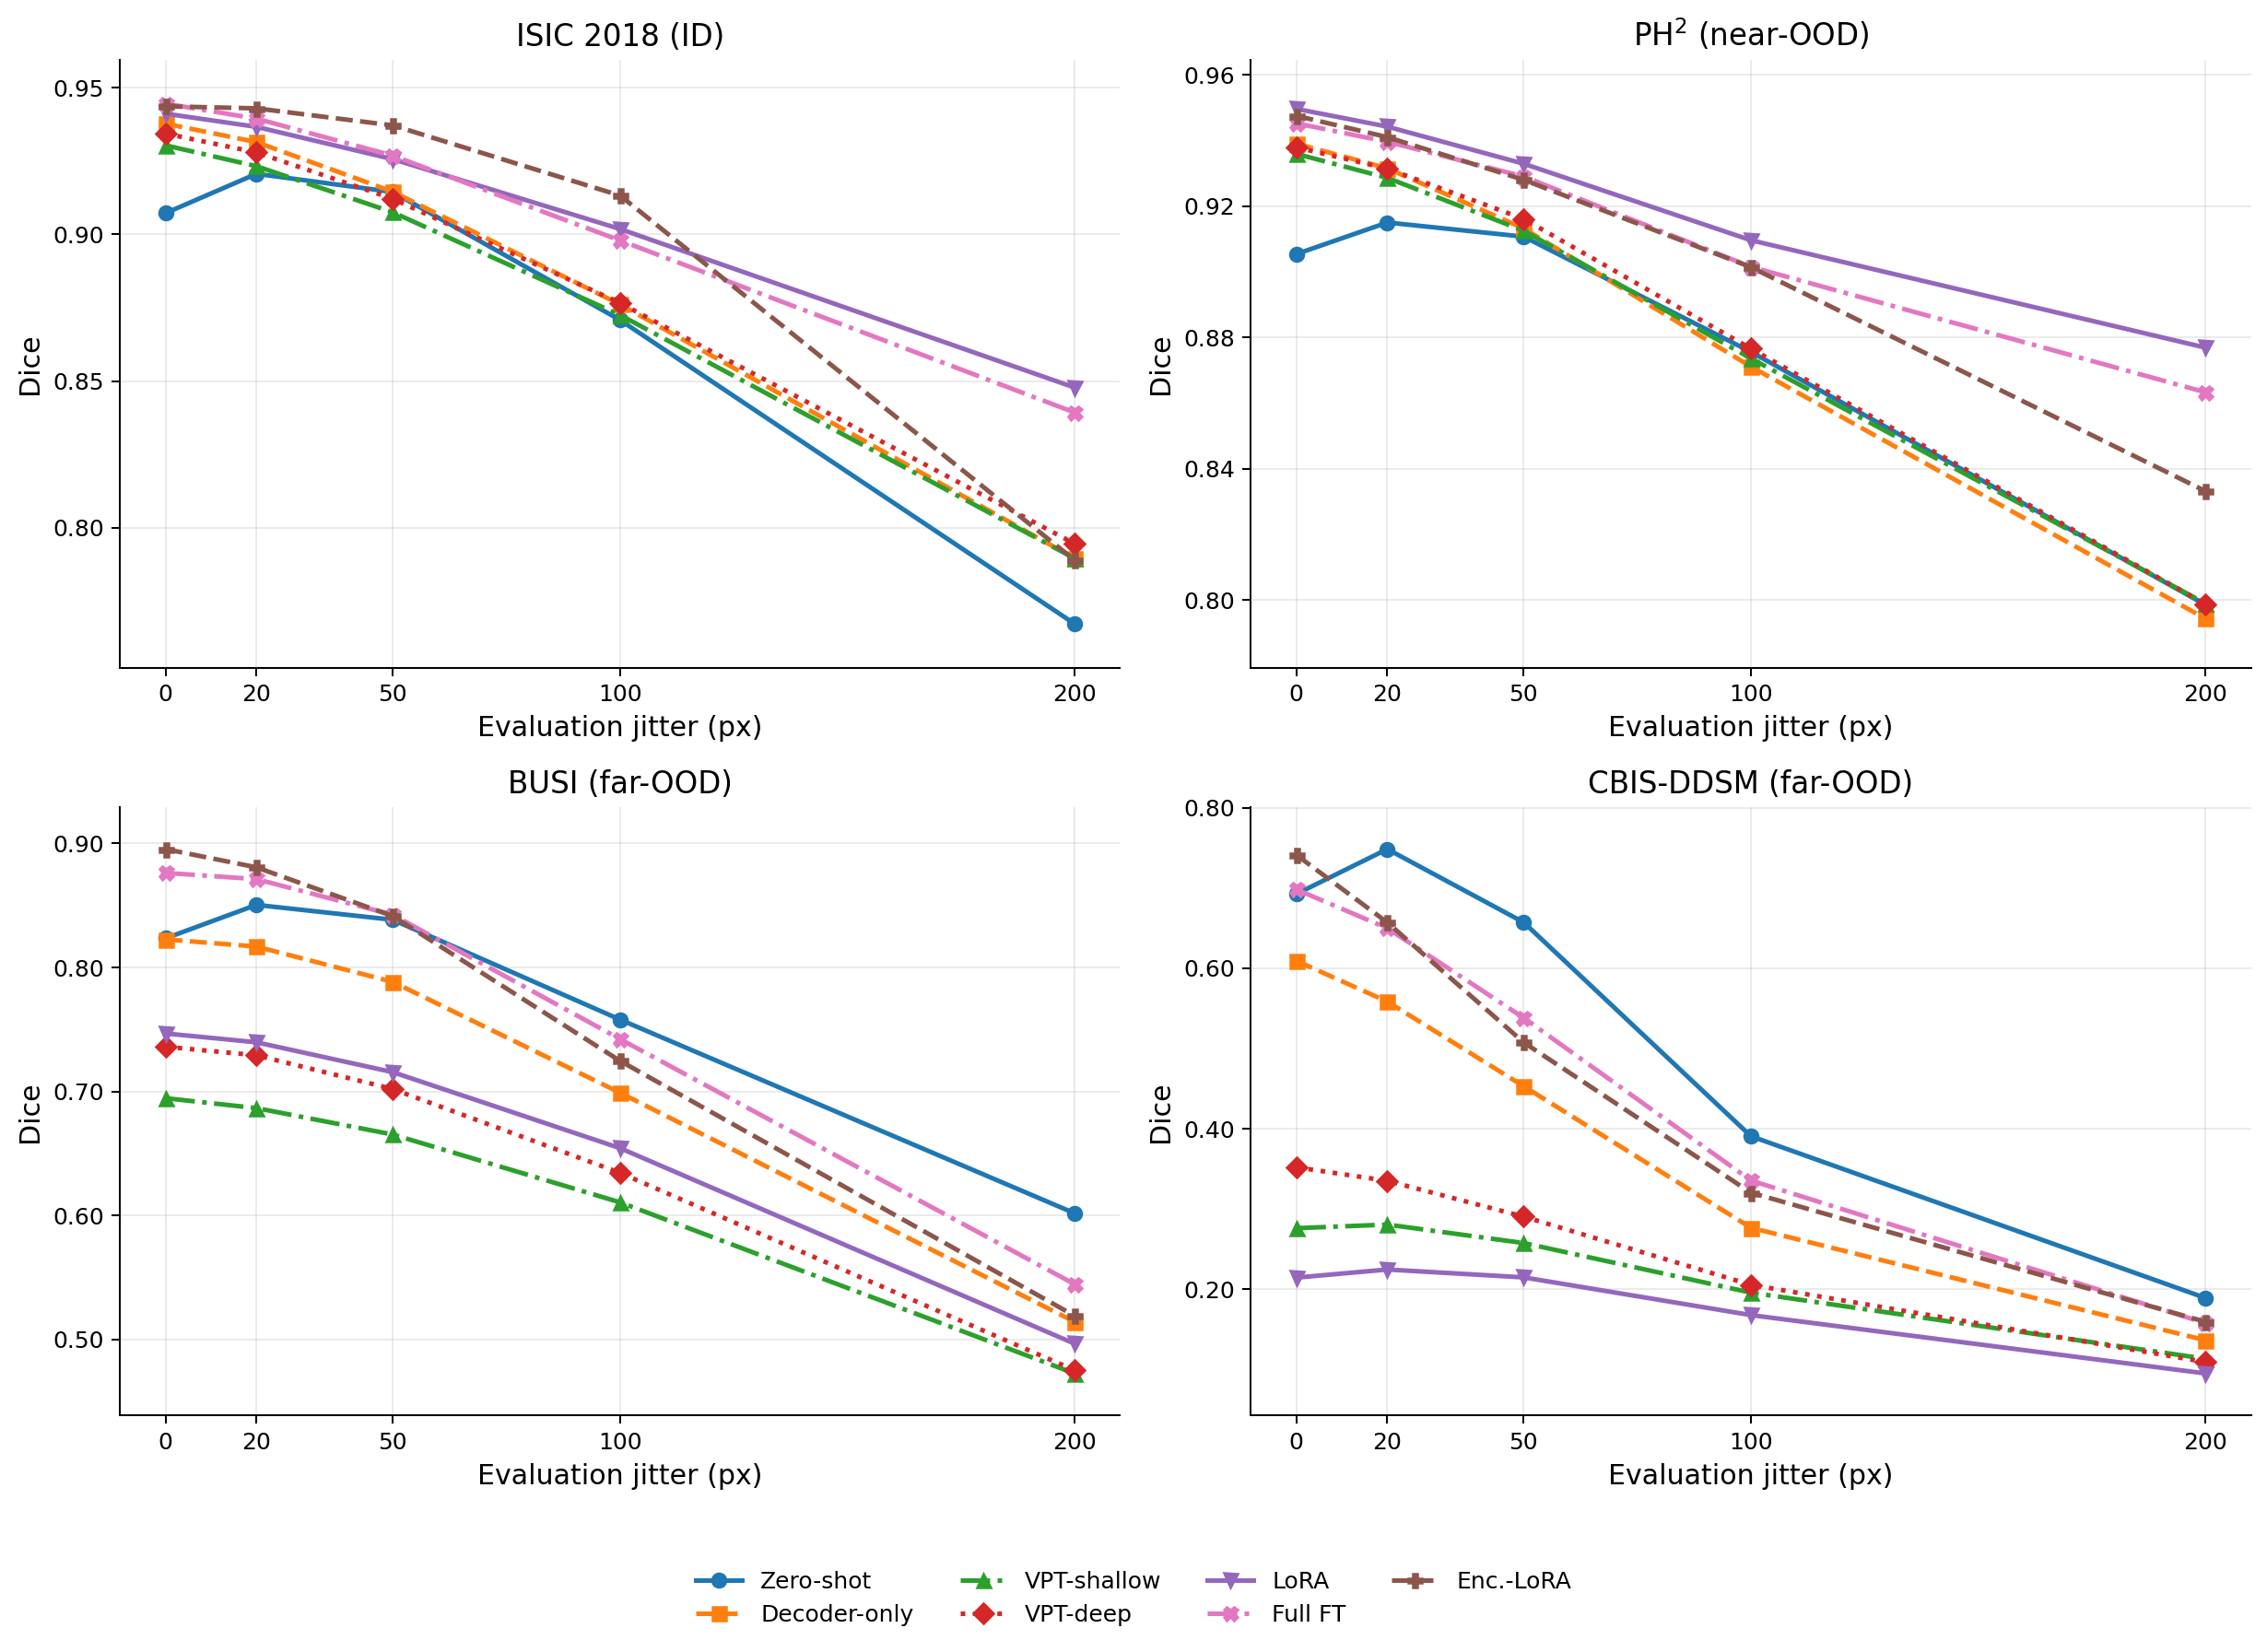
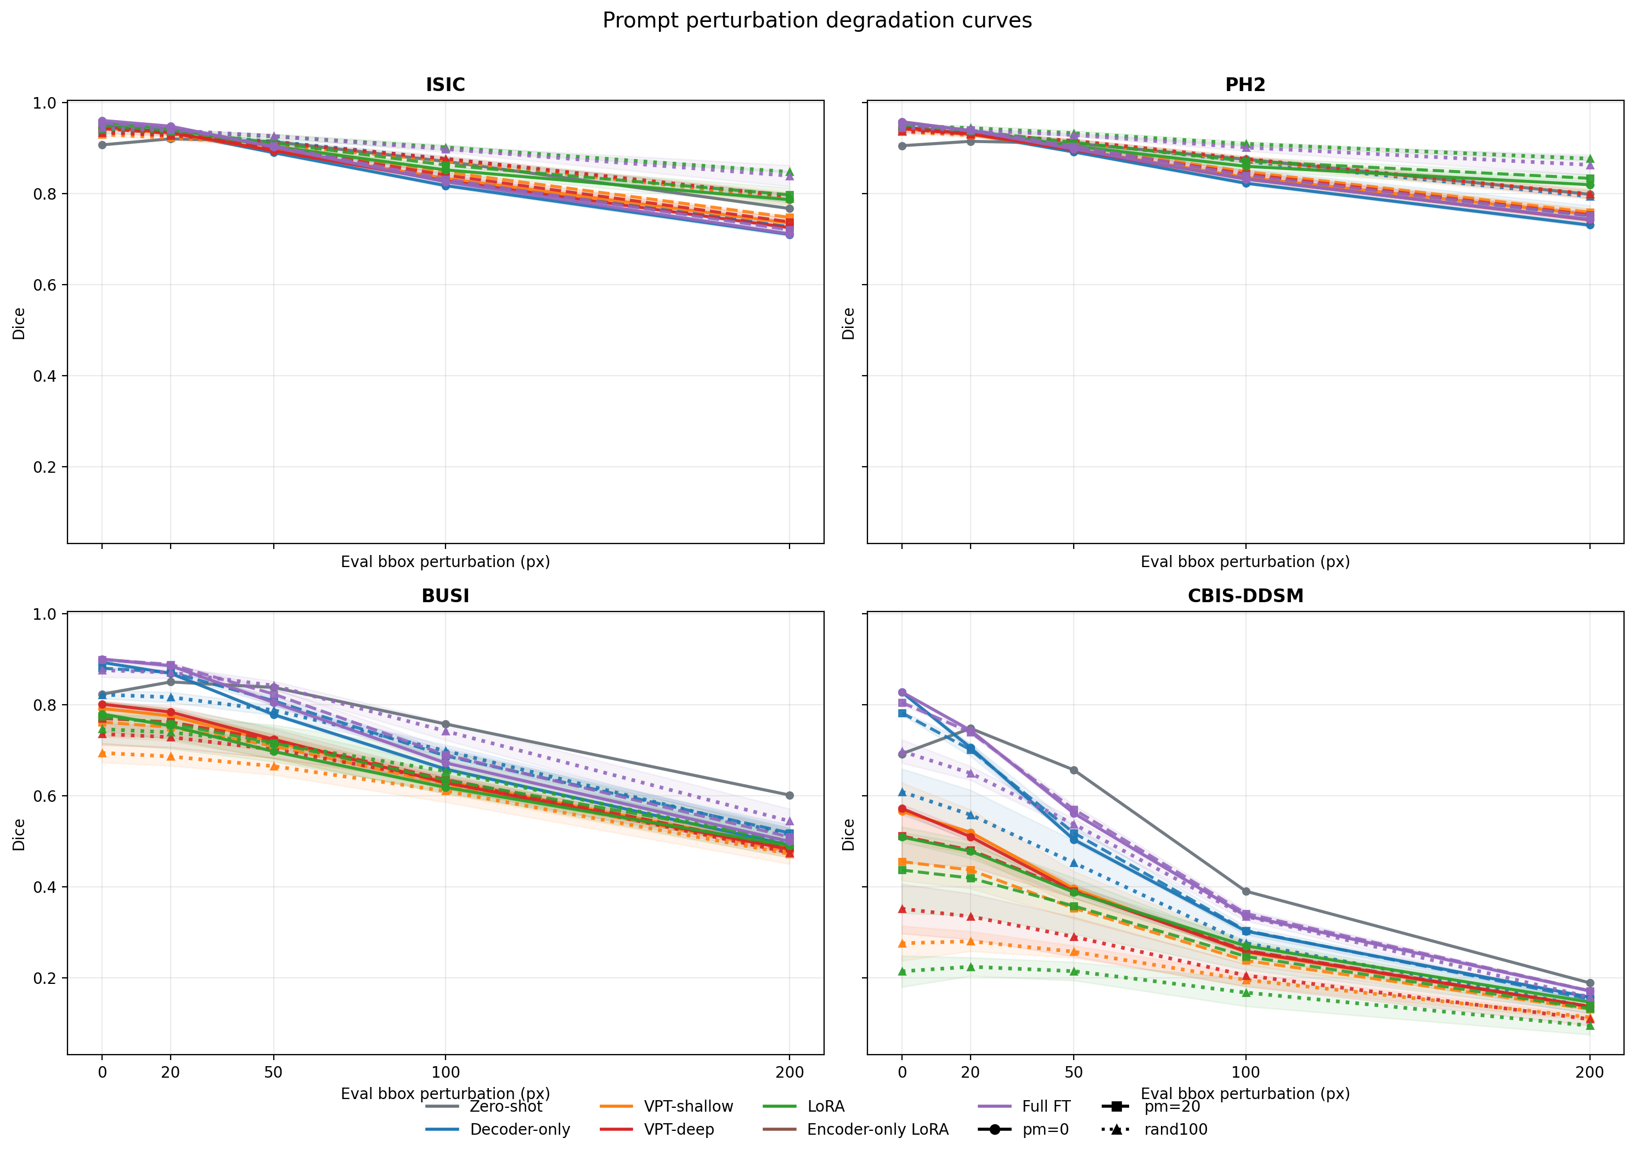
When Adaptation Hurts
Connecting Representational Drift to OOD Failures in MedSAM Fine-Tuning
Marko Haralović^{1,2,3} Sounic Akkaraju³ Carlo Baretta³ Vasil Zapryanov³ Alexia Briassouli³
1 University of Zagreb, Faculty of Electrical Engineering and Computing · 2 ETH Zurich · 3 University of Twente, Enschede
Code, configs, checkpoints
github.com/ImSounic/medsam-vpt
MICCAI 2026 · SAFER Workshop: Stable Adaptation and Faithful Evaluation of Reasoning in Medical Foundation Models · Strasbourg, 27 September 2026
Three challenges, studied separately
Result 1 · Adaptation often hurts far-OOD
Why does adaptation fail far-OOD?
•
ROI sensitivity. MedSAM needs a bounding box. Clinical boxes are loose or inconsistent, and Dice follows box quality.
Dice with clean boxes, models trained with clean boxes, mean of 3 seeds
Linear CKA scores how similar a layer's activations are before and after adaptation (1 = unchanged). We compute it per component against zero-shot MedSAM on the same images and ask whose drift predicts the far-OOD loss, i.e. which part of the model may change.
•
Distribution shift. Accuracy falls when scanner, organ or modality changes.
Method | ISIC (ID) | PH² (close) | BUSI (far) | CBIS (far)
Zero-shot | 0.907 | 0.905 | 0.823 | 0.692
Decoder-only | 0.949 | 0.947 | 0.894 | 0.828
VPT-shallow | 0.945 | 0.943 | 0.792 | 0.566
VPT-deep | 0.947 | 0.946 | 0.802 | 0.573
LoRA | 0.956 | 0.957 | 0.780 | 0.509
Encoder-only LoRA | 0.958 | 0.960 | 0.908 | 0.793
Full FT | 0.961 | 0.958 | 0.901 | 0.829
•
Adaptation cost. Fine-tuning helps in-domain but is expensive; LoRA and VPT are cheap yet sensitive to data and prompt quality.
Spearman ρ between linear CKA (adapted vs zero-shot MedSAM) and Dice gain over zero-shot. n = 3,000 pooled observations; FDR-corrected * q<0.05, *** q<0.001
This work evaluates adaptation strategy × prompt noise × domain shift jointly, and links the outcome to which internal representations drift (linear CKA vs zero-shot MedSAM).
CKA feature | ID | Close-OOD | Far-OOD
IoU token layer | 0.10 | −0.02 | 0.76 ***
Output layer | 0.06 | 0.00 | 0.76 ***
Decoder layers | −0.08 | −0.02 | 0.73 ***
Upscaled embedding | 0.20 | 0.29 * | 0.71 ***
Encoder layers | −0.28 * | −0.28 * | 0.09
•
Every adapter beats zero-shot in-domain. LoRA and both VPT variants fall below zero-shot on ultrasound and mammography (red).
Setup: adapters and the drift ladder
•
Full FT gives the best overall trade-off. Encoder-only LoRA is the strongest parameter-efficient method: the same adapter as LoRA with the decoder left alone, +0.28 Dice on mammography.
•
Decoder-side similarity predicts far-OOD gain; encoder similarity does not (and is weakly negative in-domain).
Method | Params | Updated
Zero-shot MedSAM | 0 | none (frozen baseline)
Decoder-only FT | 4.1M | mask decoder
VPT-shallow | 4.1M | 10 tokens at input + decoder
VPT-deep | 4.2M | 10 tokens per block + decoder
LoRA (r = 8, α = 16) | 4.4M | encoder + decoder adapters
Encoder-only LoRA | 4.1M | encoder adapters, decoder frozen
Full FT | 93.7M | image encoder + mask decoder
•
Decoder CKA on CBIS-DDSM follows the Dice ranking exactly, from Full FT (0.95) down to LoRA (0.76).
•
Encoder-only LoRA works because it adapts the encoder to the visual shift while preserving the decoder pathway.
Boundary error: collapse, not overlap loss
Train on ISIC 2018 dermoscopy (2,594 images, 80/10/10), 5 epochs, AdamW, Dice + CE, prompt encoder frozen, 3 seeds. Full FT: LR 1e-5, batch 1. PEFT: LR 1e-4, batch 4.
HD95 with clean boxes, median [IQR] in pixels at 1024²; lower is better. In-domain and close-OOD medians are 0–7 px for every method.
Method | BUSI (far-OOD) | CBIS-DDSM (far-OOD)
Zero-shot | 14 [9, 25] | 12 [7, 17]
Decoder-only | 4 [2, 17] | 4 [3, 6]
VPT-shallow | 21 [5, 387] | 14 [8, 37]
VPT-deep | 25 [6, 394] | 18 [10, 359]
LoRA | 26 [6, 402] | 47 [13, 438]
Encoder-only LoRA | 3 [1, 11] | 5 [3, 7]
Full FT | 4 [1, 13] | 4 [3, 6]
Evaluate along a drift ladder
Fig. 4. Linear CKA to zero-shot MedSAM per component (clean boxes). Encoder blocks drift for LoRA and encoder-only LoRA alike; the decoder attention, IoU and mask tokens collapse only for LoRA and VPT.
ISIC 2018
in-domain
1,000 test images
PH²
close-OOD dermoscopy
200 images
BUSI
far-OOD ultrasound
647 images
CBIS-DDSM
far-OOD mammography
362 images
Fig. 5. Far-OOD Dice gain vs overall CKA, one point per method × training jitter × evaluation jitter. Spearman 0.64. The lowest-similarity, lowest-gain cluster is LoRA and VPT; Full FT and encoder-only LoRA sit at the top right next to zero-shot.
Prompt protocol. Train with clean boxes, fixed 20 px, or random 0–100 px jitter. Evaluate at 0 / 20 / 50 / 100 / 200 px on 1024² images. 200 px = +280% box area on average, +1,328% on small CBIS-DDSM lesions.
•
For LoRA and VPT the upper quartile reaches ~400 px: a quarter of far-OOD cases segment the wrong structure entirely. The Dice gap to Full FT is ~0.12; the boundary gap is more than tenfold.
What jitter looks like
Result 3 · Train with random 0–100 px jitter
What we would do with MedSAM now
Mean Dice gain over zero-shot: trained with clean boxes → trained with random 0–100 px jitter
•
With compute available and far-OOD data expected, full fine-tuning at LR 1e-5 gives the best trade-off in every regime.
Method | In-domain | Far-OOD | Overall
Full FT | −0.006 → +0.034 | −0.014 → −0.029 | −0.009 → +0.013
Encoder-only LoRA | −0.027 → +0.053 | −0.024 → −0.054 | −0.023 → +0.007
LoRA | +0.012 → +0.035 | −0.142 → −0.228 | −0.038 → −0.051
Decoder-only | −0.016 → +0.014 | −0.036 → −0.088 | −0.023 → −0.022
VPT-shallow | −0.008 → +0.009 | −0.127 → −0.230 | −0.048 → −0.071
VPT-deep | −0.010 → +0.013 | −0.126 → −0.198 | −0.049 → −0.058
•
On a parameter budget, encoder-only LoRA comes closest to Full FT far-OOD with 4.1M trainable parameters.
Fig. 1. Tight box (white, dashed), perturbed prompt (red), predicted mask (cyan). Equal pixel jitter is a far larger relative change on small far-OOD lesions.
•
For a single target domain with clean prompts, standard LoRA still gives the largest in-domain and close-OOD gains.
Result 2 · Clean-box adapters are prompt-brittle
•
Whatever the adapter, train with random 0–100 px box jitter; fixed jitter overfits one noise level.
•
Jitter training restores in-domain and close-OOD robustness for every adapter (Full FT at 200 px: 0.712 → 0.839; encoder-only LoRA: 0.645 → 0.789). Fixed 20 px training overfits one noise level.
•
VPT on MedSAM is not worth it. The in-domain gain is negligible and the far-OOD loss is large.
•
Under severe prompt noise far-OOD, zero-shot MedSAM is still hard to beat and remains the fallback.
•
It costs far-OOD Dice. The cost is small for Full FT and encoder-only LoRA, large for LoRA, VPT and decoder-only (LoRA on mammography: 0.509 → 0.214).
Limitations
•
Only Full FT and encoder-only LoRA end up above zero-shot overall.
•
One training domain and two far-OOD targets: modality shift is confounded with lesion-type mismatch. Read the ranking, not the absolute Dice.
•
The same pixel jitter is a harder task far-OOD (+152% box area on ISIC vs +1,328% on CBIS-DDSM at 200 px).
•
CKA observations are not independent; the effective sample size is well below n = 3,000. Fixed recipe: 5 epochs, LoRA rank 8, 10 prompt tokens.
Fig. 2. Dice vs evaluation jitter, averaged over the three training-jitter regimes.
Take-home
•
Zero-shot MedSAM improves with 20 px of slack (CBIS-DDSM 0.692 → 0.748) and is the best model on both far-OOD sets once boxes are 100 px off (CBIS 0.391 vs ≤ 0.367 for any adapter).
1.
Adaptation can hurt. LoRA and VPT beat zero-shot in-domain and fall below it on far-OOD modalities, with boundary errors in the hundreds of pixels.
2.
Prompt noise must be trained for. Random 0–100 px jitter gives the most reliable adapters; only Full FT and encoder-only LoRA end above zero-shot overall.
•
MedSAM was pretrained on imperfect boxes; clean-box adapters unlearn that tolerance. Even encoder-only LoRA becomes the most jitter-sensitive model in-domain (ISIC, 200 px: 0.645 vs zero-shot 0.767).
3.
The decoder is the locus. Preserving decoder and output representations predicts far-OOD robustness (ρ ≈ 0.73–0.76); encoder similarity does not (ρ = 0.09). Encoder-only LoRA is the CKA-informed adapter.
Fig. 3. Dice vs evaluation jitter per training regime (solid: clean, dashed: fixed 20 px, dotted: random 0–100 px). Dotted curves are flattest in-domain and lowest on CBIS-DDSM.

