Slide 1
vis
File created on: 6/7/23

Slide 2
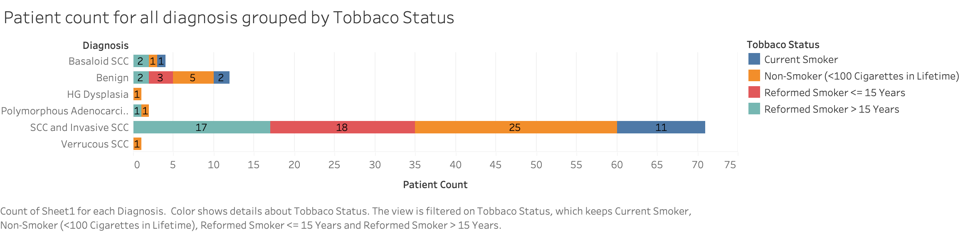
Notes:
We can see that patients with SCC or Invasive SCC are more likely to be smokers.

Slide 3
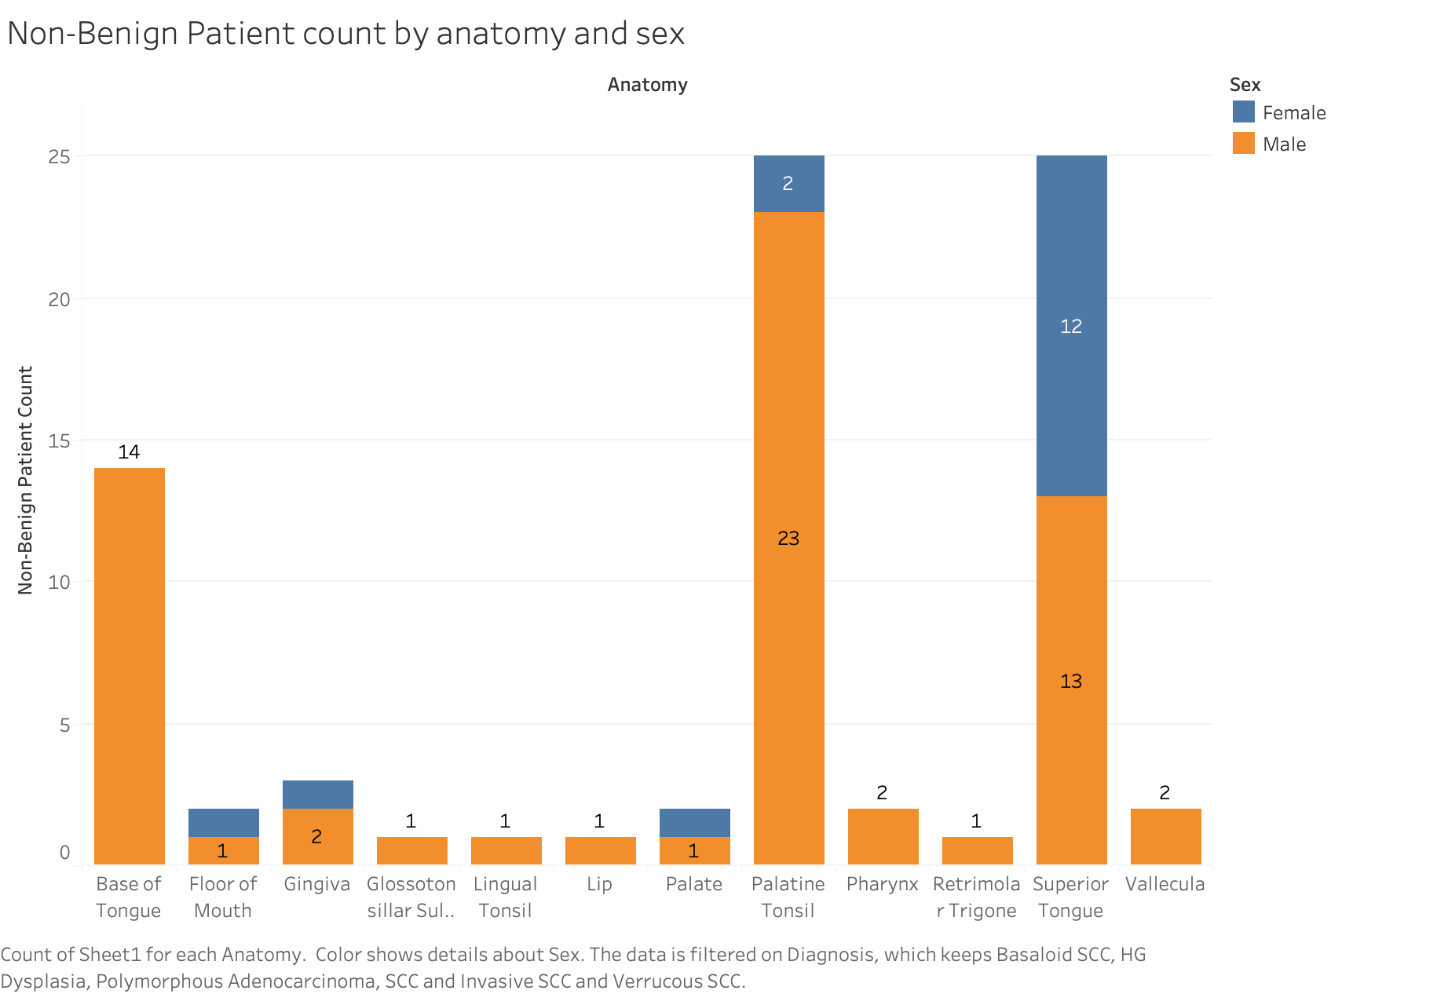
Notes:
We see that Males have a higher chance of cancerous tissues in Palastine tonsile/Base of Tongue than females. On the other hand, females are more likely have cancerous tissues than other regions.

Slide 4
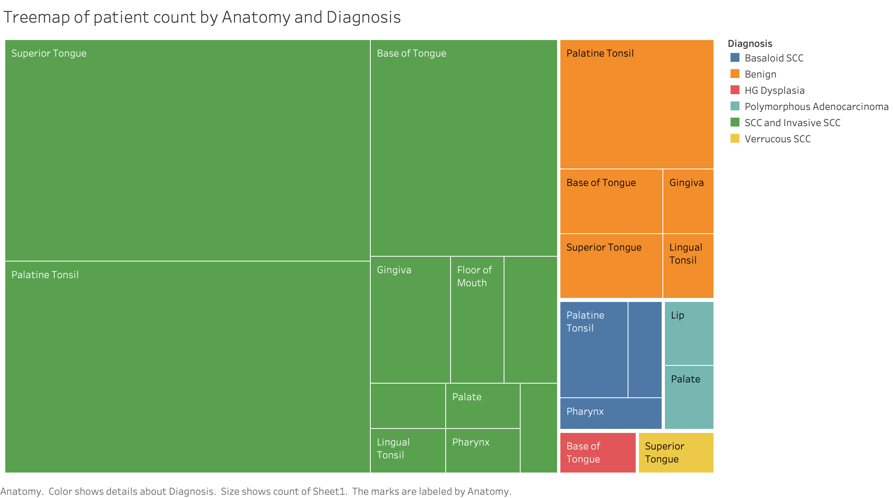
Notes:
Superior Tongue SCC has the highest occurrence followed by others

Slide 5
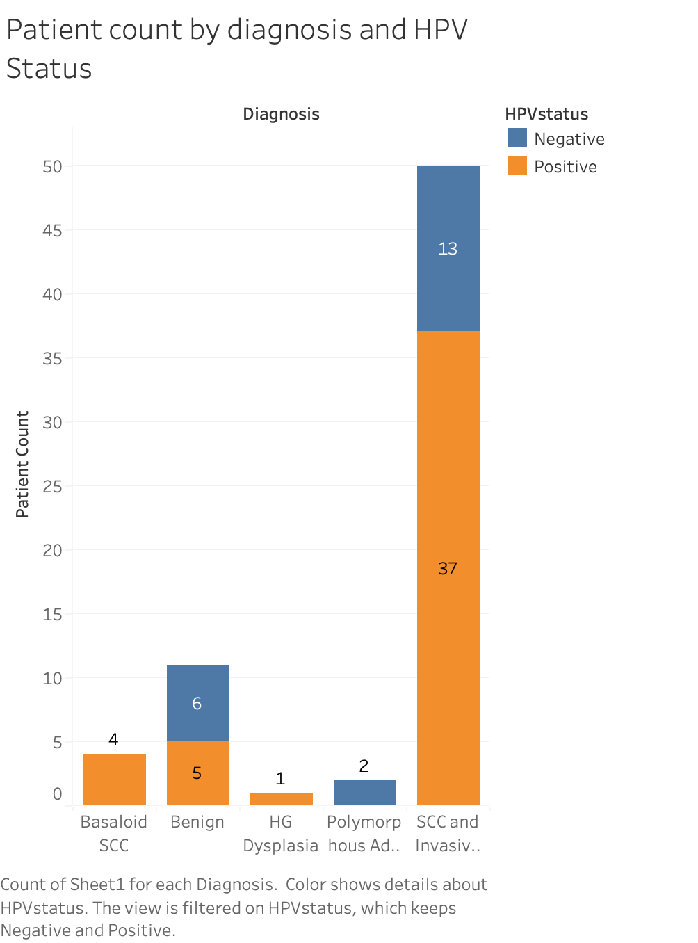
Notes:
Positive HPV Status has a high correlation with SCC and Invasive SCC

Slide 6
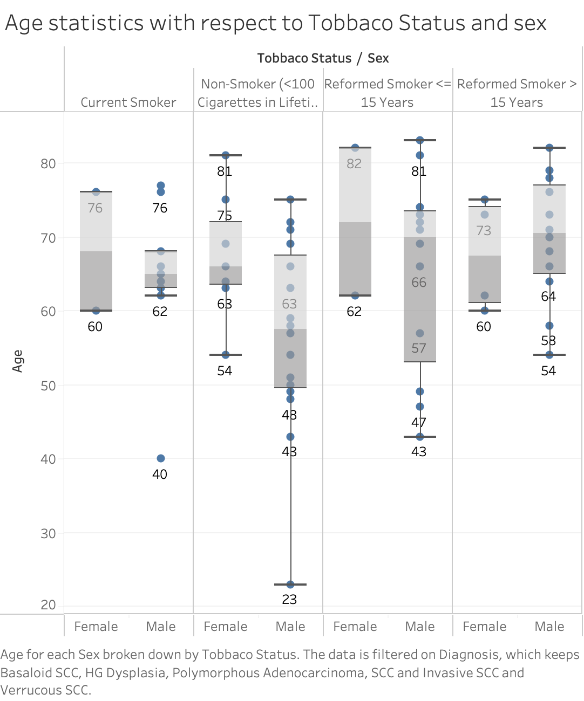
Notes:
Female age usually higher than males
Smoker age usually higher than non smokers

