Slide 1
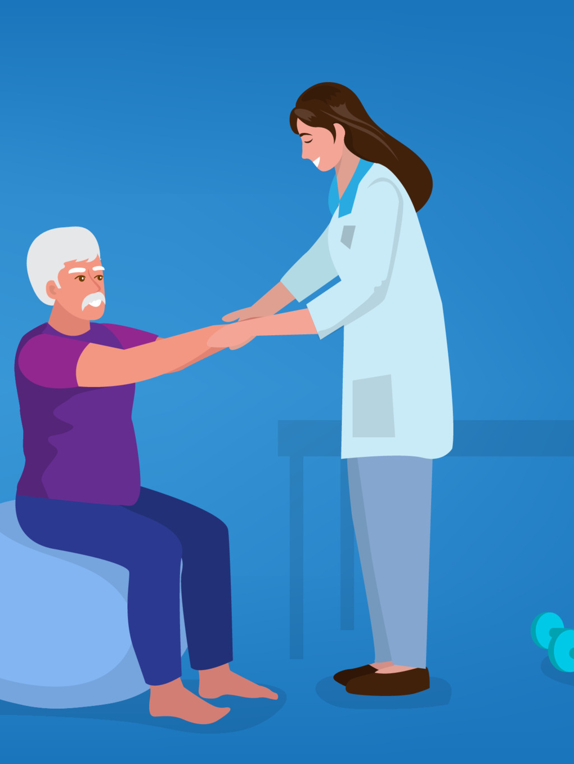
Physiotherapy Guide App
Group 10​

Slide 2
Introduction
Motivation
Problem Statement
Research Gap
Scope
Stakeholders
Literature Review
Technology Stack
Functional Requirements
Non Functional Requirements
Game Module
User Interface
Project Timeline
Conclusion
Agenda

Slide 3
Introduction
The Physiotherapy Guide App is designed to be a comprehensive mobile guide for users who require lower limb physiotherapy, providing them with lower limb oriented games and feedback to help them achieve their health goals.

Slide 4
Motivation
Children with ASD often have difficulties with movement and coordination
Research has shown that early intervention and therapy can have a significant impact on the outcomes for children with ASD
Our app is designed to help children with ASD improve their motor skills and coordination through a series of fun and engaging exercises.
It has the potential to make a real difference in the lives of these children and their families, by providing a convenient and accessible way to engage in therapy at home.

Slide 5
Problem Statement
Physiotherapy is a necessity for empowering the overall health of autistic and cerebral palsy children.
In cerebral palsy, physiotherapy can help to improve muscle strength and coordination
The problem statement is to devise an app that enables the patients to exercise while engaging in fun games.

Slide 6
Research Gap
No standard protocol for using pose detection technology for physiotherapy in autistic children.
It makes it difficult for practitioners to replicate the approach or for researchers to compare findings across different studies.
On-device machine learning have some limitations.
Integration of ML Kit with flutter

Slide 7
Scope
The app is intended for use by individuals who require lower limb physiotherapy, including people
recovering from injury or surgery
with chronic conditions
who wish to maintain their overall health and fitness.
Effective treatment without doctor’s presence.
Doctor’s can login and check the overall betterment of patients.

Slide 8
Stakeholders
Autistic and cerebral palsy children
People who require lower limb physiotherapy
Doctors
Healthcare institutions
Investors

Slide 9
Literature Review

Slide 10
S.N. | Name of paper | Authors | Inference
1. | The Benefit Assessment of the Physiotherapy Sessions for Children with Autism Spectrum Disorder https://doi.org/10.33607/bjshs.v3i118.971 | Draudvilienė, L. ., Sosunkevič, S. ., Daniusevičiūtė-Brazaitė, L. ., Burkauskienė, A. ., & Draudvila, J. (2020). | The children’s balance improved by 21.32%, coordination – 23.36%, physical and functional abilities such as speed (13.18%) and explosive leg strength (37.14%). The physiotherapy sessions improved the physical condition of children with ADS: balance, coordination, functional abilities and the explosive leg strength.
2. | Playing games can improve physical performance in children with autism https://doi.org/10.1080/20473869.2020.1752995 | Fahimeh Hassani, Shahnaz Shahrbanian, Seyed Houtan Shahidi & Mahmoud Sheikh (2022) | Experimental intervention groups received sixteen sessions of 60 min. Experimental Spark groups had increased motor skills (MS).SPARK is a comprehensive health-related program, which focuses on increasing moderate to vigorous physical activity through engaging, fun, non-traditional and adapted traditional activities
3. | A Survey on Software Applications use in Therapy for Autistic Children 10.1109/ICECCO48375.2019.9043237 | Amina Sani Adamu and Saleh E. Abdullahi and Rumana Kabir Aminu(2019). | Computer applications developed provide better learning environment and communication platform for autistic children .It outlines the type of techniques used for developing Applications used for children with Autism. It infers that several techniques have been implemented and tested on children living with autism and they serve the purpose for which the application was built for. Most of the applications have given great improvements and usefulness for children living on the Spectrum.

Slide 11
Technology Stack
ML Kit: A mobile app development platform that incorporates machine learning algorithms to detect and respond to user movements in real-time.
Flutter: A mobile app development platform that enables the development of high-quality, high-performance mobile applications for both Android and iOS devices
IDE Used : VISUAL STUDIO CODE

Slide 12
Functional Requirements

Slide 13
User Registration and Login
The app will allow users to register and create a new account or log in using their existing account. The registration process should include the following fields:
•Full Name (character length 160)
•Email Address
•Password (should contain a range of 8-15 characters)
•Confirm Password
•Age
•Medical condition
The app will use Firebase Authentication for user authentication.

Slide 14
Quiz Questions
Quiz should be presented in multiple-choice format with the following features:
Each question should have four answer options.
Correct answer should be identified through number of squats performed by the user within the given time.
Quiz should consist of at least 10 questions.
Should be timed, with a maximum time of 60 seconds per question.
App should provide immediate feedback based on user's answer choice.

Slide 15
Score Recording and Display
App will record user's score and display it after each round of each game.
User's final score will be displayed along with a message based on their score at the end of the game.
App will also store user's high score and display it on the high score screen.

Slide 16
Non Functional Requirements
Performance The app should respond quickly to user input, with minimal lag or delay. The app should be optimized to run smoothly on both iOS and Android devices. Usability The app should have a user-friendly interface that is easy to navigate. The assessment results and exercise recommendations should be presented clearly, and the app should provide easy-to-follow instructions. Security The app should be designed with security in mind, with measures in place to protect user data.

Slide 17
Game Module

Slide 18
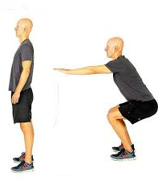
Quiz App
Quiz screen will include the quiz questions and a video feed of the user's lower limb activity.
Options for the quiz questions will change based on number of squats performed by the user.
User's score will be updated and displayed after each round of question

Slide 19
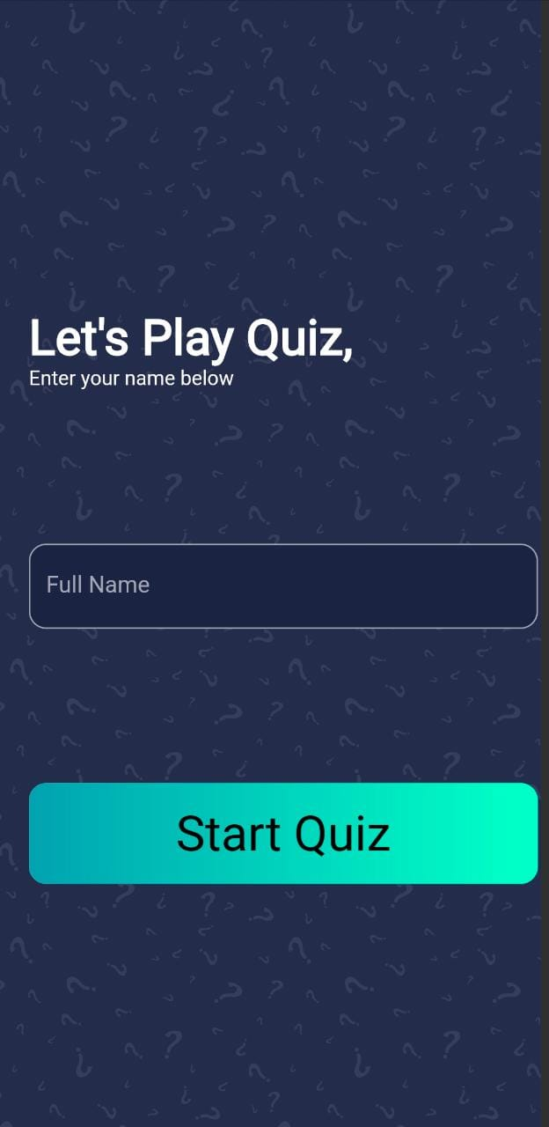
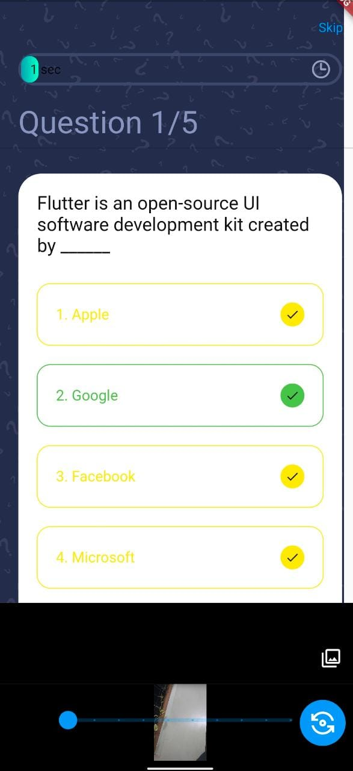
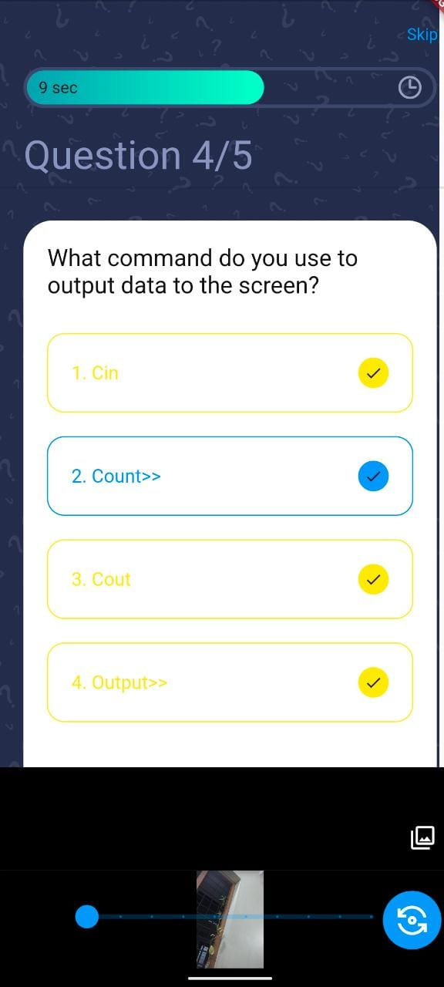

Slide 20
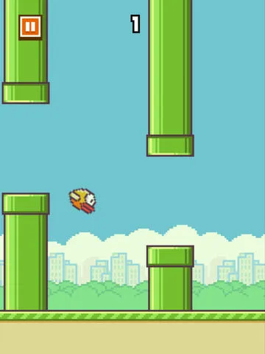
Flappy Bird
Involves controlling the vertical motion of the bird through a series of pipes without touching
Motion of the bird is controlled by up and down motion of the feet.
Ankle movement can be identified using the angle differences of the ankle.

Slide 21
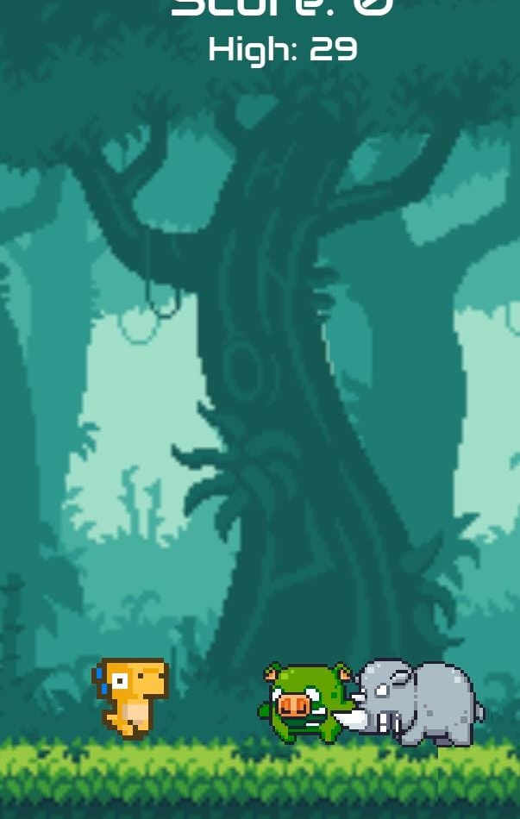
Dino Run
Contains an avatar of a dinosaur and involves running and jumping to avoid obstacles
Controlled by the up and down motion of the feet of the user.

Slide 22
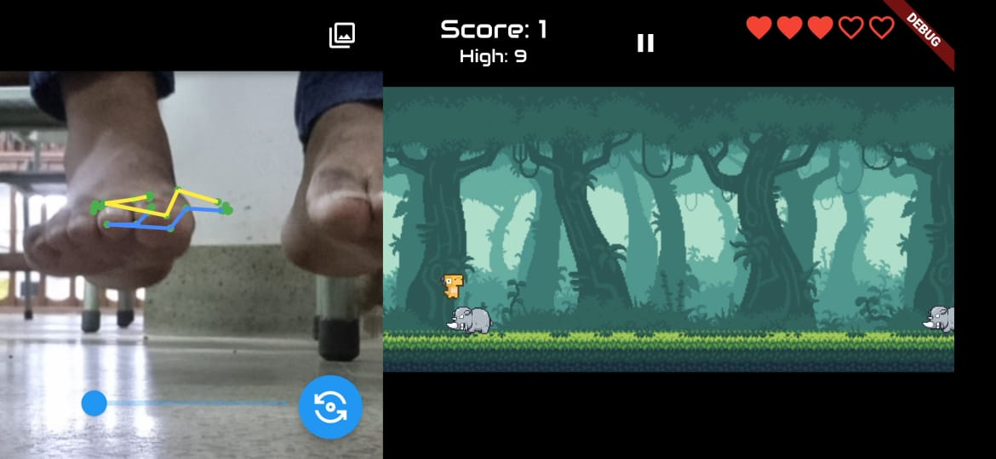
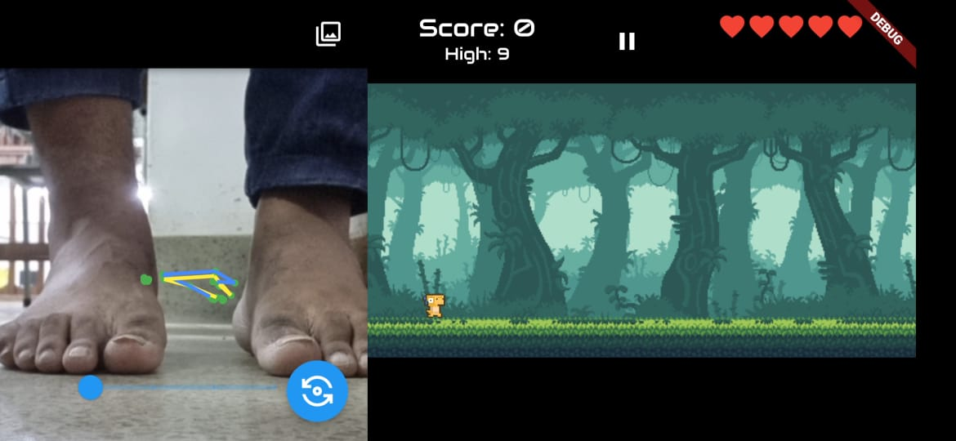

Slide 23
Implementation

Slide 24
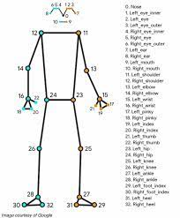
Identify a specific pose by computing the angles and positions of various joints.
Use the pose landmarks to compute the angles and movement.
The landmarks 23 to 32 is used for lower limb pose detection

Slide 25
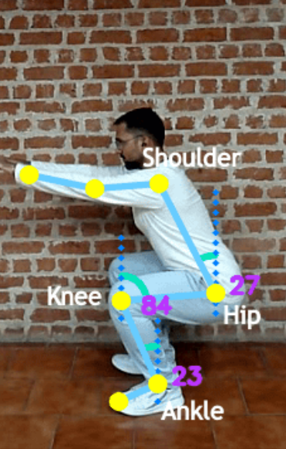
Squat Detection
Calculate angles such as the shoulder-hip, hip-knee, and knee-ankle lines with their corresponding verticals.
When the angles reach a required value squats are detected and counter is activated.

Slide 26
USER INTERFACE

Slide 27
Login and Signup
user login page is the first screen that the user sees after opening the app
user can enter username and password and login to their profile
login page will have a button which will redirect the user to the signup page of the app
signup page requires details such as the username, email, password, age and medical condition of the user

Slide 28
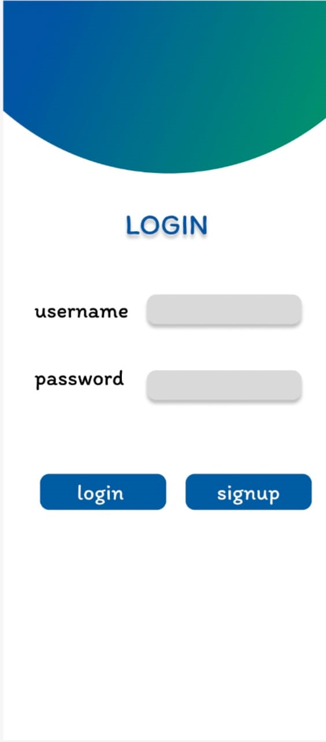
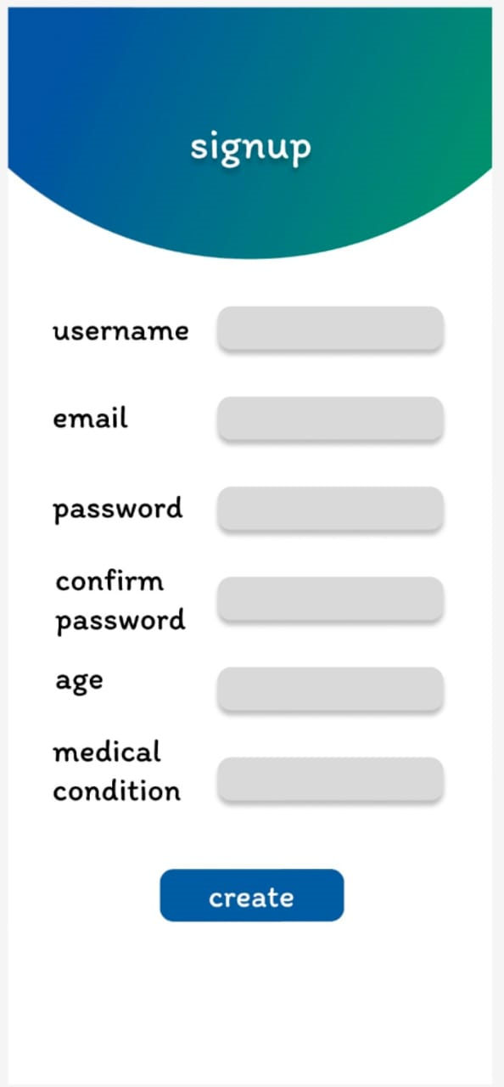

Slide 29
Navigation Menu
options to select each of the three games is provided
difficulty level of the games played can also be selected

Slide 30
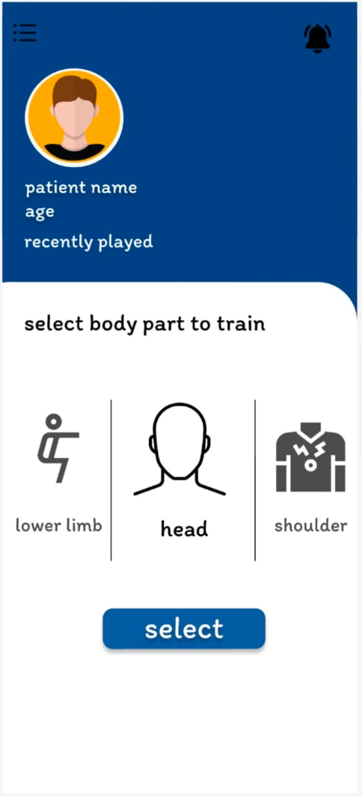
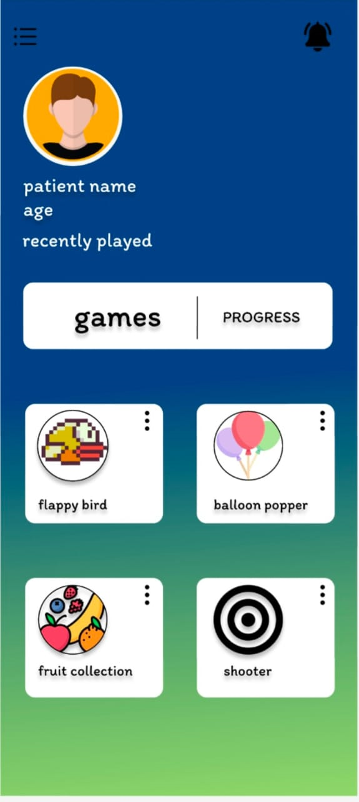

Slide 31
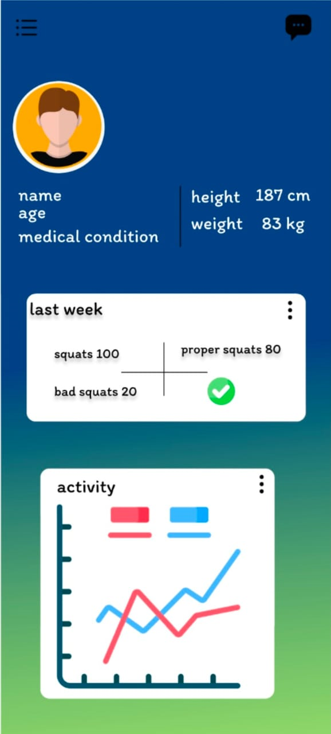
User Profile
A user profile picture, username and age are displayed on the top left corner of the screen at each navigation menu

Slide 32
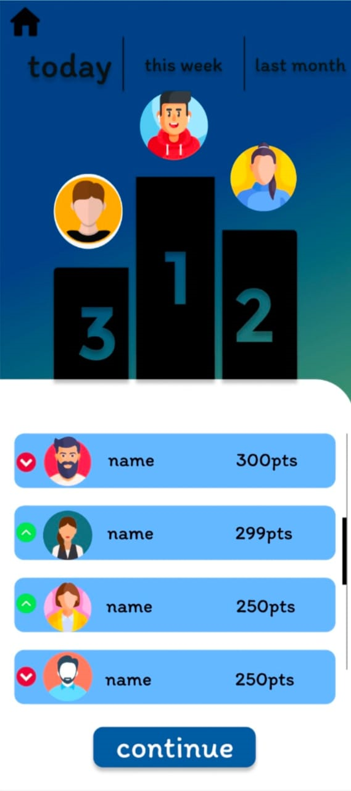
Leaderboard
The leaderboard page displays the user’s progress and increases competition
It shows all the scores of the patients and progress charts

Slide 33
Project Timeline
PHASE 1:
Research
And
Planning
15 Feb-30 Feb
PHASE 3:
Learning and
UI/UX design
10 Mar-15 Mar
PHASE 5:
Testing and
Deployment
May
PHASE 2:
Requirement Analysis
1 Mar-10 Mar
PHASE 4:
Development
16 Mar-Ongoing

Slide 34
Contributions
Kiran R ML Kit Integration
Vignesh P Ajith Front end ,UI Design
Swathy Krishna S Front end
Gayathri S Unikuttan Front end

Slide 35
Conclusion
The use of pose detection technology for physiotherapy in autistic children is a promising area of research that has the potential to improve the lives of many children and their families. This project has the potential to make a significant impact on the field of physiotherapy for autistic children.

Slide 36
Thank you

