Slide 1
pyGame
Special thanks to Roy McElmurry, John Kurkowski, Scott Shawcroft, Ryan Tucker, Paul Beck for their work.
Except where otherwise noted, this work is licensed under:
http://creativecommons.org/licenses/by-nc-sa/3.0

Slide 2


Exercise: Whack-a-mole
Goal: Let's create a "whack-a-mole" game where moles pop up on screen periodically.
  The user can click a mole to "whack" it. This leads to:
    A sound is played.
    The player gets +1 point.
    A new mole appears elsewhere on the screen.
The number of points is displayed at the top of the screen.

Slide 3

What is pyGame?
A set of Python modules to make it easier to write games.
  home page: http://pygame.org/
  documentation: http://pygame.org/docs/ref/
pyGame helps you do the following and more:
  Sophisticated 2-D graphics drawing functions
  Deal with media (images, sound F/X, music) nicely
  Respond to user input (keyboard, joystick, mouse)
  Built-in classes to represent common game objects

Slide 4
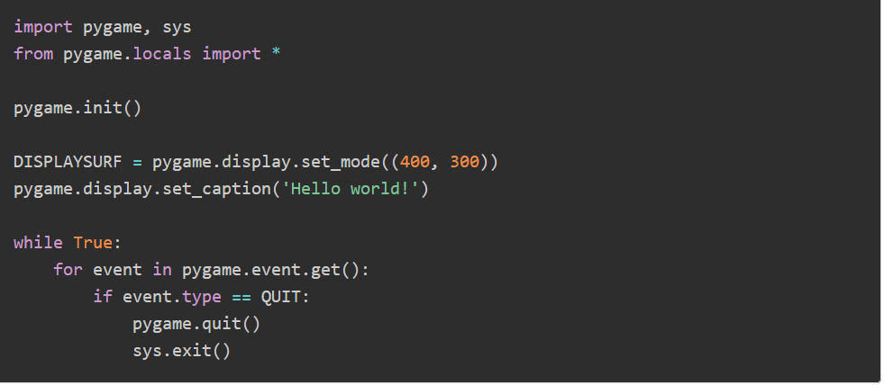
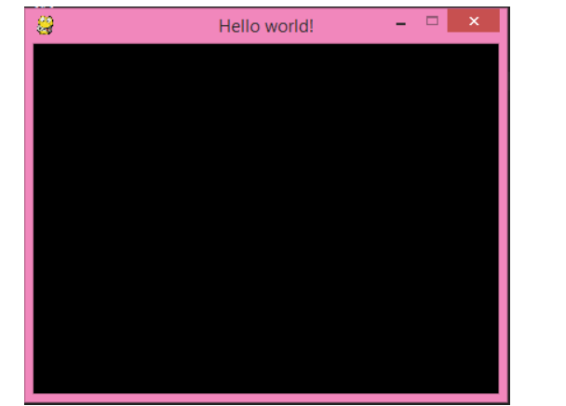

Slide 5
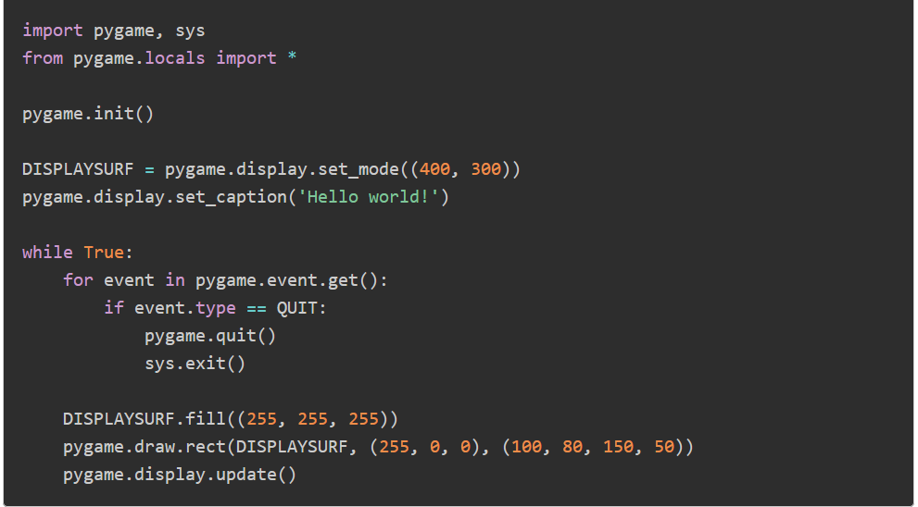
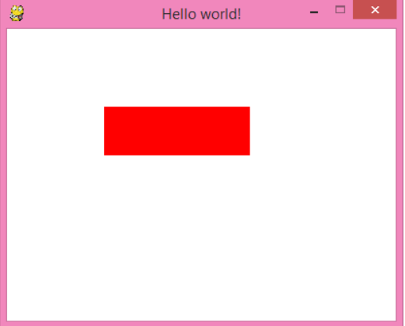

Slide 6
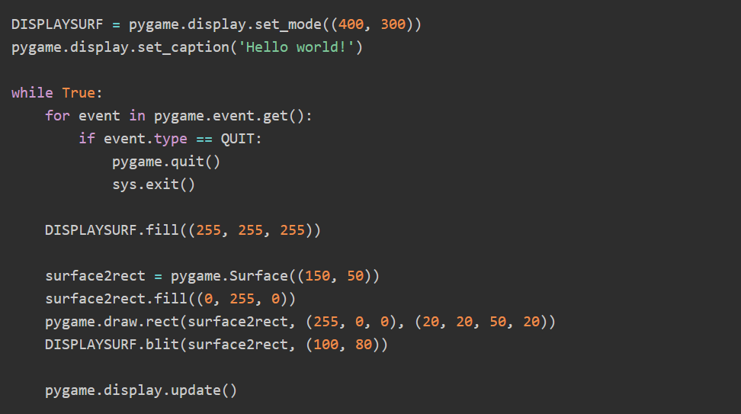
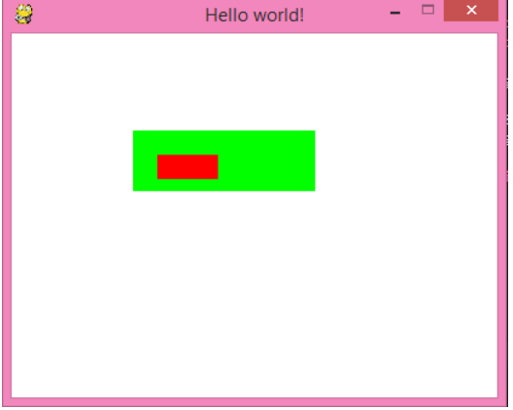

Slide 7
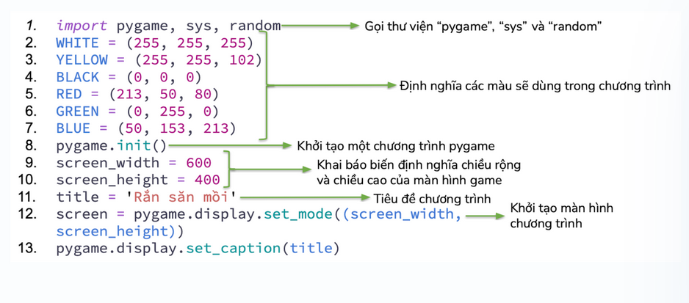
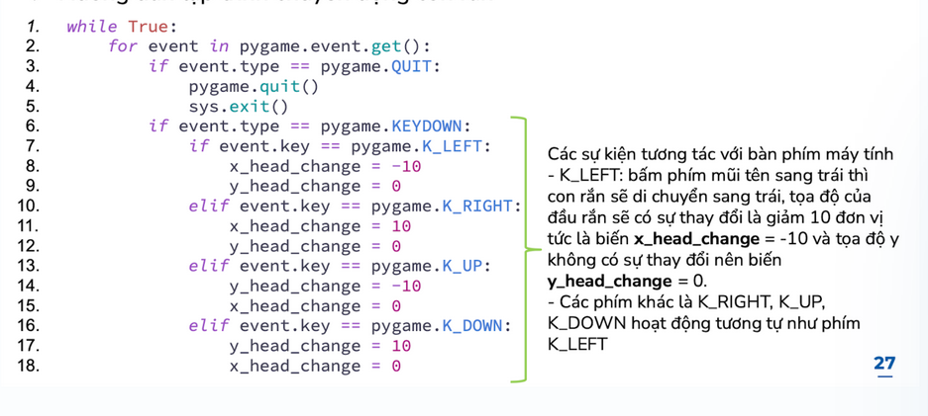
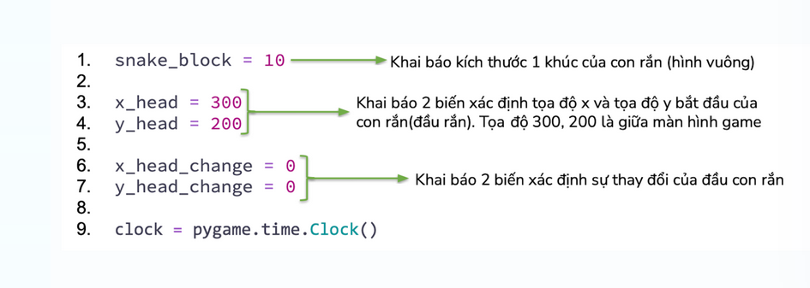
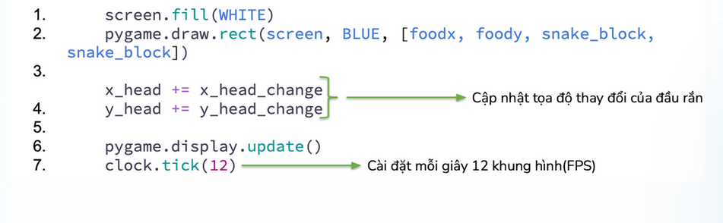

Slide 8
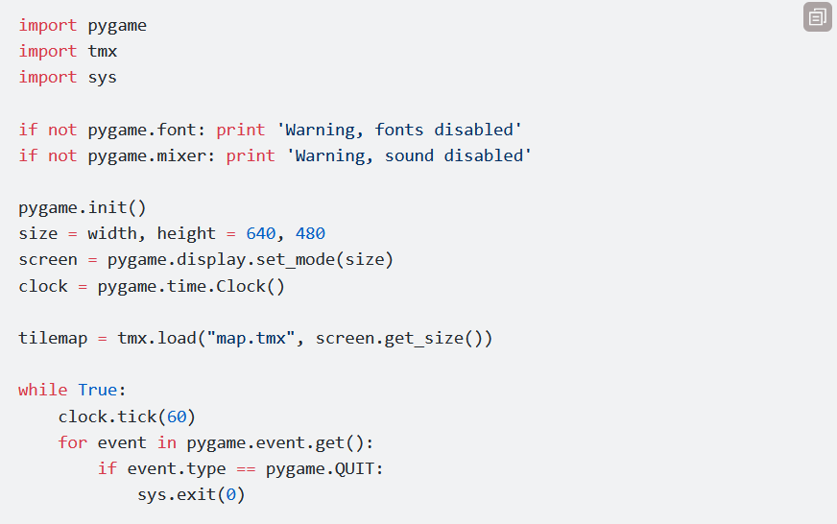
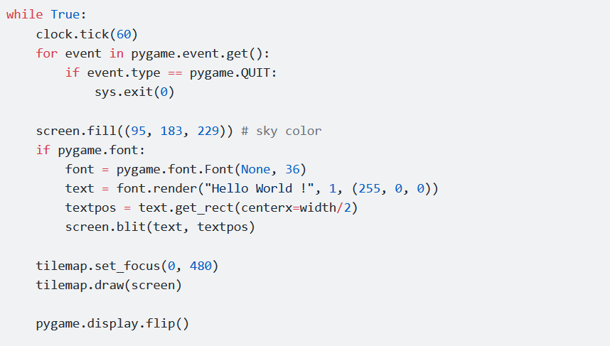

Slide 9
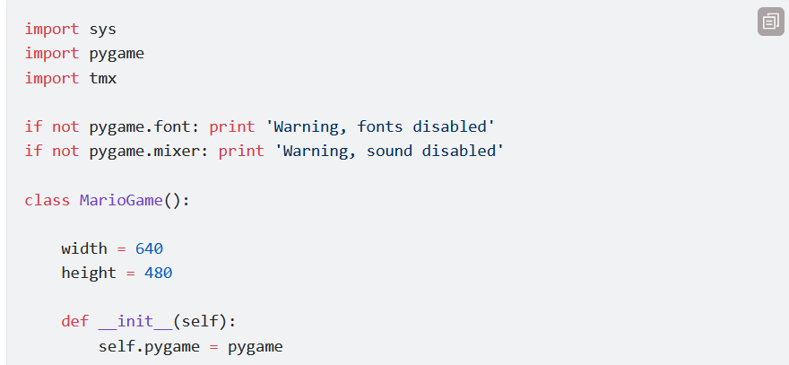
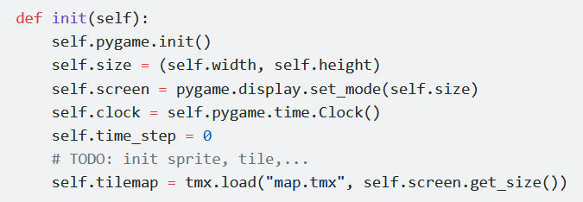
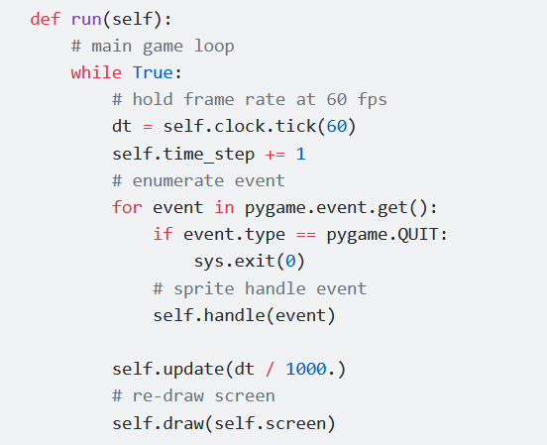
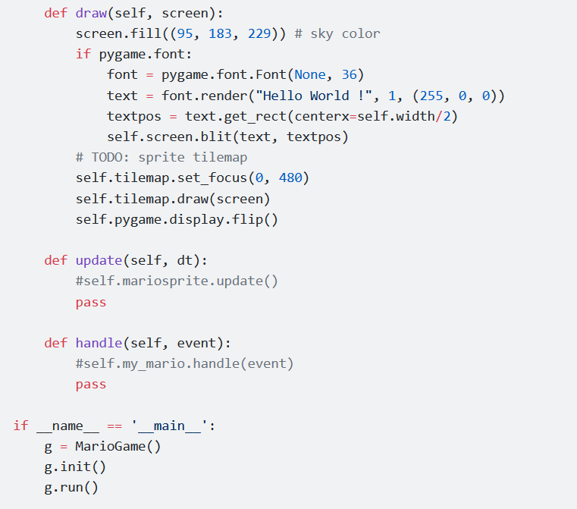

Slide 10
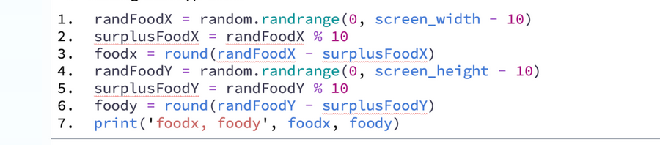
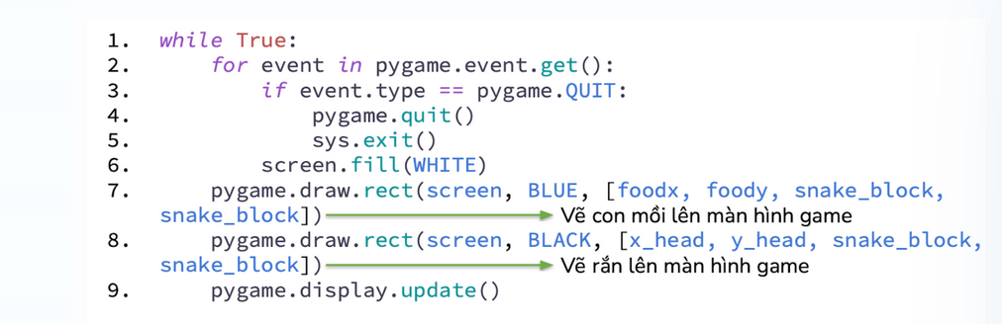

Slide 11
pyGame at a glance
pyGame consists of many modules of code to help you:
  cdrom cursors display draw event
  font image joystick key mouse
  movie sndarray surfarray time transform
To use a given module, import it. For example:
  import pygame
  from pygame import *
  from pygame.display import *

Slide 12
Trình bày các bước lập trình trò chơi pong game bằng pygame, sau đó viết code và có giải thích rõ các câu lệnh.

Slide 13
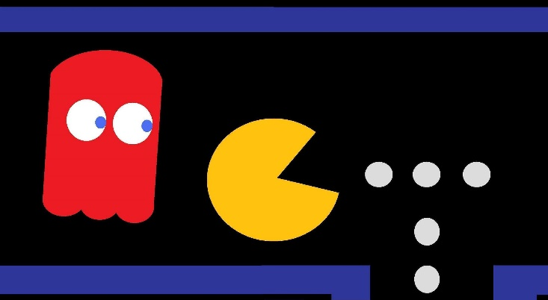
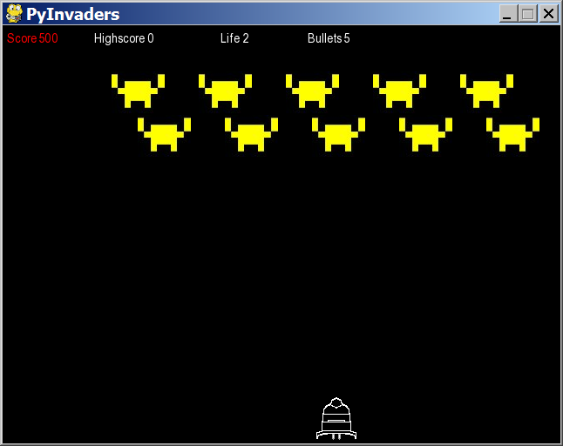
Game fundamentals
sprites: Onscreen characters or other moving objects.
collision detection: Seeing which pairs of sprites touch.
event: An in-game action such as a mouse or key press.
event loop: Many games have an overall loop that:
  waits for events to occur, updates sprites, redraws screen

Slide 14
A basic skeleton
pygame_template.py
1 2 3 4 5 6 7 8 9 10 11 12 13 14 15 16 17 18 19 | from pygame import * from pygame.sprite import * pygame.init() # starts up pyGame screen = display.set_mode((width, height)) display.set_caption("window title") create / set up sprites. # the overall event loop while True: e = event.wait() # pause until event occurs if e.type == QUIT: pygame.quit() # shuts down pyGame break update sprites, etc. screen.fill((255, 255, 255)) # white background display.update() # redraw screen

Slide 15

Initializing pyGame
To start off our game, we must pop up a graphical window.
Calling display.set_mode creates a window.
  The call returns an object of type Surface, which we will call screen. We can call methods on the screen later.
  Calling display.set_caption sets the window's title.
  from pygame import *
  pygame.init() # starts up pyGame
  screen = display.set_mode((width, height))
  display.set_caption("title")
  ...
  pygame.quit()

Slide 16
Surfaces
screen = display.set_mode((width, height)) # a surface
In Pygame, every 2D object is an object of type Surface
  The screen object, each game character, images, etc.
  Useful methods in each Surface object:
  after changing any surfaces, must call display.update()
Surface((width, height)) | constructs new Surface of given size
fill((red, green, blue)) | paints surface in given color (rgb 0-255)
get_width(), get_height() | returns the dimensions of the surface
get_rect() | returns a Rect object representing the x/y/w/h bounding this surface
blit(surface, coords) | draws another surface onto this surface at the given coordinates

Slide 17

Sprites
Sprites: Onscreen characters or
other moving objects.
A sprite has data/behavior such as:
  its position and size on the screen
  an image or shape for its appearance
  the ability to collide with other sprites
  whether it is alive or on-screen right now
  might be part of certain "groups" (enemies, food, ...)
In pyGame, each type of sprite is represented as a subclass of the class pygame.sprite.Sprite

Slide 18
A rectangular sprite
  from pygame import *
  from pygame.sprite import *
  class name(Sprite):
  def __init__(self): # constructor
  Sprite.__init__(self)
  self.image = Surface(width, height)
  self.rect = Rect(leftX, topY, width, height)
  other methods (if any)
  Important fields in every sprite:
    image - the image or shape to draw for this sprite (a Surface)
      as with screen, you can fill this or draw things onto it
    rect - position and size of where to draw the sprite (a Rect)
  Important methods: update, kill, alive

Slide 19
Rect methods
clip(rect) * | crops this rect's size to bounds of given rect
collidepoint(p) | True if this Rect contains the point
colliderect(rect) | True if this Rect touches the rect
collidelist(list) | True if this Rect touches any rect in the list
collidelistall(list) | True if this Rect touches all rects in the list
contains(rect) | True if this Rect completely contains the rect
copy() | returns a copy of this rectangle
inflate(dx, dy) * | grows size of rectangle by given offsets
move(dx, dy) * | shifts position of rectangle by given offsets
union(rect) * | smallest rectangle that contains this and rect
* Many methods, rather than mutating, return a new rect.
  To mutate, use _ip (in place) version, e.g. move_ip

Slide 20
A Sprite using an image
  from pygame import *
  from pygame.sprite import *
  class name(Sprite):
  def __init__(self): # constructor
  Sprite.__init__(self)
  self.image = image.load("filename").convert()
  self.rect = self.image.get_rect().move(x, y)
  other methods (if any)
  When using an image, you load it from a file with image.load and then use its size to define the rect field
  Any time you want a sprite to move on the screen,
  you must change the state of its rect field.

Slide 21
Setting up sprites
When creating a game, we think about the sprites.
  What sprites are there on the screen?
  What data/behavior should each one keep track of?
  Are any sprites similar? (If so, maybe they share a class.)
For our Whack-a-Mole game:
  class Mole(Sprite):
  ...

Slide 22
Sprite groups
  name = Group(sprite1, sprite2, ...)
  To draw sprites on screen, put them into a Group
  Useful methods of each Group object:
  draw(surface) - draws all sprites in group on a Surface
  update() - calls every sprite's update method
  my_mole1 = Mole() # create a Mole object
  my_mole2 = Mole()
  all_sprites = Group(my_mole1, other_mole2)
  ...
  # in the event loop
  all_sprites.draw(screen)

Slide 23
Events
event-driven programming: When the overall program is a series of responses to user actions, or "events."
event loop (aka "main loop", "animation loop"):
Many games have an overall loop to do the following:
  wait for an event to occur, or
  wait a certain interval of time
  update all game objects (location, etc.)
  redraw the screen
  repeat

Slide 24
The event loop
  In an event loop, you wait for something to happen, and then depending on the kind of event, you process it:
  while True:
  e = event.wait() # wait for an event
  if e.type == QUIT:
  pygame.quit() # exit the game
  break
  elif e.type == type:
  code to handle some other type of events;
  elif ...

Slide 25
Mouse events
Mouse actions lead to events with specific types:
  press button down: MOUSEBUTTONDOWN
  release button: MOUSEBUTTONUP
  move the cursor: MOUSEMOTION
At any point you can call mouse.get_pos() which returns the mouse's current position as an (x, y) tuple.
  e = event.wait()
  if e.type == MOUSEMOTION:
  pt = mouse.get_pos()
  x, y = pt
  ...

Slide 26
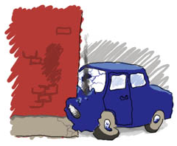

Collision detection
collision detection: Examining pairs of sprites to see if they are touching each other.
  e.g. seeing whether sprites' bounding rectangles intersect
  usually done after events occur,
  or at regular timed intervals
  can be complicated and error-prone
    optimizations: pruning (only comparing some sprites, not all), ...

Slide 27
Collisions btwn. rectangles
Recall: Each Sprite contains a Rect collision rectangle stored as a field named rect
Rect objects have useful methods for detecting collisions between the rectangle and another sprite:
  if sprite1.rect.colliderect(sprite2.rect):
  # they collide!
  ...
collidepoint(p) | returns True if this Rect contains the point
colliderect(rect) | returns True if this Rect touches the rect

Slide 28
Collisions between groups
global pyGame functions to help with collisions:
  spritecollideany(sprite, group)
  Returns True if sprite has collided with any sprite in the group
  spritecollide(sprite, group, kill)
  Returns a list of all sprites in group that collide with sprite
  If kill is True, a collision causes sprite to be deleted/killed
  groupcollide(group1, group2, kill1, kill2)
  Returns list of all sprites in group1 that collide with group2

Slide 29
Drawing text: Font
Text is drawn using a Font object:
  name = Font(filename, size)
  Pass None for the file name to use a default font.
A Font draws text as a Surface with its render method:
  name.render("text", True, (red, green, blue))
  Example:
  my_font = Font(None, 16)
  text = my_font.render("Hello", True, (0, 0, 0))

Slide 30
Displaying text
A Sprite can be text by setting that text's Surface
to be its .image property.
  Example:
  class Banner(Sprite):
  def __init__(self):
  my_font = Font(None, 24)
  self.image = my_font.render("Hello", True, \
  (0, 0, 0))
  self.rect = self.image.get_rect().move(50,70)

Slide 31
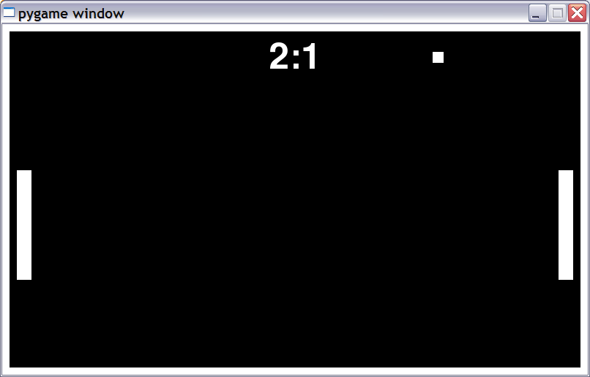
Exercise: Pong
Let's create a Pong game with a bouncing ball and paddles.
  800x480 screen, 10px white border around all edges
  15x15 square ball bounces off of any surface it touches
  two 20x150 paddles move when holding Up/Down arrows
  game displays score on top/center of screen in a 72px font

Slide 32
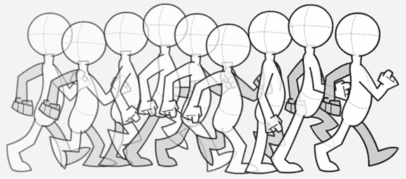
Animation
Many action games, rather than waiting for key/mouse input, have a constant animation timer.
  The timer generates events at regular intervals.
  On each event, we can move/update all sprites, look for collisions, and redraw the screen.

Slide 33
Timer events
  time.set_timer(USEREVENT, delayMS)
Animation is done using timers
  Events that automatically occur every delayMS milliseconds;
  they will have a type of USEREVENT
  Your event loop can check for these events.
  Each one is a "frame" of animation
  while True:
  e = event.wait()
  if e.type == USEREVENT:
  # the timer has ticked
  ...

Slide 34
Key presses
key presses lead to KEYDOWN and KEYUP events
key.get_pressed() returns an array of keys held down
  the array indexes are constants like K_UP or K_F1
  values in the array are booleans (True means pressed)
  Constants for keys: K_LEFT, K_RIGHT, K_UP, K_DOWN, K_a - K_z, K_0 - K_9, K_F1 - K_F12, K_SPACE, K_ESCAPE, K_LSHIFT, K_RSHIFT, K_LALT, K_RALT, K_LCTRL, K_RCTRL, ...
  keys_down = key.get_pressed()
  if keys_down[K_LEFT]:
  # left arrow is being held down
  ...
Notes:
Each time the timer ticks, you can check what keys are being held down and move whatever sprites accordingly.

Slide 35
Updating sprites
  class name(Sprite):
  def __init__(self):
  ...
  def update(self): # right by 3px per tick
  self.rect = self.rect.move(3, 0)
Each sprite can have an update method that describes how to move that sprite on each timer tick.
  Move a rectangle by calling its move(dx, dy) method.
  Calling update on a Group updates all its sprites.

Slide 36
Sounds
Loading and playing a sound file:
  from pygame.mixer import *
  mixer.init() # initialize sound system
  mixer.stop() # silence all sounds
  Sound("filename").play() # play a sound
Loading and playing a music file:
  music.load("filename") # load bg music file
  music.play(loops=0) # play/loop music
  # (-1 loops == infinite)
  others: stop, pause, unpause, rewind, fadeout, queue

Slide 37
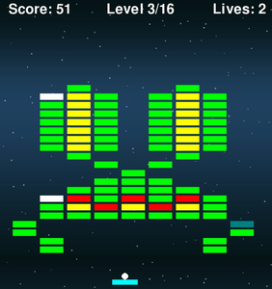
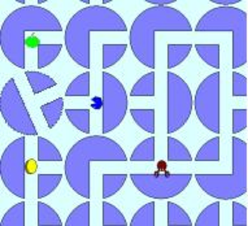
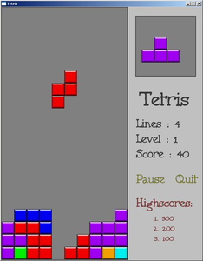
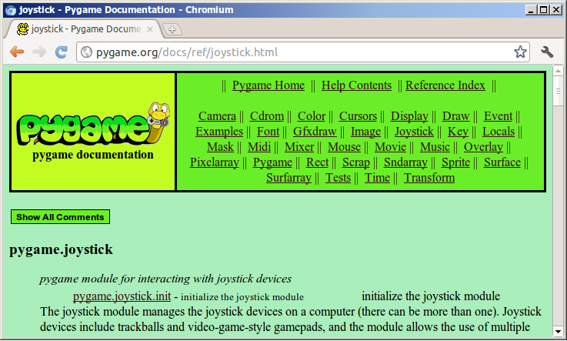
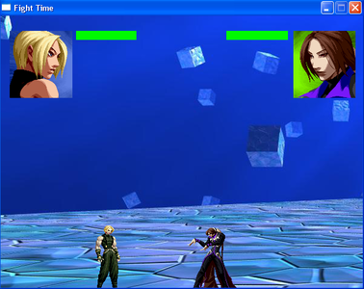
The sky's the limit!
pygame.org has lots of docs and examples
can download tons of existing games
  run them
  look at their code for ideas
if you can imagine it,
you can create it!

