Slide 1
SAPM GROUP ASSIGNMEMT
SUBMITTED BY: GROUP 16

Slide 2
CONTRIBUTORS
NAME | ID NUMBER
Vishesh Mehta | 2020A7PS2194H
Anshul Avinashe | 2020A1PS2536H
Venkatesh Ravindran | 2020A1PS2504H
Rohan Sanklecha | 2020A1PS2457H
Chaitanya Dandwate | 2020A1PS2488H
Nityan Bhalve | 2020A1PS2471H
Simratjit Singh | 2020A4PS2179H
Vaibhav Verma | 2020A4PS2274H
Vipul Singh | 2020A4PS2241H
Shreyaan Sharma | 2020A3PS1139H
Sahil Luthra | 2020A4PS0847H

Slide 3

OBJECTIVE OF ASSIGNMENT
To gain some practical experience of the Portfolio Models like Market Portfolio Theory, we learned in the class that are quite useful in Industry.
To build an optimum portfolio of 22 Assets according to the requirements, risk appetite and utility of investor using Markowitz Portfolio Model and Market Index Model.

Slide 4
Modern Portfolio Theory
The heart of MPT is the idea that risk and return are directly linked. This means that an investor must take on a higher level of risk to achieve greater expected returns.
Another main idea of MPT is that through diversification across a wide variety of security types, a portfolio's overall risk may be reduced.
MPT uses variance of asset prices as a proxy for risk.
MPT assumes that investors are risk averse.
An investor can reduce portfolio risk simply by holding combinations of instruments that are not perfectly positively correlated.
Different investors will evaluate the risk-return trade-off differently based on individual’s risk aversion characteristic.
Efficient Frontier: The graph of Expected return versus Standard Deviation. When we minimize the risk for every possible value of return or vice versa, we get Efficient Frontier.
Selection Criterion: A. Indifference curve of investor B. Utility function (function of risk and return)

Slide 5
Criteria For Stock Selection
CDSL
Zerodha is not listed and to indirectly get benefit from growth of Zerodha we bought CDSL which is official depository of Zerodha.
GOLD BEES
Diversification into Gold which is a separate asset class.
Will help during economic crisis
NIFTY BEES
Diversification by investing in an NIFTY 50 Passive Index fund.
KEI INDUSTRIES
Diversification into Wire and cabling sector.
Change in business model from B2G to B2B and B2C.
APL APOLLO
Diversification in Steel Sector.
Steel is backbone of economy but it is very cyclical nature of business when it come to profit, it is driver by commodity price.
But despite being in steel tube manufacturing business, APL has remained profitable due to the ability to pass on the raw material cost to clients.
VARUN BEVERAGES
Diversification into soft drink segment.
Unreachable Moat: Second largest bottler of Pepsi in the world. High Profit Margins.

Slide 6
PAIGE INDUSTRIES
Diversification in innerwear segment.
Strong Brand recognition
Unreachable Moat: Master Franchise of Jockey in India and several other countries.
Market Leader and strong distribution network.
HDFC BANK
Diversification into Banking Sector.
This bank has the healthiest Financials so we choose it over others.
NESTLE
Diversification into FMCG Sector.
Leader in 85% of its product portfolio
Near Monopoly in some of the segments like baby milk etc.
TCS
Diversification into IT
Trading @ 26.8 P/E lower than historic average of 37.
Strong ROCE of 43%
AIRTEL
Diversification into Telecom Sector.
With the testing of 5G started in India, we hope that the ARPU of these company will increase and will benefit the investors.
EICHER MOTOR
Diversification into two wheeler Automobile Sector.
Chosen because of strong brand recognition of Royal Enfield.
SUN PHARMA
Diversification in Pharma Sector.
India’s Largest Pharmaceutical Company
DMART
Diversification into Stores Retail Chain Segment
We chose DMART over other retailer as it has a lowest cost operating models. They don’t spend much money on the infrastructure of the store thus they become profitable more easily then the peers.

Slide 7
ASTRAL
Diversification into Plastic pipe and adhesive business.
It started 30 years back but is still growing at a rate of 15% CAGR.
ASIAN PAINTS
Diversification in Paints
Trading @ P/E of 80 lower than Historic Average of 93.
Market Leader
Unreachable Moat: Strong distribution network, which is more than twice as large as its nearest competitors.
TITAN
Diversification into Retail business of Jewelry.
Largest Market share in organized market with string ROCE and PAT Margins.
PVR
Diversification into Entertainment Sector.
PVR and INOX are going for a merger. We invested for synergies caused by the merger.
BAJAJ FINANCE
Diversification into NBFC Sector.
Fasted growing NBFC in India.
JUBILANT FOODWORKS
Diversification QSR Sector.
As more discretionary spending is being done by India, it is one of the best sector to invest.
TATA MOTORS
Diversification into Automobile Sector.
Choose Tata Motors over other as Tata aggressively working on EV.
ALKYL AMINES
Diversification into Chemical Segment.
Market leader in Alkyl Amines with market share of ~68%

Slide 8
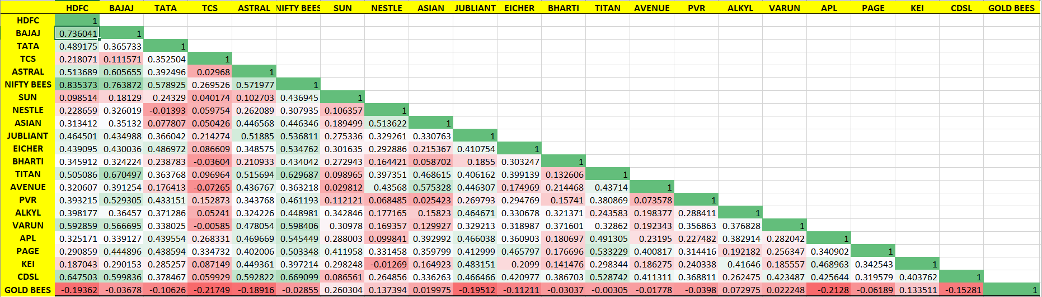
CORRELATION MATRIX

Slide 9
NO SHORT SELLING & NO RISKLESS ASSET
NO SHORT SELLING ALLOWED (OBJECTIVE FUNCTION)
Minimize (W^{T}ΣW) ➔ Minimize (Variance)
W^{T}I = 1 ➔ Sum of weight = 1
Each w >= 0 ➔ Weight of each element is positive
For Target Return we add an additional constraint: W^{T}R = Target Return
Using the various values of Target Returns we can plot Efficient Frontier.
Utility Function U(r,σ) = E{R} – 0.5A σ²
Maximizing Utility of Investor(OBJECTIVE FUNCTION):
Maximize U(r,σ)
W^{T}I = 1, w>=0
The point at which Utility curve intersects Efficient frontier will give us various weightage of assets as our solution.

Slide 10
EFFICIENT FRONTIER
Solution:
Return: 47%
Risk: 27%

Slide 11
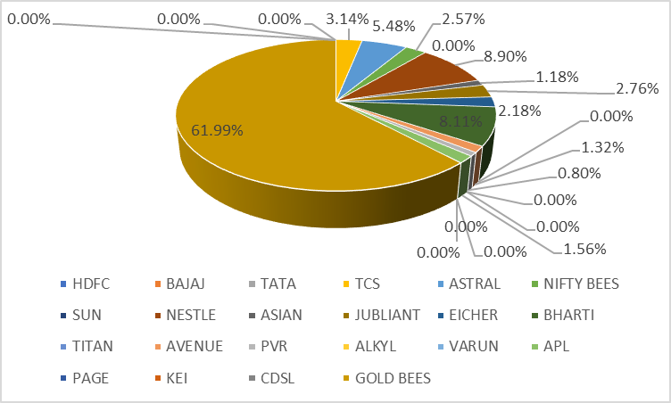
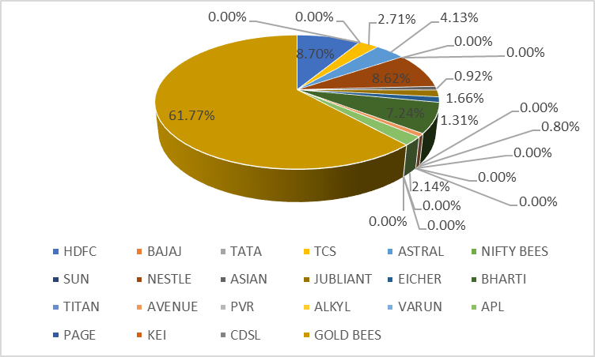
Markowitz Portfolio Theory Mean
Variance Portfolio (NO SHORT ALLOWED)
Markowitz Model Optimal Portfolio for Target Return = 19% (SHORT ALLOWED)
MARKET MODEL THEORY Mean
Variance Portfolio (NO SHORT ALLOWED)

Slide 12
RISKFREE ASSET WITH SHORT SELLING
SHORT SELLING ALLOWED FOR N RISK ASSETS PORTFOLIO (OBJECTIVE FUNCTION)
Minimize (W^{T}ΣW)
W^{T}I = 1
Using the various values of Target Returns we can plot Efficient Frontier.
Now we create a portfolio of 1 risky asset portfolio and 1 riskless asset.
Maximize Sharpe Ratio to get CAL (OBJECTIVE FUNCTION):
Maximize (Rp−Rf) / σp) ➔ Maximizing Sharpe Ratio
W^{T}I = 1
Maximize the Utility of investor (OBJECTIVE FUNCTION):
Maximize U(r,σ) ➔ Maximizing Utility of Investor
W^{T}I = 1
PLOT: CAL and Utility Curve. The point at which Utility curve intersects CAL will give us weightage of assets as our solution.

Slide 13
EFFICIENT FRONTIER
Solution:
Return: 104%
Risk: 46%

Slide 14
Markowitz Portfolio Theory MVP
(Short Selling & Riskless Allowed)
Market Index Model Optimal Portfolio for Target Return = 23%
Market Model Theory
(Short Selling & Riskless Allowed)

Slide 15
THANK YOU

