Slide 1



Cortex: Adaptive Multi Channel Communication Assistant
Jaypee University of Information Technology
Department of Computer Science and Engineering and Information Technology
Major Project - II (18B19CI891) | AY 2024-25
End-Term Evaluation | May 16-17, 2025.
Group No.: 3
Team Member (s)
ARYAMAN TIWARI (211130)
VIVEK KR. KATARIA (211377)
YASH SINGH (211446)
Supervisor (s)
Name: Dr. Aman Sharma
Department: Computer Science & Engineering

Slide 2
Outline
Introduction
Problem Statement
Objectives
Work Done (after Mid-Term Evaluation)
Project Design
Implementation
Experimental Results and Evaluation
Key Learnings
Future Work
Work Contribution and Attendance
Supervisor Interactions
References

Slide 3
Introduction
Overview: The project aims to develop an integrated, multi-channel communication platform tailored to startups and small businesses.
Purpose: The goal is to streamline customer communication across email, chat, and social media, enhancing response quality and speed.
Key Features: The platform will use adaptive learning and contextual understanding to deliver personalized, relevant responses in real-time.
Escalation Mechanisms: It will include escalation processes for managing complex or high-priority customer inquiries effectively.
Personalization: The system will focus on improving customer experience by offering tailored responses based on past interactions.
Consistency: Seamless interaction across multiple channels will ensure consistency and maintain customer satisfaction.

Slide 4
Problem Statement
Customer Communication Challenges: Startups struggle to manage communication across channels due to limited resources.
Delayed Responses: Slow and inconsistent replies lead to customer dissatisfaction and loss of trust.
Competitive Pressure: Existing solutions are too costly or complex for startups to engage customers effectively.
Lack of Integration: Current systems don’t integrate well across platforms or meet startups' evolving needs.
Need for Emotional Intelligence: Startups need tools that deliver emotionally aware, real-time responses.
Cortex Solution: Cortex automates and personalized responses, improving customer satisfaction and loyalty.

Slide 5
Objectives
Develop an integrated platform for managing communication across multiple channels (email, chat, social media).
Implement adaptive learning to improve the system's response capabilities over time.
Enable contextual understanding to deliver more relevant and accurate responses.
Enhance the system’s ability to personalize communication based on individual customer interactions.
Introduce escalation mechanisms to handle complex or urgent customer issues.
Ensure seamless interaction across all communication channels to maintain consistency.

Slide 6
Work Done (after Mid-Term Evaluation)
Optimized Query Caching: Improved caching efficiency using consistent hashing and Redis-backed LRU mechanism.
Semantic Matching via NLP: Integrated SBERT-based semantic search with vector embeddings and cosine similarity to match user queries meaningfully.
Feedback-Driven Tuning: Captured user feedback in real time and used it to dynamically fine-tune similarity thresholds and routing logic.
Incremental Processing Pipeline: Redesigned the query handling into staged modules—validation, cache check, semantic match, and knowledge routing.
Hierarchical Decision Tree: Implemented rule+ML hybrid decision logic to route queries based on complexity and intent, improving accuracy and explainability.
Final Testing & Demo Prep: Ran full-system load tests, built a live analytics dashboard, polished UI/UX for multichannel support, and delivered a successful final demo.

Slide 7
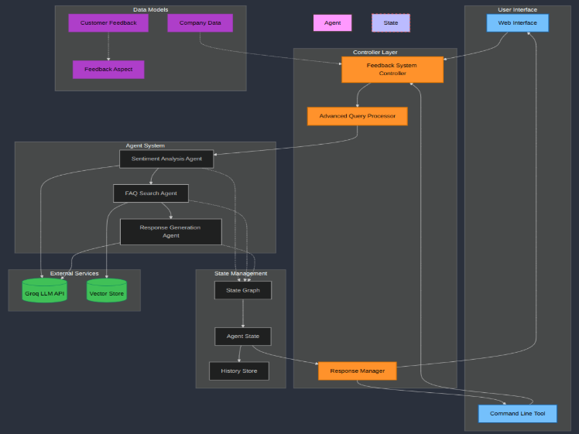
Project Design (cont…)
Fig.:Feedback-driven query system with agents, LLM services & multi-interface response delivery.

Slide 8
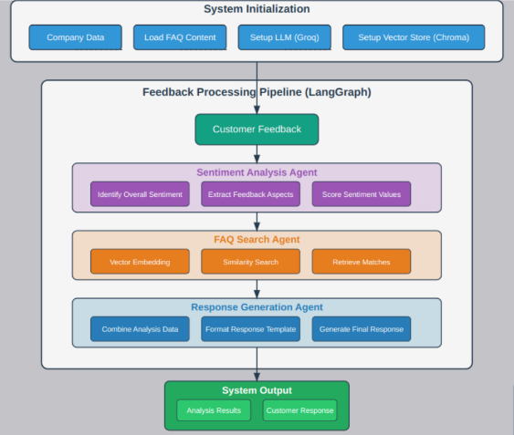
Project Design (cont…)
Fig.: Diagram illustrating an end-to-end feedback processing pipeline using LangGraph, matched with relevant FAQs, and used to generate a structured response.

Slide 9
Project Design
Multi-agent Architecture: Specialized components working in concert via StateGraph framework.
Vector-based FAQ Retrieval: Semantic search with Chroma + HuggingFace embeddings for meaning-based matching.
Advanced Language Model Integration: Groq's Mixtral-8x7b with custom prompting extracts nuanced sentiment aspects.
Robust State Management: TypedDict + LangGraph ensures data integrity throughout processing pipeline.
Error-resilient Processing: Advanced Query Processor with auto-retry logic and comprehensive logging/history tracking.

Slide 10
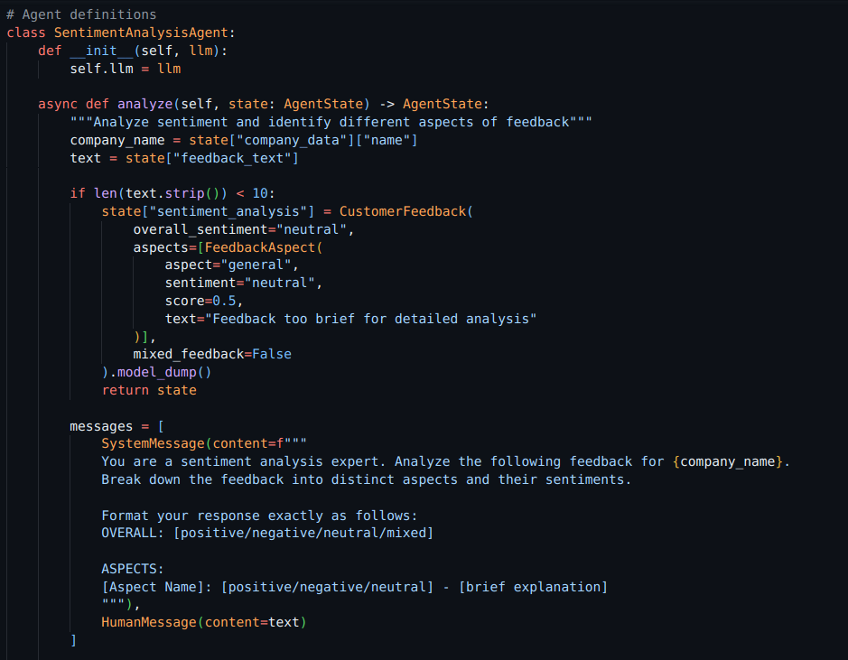
Implementation
Agentic Define:{Sentimental Analysis}

Slide 11
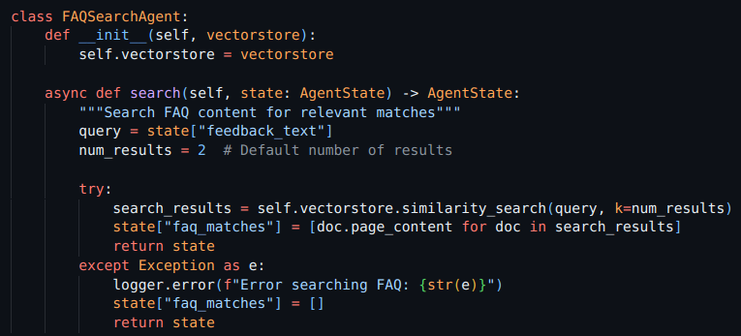
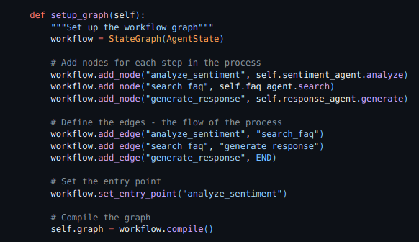
Implementation (cont…)
Implementation (cont…)
Agentic Define {FAQ}:

Slide 12
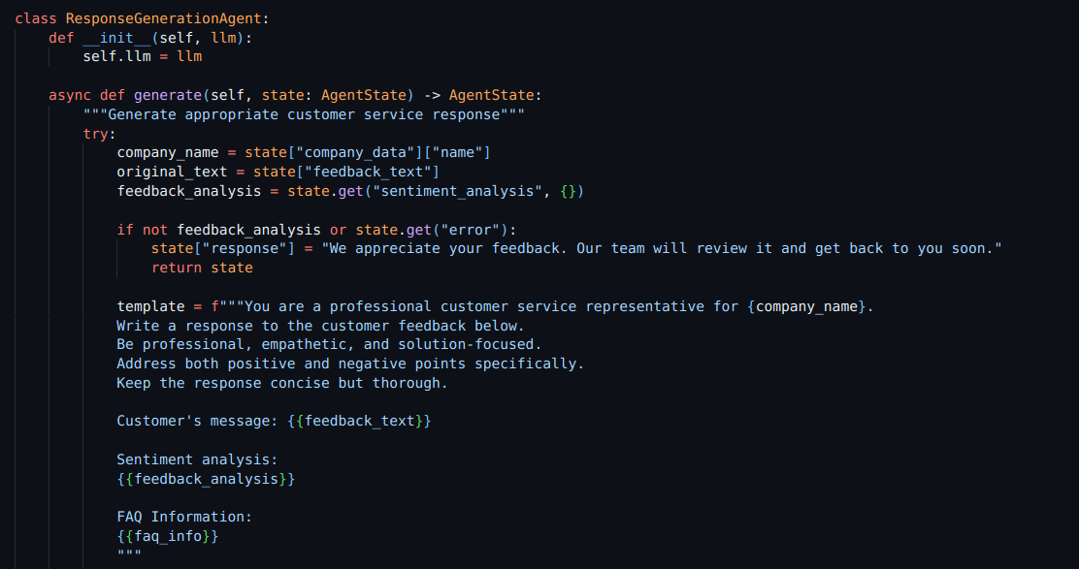
Implementation (cont…)
Implementation (cont…)
Agentic Response Generation

Slide 13
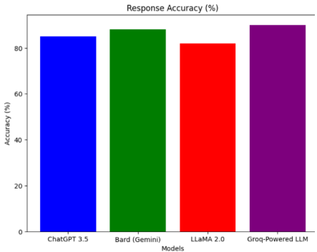
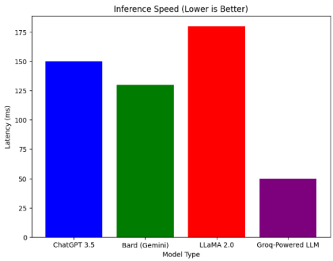
Experimental Results and Evaluation
Bar chart showing Groq-Powered LLM
achieving the highest response accuracy
at 90%, followed by Bard (Gemini) at 88%,
indicating strong performance across
leading AI models.
This bar chart highlights Groq-Powered
LLM's superior inference speed with
lowest latency at 50ms,while LLaMA
registers the highest latency at 180ms.

Slide 14
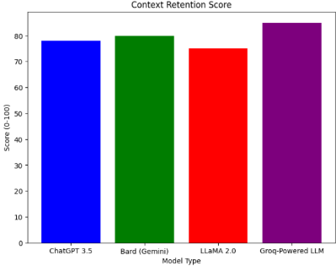
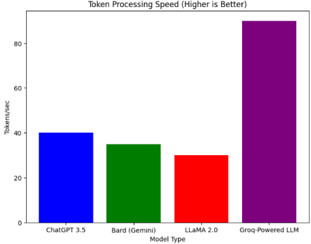
Experimental Results and Evaluation (cont…)
Experimental Results and Evaluation (cont…)
3. This chart shows Groq-Powered LLM leading
with an 85% Context Retention Score,
indicating superior memory, while LLaMA 2.0
scored the lowest at 75%, though all models
demonstrated strong performance.
4. This bar chart demonstrates Groq-Powered
LLM's superior token processing speed at
90 tokens/sec, significantly outpacing LLaMA
2.0, which was the slowest at 30 tokens/sec.

Slide 15
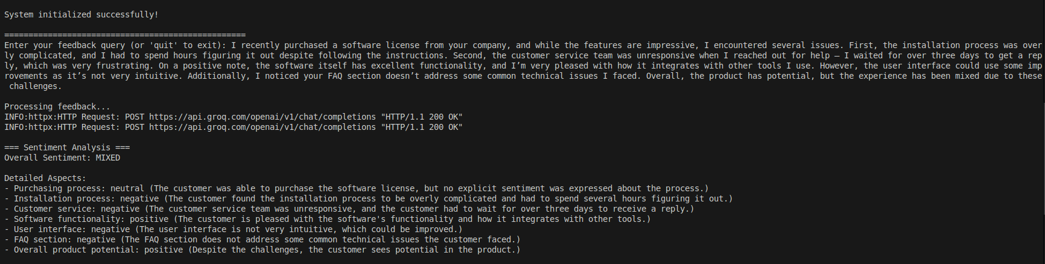
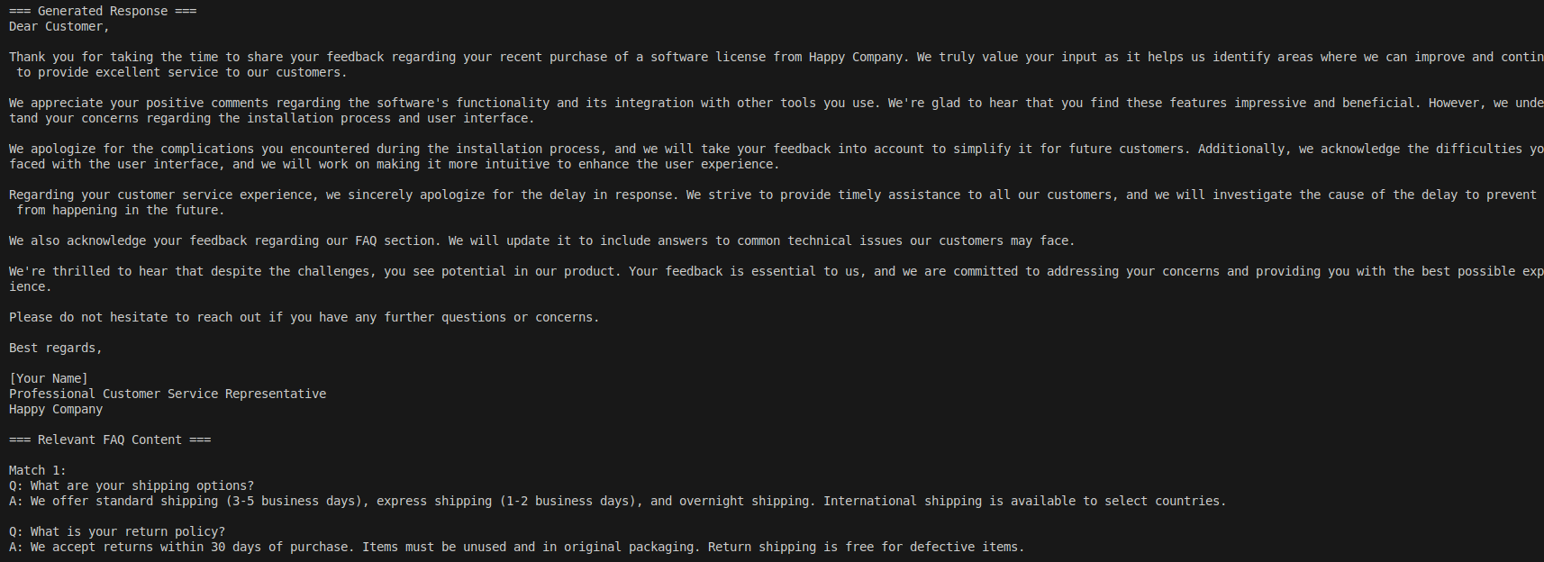
Experimental Results and Evaluation (cont…)

Slide 16
Key Learnings
Applied NLP techniques (BERT/SBERT, cosine similarity) for semantic query understanding.
Gained hands-on experience with Redis, consistent hashing, and LRU cache design.
Designed modular, latency-optimized backend workflows with real-time logging and analytics.
Developed and tuned hybrid decision trees combining rule-based and ML logic.
Adopted iterative testing, benchmarking, and A/B validation for performance tuning.
Practiced full-stack development—from backend logic to UI/UX and API design.

Slide 17
Future Work
Expand multilingual NLP support for regional language query handling
Integrate domain-specific models to improve contextual accuracy
Develop auto-learning FAQ updater from unmatched queries
Implement advanced feedback analytics using sentiment and intent signals
Optimize for scalability by migrating to microservices architecture
Publish research findings and explore real-world deployment opportunities

Slide 18
Work Contribution and Attendance
GitHub Repository URL: https://github.com/Aryamantiwari17/Just_another_Friday
Team Member | Roll No. | Work Done (provide complete details) | Work Contribution (%) | Lines of Code (LoC) | Lab Attendance (%)
1. | 211130 | Explored caching and vector search. Compared ChromaDB vs. FAISS for scalability. Identified Cortex learning improvements. | 50 | 350 | 80
2. | 211377 | Develop a responsive React UI with a clean and intuitive design. Implement real-time updates and dynamic components for seamless interaction. Optimize performance using efficient state management and lazy loading | 30 | 200 | 80
3. | 211446 | Integrate ChromaDB for storing and retrieving embeddings efficiently. Build an FAQ database with vectorized queries for semantic search. Implement an API to fetch and rank relevant FAQs using embeddings and LLMs | 20 | 130 | 80

Slide 19
Supervisor Interactions (as mentioned in weekly log)
No. of Meetings with Supervisor:
Week No. | Duration | Remarks (as mentioned in the weekly log) | Incorporated (Yes/No)
1. | 24/03/2025 to 31/03/2025 | Identified hash generation as a caching bottleneck. Introduced a priority-based LRU eviction system. Benchmarks showed a 23% drop in redundant query processing. | Yes
2. | 31/03/2025 to 3/04/2025 | Explored SBERT-based semantic matching. Integrated cosine similarity for vector-based retrieval. Developed a feedback loop for continuous relevance evaluation. | Yes
3. | 3/04/2025 to 7/04/2025 | Conducted beta testing for the semantic match module. Incorporated conversational history. Began automatic FAQ suggestions based on unmatched queries. | Yes
4. | 7/04/2025 to 14/04/2025 | Modularized the workflow into distinct stages. Achieved nearly 30% improvement in latency during query handling. Implemented detailed stage-level logging for debugging & fine-tuning. | Yes
5. | 14/04/2025 to 21/04/2025 | Designed a decision tree to classify queries by complexity and route. Balanced rule-based, LLM-based handling using hybrid scoring model. Logged decisions and added visualization for transparency and traceability. | Yes

Slide 20
Supervisor Interactions (cont…)
Week No. | Duration | Remarks (as mentioned in the weekly log) | Incorporated (Yes/No)
6. | 21/04/2025 to 28/04/2025 | Integrated structured feedback capture into the user interface. Built a weighted learning model to adapt thresholds and routing paths. Feedback cycles improved repeated query handling & personalization. | Yes
7. | 28/04/2025 to 5/05/2025 | Streamlined response formatting across multiple platforms. Implemented escalated query alerts & ensured rendering consistency. Finalized regression testing and prepared stakeholder-facing. | Yes
8. | 5/05/2025 to 9/05/2025 | Simulated real-world workloads to test performance under live condit. Fixed metadata-related inconsistencies in FAQ fallback. Created a Grafana-based dashboard and finalized all deliverables. | Yes
9. | 09/05/2025 to 10/05/2025 | Demonstrated full system capabilities in the live final presentation. Received praise for research depth, robustness, and explainability. Delivered a complete project report and proposed future scalability directions. | Yes

Slide 21
References (cont…)
[1] Y. LeCun, Y. Bengio, and G. E. Hinton, "Deep learning," Nature, vol. 521, no. 7553, pp. 436–444, May 2015.
[2] D. Silver, J. Schrittwieser, K. Simonyan, et al., "Mastering the game of Go with deep neural networks and tree search," Nature, vol. 529, no. 7587, pp. 484–489, Jan. 2016.
[3] A. Vaswani, N. Shazeer, N. Parmar, et al., "Attention Is All You Need," in Proc. Advances in Neural Information Processing Systems (NeurIPS), Long Beach, CA, USA, 2017, pp. 5998–6008.
[4] S. J. Russell and P. Norvig, "Search in Complex Environments," in Artificial Intelligence: A Modern Approach, 4th ed. Upper Saddle River, NJ, USA: Pearson, 2020, ch. 4, pp. 127–180.
[6] I. Goodfellow, Y. Bengio, and A. Courville, "Optimization for Training Deep Models," in Deep Learning. Cambridge, MA, USA: MIT Press, 2016, ch. 8, pp. 271–322.
[7] OpenAI, "GPT-4 Technical Report," Mar. 2023. [Online]. Available: https://arxiv.org/abs/2303.08774
[8] DeepMind, "AlphaFold: Revolutionizing Biology with AI," July 2021. [Online]. Available: https://www.deepmind.com/research/highlighted-research/alphafold
[9] A. Karpathy, "The Unreasonable Effectiveness of Recurrent Neural Networks," Andrej Karpathy’s Blog, May 21, 2015. [Online]. Available: http://karpathy.github.io/2015/05/21/rnn-effectiveness/

Slide 22
References (cont…)
[7] A. Vaswani, N. Shazeer, N. Parmar, J. Uszkoreit, L. Jones, A. N. Gomez, Ł. Kaiser, and I. Polosukhin, "Attention is all you need," in Advances in Neural Information Processing Systems, vol. 30, 2017.
[8] J. Devlin, M.-W. Chang, K. Lee, and K. Toutanova, "BERT: Pre-training of deep bidirectional transformers for language understanding," in Proc. 2019 Conf. North Am. Chapter Assoc. Comput. Linguistics: Human Lang. Technol., pp. 4171-4186, 2019.
[9] T. Q. T. Nguyen, T. T. Nguyen, and L. M. Nguyen, "An overview of text classification techniques," IEEE Access, vol. 8, pp. 103708-103726, 2020.
[10] Y. Zhang, B. Wang, F. Yu, and J. Liu, "A survey on sentiment analysis: From traditional machine learning to deep learning," IEEE Access, vol. 8, pp. 174025-174049, 2020.
[11] A. Radford, J. Wu, R. Child, D. Lu, and D. Amodei, "Language models are unsupervised multitask learners," OpenAI, Tech. Rep., 2019.
[12] J. Liu, M. Ott, N. Goyal, J. Du, M. Joshi, P. Chen, O. Levy, M. Lewis, D. Zettlemoyer, and V. Stoyanov, "RoBERTa: A robustly optimized BERT pretraining approach," arXiv preprint arXiv:1907.11692, 2019
[13] H. Wang et al., "Deep learning for text classification: A comprehensive review," IEEE Trans. Neural Netw. Learn. Syst., vol. 32, no. 5, pp. 2044-2060, 2021.

Slide 23
References
[14] L. P. van der Maaten and G. E. Hinton, "Visualizing data using t-SNE," J. Mach. Learn. Res., vol. 9, pp. 2579-2605, 2008.
[15] X. Chen et al., "A survey on multi-channel communication and collaboration," IEEE Trans. Human-Mach. Syst., vol. 51, no. 5, pp. 431-442, 2021.
[16] Y. Qiu et al., "Deep reinforcement learning for dialogue generation: A survey," IEEE Trans. Affect. Comput., vol. 12, no. 3, pp. 526-536, 2021
[17] S. V. Praveen, P. Gajjar, R. K. Ray, and A. Dutt, "Crafting clarity: Leveraging large language models to decode consumer reviews," Dept. Data Sci., MICA, Ahmedabad, India, and Dept. Cyber Secur. Eng., College of Eng. Comput., George Mason Univ., 2023.
[18] Gupta, A. K., et al. (2021). “A Comprehensive Survey on Natural Language Processing. IEEE Transactions on Knowledge and Data Engineering”, 33(5), 1753-1768.

Slide 24

Thanks.

