Slide 1
FACULTY OF ENGINEERING AND TECHNOLOGY
SCHOOL OF COMPUTER SCIENCE AND ENGINEERING
DEPARTMENT OF COMPUTER ENGINEERING AND TECHNOLOGY
Academic Year 2025-2026 · M.Tech Research Project · LCA-2 · 13 October 2026
Neural Architecture Search via Trie-Based Deduplication and Zero-Cost Proxies, with Hardware-Aware Coverage: An Empirical Study of LLM-Guided Warm-Start
Presented By-
Imaad Hajwane (PRN: 1262250486)
Under the Guidance of-
Dr. Jayshree Aher
Notes:
Introduce yourself and the topic in one line: ArchTree-LLM is a cheaper way to automatically design neural networks. LCA-2 focuses on the problem, the pipeline and the final results (all runs completed Oct 4, 2026).

Slide 2
CONTENTS
Outline
1
Introduction & Problem Statement
7
Results & Analysis
2
Objectives & Research Gaps
8
Existing vs Proposed
3
Dataset Description & Snippets
9
Research Significance & Contribution
4
Proposed Pipeline
10
Conclusion & Future Scope
5
Mathematical Model
11
References
6
Baselines & Evaluation Metrics
ArchTree-LLM | Imaad Hajwane (PRN 1262250486) | MIT-WPU | LCA-2 | 13 October 2026
2
Notes:
Twelve parts. Results (item 10) is the main section with nine short result slides.

Slide 3
PROJECT OVERVIEW
Introduction & Problem Statement
Architecture = a network's layers and how they are connected; designing it by hand is slow trial-and-error.
NAS automates this loop: propose a design → test it (train the network, then measure its accuracy) → learn from the result → repeat [1], [2].
Problem: one test = fully training one network (hours of GPU time), and many tests are wasted on repeated or weak designs [3], [4].
ArchTree-LLM: a trie skips repeated designs [5], a free zero-cost proxy gate filters weak ones before training [6], and an LLM suggests a good starting point [7].
Search space
15,625 designs
Feedback
accuracy updates search
Search strategy
picks the next design
Evaluate (test)
train + measure accuracy
Fig. 1. The NAS loop; evaluation (test) is the costly step.
Problem Statement
Neural architecture search is computationally expensive because every candidate must be trained, and existing methods waste evaluations on duplicate and weak designs [8], [9]. This work aims to find near-optimal architectures with far fewer evaluations and GPU-hours using a label-free zero-cost filter, validated under an equal-compute comparison.
ArchTree-LLM | Imaad Hajwane (PRN 1262250486) | MIT-WPU | LCA-2 | 13 October 2026
3
Notes:
Explain NAS with the loop on the right. 'Test' means: train the proposed network and measure its accuracy; that is the expensive red step. The box below is our research question: fewer evaluations and GPU-hours, no labels for the filter, proven under a fair GPU-hour budget.

Slide 4
AIMS & MOTIVATION
Objectives & Research Gaps
Objectives
Research Gaps Addressed
1
To design a trie-based search space [5] with UCB1 traversal [10] that guarantees zero duplicate evaluations.
G1
No duplicate guarantee
Same design paid for twice (30–67% repeats) [17], [12].
2
To develop a label-free zero-cost proxy gate [6], [11] that evaluates only the top 35% of candidates.
G2
Label-dependent proxies
Need 1,500 labelled designs: a hidden cost [6].
3
To integrate an LLM warm-start prior [7], [12] and test it against memorisation and size-bias controls.
G3
Untested LLM value
No check for memorisation or size bias [12].
4
To extend the search to hardware-aware, accuracy–latency optimisation on 6 edge devices [13].
G4
Hardware ignored
Latency on edge devices often not considered [18], [19].
5
To validate all results at equal GPU-hours on 3 benchmarks against 10 baselines [14], [15], [16].
G5
Unfair evaluation
Equal evaluations, not GPU-hours; few seeds [9], [8].
ArchTree-LLM | Imaad Hajwane (PRN 1262250486) | MIT-WPU | LCA-2 | 13 October 2026
4
Notes:
Left: our five objectives. Right: the research gap each objective addresses, row by row. Objective 2, the label-free gate, turned out to be the main contribution.

Slide 5
DATA
Dataset Description
Table 1. Benchmarks used in this study
Benchmark | Search space | # Architectures | Image datasets | What it gives us | Role
NAS-Bench-201 [20] | Cell: 6 edges × 5 ops | 15,625 | CIFAR-10/100, IN16-120 | Accuracy + train time | Main
NAS-Bench-101 [21] | Cell: ≤ 7 nodes | 423,624 | CIFAR-10 | Accuracy + train time | Transfer
NATS-Bench SSS [22] | Channel widths | 32,768 | CIFAR-10/100, IN16-120 | Accuracy + train time | 3rd benchmark
HW-NAS-Bench [13] | NB201 cells | 15,625 × 6 | CIFAR-10 | Latency on 6 edge devices | Hardware
Table 2. Image datasets behind the benchmarks
How one architecture is stored in the search tree (trie)
Image dataset | Classes | Size | Images
CIFAR-10 [23] | 10 | 32 × 32 | 60,000
CIFAR-100 [23] | 100 | 32 × 32 | 60,000
ImageNet16-120 [24] | 120 | 16 × 16 | ~151,700
root
conv 3×3
conv 3×3
conv 3×3
skip
conv 3×3
conv 1×1
leaf
94.37%
edge 1
edge 2
edge 3
edge 4
edge 5
edge 6
1 level = 1 edge, 5 ops each → 5⁶ = 15,625 leaves. A visited leaf is never evaluated again.
Tabular: all designs pre-trained → evaluation = lookup; train time = GPU cost.
Fig. 2. Trie path of architecture #11667, the best CIFAR-10 cell (test accuracy 94.37%).
ArchTree-LLM | Imaad Hajwane (PRN 1262250486) | MIT-WPU | LCA-2 | 13 October 2026
5
Notes:
Top: the four benchmarks. Bottom left: the image datasets behind them. Bottom right: how one design is stored. A NAS-Bench-201 cell has 6 edges; each edge picks one of 5 operations. In the trie, each level is one edge, so a full design is a path from the root to a leaf, and the leaf holds its accuracy (94.37% test for this example). Because paths are shared, the search can tell instantly if a design was already tried.

Slide 6
DATA · REAL CACHED RECORDS
Dataset Snippets
NAS-Bench-201 [20] nb201_cache_v2.json · 15,625 records
NAS-Bench-101 [21] nb101_cache.npz · 423,624 rows
# key = base-5 index of the 6 edge operations
"11667": {
"cifar10": {"valid":91.61,"test":94.37,"train_sec":2880},
"cifar100": {"valid":72.75,"test":73.22,"train_sec":5759},
"ImageNet16-120": {"valid":45.56,"test":46.71, ...}
}
# 11667 = conv3x3|conv3x3|conv3x3|skip|conv3x3|conv1x1
hash : 00005c142e6f48ac74fdcf73e3439874
ops : [conv3x3, maxpool3x3, conv3x3, conv3x3, conv1x1]
adj : 7x7 upper-triangular 0/1 matrix (DAG edges)
params : 8,555,530
valid : [92.42, 92.46, 93.05] # 3 training repeats
test : [92.12, 91.91, 92.16]
train : [1769.1, 1768.3, 1769.0] s
NATS-Bench SSS [22] natssss_cache.json · 32,768 records
HW-NAS-Bench [13] hw_table__cifar10.npz · 15,625 × 6
"32767": {
"arch": "64:64:64:64:64", # channels per layer
"cifar10": {"valid":90.71,"test":93.40,"train_sec":511},
"cifar100": {"valid":70.30,"test":70.72,"train_sec":976},
"ImageNet16-120": {"valid":44.73,"test":47.17, ...},
"params": 0.714, "flops": 274.4 # millions
}
# same architecture 11667, latency per device
acc : 91.61 # CIFAR-10 validation %
edgegpu : 6.81 ms raspi4 : 68.40 ms
edgetpu : 1.38 ms pixel3 : 23.59 ms
eyeriss : 7.82 ms fpga : 6.68 ms
# true_pareto_front__edgegpu.json
[[91.61, 6.81], [91.57, 4.75], [91.34, 3.65], ...]
Fig. 3. One real record from each cached dataset, as read by the code.
ArchTree-LLM | Imaad Hajwane (PRN 1262250486) | MIT-WPU | LCA-2 | 13 October 2026
6
Notes:
One real record from each cached dataset, exactly as the code reads it. NB201: one key per architecture with validation accuracy (used to search), test accuracy (reported) and training seconds (our GPU cost). NB101 stores a graph (adjacency matrix + ops) with three training repeats. NATS-SSS changes only channel widths. HW-NAS-Bench gives latency of the same NB201 architecture on six devices; architecture 11667 is the best CIFAR-10 cell and is also the first point of the EdgeGPU Pareto front.

Slide 7
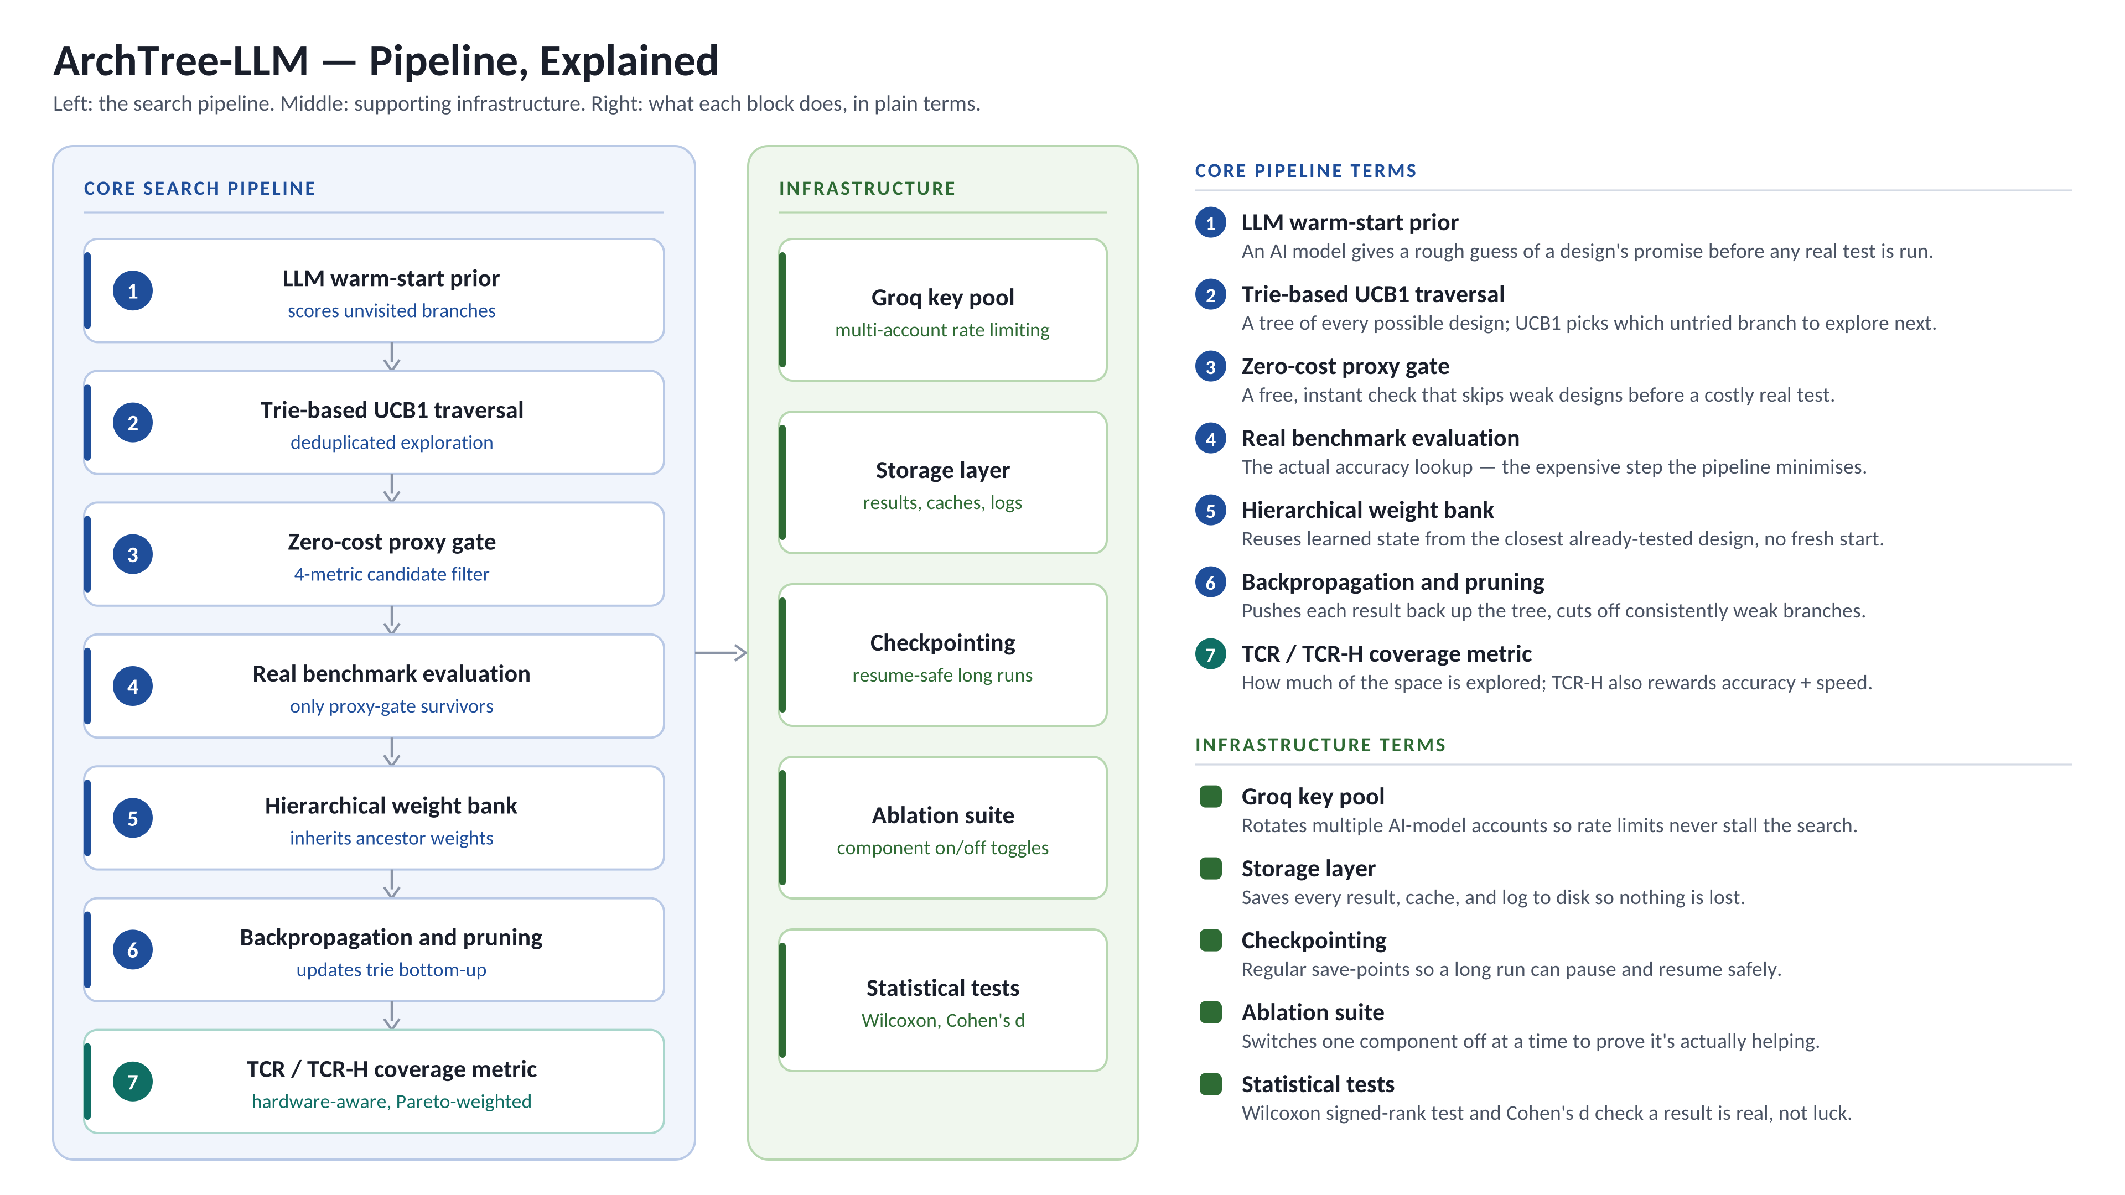
SYSTEM DESIGN
Proposed Pipeline: Working Model
Fig. 4. ArchTree-LLM pipeline: core search loop (UCB1 [10], zero-cost proxy gate [6]) and supporting infrastructure.
ArchTree-LLM | Imaad Hajwane (PRN 1262250486) | MIT-WPU | LCA-2 | 13 October 2026
7
Notes:
This is the full pipeline. Read the core column top to bottom: the LLM gives an early guess, UCB1 walks the trie to pick a new design, the free proxy gate throws away weak ones, only survivors get the real evaluation, the result is pushed back up the tree and weak branches are pruned, and TCR-H measures coverage. The infrastructure column keeps long runs safe and the statistics honest. Note: on tabular benchmarks nothing is trained, so the weight bank is simulated and is not claimed as a result.

Slide 8
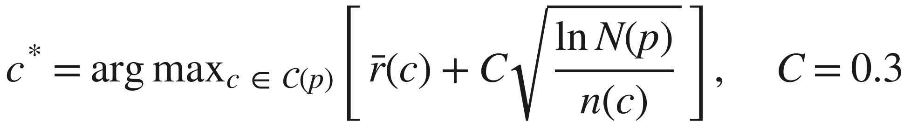
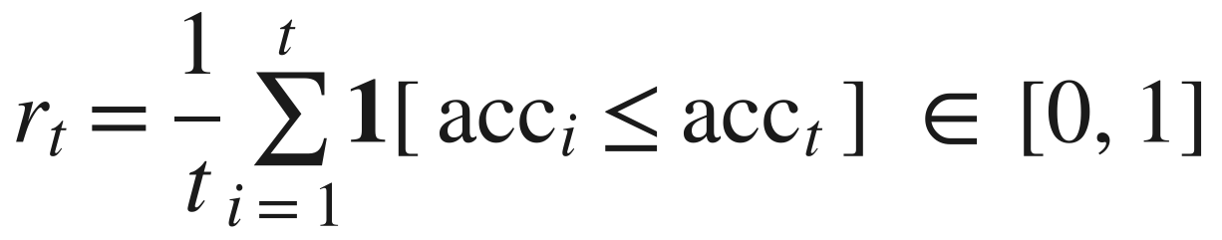
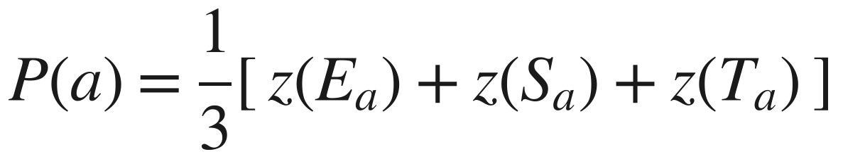
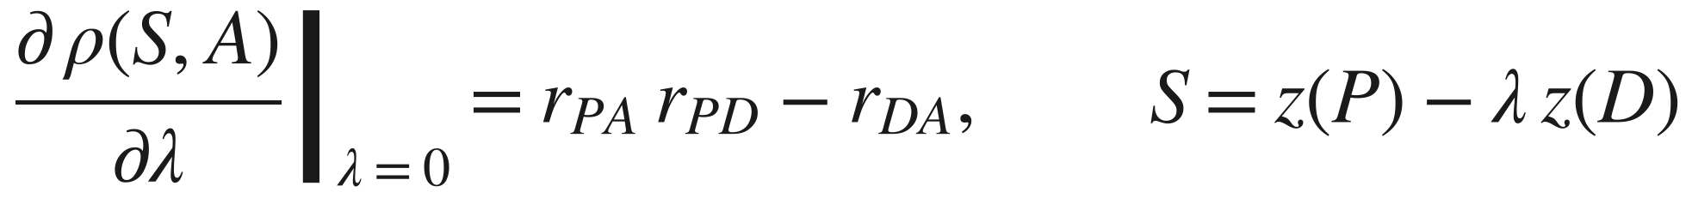
METHODOLOGY
Mathematical Model
UCB1 branch selection [10], [25]
Rank-normalised reward (proposed)
(1)
(2)
Balance good vs unexplored branches
Spreads squashed accuracies over [0, 1]
LLM warm-start prior [7]
Label-free proxy ensemble [26], [27]
(3)
(4)
LLM guess, fades as data arrives
Mean of 3 z-scored proxies, 0 labels
Zero-cost gate [6]
Equal GPU-hour budget [9]
(5)
(6)
Only the top 35% are evaluated
Same training time H for all methods
Gate-cost criterion (proposed)
Notation c, p: child / parent node · N, n: visits · E, S, T: proxies · z: z-score · τ: training time · ℰ: evaluated set · A: accuracy · D: cost · ρ, r: correlation
(7)
< 0 ⇒ a cost penalty will hurt
ArchTree-LLM | Imaad Hajwane (PRN 1262250486) | MIT-WPU | LCA-2 | 13 October 2026
8
Notes:
Seven numbered equations. (1) UCB1 picks the next branch. (2) The reward is the rank of the accuracy, not the raw value; this fixed a real problem. (3) The LLM prior only sets the starting value of unvisited branches. (4)-(5) the free proxy score and the gate: top 35% only. (6) the fair budget in GPU-hours. (7) our gate-cost criterion, which predicts in advance whether a cost penalty helps or hurts.

Slide 9
EXPERIMENTAL SETUP
Baselines Compared
Sampling & evolution
RL & tree search
Proxy-guided
LLM & multi-objective
RS
ENAS
ZiCo
LLM-NAS
Random Search
Efficient NAS (policy)
Zero-shot proxy search
LLM proposes designs
uniform sampling [8]
Pham et al., ICML 2018 [30]
Li et al., ICLR 2023 [31]
gpt-oss-20b via Groq [12]
RE
MCTS
RZ
NSGA-II
Regularized Evolution
Monte-Carlo Tree Search
Zero-cost mutation walk
Multi-objective evolution
Real et al., AAAI 2019 [28]
AlphaX, Wang et al., 2019 [17]
RZ-NAS style
Deb et al., 2002 [32] · hardware study
RE + ZC
RE with zero-cost warm-up
Abdelfattah et al., ICLR 2021 [6]
LS
Local Search
White et al., UAI 2021 [29]
Internal arms: ArchTree v1 · no gate · #params gate · supervised gate · cost-penalised gate · flat UCB (no trie)
ArchTree-LLM | Imaad Hajwane (PRN 1262250486) | MIT-WPU | LCA-2 | 13 October 2026
9
Notes:
Ten external baselines in four families. RE and Local Search are the strongest known baselines; RE + zero-cost warm-up is the closest prior work. NSGA-II is only used for the hardware study. Internal arms are switched-off versions of our own system.

Slide 10
EXPERIMENTAL SETUP
Evaluation Metrics
Accuracy
Cost
Efficiency
Statistics
Hardware
Test accuracy (%)
Real evaluations
Savings (%)
Avg rank + CD
Hypervolume (HV)
Best design found, CIFAR-10, budget 200
Designs actually trained, budget 200
GPU-hours saved vs no gate, budget 200
Friedman rank at equal GPU-hours [16]
Accuracy–latency front (×10³), budget 200
↑ High: ≥ 94.2%
↓ Low: ≤ 100 of 200
↑ High: ≥ 50%
↓ Good: gap < CD (1.91)
↑ High: ≥ 91.0
Ours: 94.28% ✓
Ours: ~82 ✓
Ours: 53% ✓
Ours: tied-best of 14 ✓
Ours: 91.00–91.41 ✓
Kendall τ
GPU-hours
Evals to within 1 pt
Wins / ties / losses
HV transfer
Proxy vs true ranking [33]
Training time, CIFAR-100, budget 200
Speed to near-final result, CIFAR-10
Paired Wilcoxon + Holm [14], [15]
HV kept when a front is reused on another device
↑ High: τ ≥ 0.60
↓ Low: ≤ 50% of no-gate
↓ Low: ≤ 10 evals
Good: 0 losses (p < 0.05)
↑ High: ≥ 90%
Ours: 0.63–0.68 ✓
Ours: 47% (115 / 243 h) ✓
Ours: 5 evals ✓
Ours: 17 / 55 / 0 ✓
Ours: ~98% ✓
ArchTree-LLM | Imaad Hajwane (PRN 1262250486) | MIT-WPU | LCA-2 | 13 October 2026
10
Notes:
Each metric now has a numerical threshold for this project and our measured value. Thresholds: accuracy within ~0.2 pt of the oracle (94.37%); Kendall tau 0.6 = strong rank agreement; at most half the budget evaluated; at least 50% saving; ranking within the Nemenyi critical difference; zero significant losses; HV at least 91.0k at budget 200; at least 90% HV kept on transfer. All are met.

Slide 11
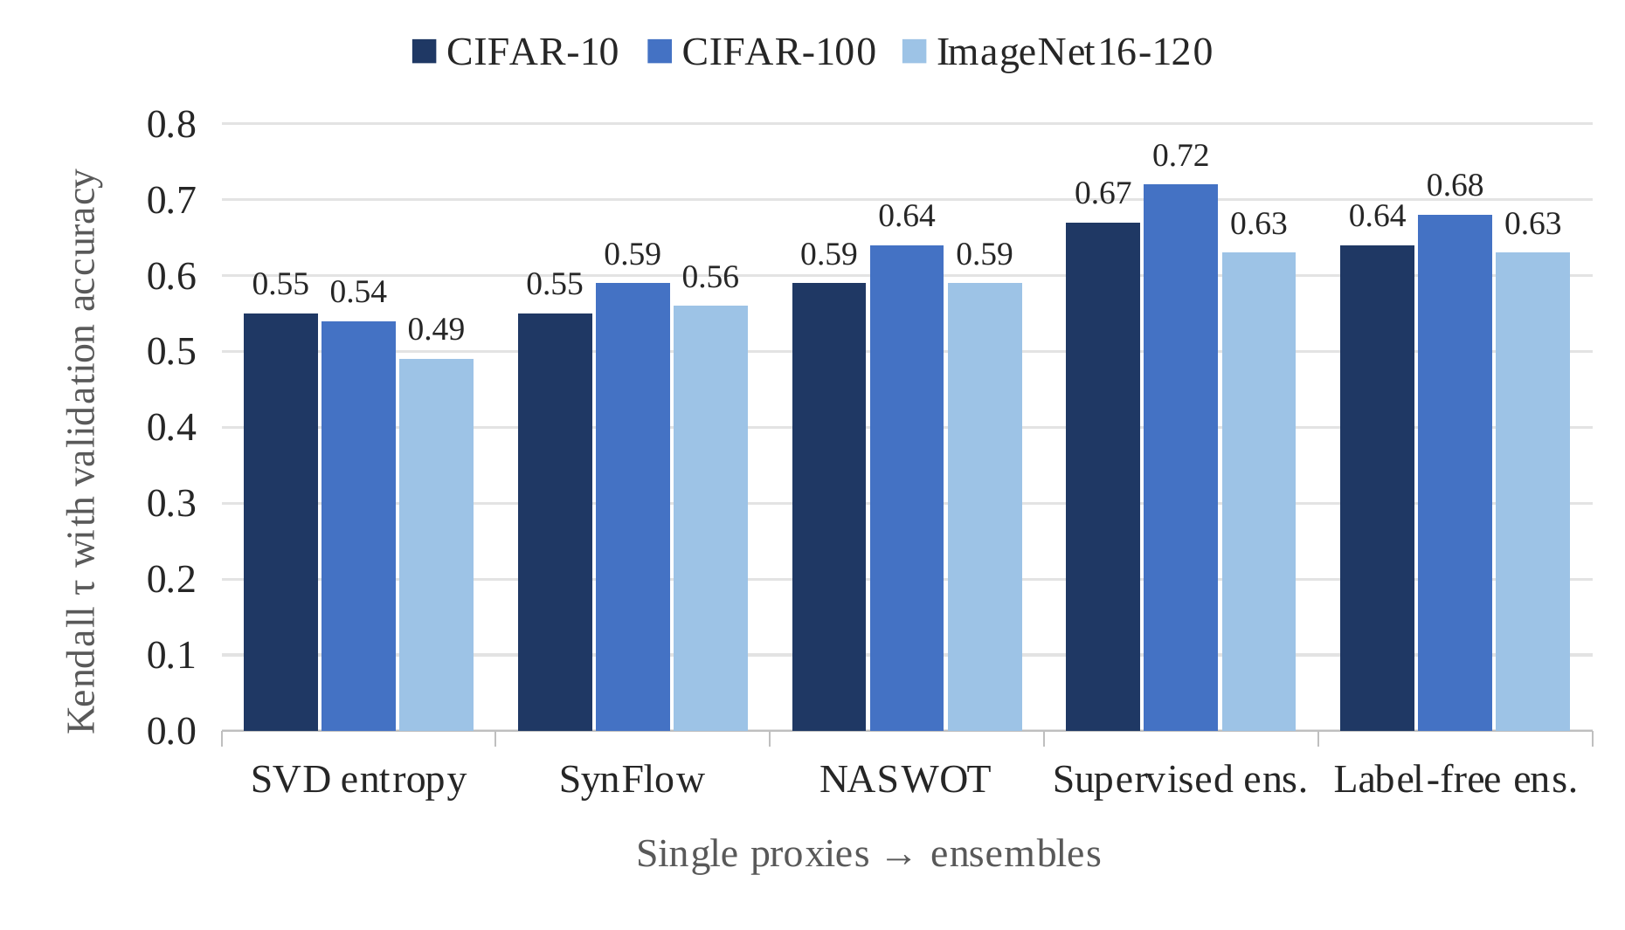
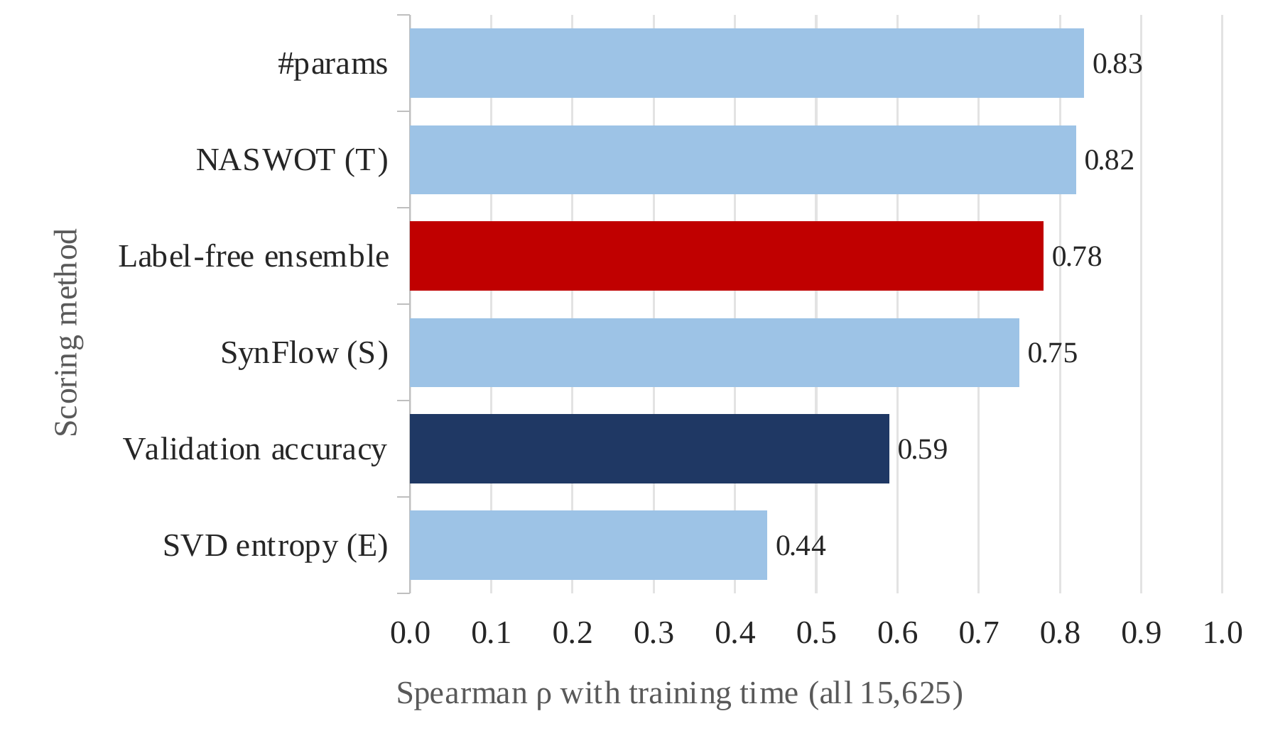
RESULTS · PROXIES
Result 1: Proxy Quality & Cost Bias
Fig. 5. Proxy quality: Kendall τ with validation accuracy.
Fig. 6. Cost bias: correlation with training time.
Inference
Label-free ensemble (0 labels) ≈ supervised (1,500 labels): used as the gate [26], [27].
Proxies favour costly networks (ρ 0.78 with training time).
A cost penalty hurts (16 losses, 0 wins), as our criterion predicted on 7/7 pairs.
ArchTree-LLM | Imaad Hajwane (PRN 1262250486) | MIT-WPU | LCA-2 | 13 October 2026
11
Notes:
Left: Kendall tau, 1 = the proxy ranks designs exactly like true accuracy. Combining three proxies beats any single one, and the label-free version needs no labelled data. Right: proxies also correlate with training time, almost as much as model size does. A cost penalty sounds like a fix, but our closed-form criterion predicted it would hurt, and it did on every benchmark.

Slide 12
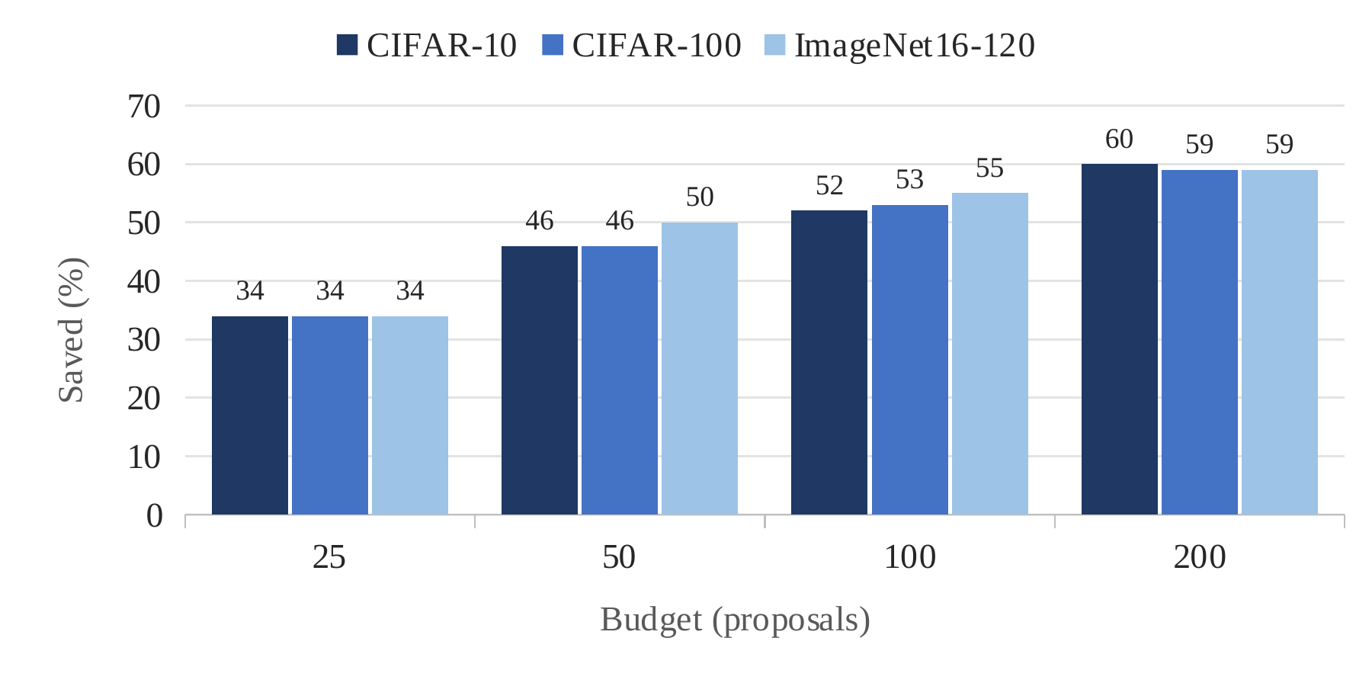
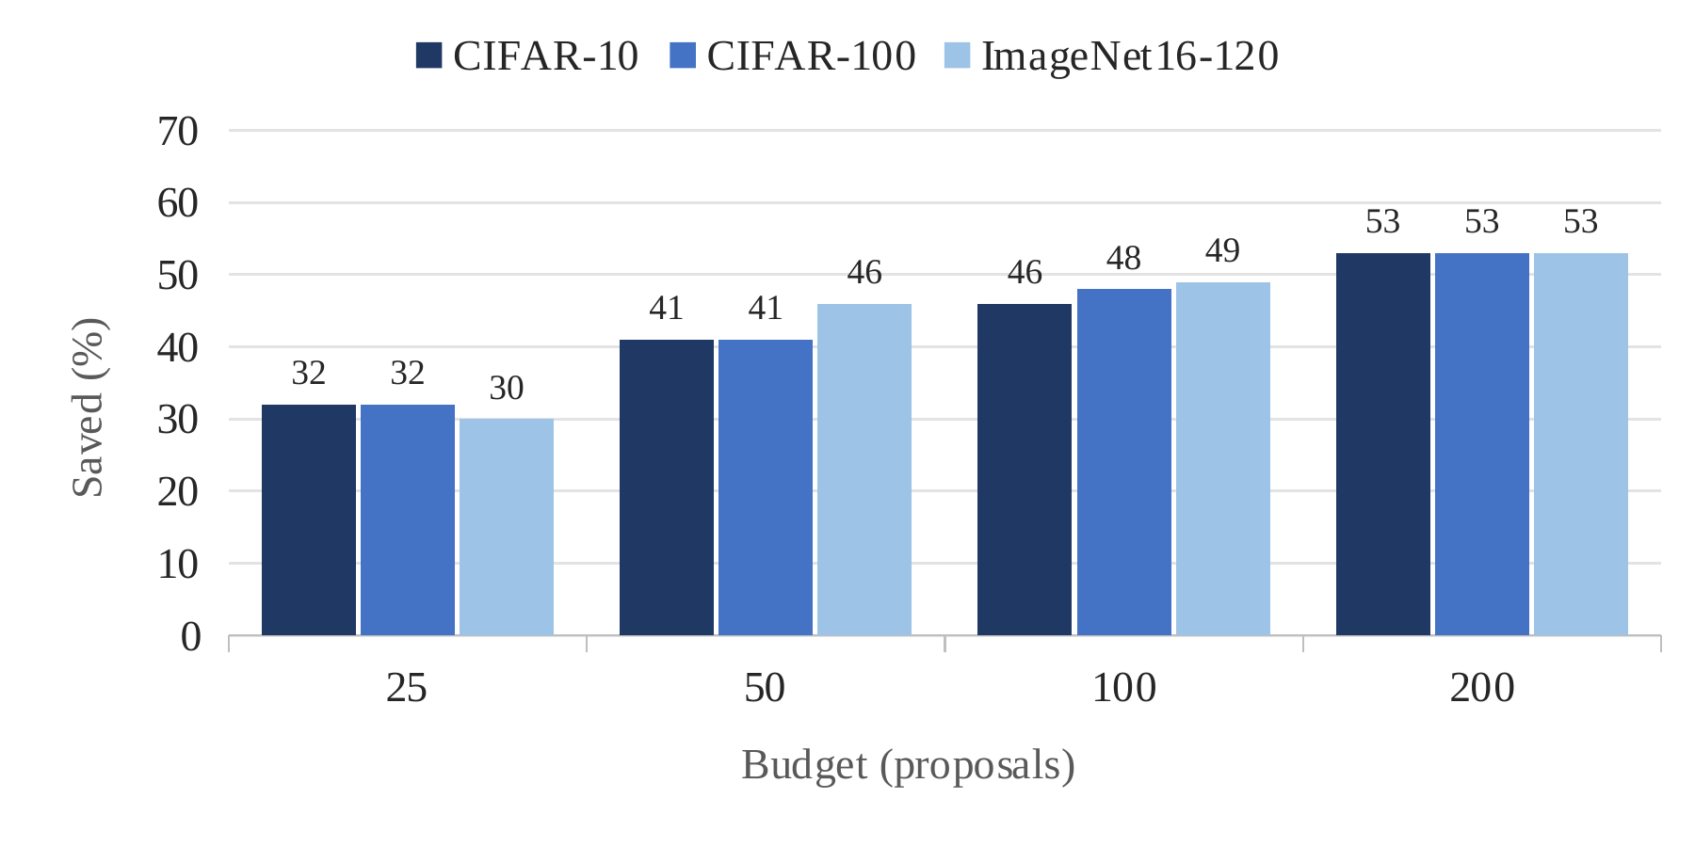
RESULTS · NAS-BENCH-201
Result 2: Cost Saved by the Gate
Fig. 7. Real evaluations saved by the zero-cost gate [6], per dataset.
Fig. 8. GPU-hours saved by the gate, per dataset.
Table 3. Test-accuracy change with the gate (pts)
Savings grow with budget: ~60% evaluations, 53% GPU-hours at 200, on all 3 datasets.
GPU savings ~6 pts lower: the gate prefers larger networks.
Accuracy unchanged (−0.16 to +0.43 pts).
Budget | CIFAR-10 | CIFAR-100 | IN16-120
25 | −0.08 | +0.06 | +0.04
50 | +0.05 | −0.16 | +0.36
100 | +0.11 | +0.11 | +0.27
200 | +0.16 | +0.43 | +0.02
Inference
ArchTree-LLM | Imaad Hajwane (PRN 1262250486) | MIT-WPU | LCA-2 | 13 October 2026
12
Notes:
Now on all three datasets. Left: share of real evaluations saved; right: share of GPU-hours saved, against the same search without the gate. The picture is the same on CIFAR-10, CIFAR-100 and ImageNet16-120. The small table shows accuracy does not drop.

Slide 13
RESULTS · NAS-BENCH-201
Result 3: Accuracy Across All Datasets
Table 4. Test accuracy (%) on NAS-Bench-201 at budgets 50 / 100 / 200, mean of 12 seeds
Method | Real evals @200 | CIFAR-10 |  |  | CIFAR-100 |  |  | ImageNet16-120
 |  | @50 | @100 | @200 | @50 | @100 | @200 | @50 | @100 | @200
Random Search [8] | 200 | 93.62 | 93.82 | 93.92 | 71.06 | 71.54 | 71.92 | 45.15 | 45.49 | 45.47
MCTS-style [17] | 200 | 93.68 | 93.89 | 93.89 | 70.97 | 71.62 | 71.94 | 44.66 | 45.14 | 45.44
ENAS-style [30] | 200 | 93.68 | 93.74 | 94.09 | 71.58 | 71.79 | 72.59 | 45.84 | 46.04 | 46.16
LLM-NAS [12] | 200 | 93.99 | 94.04 | 94.28 | 71.39 | 71.96 | 72.14 | 45.35 | 45.29 | 45.37
ZiCo-style [31] | 200 + P | 94.08 | 94.17 | 94.29 | 72.33 | 72.68 | 72.97 | 46.11 | 46.22 | 46.28
RZ-style ZC walk | 200 + P | 94.06 | 94.28 | 94.33 | 72.17 | 73.20 | 73.39 | 46.06 | 46.22 | 46.32
Regularized Evolution [28] | 200 | 93.94 | 94.17 | 94.31 | 71.61 | 72.96 | 73.37 | 45.67 | 46.51 | 46.48
RE + ZC warm-up [6] | 200 + P | 94.26 | 94.22 | 94.28 | 72.92 | 73.13 | 73.36 | 46.31 | 46.14 | 46.34
Local Search [29] | 200 | 93.97 | 94.27 | 94.37 | 72.63 | 73.36 | 73.51 | 46.05 | 46.11 | 46.52
ArchTree v1 (no proxy) | 200 | 93.99 | 94.09 | 94.11 | 72.06 | 72.50 | 73.12 | 45.70 | 46.11 | 46.25
ArchTree (ZC only) | 200 | 93.98 | 94.15 | 94.17 | 71.46 | 72.26 | 72.45 | 45.72 | 45.81 | 46.39
ArchTree-LLM v2 (flagship) | ~82 | 94.04 | 94.19 | 94.28 | 72.19 | 73.02 | 73.40 | 45.91 | 46.45 | 46.41
Oracle (best possible) | – | 94.37 | 94.37 | 94.37 | 73.51 | 73.51 | 73.51 | 46.20 | 46.20 | 46.20
Green = best in column · + P = every candidate proxy-scored · Oracle = best possible.
Inference
Within 0.1–0.2 pts of the best on every dataset, with only ~82 of 200 evaluations.
Local Search and RE + ZC lead some columns, but tie with us statistically.
ArchTree-LLM | Imaad Hajwane (PRN 1262250486) | MIT-WPU | LCA-2 | 13 October 2026
13
Notes:
Full table in the same format as LCA-1, now with the corrected October numbers: three budgets for each dataset. Green marks the best value in each column; the red row is ours. The point is not that we top every column; it is that we sit with the best methods while paying for less than half the evaluations.

Slide 14
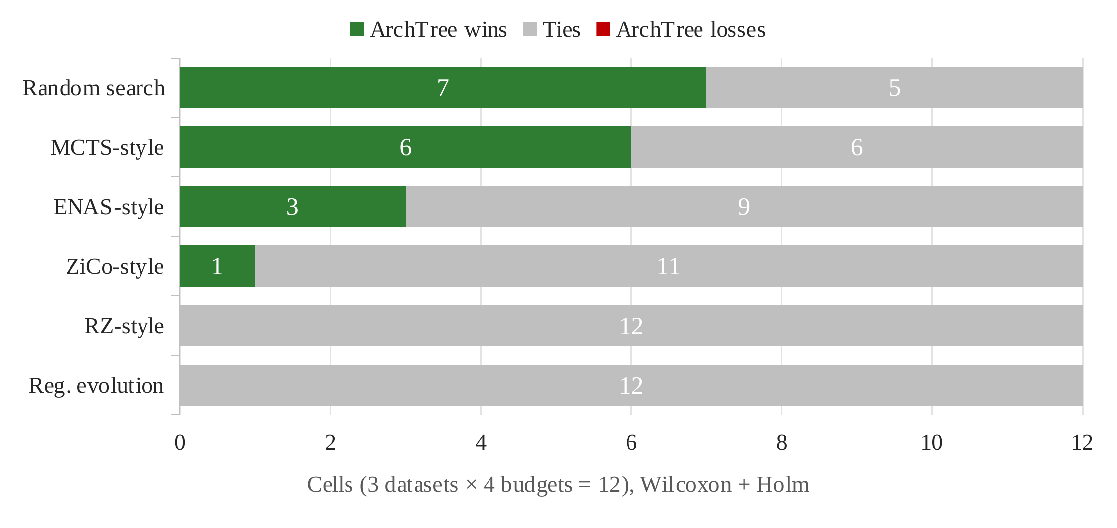
RESULTS · STATISTICS
Result 4: Is the Difference Real?
17 / 55 / 0
wins / ties / losses vs 6 baselines
0 of 192
losses when every searcher uses the same gate
19–23%
fewer GPU-hours than RE at equal accuracy
Fig. 9. Paired-test outcomes of ArchTree v2 vs six baselines (Wilcoxon [14], Holm-corrected [15]).
Inference
Never worse: 0 losses in 72 comparisons (0 of 192 with the same gate).
Beats weak searchers; ties the strongest (RE, RZ).
Ties use ~40% of the budget: same accuracy, less than half the cost.
ArchTree-LLM | Imaad Hajwane (PRN 1262250486) | MIT-WPU | LCA-2 | 13 October 2026
14
Notes:
Green = we are significantly better, grey = no significant difference, red = significantly worse. There is no red. Read the inference box: never worse, better than weak methods, equal to the strongest while using far fewer evaluations.

Slide 15
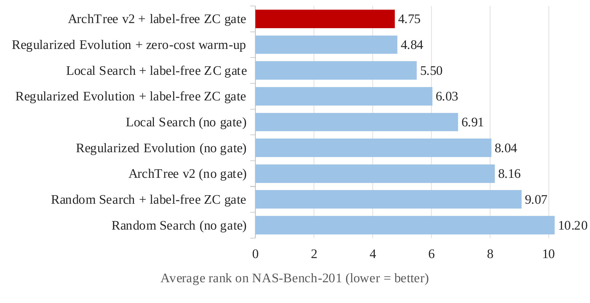
RESULTS · FAIR COMPUTE
Result 5: Equal GPU-Hour Comparison
Table 5. Equal GPU-hour ranking per benchmark
Benchmark | Arms | ArchTree rank | Best | Within CD?
NAS-Bench-201 | 14 | Tied-best | ArchTree v2 ≈ RE + ZC | best
NAS-Bench-101 | 10 | 2nd | Local Search + gate | yes
NATS-Bench SSS | 14 | 4th | Local Search + gate | yes
Fairest test: same GPU-hour budget for all.
1,128 runs · 12 seeds · Friedman p < 1e-14 · CD = critical difference [16]
Fig. 10. Average rank at equal GPU-hours on NAS-Bench-201 (lower is better).
Inference
Tied-best of 14 on NAS-Bench-201 (4.75 vs 4.84); 0 losses vs 13 methods on 3 benchmarks.
2nd / 4th elsewhere, within CD: not significantly worse.
The gate improves every searcher (+0.17 to +0.38 pts).
ArchTree-LLM | Imaad Hajwane (PRN 1262250486) | MIT-WPU | LCA-2 | 13 October 2026
15
Notes:
Every method gets exactly the same GPU-hours. Ranks are averaged over datasets, budgets and seeds; lower is better. We are first on NB201, never significantly worse elsewhere, and the gate helps every searcher.

Slide 16
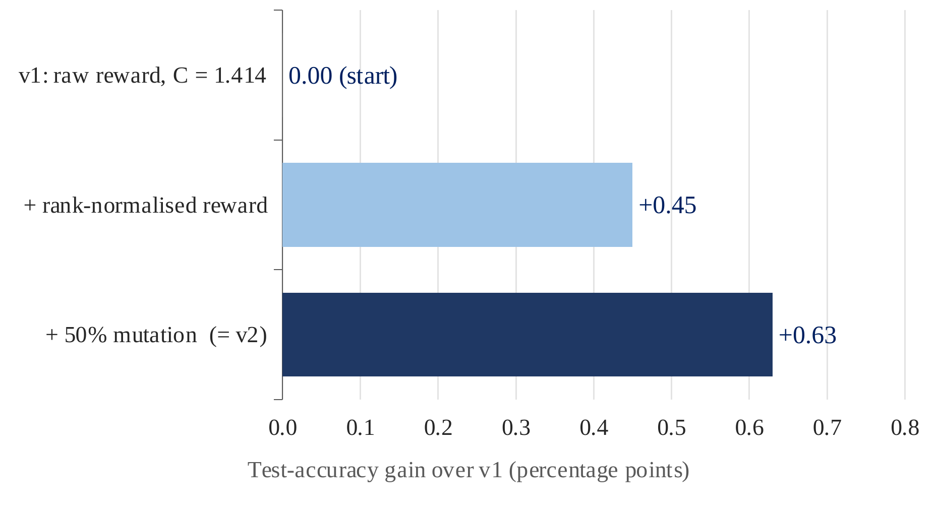
RESULTS · ABLATIONS
Result 6: What Actually Helps
0%
+0.53
duplicate evaluations
trie vs flat, no dedup
vs 30–67% in other searches
gain comes from dedup
+0.06
0 / 78
trie vs flat, with dedup
UCB-constant tests significant
tree shape adds little
robust to C
Fig. 11. Test-accuracy gain over v1 from each design change (12 held-out seeds).
Inference
Rank reward adds +0.45 pts, mutation +0.18: v2 beats v1.
v2 ties regularized evolution [28] with 12–19% fewer GPU-hours.
The trie helps through deduplication, not tree shape.
ArchTree-LLM | Imaad Hajwane (PRN 1262250486) | MIT-WPU | LCA-2 | 13 October 2026
16
Notes:
Left: a ladder from the old version v1 (before the October fixes) to v2. The rank reward closes most of the gap, mutation closes the rest. Right: four checks. The trie never evaluates a design twice; that, not the tree shape, is where its gain comes from. The search is not sensitive to the UCB constant.

Slide 17
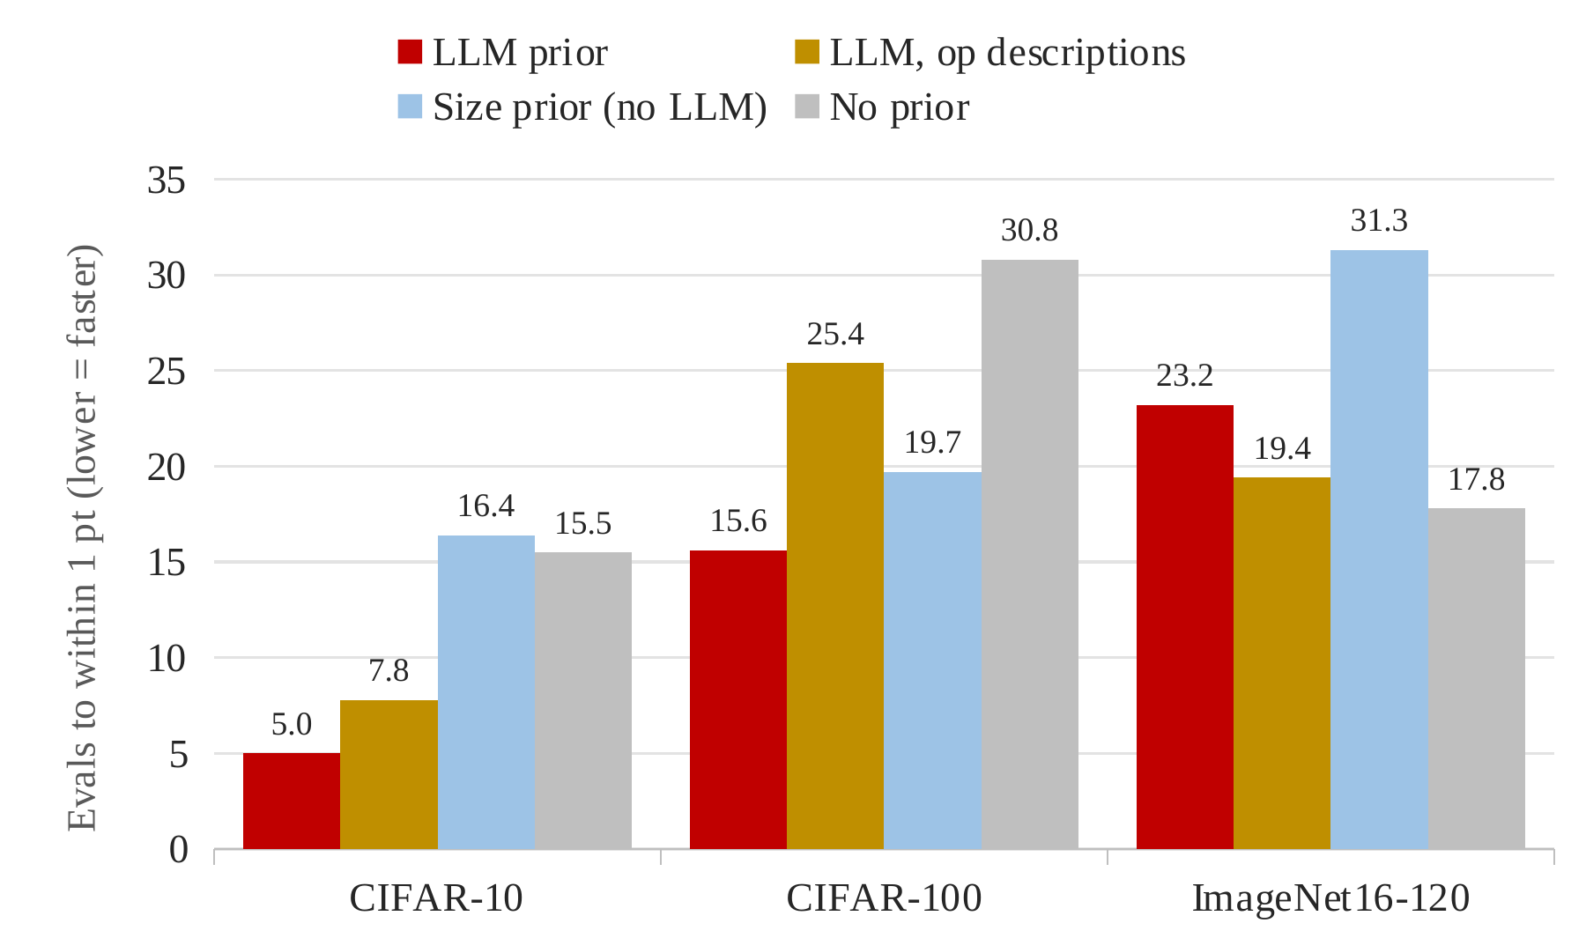
RESULTS · LLM PRIOR
Result 7: Does the LLM Prior Help?
Table 6. Memorisation check: does the LLM just remember NAS-Bench-201 [20]?
Prompt | What the LLM sees | ρ | What it tells us
Anonymous | op_A … op_E | 0.14 | ≈ chance
Standard | conv_3x3, skip … | 0.57 | good
Described | op meaning only | 0.70 | best: real knowledge
ρ = LLM op ranking vs true ranking (0 = random, 1 = perfect).
Fig. 12. Evaluations needed to reach within 1 pt of the final result, per prior.
Inference
3× faster on CIFAR-10, 2× on CIFAR-100 (p = 0.047).
No gain on ImageNet16-120 or in final accuracy: a warm-start only.
Descriptions beat names → general knowledge, not memorisation.
ArchTree-LLM | Imaad Hajwane (PRN 1262250486) | MIT-WPU | LCA-2 | 13 October 2026
17
Notes:
Left: lower bars = faster. The LLM prior gets close to the final result much sooner on CIFAR-10 and CIFAR-100. Right: the memorisation check. If the LLM had memorised the benchmark, it would do best with the exact benchmark names. Instead, with meaningless labels it is at chance, and with plain descriptions (no benchmark names) it is best, so it uses real architecture knowledge.

Slide 18
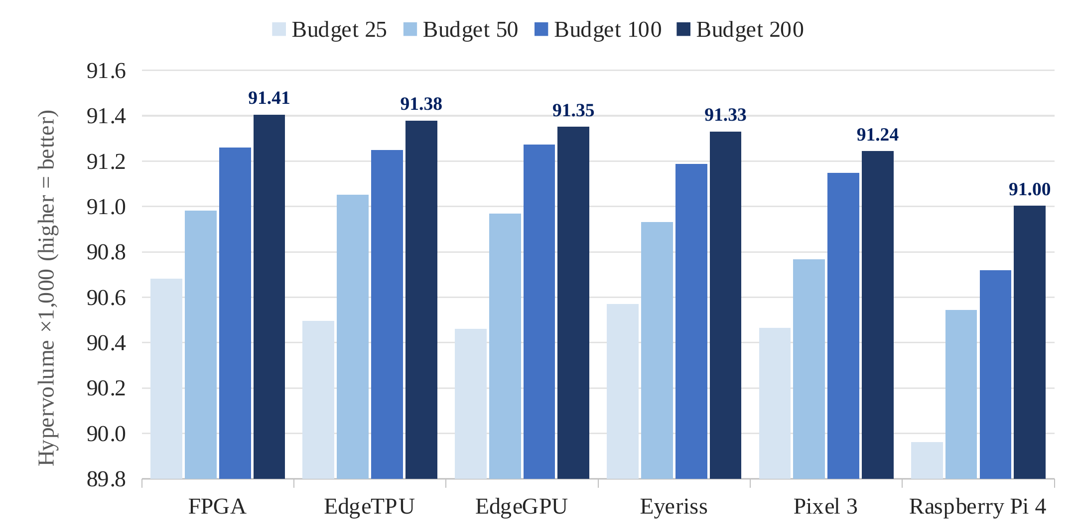
RESULTS · HW-NAS-BENCH
Result 8: Hardware-Aware Search
96 / 96
~0.13
ties vs random and NSGA-II
overlap of device fronts
1 of 15,625
~98%
designs optimal on all devices
HV kept when a front is reused
Fig. 13. Hypervolume of the accuracy–latency front per device and budget (HW-NAS-Bench [13]).
Inference
HV rises with budget on all 6 devices (best FPGA, lowest Raspberry Pi 4).
Ties random and NSGA-II [32]: no hardware search advantage.
Each device needs its own front; reuse keeps ~98% HV.
ArchTree-LLM | Imaad Hajwane (PRN 1262250486) | MIT-WPU | LCA-2 | 13 October 2026
18
Notes:
Each device has four bars, one per budget, light to dark. Darker = more search. Hypervolume measures how good the accuracy/latency trade-off front is. It grows on every device; FPGA reaches the best fronts, Raspberry Pi 4 the weakest. No search advantage over simpler baselines; the value is the cross-device analysis.

Slide 19
COMPARISON
Existing vs Proposed
Table 7. Comparison of existing NAS methods [1], [28], [34], [35], [36], [31] with the proposed approach
Aspect | Existing NAS methods | ArchTree-LLM (proposed)
Duplicate evaluations | 30–67% repeats | 0 (trie)
Filtering | Train all, or rank by proxy | Label-free gate (top 35%)
Labels for filter | ~1,500 | 0
Cost measure | Evaluations | Equal GPU-hours
LLM use | Proposes designs, untested | UCB prior, tested for memorisation
Cost bias | Not studied | Sign predicted and confirmed
Hardware | Single device | 6 devices
Validation | 1 benchmark, few seeds | 3 benchmarks, 24 seeds, Holm
ArchTree-LLM | Imaad Hajwane (PRN 1262250486) | MIT-WPU | LCA-2 | 13 October 2026
19
Notes:
Row by row, what is new compared with existing NAS methods.

Slide 20
SIGNIFICANCE
Research Significance & Contribution
Table 8. Contribution and evidence for each objective
Objective | Contribution | Evidence (results) | Status
1. Trie + UCB1 search | Deduplicating search with a rank-normalised UCB reward | 0 duplicate evaluations (vs 30–67%); robust to C (0 / 78 tests) | Met
2. Label-free proxy gate | Zero-label gate inside the search (main contribution) | τ 0.63–0.68 with 0 labels; 53% fewer GPU-hours at equal accuracy | Met
3. LLM warm-start prior | LLM prior tested against memorisation and size bias | 2–3× faster early search (CIFAR-10/100); ρ 0.70 described vs 0.14 anonymous | Partly met
4. Hardware-aware search | Accuracy–latency analysis on 6 edge devices | Front overlap ~0.13; ~98% HV kept on transfer; ties NSGA-II (96 / 96) | Met (analysis)
5. Fair validation | Equal-GPU-hour protocol and gate-cost criterion | 0 losses vs 13 methods on 3 benchmarks; criterion correct on 7 / 7 pairs | Met
Research significance: a practical, label-free way to roughly halve NAS cost without losing accuracy, a fair equal-GPU-hour evaluation protocol, and a criterion that predicts when cost-aware filtering helps or hurts.
ArchTree-LLM | Imaad Hajwane (PRN 1262250486) | MIT-WPU | LCA-2 | 13 October 2026
20
Notes:
One row per objective: what we contributed, the measured evidence, and whether the objective was met. Objective 2, the label-free gate, is the main contribution. Objective 3 is only partly met: the LLM speeds up early search but does not change final accuracy.

Slide 21
SUMMARY
Outcomes, Conclusion & Future Scope
ROBUSTNESS
COST
SUPERVISION
EFFICIENCY
LLM PRIOR
RANKING
0 losses
53%
0 labels
0 repeats
2–3×
Tied-best
against 13 methods at equal GPU-hours
fewer GPU-hours with the proxy gate
needed to build the proxy gate
no architecture is ever evaluated twice
faster early search on CIFAR-10 / 100
of 14 methods on NAS-Bench-201
Conclusion
Future scope
Matches the best baselines with ~40% of the evaluations.
Gate-cost criterion predicted the sign correctly (7 / 7 pairs).
Did not hold: tree shape, LLM final gain, hardware advantage.
Real training on larger spaces [37].
Real weight inheritance [38].
LLM prior for NB101 and hardware.
Paper: TMLR / AutoML-Conf.
Core claim: same accuracy at half the GPU cost, never beaten at equal compute.
ArchTree-LLM | Imaad Hajwane (PRN 1262250486) | MIT-WPU | LCA-2 | 13 October 2026
21
Notes:
Six headline numbers on top, each with what it measures. Conclusion and what did not hold on the left, next steps on the right, and the core claim at the bottom.

Slide 22
BIBLIOGRAPHY
References
[1] B. Zoph and Q. V. Le, “Neural architecture search with reinforcement learning,” in Proc. ICLR, 2017.
[2] T. Elsken, J. H. Metzen, and F. Hutter, “Neural architecture search: A survey,” JMLR, vol. 20, 2019.
[3] E. Real, S. Moore, A. Selle, S. Saxena, Y. L. Suematsu, J. Tan, Q. V. Le, and A. Kurakin, “Large-scale evolution of image classifiers,” in Proc. ICML, 2017.
[4] B. Zoph, V. Vasudevan, J. Shlens, and Q. V. Le, “Learning transferable architectures for scalable image recognition,” in Proc. CVPR, 2018.
[5] E. Fredkin, “Trie memory,” Communications of the ACM, vol. 3, no. 9, pp. 490–499, 1960.
[6] M. S. Abdelfattah, A. Mehrotra, Ł. Dudziak, and N. D. Lane, “Zero-cost proxies for lightweight NAS,” in Proc. ICLR, 2021.
[7] A. Chen, D. M. Dohan, and D. R. So, “EvoPrompting: Language models for code-level neural architecture search,” in Proc. NeurIPS, 2023.
[8] L. Li and A. Talwalkar, “Random search and reproducibility for neural architecture search,” in Proc. UAI, 2019.
[9] A. Yang, P. M. Esperança, and F. M. Carlucci, “NAS evaluation is frustratingly hard,” in Proc. ICLR, 2020.
[10] P. Auer, N. Cesa-Bianchi, and P. Fischer, “Finite-time analysis of the multiarmed bandit problem,” Machine Learning, vol. 47, 2002.
[11] A. Krishnakumar, C. White, A. Zela, R. Tu, M. Safari, and F. Hutter, “NAS-Bench-Suite-Zero: Accelerating research on zero cost proxies,” in Proc. NeurIPS Datasets and Benchmarks Track, 2022.
[12] M. Zheng et al., “Can GPT-4 perform neural architecture search?” (GENIUS), arXiv:2304.10970, 2023.
[13] C. Li et al., “HW-NAS-Bench: Hardware-aware neural architecture search benchmark,” in Proc. ICLR, 2021.
[14] F. Wilcoxon, “Individual comparisons by ranking methods,” Biometrics Bulletin, vol. 1, no. 6, pp. 80–83, 1945.
[15] S. Holm, “A simple sequentially rejective multiple test procedure,” Scandinavian Journal of Statistics, vol. 6, no. 2, pp. 65–70, 1979.
[16] J. Demšar, “Statistical comparisons of classifiers over multiple data sets,” JMLR, vol. 7, 2006.
[17] L. Wang, S. Xie, T. Li, R. Fonseca, and Y. Tian, “AlphaX: Exploring neural architectures with deep neural networks and Monte Carlo tree search,” arXiv:1903.11059, 2019.
[18] H. Cai, L. Zhu, and S. Han, “ProxylessNAS: Direct neural architecture search on target task and hardware,” in Proc. ICLR, 2019.
[19] M. Tan, B. Chen, R. Pang, V. Vasudevan, M. Sandler, A. Howard, and Q. V. Le, “MnasNet: Platform-aware neural architecture search for mobile,” in Proc. CVPR, 2019.
ArchTree-LLM | Imaad Hajwane (PRN 1262250486) | MIT-WPU | LCA-2 | 13 October 2026
22

Slide 23
BIBLIOGRAPHY
References
[20] X. Dong and Y. Yang, “NAS-Bench-201: Extending the scope of reproducible neural architecture search,” in Proc. ICLR, 2020.
[21] C. Ying, A. Klein, E. Christiansen, E. Real, K. Murphy, and F. Hutter, “NAS-Bench-101: Towards reproducible neural architecture search,” in Proc. ICML, 2019.
[22] X. Dong, L. Liu, K. Musial, and B. Gabrys, “NATS-Bench: Benchmarking NAS algorithms for architecture topology and size,” IEEE TPAMI, 2021.
[23] A. Krizhevsky, “Learning multiple layers of features from tiny images,” Tech. Rep., University of Toronto, 2009.
[24] P. Chrabaszcz, I. Loshchilov, and F. Hutter, “A downsampled variant of ImageNet as an alternative to the CIFAR datasets,” arXiv:1707.08819, 2017.
[25] L. Kocsis and C. Szepesvári, “Bandit based Monte-Carlo planning,” in Proc. ECML, 2006.
[26] J. Mellor, J. Turner, A. Storkey, and E. J. Crowley, “Neural architecture search without training,” in Proc. ICML, 2021.
[27] H. Tanaka, D. Kunin, D. L. Yamins, and S. Ganguli, “Pruning neural networks without any data by iteratively conserving synaptic flow,” in Proc. NeurIPS, 2020.
[28] E. Real, A. Aggarwal, Y. Huang, and Q. V. Le, “Regularized evolution for image classifier architecture search,” in Proc. AAAI, 2019.
[29] C. White, S. Nolen, and Y. Savani, “Exploring the loss landscape in neural architecture search,” in Proc. UAI, 2021.
[30] H. Pham, M. Guan, B. Zoph, Q. Le, and J. Dean, “Efficient neural architecture search via parameter sharing,” in Proc. ICML, 2018.
[31] G. Li, Y. Yang, K. Bhardwaj, and R. Marculescu, “ZiCo: Zero-shot NAS via inverse coefficient of variation on gradients,” in Proc. ICLR, 2023.
[32] K. Deb, A. Pratap, S. Agarwal, and T. Meyarivan, “A fast and elitist multiobjective genetic algorithm: NSGA-II,” IEEE Trans. Evol. Comput., vol. 6, no. 2, 2002.
[33] M. G. Kendall, “A new measure of rank correlation,” Biometrika, vol. 30, no. 1–2, pp. 81–93, 1938.
[34] C. Liu et al., “Progressive neural architecture search,” in Proc. ECCV, 2018.
[35] C. White, W. Neiswanger, and Y. Savani, “BANANAS: Bayesian optimization with neural architectures for neural architecture search,” in Proc. AAAI, 2021.
[36] N. Lee, T. Ajanthan, and P. H. S. Torr, “SNIP: Single-shot network pruning based on connection sensitivity,” in Proc. ICLR, 2019.
[37] H. Liu, K. Simonyan, and Y. Yang, “DARTS: Differentiable architecture search,” in Proc. ICLR, 2019.
[38] H. Cai, C. Gan, T. Wang, Z. Zhang, and S. Han, “Once-for-all: Train one network and specialize it for efficient deployment,” in Proc. ICLR, 2020.
ArchTree-LLM | Imaad Hajwane (PRN 1262250486) | MIT-WPU | LCA-2 | 13 October 2026
23

Slide 24
THANK YOU
Questions and discussion are welcome
Imaad Hajwane (PRN: 1262250486) · Guide: Dr. Jayshree Aher
MIT-WPU · 13 October 2026

