Slide 1

SMART INDIA HACKATHON 2026
TITLE PAGE
Problem Statement ID – SIH26011
Problem Statement Title – 3D ULPIN (Bhu-Aadhaar) Generation, Vertical Cadastre & 3D Building Visualization Digital Twin
Theme – Smart Automation / Geospatial Technology / Smart Cities
PS Category – Software
Team Name (Registered on portal) – GeoVoxel The coders

Slide 2
GEO-CADASTRE 3D: Autonomous 3D ULPIN & Vertical Cadastre Digital Twin
GeoVoxel
The coders
Proposed Solution
Autonomous geospatial pipeline generating India's first 3D vertical cadastre from open-source satellite and survey data.
60 FPS WebGL digital twin with real-time building inspection, floor isolation, and solar analysis.
Technical Approach
Tier 1 — Unit-Level: Parses RERA blueprints into individual flat parcels with carpet area, facing, and Z-coordinates.
Tier 2 — Floor-Level: Automated slicing via DSM-DEM height estimation with zero-discrepancy normalization.
Problem Addressed
Replaces ambiguous 2D survey numbers with unique 3D spatial identities for every apartment unit.
ISO 19152 LADM + OGC CityGML compliant legal 3D parcels (Z-min, Z-max MSL).
Innovation
Zero-Discrepancy Floor Slab Engine: cumulative height error = 0.00m across 4,641 buildings.
Client-side 60 FPS rendering of 22,761 volumetric parcels — no server GPU required.
GOVERNMENT 2D BHU-AADHAAR (ULPIN)
3621050103VUWK 14-Digit DoLR Standard
State 36 | District 21 | Mandal 05 | Village 0103 | Survey 83/1
TIER 1: UNIT 3D ULPIN
Sanctioned RERA Blueprints
-FL32-U3201
4BHK Luxury | 318 m² | East
-FL32-U3202
3BHK Premium | 241 m² | West
-FL32-U3203
3BHK Premium | 241 m² | North
-FL32-ULOBBY
Common Area | Lift & Fire | 85 m²
TIER 2: FLOOR 3D ULPIN
Automated Height Slicing
-FL32
Floor 32 | Z: 691.01 – 694.00m MSL
-FL15
Floor 15 | Z: 639.75 – 642.75m MSL
-FL08
Floor 8 | Z: 618.34 – 621.34m MSL
-FL00
Ground | Z: 594.00 – 598.34m MSL

Slide 3
TECHNICAL APPROACH & PIPELINE ARCHITECTURE
GeoVoxel
The coders
STAGE 1: DATA INGESTION
STAGE 2: HEIGHT ENGINE
STAGE 3: 3D CADASTRE
STAGE 4: DIGITAL TWIN
OpenStreetMap (Overpass QL)
Copernicus GLO-30 DSM
SRTM GL1 DEM (OpenTopo)
ISRO Bhuvan OGC Geoportal
TS-RERA & Dharani Land DB
Landmark / RERA Registry
DSM-DEM Zonal Statistics
Annular Buffer Sampling
Morphological Typology
Cluster Spatial Propagation
14-Digit Bhu-Aadhaar (NIC)
Unit ULPIN (-FLxx-Uyyyy)
Floor ULPIN (-FLxx)
Zero-Discrepancy Normalizer
ISO 19152 / CityGML 3.0
Next.js 16 + Three.js r185
60 FPS BatchedMesh / LOD
Interactive Floor Isolation
Solar & Flood Simulation
238 km Road Network
4,641
Buildings
22,761
3D Parcels
238 km
Roads
12.5s
Execution
60 FPS
Rendering
Technologies & Frameworks
Geospatial: Python 3.10+, GDAL, Rasterio, Shapely, GeoPandas, PyProj, SciPy k-d trees.
Remote Sensing: Copernicus GLO-30 DSM, SRTM GL1 DEM, ISRO Bhuvan WFS/WMS, OSM Overpass QL.
3D Platform: Next.js 16 (Turbopack), React 19, Three.js r185, React Three Fiber, WebGL 2.0.
Methodology & Implementation
1. Ingestion: Bounding box clipping, UTM reprojection, OSM vector extraction, Bhuvan validation.
2. Height: DSM-DEM zonal diff + annular buffer terrain sampling + typology heuristics.
3. Cadastre: 14-digit ULPIN, zero-discrepancy floor normalization, dual-tier volumetric parcels.
4. Digital Twin: Instanced rendering of 4,641 buildings + 238 km roads; interactive inspection.

Slide 4
FEASIBILITY AND VIABILITY ANALYSIS
GeoVoxel
The coders
Feasibility Analysis
Data: 100% open sovereign data — Copernicus DEM, SRTM, ISRO Bhuvan, OSM. Zero licensing fees.
Operations: Entire 9 km² urban sector processed in 12.5 seconds on commodity hardware.
Technical: Built on ISO 19152 LADM, OGC CityGML, 14-digit DoLR ULPIN standards.
Deployment: Client-side WebGL at 60 FPS in any browser — no GPUs or native installs.
Challenges & Risks
Raster Noise: 30m DSM/DEM data has height distortion in dense high-rise clusters.
Missing Plans: 95%+ of municipal buildings lack digitized floor plans for unit mapping.
Browser Limits: Simultaneous volumetric rendering can exhaust WebGL memory.
Elevation Drift: Rounding errors cause cumulative drift between slices and rooftops.
Mitigation Strategies
5-Tier Fallback: Annular terrain buffering + morphological typology + landmark registries.
Dual-Mode: Floor-level slicing as default; upgrades to unit-level when blueprints exist.
On-Demand LOD: Only selected building is volumetrically extruded; others stay as batched mesh.
Normalizer: Enforces cumulative height = building height with 0.00m error tolerance.

Slide 5
IMPACT AND MULTI-SECTOR BENEFITS
GeoVoxel
The coders
Potential Impact on Target Audience
Dept. of Land Resources & Survey of India
Blueprint to transition 2D Bhu-Aadhaar into a national 3D cadastral framework.
Urban Local Bodies (GHMC / Smart City)
15–25% higher property tax via detection of unassessed floors and FAR violations.
Homebuyers & Citizens
Undisputed legal title to specific vertical airspace, replacing UDS agreements.
Banks & Mortgage Lenders
Instant 3D collateral verification; eliminates fraudulent multi-mortgaging.
Benefits (Social, Economic, Environmental)
Economic
Eliminates land litigation costs; accelerates bank loan approvals from weeks to minutes.
Social & Governance
100% transparency in vertical ownership; prevents double-selling scams.
Disaster Management
Floor-level flood simulation identifies submerged levels for precision rescue.
Environmental
3D solar shadow analysis enables rooftop PV capacity estimation and heat island mitigation.

Slide 6
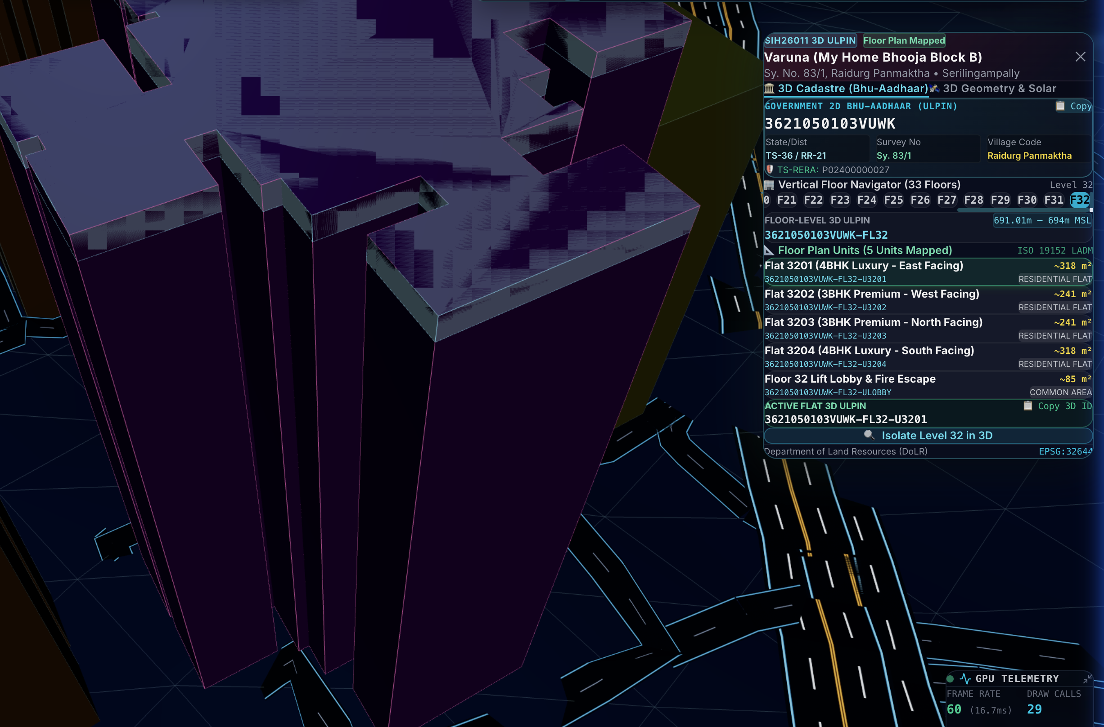
RESEARCH, REFERENCES & WORKING PROTOTYPE
GeoVoxel
The coders
Research & Reference Work
DoLR / NIC Guidelines: ULPIN / Bhu-Aadhaar Technical Specifications & Design Guidelines (2021–2024).
ISO 19152 (LADM): Land Administration Domain Model — Part 3: 3D/4D Spatial Administration.
OGC Standards: CityGML 3.0 & 3D Tiles Community Standard for streaming geospatial models.
Survey of India & MoHUA: National Geospatial Policy 2022 & NUDM Smart City guidelines.
Academic Research: Biljecki et al. (2015): 3D City Models; Stoter et al. (2020): 3D Cadastre in Practice.
Data Sources: Copernicus GLO-30 DSM, SRTM DEM, ISRO Bhuvan, OSM (ODbL), TS-RERA Portal.
Working Prototype & Repository
GitHub: github.com/Imad-81/SIH-26011
3D Viewer: localhost:3000 (Next.js 16 + Three.js)
Pipeline: python scripts/pipeline.py --city hyderabad

