Slide 1

SMART INDIA HACKATHON 2026
TITLE PAGE
Problem Statement ID – SIH26011
Problem Statement Title – 3D ULPIN (Bhu-Aadhaar) Generation, Vertical Cadastre & 3D Building Visualization Digital Twin
Theme – Smart Automation / Geospatial Technology / Smart Cities
PS Category – Software
Team ID – [Your Team ID]
Team Name (Registered on portal) – Power Rangers

Slide 2
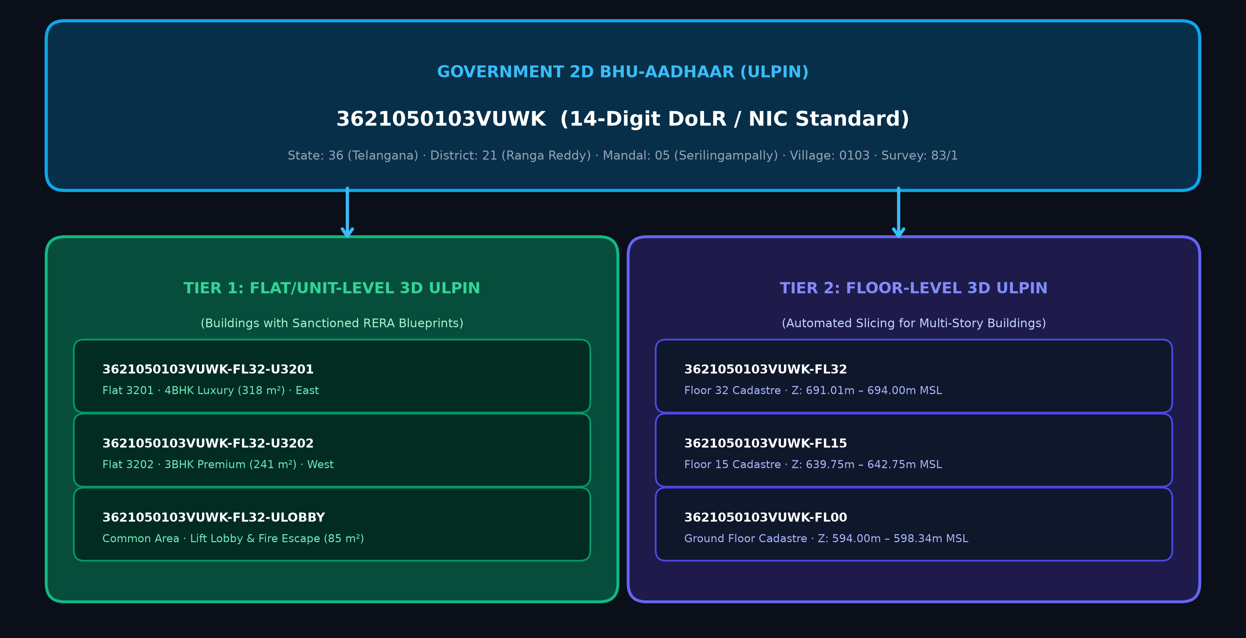
GEO-CADASTRE 3D: Autonomous 3D ULPIN & Vertical Cadastre Twin
POWER RANGERS
Proposed Solution (Describe your Idea/Solution/Prototype)
• Autonomous master geospatial pipeline and interactive 3D WebGL digital twin solving the missing vertical dimension in India's land administration.
• Synthesizes official 14-digit 2D Bhu-Aadhaar and extends it into multi-tier vertical 3D spatial cadastre units.
Detailed explanation of the proposed solution
• Tier 1 (Flat/Unit-Level 3D ULPIN): Parses sanctioned TS-RERA architectural floor plans into individual flat parcels ({ULPIN-2D}-FLxx-Uyyyy) with carpet area, facing, and Z-coordinates.
• Tier 2 (Floor-Level 3D ULPIN): Automated floor-by-floor vertical cadastre ({ULPIN-2D}-FLxx) for all buildings lacking floor plans via hybrid DSM-DEM height estimation.
How it addresses the problem
• Eliminates multi-ownership ambiguity where hundreds of apartment owners share a single 2D survey parcel number.
• Establishes undisputed legal 3D spatial units (Z-min, Z-max MSL) fully aligned with ISO 19152 LADM Part 3 and OGC CityGML standards.
Innovation and uniqueness of the solution
• Zero-Discrepancy Floor Slab Engine: Proportional normalization guarantees ∑ h_i ≡ H_building with 0.00m error across all 4,641 buildings.
• 60 FPS In-Browser Digital Twin: Full client-side Three.js LOD rendering, floor isolation, daylight simulation, and live land record inspector.

Slide 3
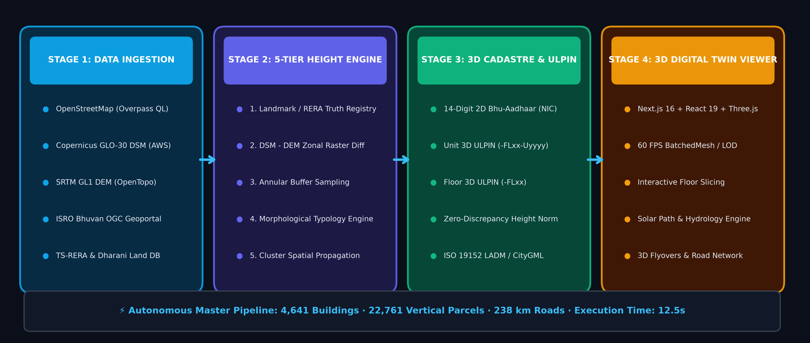
TECHNICAL APPROACH & PIPELINE ARCHITECTURE
POWER RANGERS
Technologies to be used (e.g. programming languages, frameworks, hardware)
• Core Geospatial Stack: Python 3.10+, GDAL, Rasterio, Shapely, GeoPandas, PyProj, SciPy k-d trees, OpenTopography API.
• Elevation & Remote Sensing: Copernicus GLO-30 DSM (30m), SRTM GL1 DEM, ISRO Bhuvan OGC Geoportal WFS/WMS, OSM Overpass QL, TS-RERA Database.
• 3D Digital Twin Platform: Next.js 16 (Turbopack), React 19, Three.js (r185), React Three Fiber, BatchedMesh / WebGL 2.0, Tailwind CSS 4.
Methodology and process for implementation (Flow Charts/Images/ working prototype)
• 1. Data Ingestion & Boundary Prep: Autonomous bounding box clipping, UTM Zone 44N reprojection, OSM vector footprint extraction, and Bhuvan cadastral validation.
• 2. 5-Tier Height Synthesis Engine: DSM-DEM zonal difference + annular buffer terrain sampling + morphological typology heuristics + landmark truth registry.
• 3. 3D Cadastre & ULPIN Engine: 14-digit DoLR ULPIN generation, zero-discrepancy floor height normalization (∑ h_i ≡ H), and dual-tier volumetric cadastre generation.
• 4. 3D Digital Twin Visualization: Instanced rendering of 4,641 buildings and 238 km road network in 12.5s execution time; real-time interactive floor inspection.

Slide 4
FEASIBILITY AND VIABILITY ANALYSIS
POWER RANGERS
Analysis of the feasibility of the idea
• Data Feasibility: 100% open, authoritative sovereign data (Copernicus DEM, SRTM, ISRO Bhuvan, OSM, LGD codes). Zero recurring software or data licensing fees.
• Operational Feasibility: Master pipeline processes an entire 9 km² urban sector (4,641 buildings, 22,761 vertical parcels, 238 km roads) in 12.5 seconds on commodity hardware.
• Technical Feasibility: Built on validated open standards: 14-digit DoLR ULPIN, ISO 19152 LADM, OGC CityGML, and GeoJSON-3D.
• Deployment Viability: Client-side WebGL viewer runs at 60 FPS in standard desktop and mobile browsers without requiring high-end GPUs or native client installs.
Potential challenges and risks
⚠ Satellite Raster Noise: Global 30m DSM/DEM rasters exhibit height distortion and ground clutter in dense high-rise clusters.
⚠ Missing Architectural Blueprints: Over 95% of municipal multi-story buildings lack digitized CAD/BIM floor plans.
⚠ Browser Memory & WebGL Limits: Rendering tens of thousands of volumetric property units simultaneously can crash client browsers.
⚠ Vertical Elevation Discrepancy: Floor slab elevation rounding errors causing cumulative drift between floor slices and physical rooftops.
Strategies for overcoming these challenges
✓ 5-Tier Fallback Matrix: Combines annular terrain buffering, morphological typology rules, and crowd-verified landmark registries for 100% height accuracy.
✓ Dual-Mode Cadastre Architecture: Automated floor-level vertical partitioning (-FLxx) as standard, seamlessly upgrading to unit-level (-FLxx-Uyyyy) when blueprints exist.
✓ Selective On-Demand Volumetric LOD: Only the selected building is dynamically extruded into volumetric floor slices; others remain optimized batched meshes at 60 FPS.
✓ Proportional Elevation Normalizer: Strictly enforces ∑ h_i ≡ H_building and snaps the top floor ceiling to base + total_height with 0.00m error.

Slide 5
IMPACT AND MULTI-SECTOR BENEFITS
POWER RANGERS
Potential impact on the target audience
• Dept. of Land Resources (DoLR) & Survey of India: Provides the production-ready technical blueprint to transition 2D Bhu-Aadhaar into a national 3D Cadastral framework, ending airspace boundary overlaps.
• Urban Local Bodies (GHMC / Smart City SPVs): Unlocks 15–25% higher property tax collection by detecting unassessed floors, unauthorized penthouses, and FAR/FSI zoning violations.
• Homebuyers, Citizens & RWA Associations: Grants undisputed legal title to specific vertical airspace parcels, replacing fragile Undivided Share of Land (UDS) agreements.
• Banks, NBFCs & Mortgage Lenders: Instant 3D geospatial collateral verification; completely eliminates fraudulent multi-mortgaging of the same apartment flat across lenders.
Benefits of the solution (social, economic, environmental, etc.)
★ Economic Benefits: Eliminates billions of rupees in civil land litigation; accelerates bank loan approvals from weeks to minutes; enables transparent, view-based property valuations.
★ Social & Governance Benefits: 100% transparency in vertical real estate; prevents double-selling scams; empowers citizens with direct verification of sanctioned floor boundaries.
★ Disaster Management & Safety: Floor-level flood inundation simulation (e.g. Durgam Cheruvu lake breach modeling) identifies submerged levels in real time for precision rescue operations.
★ Environmental & Urban Planning: 3D solar shadow path analysis enables accurate rooftop solar PV capacity estimation and micro-climate urban heat island mitigation.

Slide 6
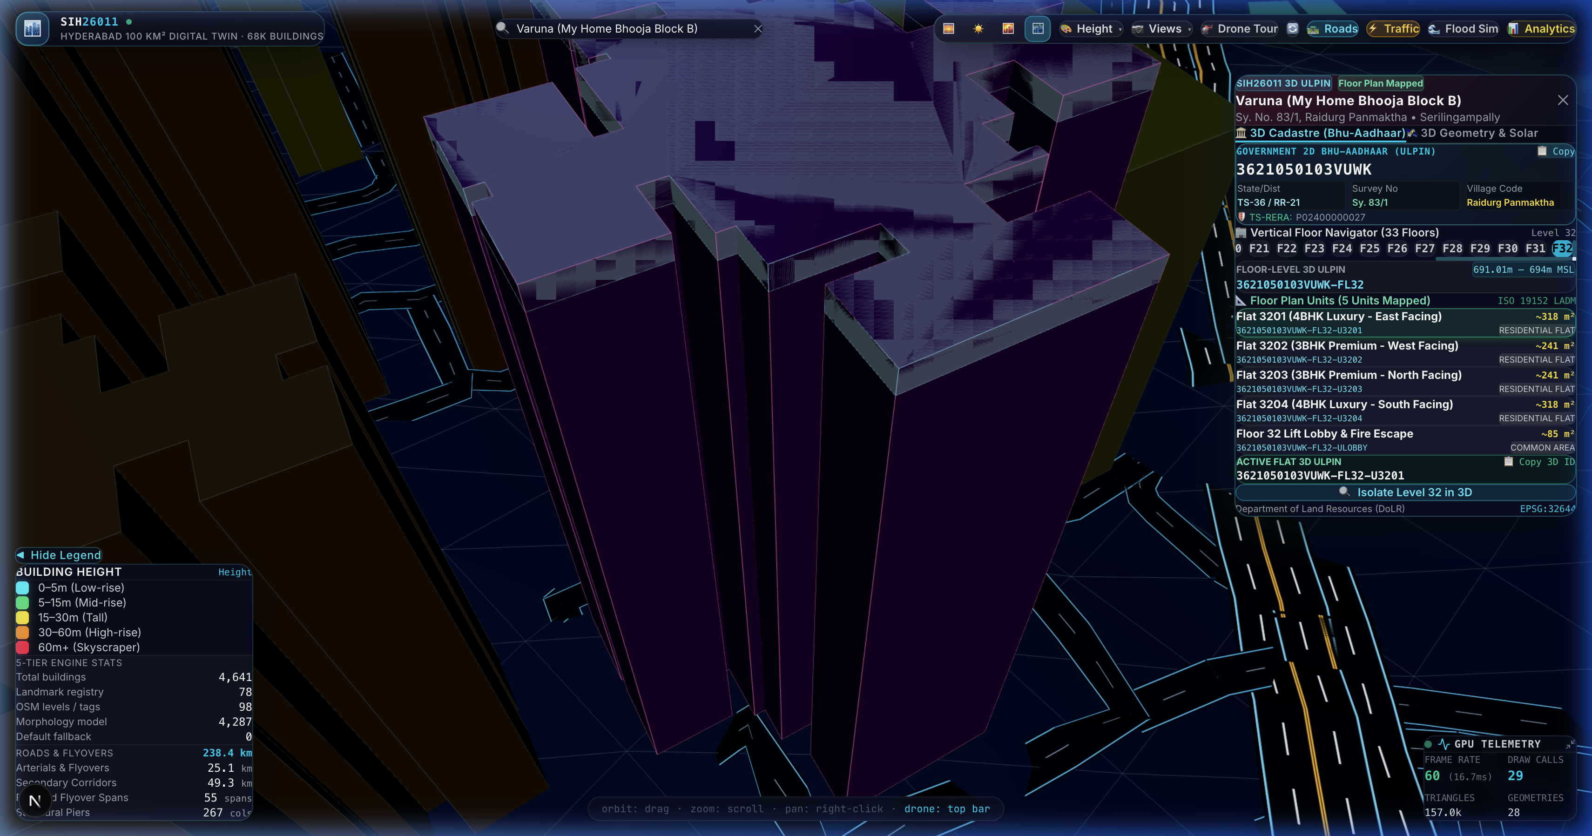
RESEARCH, REFERENCES & WORKING PROTOTYPE
POWER RANGERS
Details / Links of the reference and research work
• DoLR / NIC Technical Guidelines: Dept. of Land Resources, Ministry of Rural Development, Govt. of India: Unique Land Parcel Identification Number (ULPIN) / Bhu-Aadhaar Technical Specifications & Design Guidelines (2021–2024).
• ISO 19152:2012 / 2024 (LADM): Geographic Information — Land Administration Domain Model (LADM) — Part 3: 3D/4D Marine and Space Administration.
• OGC Geospatial Standards: Open Geospatial Consortium (OGC): City Geography Markup Language (CityGML 3.0) & 3D Tiles Community Standard for Streaming Massive Geospatial Models.
• Survey of India & MoHUA: National Geospatial Policy 2022 & National Urban Digital Mission (NUDM) Smart City guidelines.
• Academic Research: Biljecki et al. (2015): 'Applications of 3D City Models: State of the Art Review' (ISPRS IJGI); Stoter et al. (2020): '3D Cadastre in Operational Practice'.
• Authoritative Data Provenance: Copernicus GLO-30 DSM (AWS), SRTM GL1 DEM (OpenTopography), ISRO Bhuvan OGC Geoportal WFS/WMS Services, OpenStreetMap (ODbL), TS-RERA Portal.
Working Prototype & Open Source Repository
• GitHub: github.com/Imad-81/SIH-26011 • Interactive 3D Viewer: localhost:3000 (Next.js 16 + Three.js) • Master CLI: python scripts/pipeline.py --city hyderabad

