Slide 1
Some logistics
Video is posted shortly after class to forum thread
You can join class remotely up to 2 times if you have to
Please ask questions or add comments through forums
Questions with <x>+ likes will be asked by Rachel if she thinks it’s of general interest, so be sure to ‘like’ anything you want to see addressed
If you aren’t sure whether to ask – just ask anyway! There are no stupid questions ☺
I’ll be looking at questions after class too

Slide 2
Get to know the forum
Shift-r to reply; Ctrl-enter to send
Replies are instant: join the ‘lesson 8 in-class’ thread now!
You can watch and pin threads
Try creating a thread for your area of interest, for ongoing discussion
Feel free to experiment with ways to organize study groups, topics you’re interested in, etc
Don’t at-mention to encourage an answer, or the people you at-mention may turn off notifications! If you don’t get an answer, try to rephrase

Slide 3
Study group
Room 153 @ USF (101 Howard St)
For in person participants only.
Interstate/international visitors priority if full
Generally someone is there at least 10a-4p

Slide 4
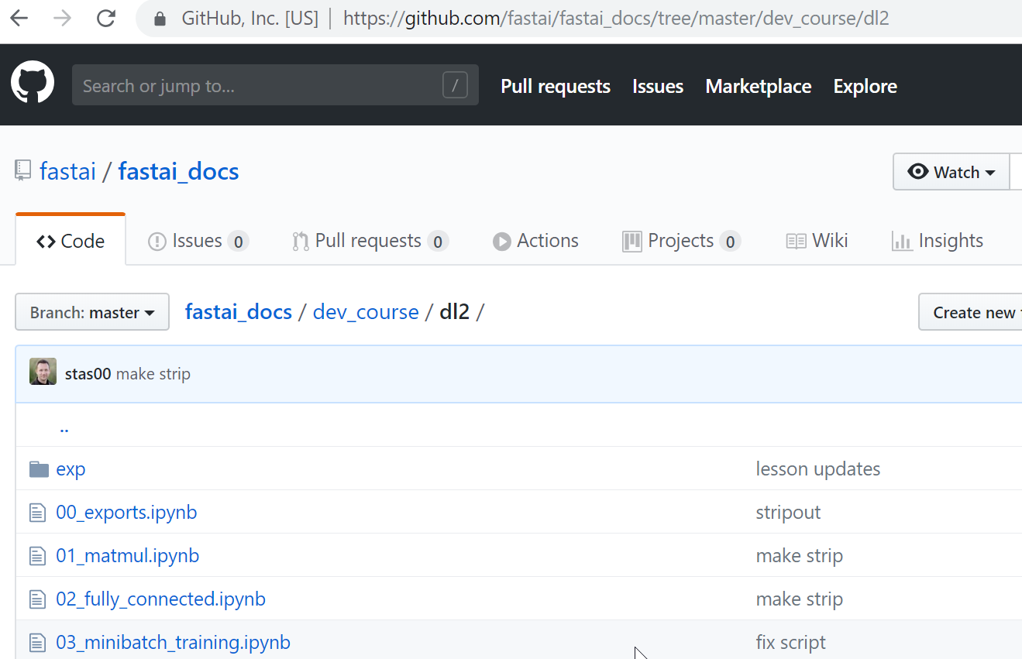

Slide 5
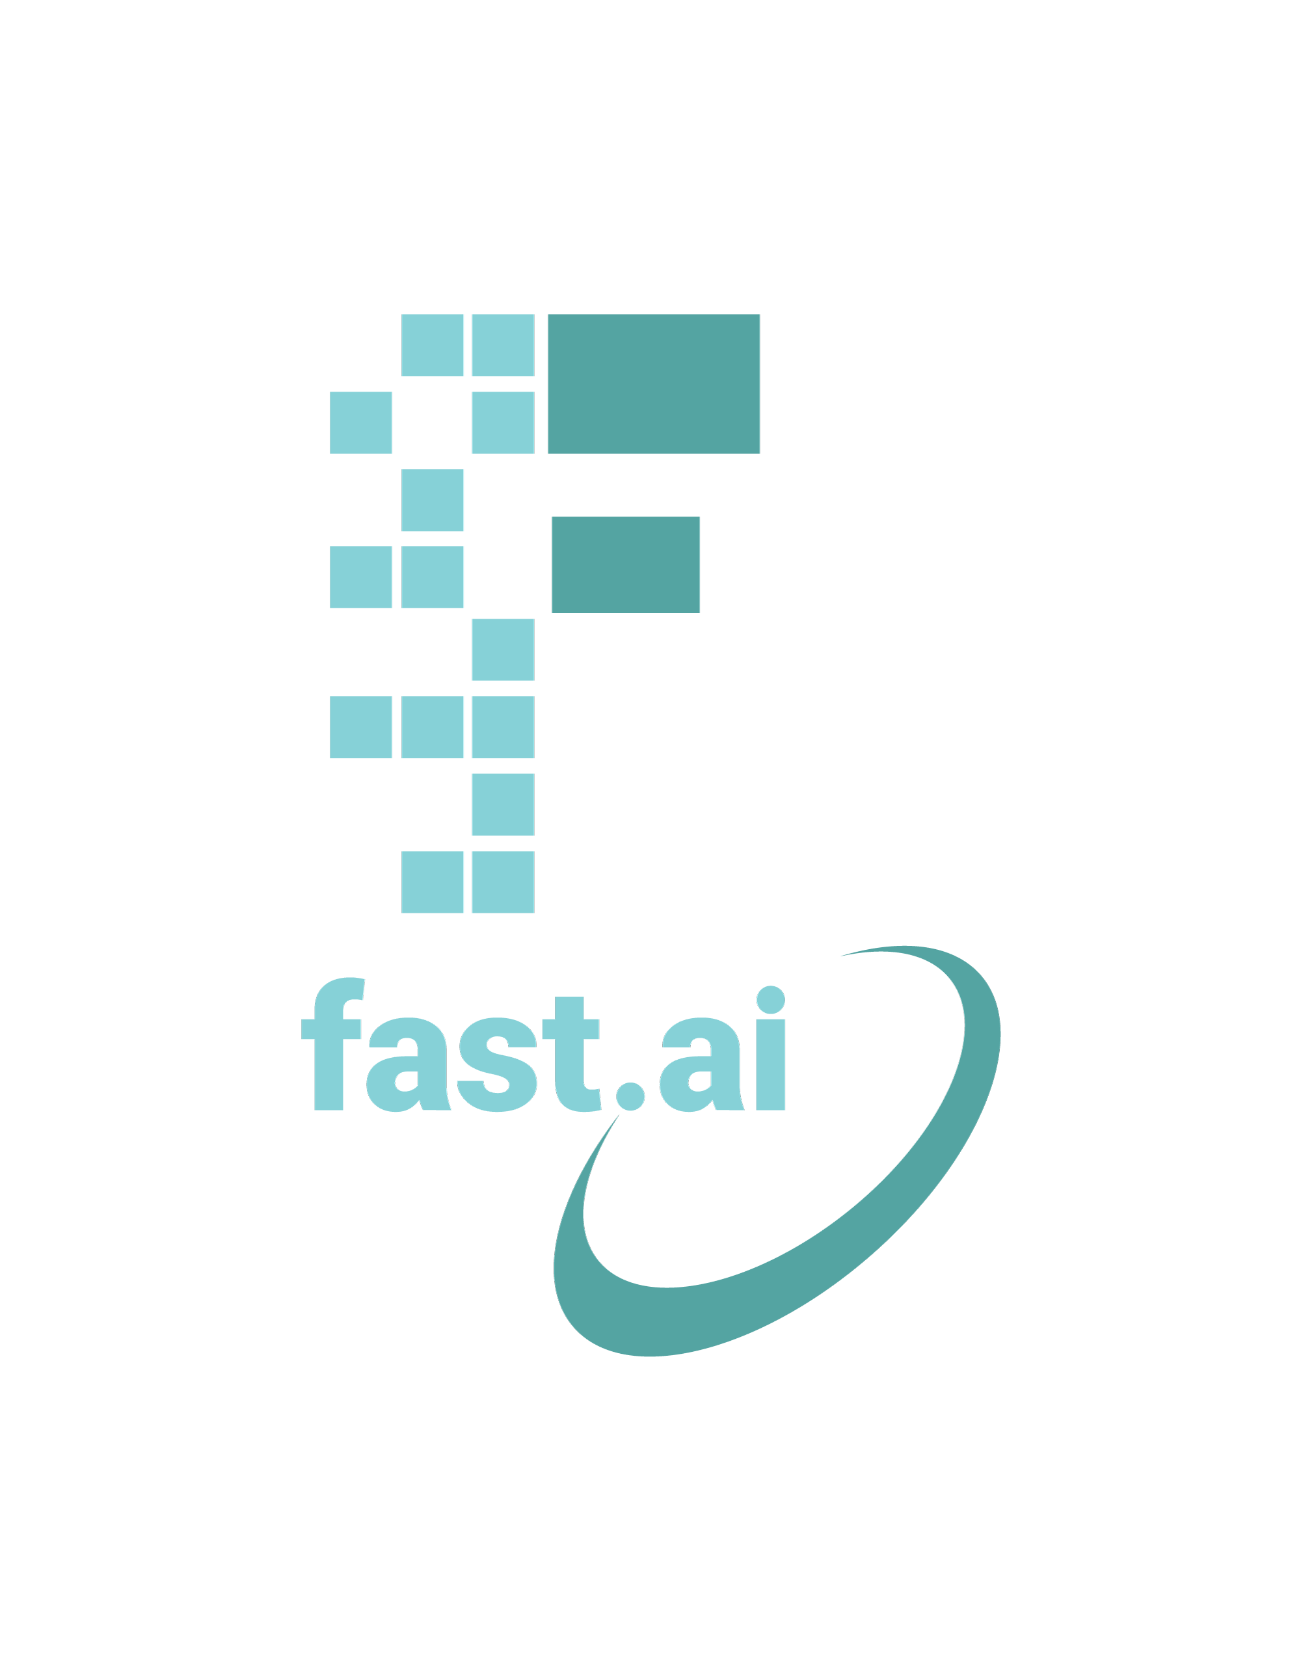

Deep learning…
…from the foundations. Lesson 8.

Slide 6
“Deep Learning from the Foundations”
Implement much of fastai from Foundations
Basic matrix calculus; Training loops w callbacks; Custom optimizer; custom annealing; regularization; dataset, loader, and blocks
Lots of layers and architectures
Jupyter dev, testing and docs
Read papers, and implement them. We’ll even do some new research!
Learn object detection, seq2seq/attention, Transformer/XL, CycleGAN, Audio…
Performance: distributed training, JIT, CUDA/C++
Implement some of fastai in Swift
(aka “Impractical Deep Learning for Coders”)

Slide 7
Top down
Bottom up (with code)
Context
See the connections
Motivation
Results
Customize
Performance

Slide 8
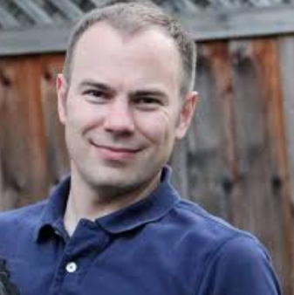
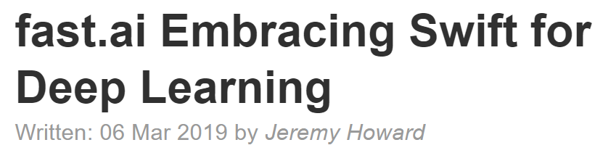
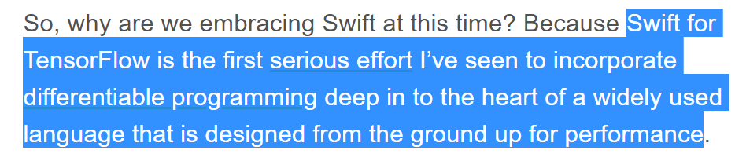

Slide 9
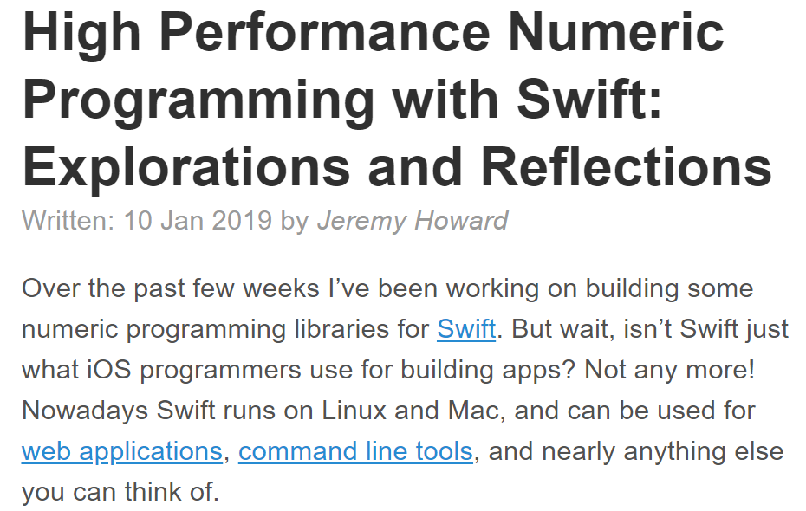

Slide 10
PyTorch Pros
Get work done now!
Great ecosystem
S4TF Pros
Write everything in Swift
See exactly what’s happening
Docs & tutorials
Opportunities
PyTorch Cons
Python’s performance
Python’s types
Mismatch with backend libs
S4TF Cons
Minimal ecosystem
Very little works
Lots to learn

Slide 11
What do we mean by “from the foundations”?
Recreate: fastai*
…and much of PyTorch: matrix multiply, torch.nn, torch.optim, Dataset, DataLoader
Python
Python stdlib
Non-data science modules
PyTorch array creation, RNG, indexer
fastai.datasets
matplotlib
* but we’ll make it even better!

Slide 12
But why?...
Understand it by creating it
Really experiment
Tweak everything
Contribute
Correlate papers with code

Slide 13
There are many opportunities for you in this class
Your homework will be at the cutting edge
There are few DL practitioners that know what you know now
Experiment lots, especially in your area of expertise
Much of what you find will have not be written about before
Don’t wait to be perfect before you start communicating
If you don’t have a blog, try medium.com

Slide 14
Affine functions & non-linearities
Convolutions
Batch-norm
Data augmentation
Weight decay
Dropout
Res/dense blocks
Parameters & activations
SGD; Momentum, Adam
Embeddings
Collaborative filtering
Continuous & Categorical Variables
Language models; NLP classification
Random init & transfer learning
Segmentation; U-net; GANs
Image classification and regression

Slide 15
1. Overfit
2. Reduce over-fitting
3. There is no step 3

Slide 16
Five steps to avoiding overfitting
More data
Data augmentation
Generalizable architectures
Reduce architecture complexity
Regularization

Slide 17
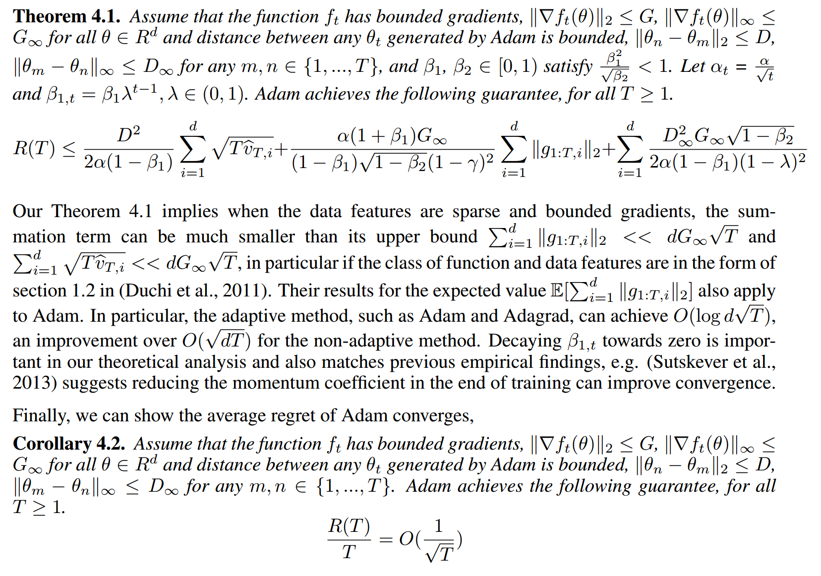
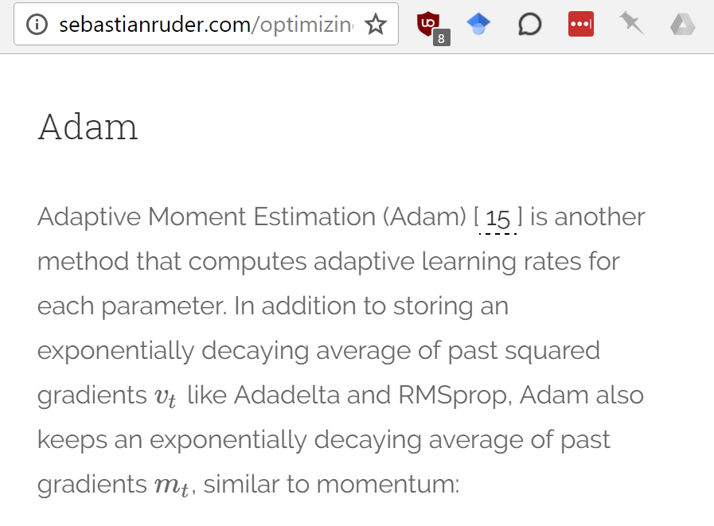
It’s time to start reading papers
Even familiar stuff looks complex in a paper!
Papers are important for deep learning beyond the basics, but hard to read
Google for a blog post describing the paper
Learn to pronounce Greek letters

Slide 18
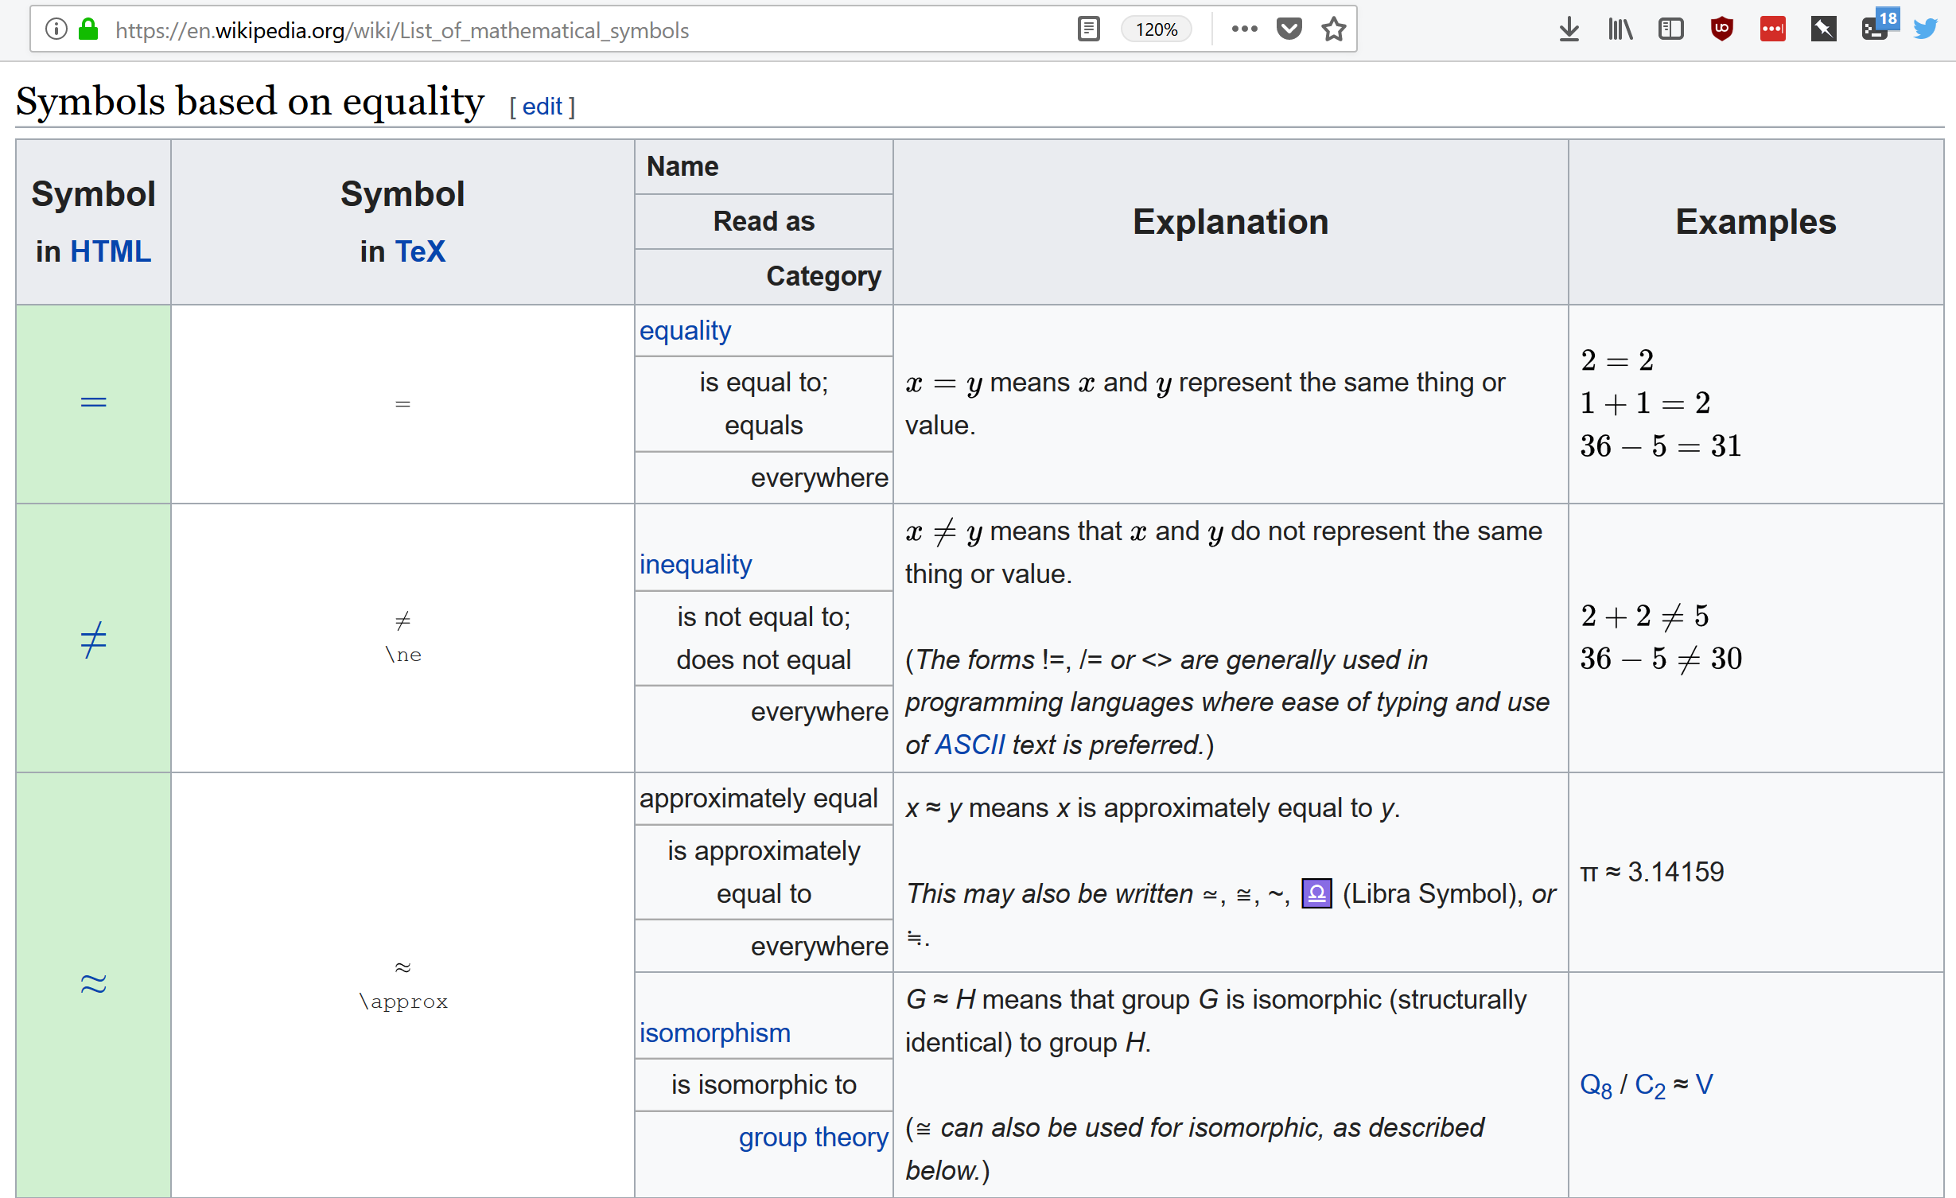

Slide 19
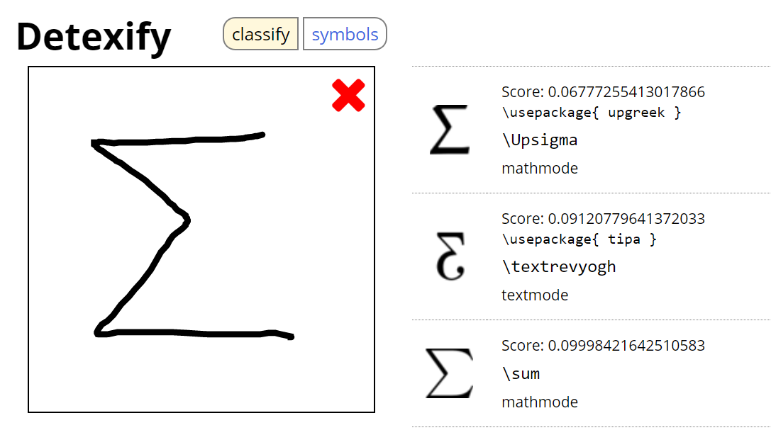

Slide 20
What do we mean by “from the foundations”?
Recreate: fastai*
…and much of PyTorch: matrix multiply, torch.nn, torch.optim, Dataset, DataLoader
Python
Python stdlib
Non-data science modules
PyTorch array creation, RNG, indexer
fastai.datasets
matplotlib
* but we’ll make it even better!

Slide 21
Steps to a basic modern CNN model
Matmul
Conv
Batch-norm
FC forward
Relu / Init
FC backward
Train loop
Optim
Resnet

Slide 23
Python / PyTorch
Numpy lib
Cython / C
S4TF
TensorFlow lib (ops)
LLVM compilation
Aten lib
Torchscript translation

