Slide 1
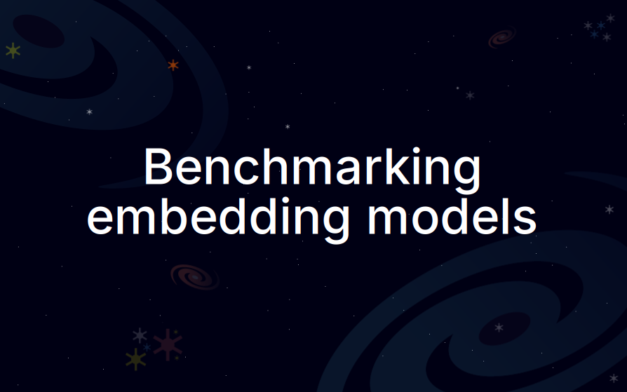

Slide 2
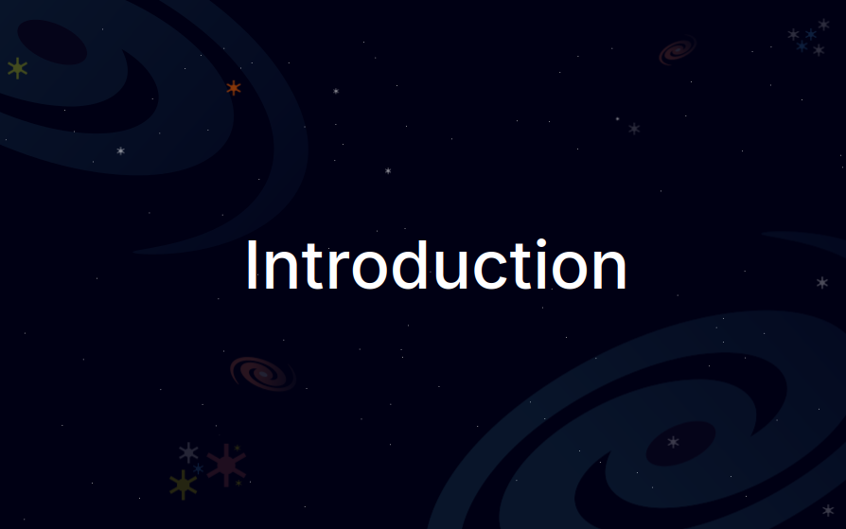

Slide 3



Benchmarking embedding models
Embedding models convert text (or other modalities) to a dense vector.
With embedding models, you can build RAG and recommendation systems.
But how do you choose an embedding model?
Hi Cassiopeia! Have you talked with Andromeda?
Embedding model
[0.69, 0.42, ...]

Slide 4
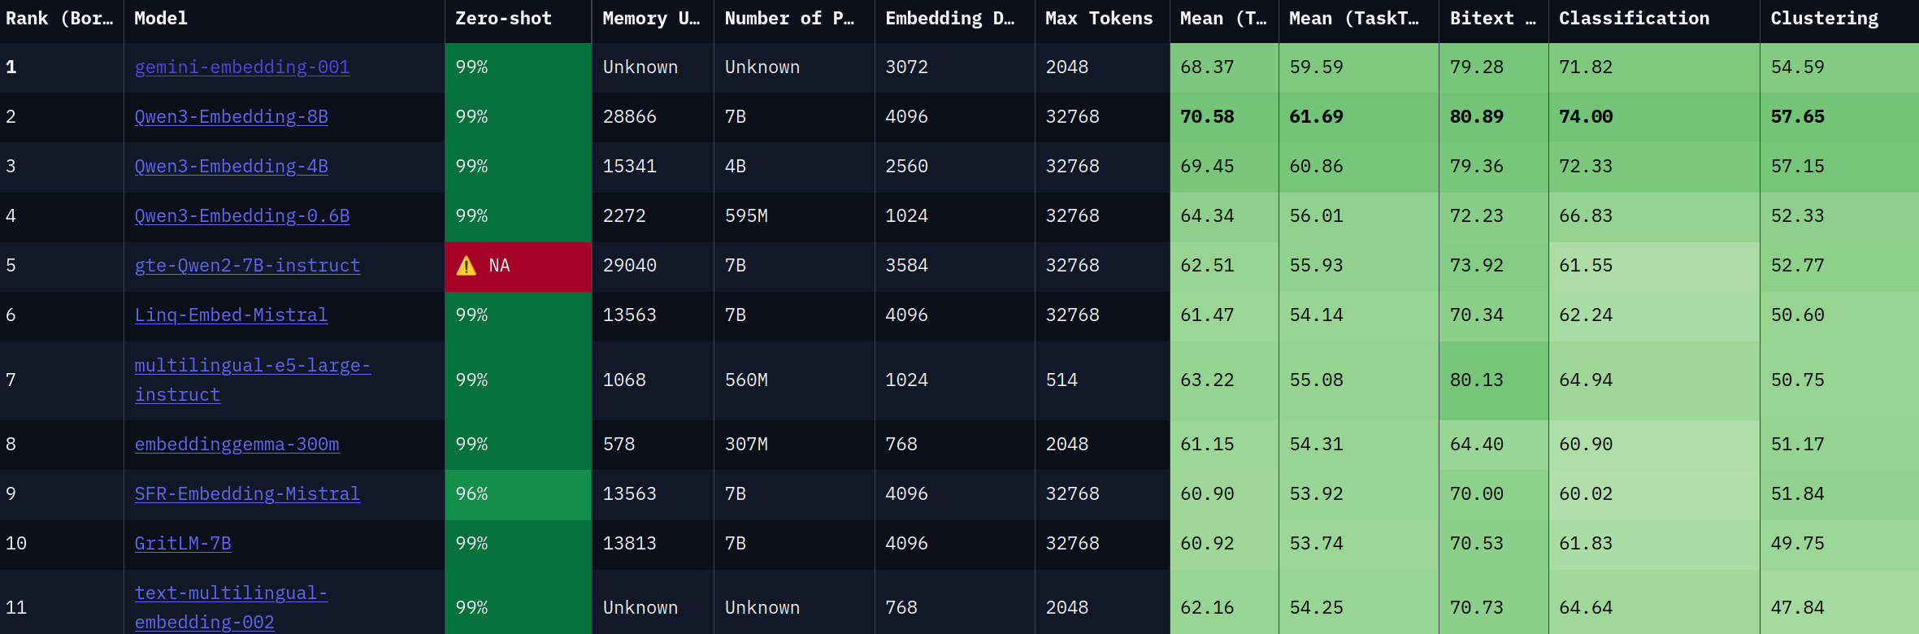
Benchmarking embedding models
How do you choose an embedding model?
You look at benchmarks!
MTEB ranks models based on their performance on different benchmarks.
The MTEB leaderboard on 20/09/2025.

Slide 5
Benchmarking embedding models
Should we trust these public benchmarks?
You can also create your own benchmark with your private data.
The dataset must be clean, diverse, and in your language (or multilingual).
The MTEB leaderboard on 20/09/2025.

Slide 6
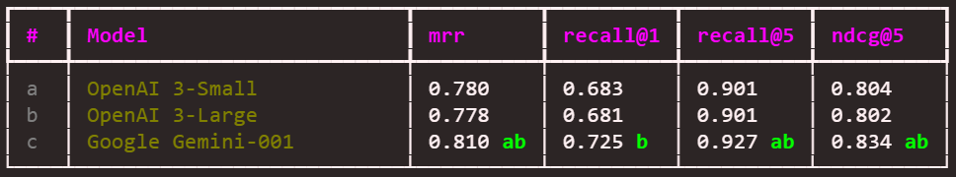
Benchmarking embedding models
In this course, you will:
  Create a golden dataset.
  Run open source and proprietary models.
  Compute metrics to grade the models.
  Perform statistical tests to prove if a model is better than another.
  Automate some steps in the pipeline.
  Generate tables to compare the models.
Comparing Gemini embedding to OpenAI’s embedding models.

Slide 7
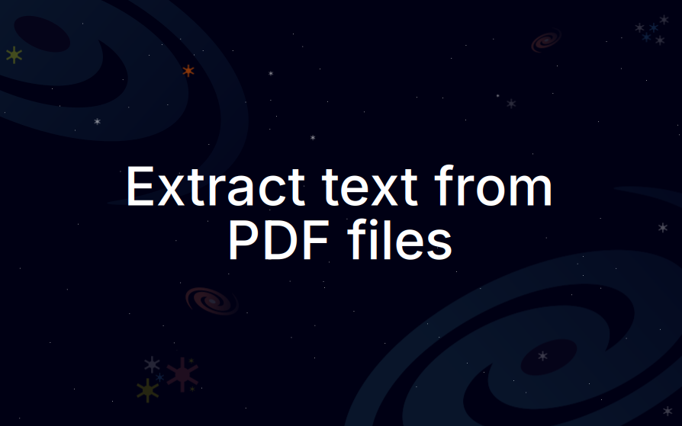

Slide 8
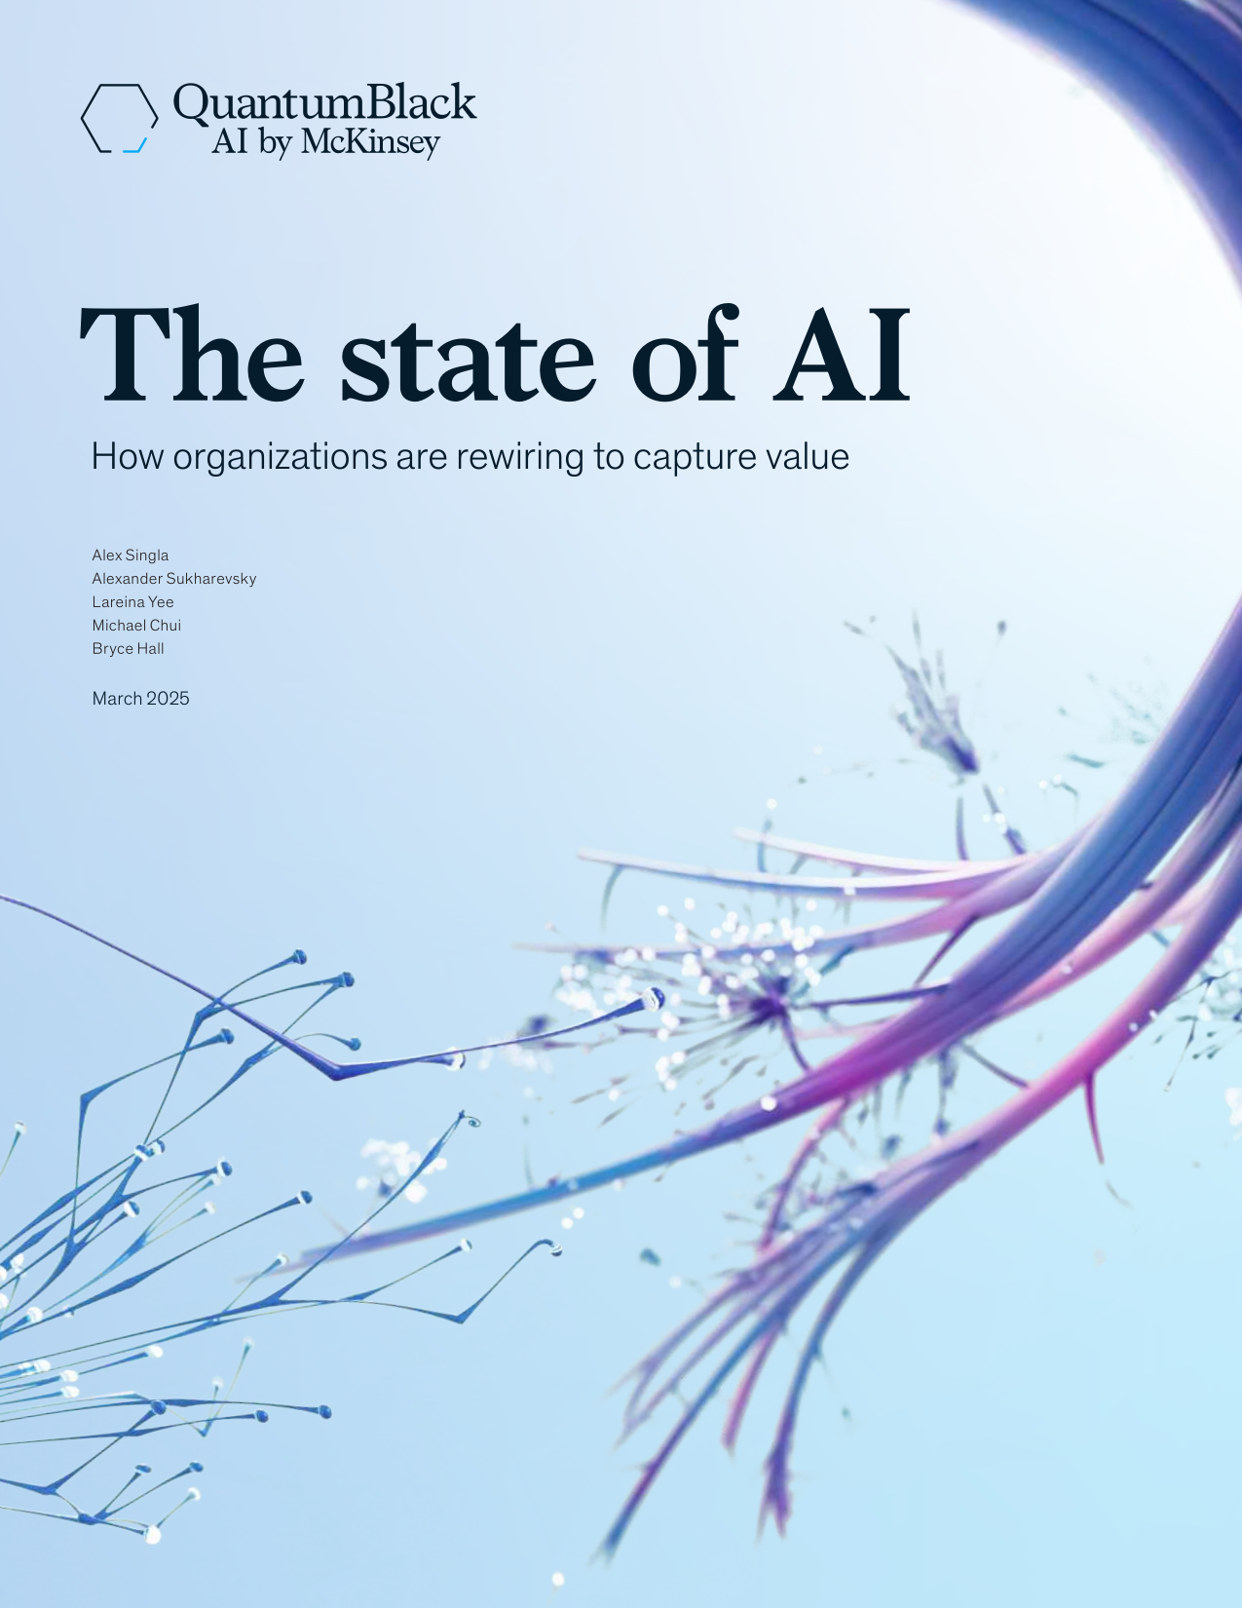
Extract text from PDF files
Extracting text from PDF files is challenging.
PDF files can be scanned, have complex layouts, and contain images, tables, etc
In Python, we can use libraries like PyMuPDF, PyPDF2, and pdfplumber.
These libraries are ineffective if you want to preserve the structure of the document.
The state of AI
March 2025
Alex Singla
Alexander Sukharevsky
Lareina Yee
Michael Chui
Bryce Hall
How organizations are rewiring to capture value
PyMuPDF

Slide 9

Extract text from PDF files
We can use vision language (VL) models to parse PDF documents and images.
VL models can see images

Slide 10


Extract text from PDF files
We can use vision language (VL) models to parse PDF documents and images.
VL models can see images, read and understand text.

Slide 11
Extract text from PDF files
We can use vision language (VL) models to parse PDF documents and images.
VL models can see images, read and understand text.
The vision and language parts work together to parse the image effectively.
QuantumBlack
AI by McKinsey
The state of AI
How organizations are rewiring to capture value
Alex Singla
Alexander Sukharevsky
Lareina Yee
Michael Chui
Bryce Hall
March 2025

Slide 12
Extract text from PDF files
What is the trade-off?
Let’s compare both methods side-by-side.
 | Python libraries | VL models
Cost | Free | Free / Paid
Scanned input | No | Yes
Resources | Low | High / Low
Preserve structure | No | Yes
Handle complex layouts | No | Yes
Understand the content | No | Yes
Speed | Fast | Slow

Slide 13
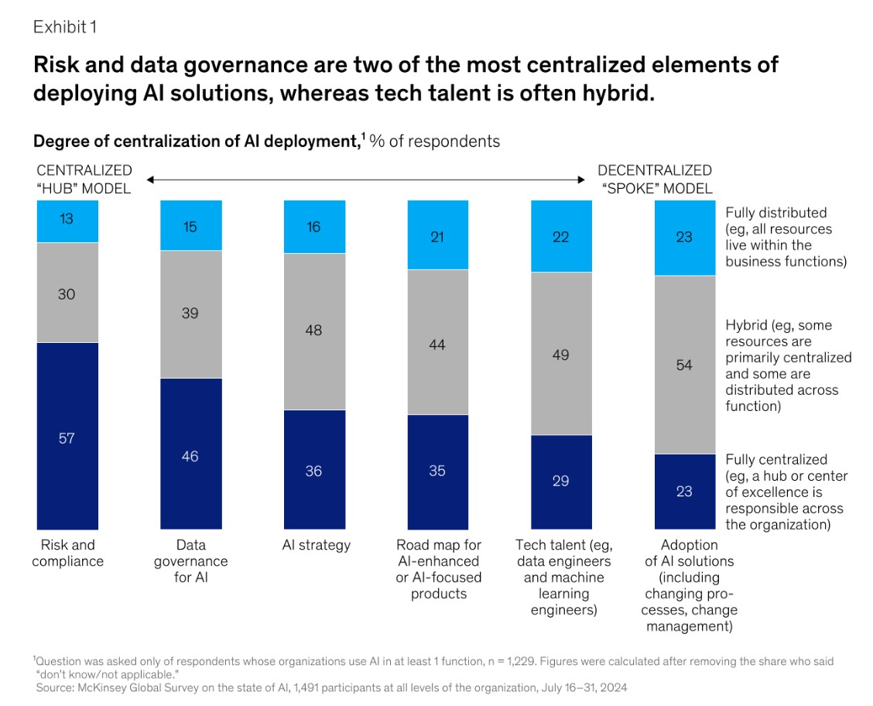
Extract text from PDF files
Side-by-side comparison: Test N°1

Slide 14
Extract text from PDF files
Side-by-side comparison: Test N°1
PyMuPDF
Exhibit 1
Degree of centralization of AI deployment,¹ % of respondents
McKinsey & Company
¹Question was asked only of respondents whose organizations use AI in at least 1 function, n = 1,229. Figures were calculated after removing the share who said
“don’t know/not applicable.”
Source: McKinsey Global Survey on the state of AI, 1,491 participants at all levels of the organization, July 16–31, 2024
Risk and data governance are two of the most centralized elements of
deploying AI solutions, whereas tech talent is often hybrid.
57
46
36
35
29
23
30
39

Slide 15
Extract text from PDF files
Side-by-side comparison: Test N°1
PyMuPDF
Exhibit 1
Degree of centralization of AI deployment,¹ % of respondents
McKinsey & Company
¹Question was asked only of respondents whose organizations use AI in at least 1 function, n = 1,229. Figures were calculated after removing the share who said
“don’t know/not applicable.”
Source: McKinsey Global Survey on the state of AI, 1,491 participants at all levels of the organization, July 16–31, 2024
Risk and data governance are two of the most centralized elements of
deploying AI solutions, whereas tech talent is often hybrid.
57
46
36
35
29
23
30
39

Slide 16
Extract text from PDF files
Side-by-side comparison: Test N°1
PyMuPDF
Exhibit 1
Degree of centralization of AI deployment,¹ % of respondents
McKinsey & Company
¹Question was asked only of respondents whose organizations use AI in at least 1 function, n = 1,229. Figures were calculated after removing the share who said
“don’t know/not applicable.”
Source: McKinsey Global Survey on the state of AI, 1,491 participants at all levels of the organization, July 16–31, 2024
Risk and data governance are two of the most centralized elements of
deploying AI solutions, whereas tech talent is often hybrid.
57
46
36
35
29
23
30
39

Slide 17
Extract text from PDF files
Side-by-side comparison: Test N°1
PyMuPDF
Exhibit 1
Degree of centralization of AI deployment,¹ % of respondents
McKinsey & Company
¹Question was asked only of respondents whose organizations use AI in at least 1 function, n = 1,229. Figures were calculated after removing the share who said
“don’t know/not applicable.”
Source: McKinsey Global Survey on the state of AI, 1,491 participants at all levels of the organization, July 16–31, 2024
Risk and data governance are two of the most centralized elements of
deploying AI solutions, whereas tech talent is often hybrid.
57
46
36
35
29
23
30
39

Slide 18
Extract text from PDF files
Side-by-side comparison: Test N°1
PyMuPDF (Continuation)
49
54
13
15
16
21
22
23
Fully centralized
(eg, a hub or center
of excellence is
responsible across
the organization)
Hybrid (eg, some
resources are
primarily centralized
and some are ...

Slide 19
Extract text from PDF files
Side-by-side comparison: Test N°1
VL model (Gemini 2.5 Pro)
Exhibit 1
Risk and data governance are two of the most centralized elements of deploying AI solutions, whereas tech talent is often hybrid.
The chart shows two models of centralization: a "CENTRALIZED 'HUB' MODEL" on the left and a "DECENTRALIZED 'SPOKE' MODEL" on the right. The chart has six vertical stacked bars, each representing a different aspect of AI deployment. The legend on the right explains the color coding for the segments of each bar: a dark blue segment represents "Fully centralized (eg, a hub or center of excellence is responsible across the organization)", a gray segment represents "Hybrid (eg, some resources are primarily centralized and some are distributed across function)", and a light blue segment represents "Fully distributed (eg, all resources live within the business functions)".
The six bars are for the following categories, with their respective data breakdowns:
1. Risk and compliance: 57% Fully centralized, 30% Hybrid, 13% Fully distributed.
2. Data governance for AI: 46% Fully centralized, 39% Hybrid, 15% Fully distributed.
3. AI strategy: 36% Fully centralized, 48% Hybrid, 16% Fully distributed.
4. Road map for AI-enhanced or AI-focused products: 35% Fully centralized, 44% Hybrid, 21% Fully distributed.
5. Tech talent (eg, data engineers and machine learning engineers): 29% Fully centralized, 49% Hybrid, 22% Fully distributed.
6. Adoption of AI solutions (including changing processes, change management): 23% Fully centralized, 54% Hybrid, 23% Fully distributed.] ...

Slide 20
Extract text from PDF files
Side-by-side comparison: Test N°1
VL model (Gemini 2.5 Pro)
Exhibit 1
Risk and data governance are two of the most centralized elements of deploying AI solutions, whereas tech talent is often hybrid.
The chart shows two models of centralization: a "CENTRALIZED 'HUB' MODEL" on the left and a "DECENTRALIZED 'SPOKE' MODEL" on the right. The chart has six vertical stacked bars, each representing a different aspect of AI deployment. The legend on the right explains the color coding for the segments of each bar: a dark blue segment represents "Fully centralized (eg, a hub or center of excellence is responsible across the organization)", a gray segment represents "Hybrid (eg, some resources are primarily centralized and some are distributed across function)", and a light blue segment represents "Fully distributed (eg, all resources live within the business functions)".
The six bars are for the following categories, with their respective data breakdowns:
1. Risk and compliance: 57% Fully centralized, 30% Hybrid, 13% Fully distributed.
2. Data governance for AI: 46% Fully centralized, 39% Hybrid, 15% Fully distributed.
3. AI strategy: 36% Fully centralized, 48% Hybrid, 16% Fully distributed.
4. Road map for AI-enhanced or AI-focused products: 35% Fully centralized, 44% Hybrid, 21% Fully distributed.
5. Tech talent (eg, data engineers and machine learning engineers): 29% Fully centralized, 49% Hybrid, 22% Fully distributed.
6. Adoption of AI solutions (including changing processes, change management): 23% Fully centralized, 54% Hybrid, 23% Fully distributed.] ...

Slide 21
Extract text from PDF files
Side-by-side comparison: Test N°1
VL model (Gemini 2.5 Pro)
Exhibit 1
Risk and data governance are two of the most centralized elements of deploying AI solutions, whereas tech talent is often hybrid.
The chart shows two models of centralization: a "CENTRALIZED 'HUB' MODEL" on the left and a "DECENTRALIZED 'SPOKE' MODEL" on the right. The chart has six vertical stacked bars, each representing a different aspect of AI deployment. The legend on the right explains the color coding for the segments of each bar: a dark blue segment represents "Fully centralized (eg, a hub or center of excellence is responsible across the organization)", a gray segment represents "Hybrid (eg, some resources are primarily centralized and some are distributed across function)", and a light blue segment represents "Fully distributed (eg, all resources live within the business functions)".
The six bars are for the following categories, with their respective data breakdowns:
1. Risk and compliance: 57% Fully centralized, 30% Hybrid, 13% Fully distributed.
2. Data governance for AI: 46% Fully centralized, 39% Hybrid, 15% Fully distributed.
3. AI strategy: 36% Fully centralized, 48% Hybrid, 16% Fully distributed.
4. Road map for AI-enhanced or AI-focused products: 35% Fully centralized, 44% Hybrid, 21% Fully distributed.
5. Tech talent (eg, data engineers and machine learning engineers): 29% Fully centralized, 49% Hybrid, 22% Fully distributed.
6. Adoption of AI solutions (including changing processes, change management): 23% Fully centralized, 54% Hybrid, 23% Fully distributed.] ...

Slide 22
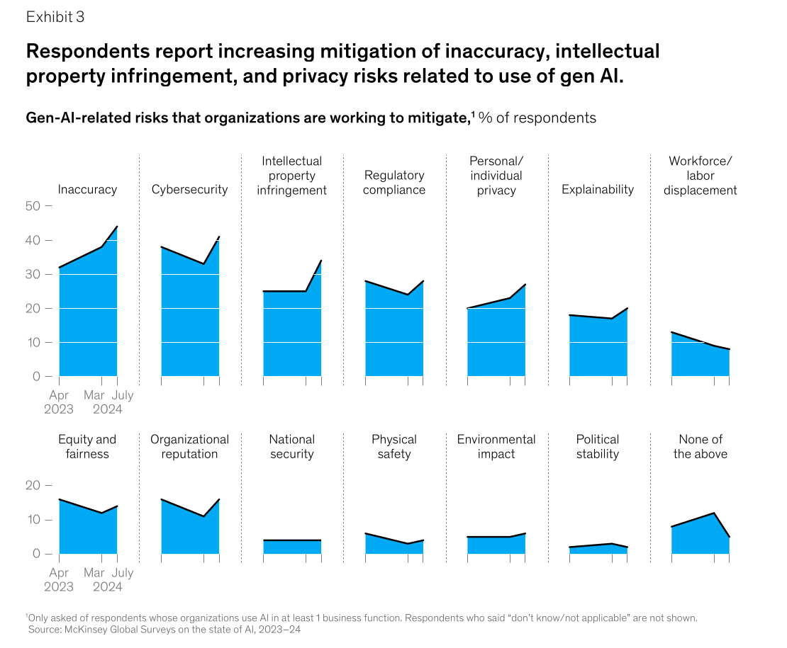
Extract text from PDF files
Side-by-side comparison: Test N°2

Slide 23
Extract text from PDF files
Side-by-side comparison: Test N°2
PyMuPDF
Exhibit 3
Gen-AI-related risks that organizations are working to mitigate,1 % of respondents
1Only asked of respondents whose organizations use Al in at least 1 business function. Respondents who said “don’t know/not applicable” are not shown.
Source: McKinsey Global Surveys on the state of AI, 2023–24
Respondents report increasing mitigation of inaccuracy, intellectual
property infringement, and privacy risks related to use of gen AI.
McKinsey & Company
0
10
20
30
40
50
0
10
20
...

Slide 24
Extract text from PDF files
Side-by-side comparison: Test N°2
VL model (Gemini 2.5 Pro)
Exhibit 3
Respondents report increasing mitigation of inaccuracy, intellectual property infringement, and privacy risks related to use of gen AI.
Gen-AI-related risks that organizations are working to mitigate,¹ % of respondents
Image of a series of 14 area charts arranged in two rows of seven. The charts show the percentage of respondents working to mitigate various generative AI-related risks over time, from April 2023 to July 2024.
The charts in the top row have a y-axis ranging from 0 to 50. The charts are:
* Inaccuracy: Shows a significant increasing trend, starting around 32% in April 2023 and rising to approximately 45% by July 2024.
* Cybersecurity: Shows a slight overall decrease, starting near 38% in April 2023 and ending around 35% in July 2024, with a dip in between.
* Intellectual property infringement: Shows a clear increasing trend, starting at about 25% in April 2023 and rising to roughly 35% in July 2024.
* Regulatory compliance: Shows a slight downward trend, starting at about 28% in April 2023 and ending around 25% in July 2024.
* Personal/individual privacy: Shows an increasing trend, starting from approximately 22% in April 2023 and rising to about 28% by July 2024.
* Explainability: Shows a slight increase, starting from about 18% in April 2023 and ending around 20% in July 2024 ...

Slide 25
Extract text from PDF files
Side-by-side comparison: Test N°2
VL model (Gemini 2.5 Pro)
Exhibit 3
Respondents report increasing mitigation of inaccuracy, intellectual property infringement, and privacy risks related to use of gen AI.
Gen-AI-related risks that organizations are working to mitigate,¹ % of respondents
Image of a series of 14 area charts arranged in two rows of seven. The charts show the percentage of respondents working to mitigate various generative AI-related risks over time, from April 2023 to July 2024.
The charts in the top row have a y-axis ranging from 0 to 50. The charts are:
* Inaccuracy: Shows a significant increasing trend, starting around 32% in April 2023 and rising to approximately 45% by July 2024.
* Cybersecurity: Shows a slight overall decrease, starting near 38% in April 2023 and ending around 35% in July 2024, with a dip in between.
* Intellectual property infringement: Shows a clear increasing trend, starting at about 25% in April 2023 and rising to roughly 35% in July 2024.
* Regulatory compliance: Shows a slight downward trend, starting at about 28% in April 2023 and ending around 25% in July 2024.
* Personal/individual privacy: Shows an increasing trend, starting from approximately 22% in April 2023 and rising to about 28% by July 2024.
* Explainability: Shows a slight increase, starting from about 18% in April 2023 and ending around 20% in July 2024 ...

Slide 26
Extract text from PDF files
VL models will help you create high quality datasets by:
  Annotating images.
  Describing tables or outputting them in Markdown.
  Preserve the layout.
  Extract only what you need from the documents.
  Working with scanned documents.

Slide 27
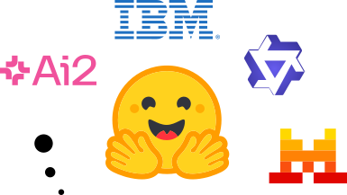

Extract text from PDF files
What model should you use?
Use proprietary and open models through the API. Cheaper!
Host the models in your own servers. Expensive!!!
Proprietary models
Open models

Slide 28
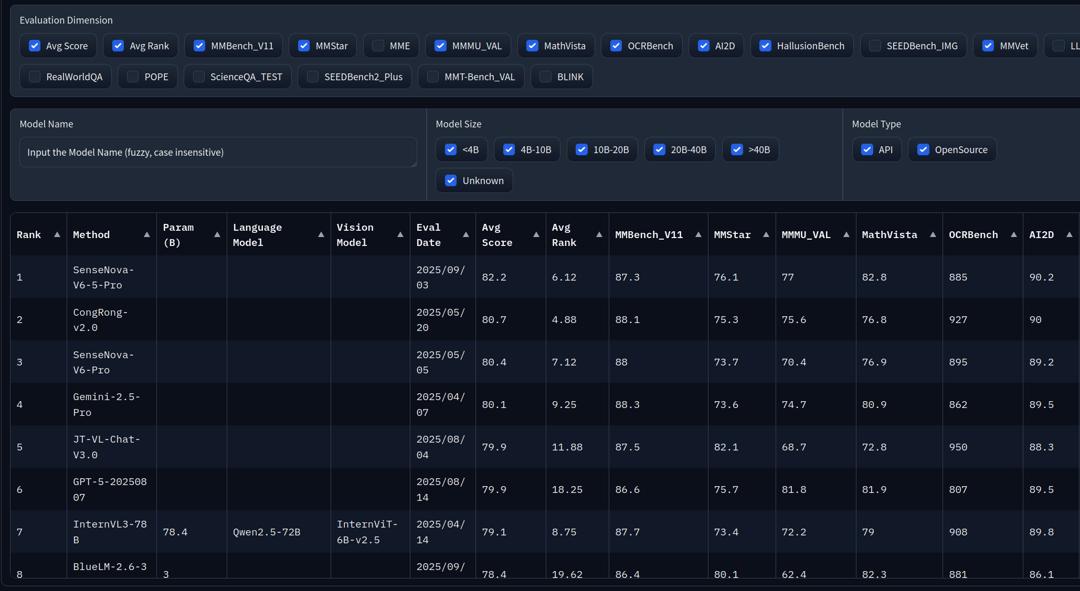
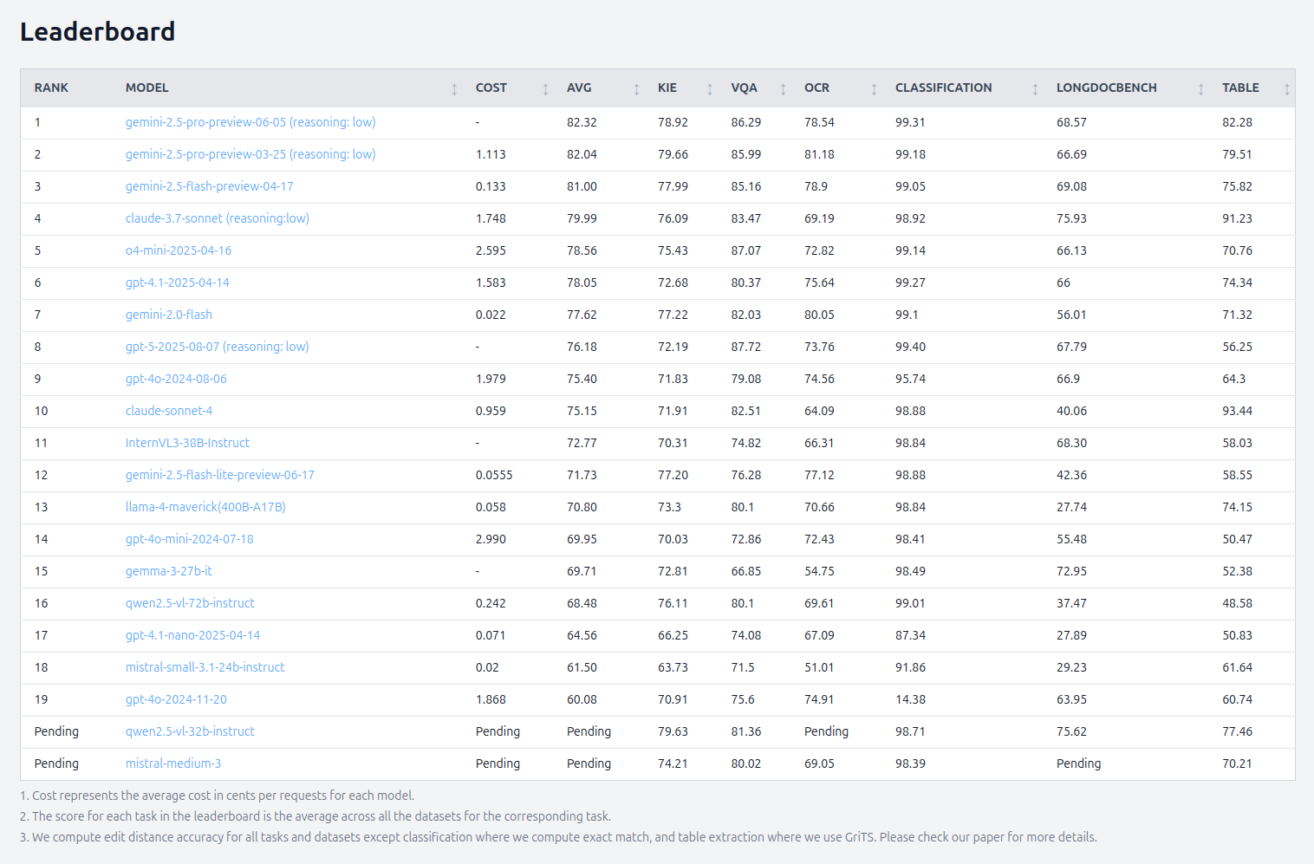
Extract text from PDF files
Keep track of the best models with these leaderboards:
  OpenVLM leaderboard.
  Intelligent document processing leaderboard.

Slide 29
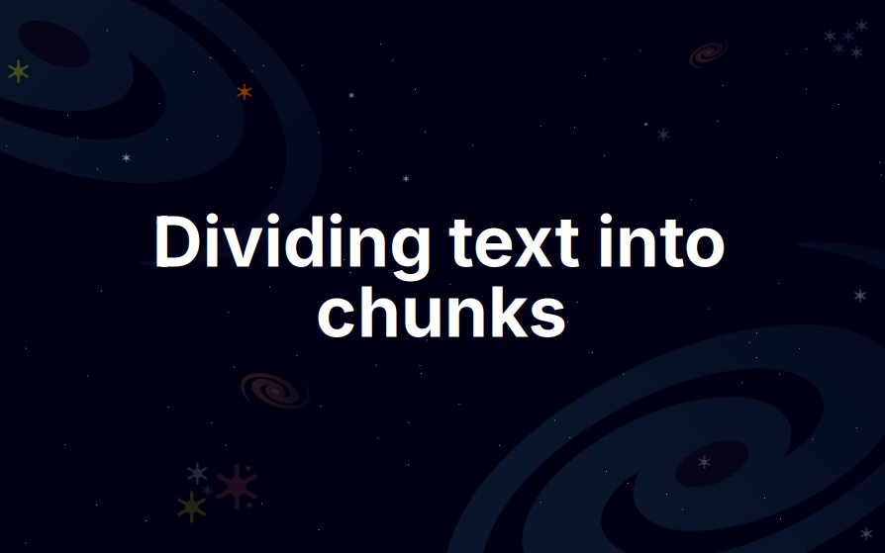

Slide 30
Divide text into chunks
How do we divide the extracted text?
Dividing the text programmatically is not a good idea.
The chart shows two models of centralization: a "CENTRALIZED 'HUB' MODEL" on the left and a "DECENTRALIZED 'SPOKE' MODEL" on the right. The chart has six vertical stacked bars, each representing a different aspect of AI deployment. The legend on the right explains the color coding for the segments of each bar: a dark blue segment represents "Fully centralized (eg, a hub or center of excellence is responsible across the organization)", a gray segment represents "Hybrid (eg, some resources are primarily centralized and some are distributed across function)", and a light blue segment represents "Fully distributed (eg, all resources live within the business functions)".
The six bars are for the following categories, with their respective data breakdowns:
1. Risk and compliance: 57% Fully centralized, 30% Hybrid, 13% Fully distributed.
2. Data governance for AI: 46% Fully centralized, 39% Hybrid, 15% Fully distributed.
3. AI strategy: 36% Fully centralized, 48% Hybrid, 16% Fully distributed.

Slide 31
Divide text into chunks
How do we divide the extracted text?
Dividing the text programmatically is not a good idea.
Each chunk should contain text that focus on a specific idea.
The chart shows two models of centralization: a "CENTRALIZED 'HUB' MODEL" on the left and a "DECENTRALIZED 'SPOKE' MODEL" on the right. The chart has six vertical stacked bars, each representing a different aspect of AI deployment. The legend on the right explains the color coding for the segments of each bar: a dark blue segment represents "Fully centralized (eg, a hub or center of excellence is responsible across the organization)", a gray segment represents "Hybrid (eg, some resources are primarily centralized and some are distributed across function)", and a light blue segment represents "Fully distributed (eg, all resources live within the business functions)".
The six bars are for the following categories, with their respective data breakdowns:
1. Risk and compliance: 57% Fully centralized, 30% Hybrid, 13% Fully distributed.
2. Data governance for AI: 46% Fully centralized, 39% Hybrid, 15% Fully distributed.
3. AI strategy: 36% Fully centralized, 48% Hybrid, 16% Fully distributed.

Slide 32
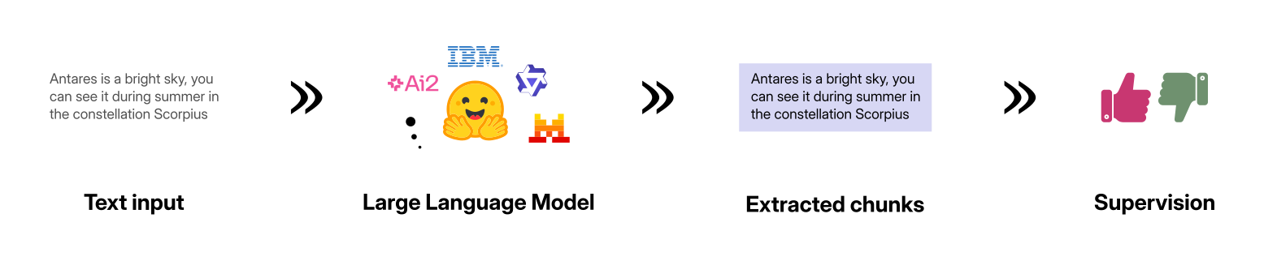
Divide text into chunks
How do we divide the extracted text?
Dividing the text programmatically is not a good idea.
Each chunk should contain text that focus on a specific idea.
How do we do that?
  We can do it manually (slow).
  We use large language models (fast), but needs supervision.

Slide 33
Divide text into chunks
How do we divide the extracted text?
Dividing the text programmatically is not a good idea.
Each chunk should contain text that focus on a specific idea.
How do we do that?
  We can do it manually (slow).
  We use large language models (fast), but needs supervision.

Slide 34
Divide text into chunks
How do we divide the extracted text?
Dividing the text programmatically is not a good idea.
Each chunk should contain text that focus on a specific idea.
How do we do that?
  We can do it manually (slow).
  We use large language models (fast), but needs supervision.

Slide 35
Divide text into chunks
How do we divide the extracted text?
Dividing the text programmatically is not a good idea.
Each chunk should contain text that focus on a specific idea.
How do we do that?
  We can do it manually (slow).
  We use large language models (fast), but needs supervision.

Slide 36
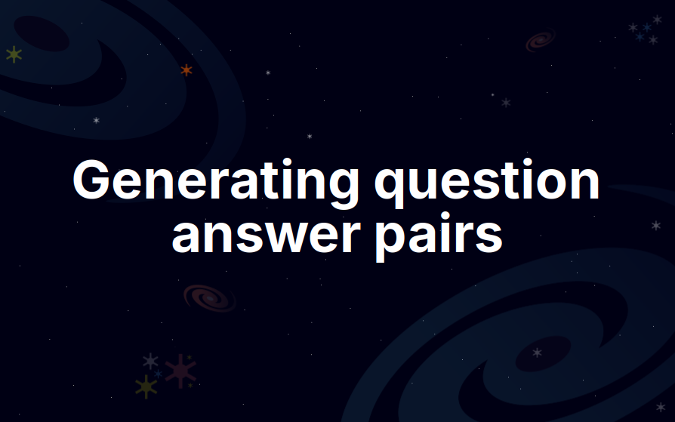

Slide 37
Generate question-answer pairs
Generate questions that can be answered by a chunk of text.
A chunk can answer one or more questions.
A question can be answered by one or more chunks.
bitsandbytes enables accessible large language models via k-bit quantization for PyTorch. bitsandbytes provides three main features for dramatically reducing memory consumption for inference and training: 8-bit optimizers, LLM.int8() or 8-bit quantization, and QLoRA or 4-bit quantization.
Q.1/ What is the primary purpose of the bitsandbytes library?
Q.2/ What are the three main features bitsandbytes provides for reducing memory consumption?
Text chunk
Questions

