Slide 1
Module 1: The foundation
Cloud setup & access

Slide 2




Cloud setup & access
Prerequisites
Goal: A secure environment before deploying code.
Providers: DigitalOcean, AWS EC2, Linode, or Raspberry Pi.

Slide 3

Cloud setup & access
Prerequisites
Goal: A secure environment before deploying code.
Providers: DigitalOcean, AWS EC2, Linode, or Raspberry Pi.
Learning objectives
Deploy a server running Ubuntu 24.04 LTS.
Generate and configure SSH Keys (Ed25519).
Understand the "Lock & Key" security model.
Security: Disable password authentication completely.

Slide 4
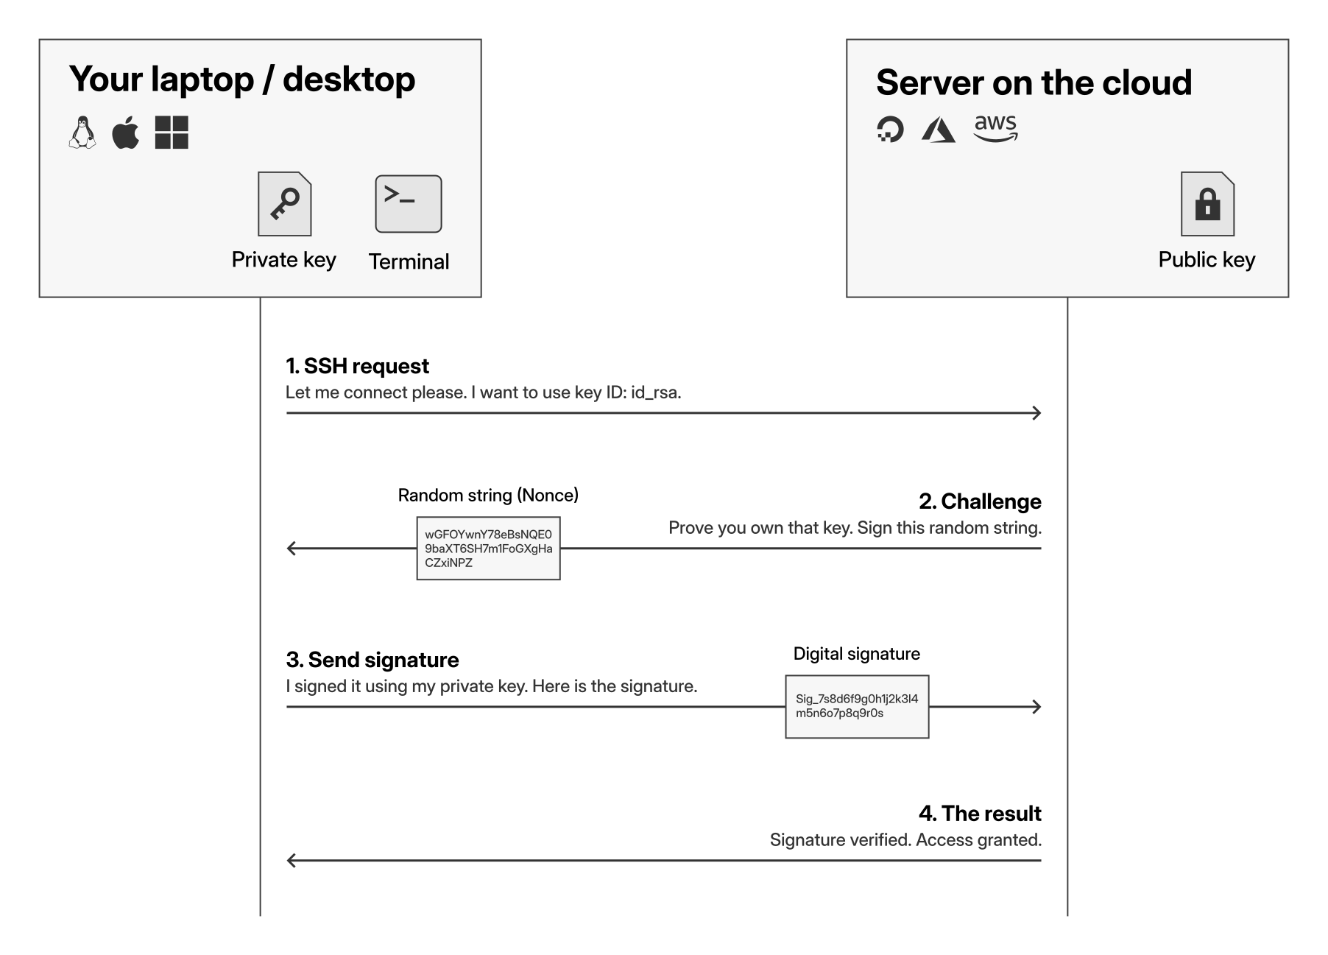
How SSH keys work

Slide 5
How SSH keys work

Slide 6
How SSH keys work

Slide 7
How SSH keys work

Slide 8
How SSH keys work

Slide 9

What is next?
Current status: You now have a clean, secure Ubuntu server.
The risk: The server is still exposed to the open internet.
Next steps:
  Firewall configuration: Setting up UFW (Uncomplicated Firewall).
  Brute force protection: Installing Fail2Ban to block attackers.
  Emergency access: How to use the recovery console.

Slide 10
Module 1: The foundation
The firewall strategy

Slide 11
The firewall strategy
Problem: Default Linux servers accept traffic on all ports.
Solution: Use UFW to block everything by default.
Automation: Use Fail2Ban to block bots instantly.
Safety net: Using the DigitalOcean Recovery Console.

Slide 12
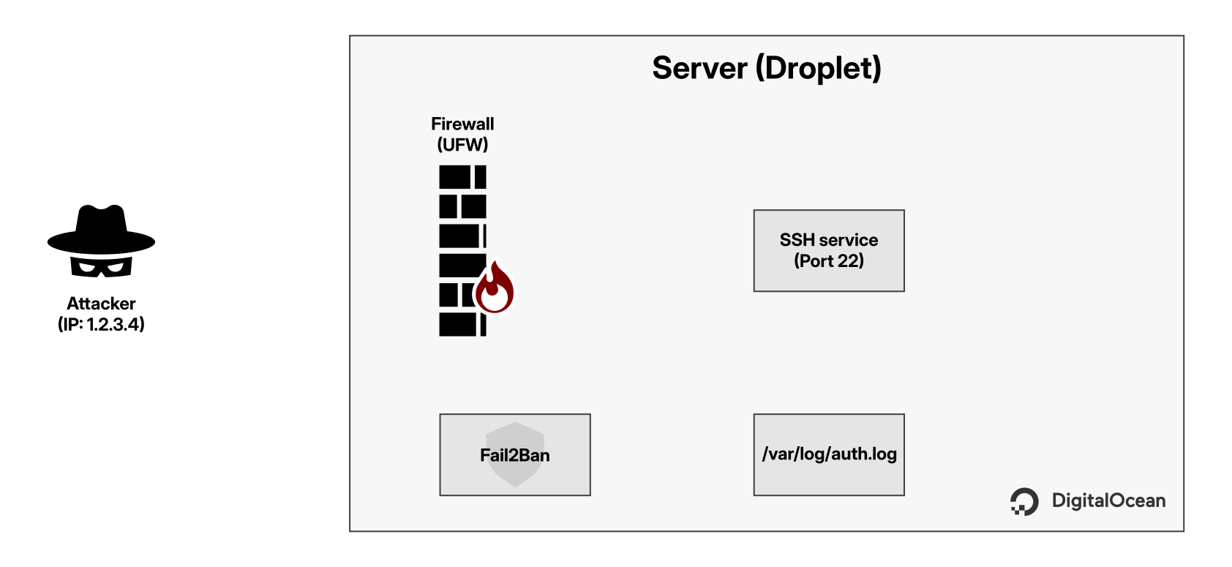
How Fail2Ban works

Slide 13
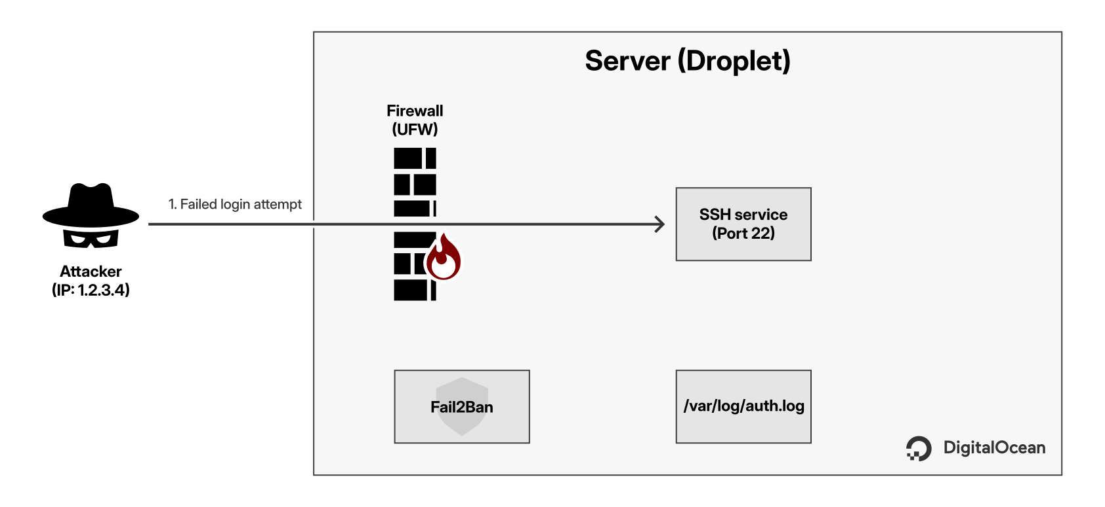
How Fail2Ban works

Slide 14
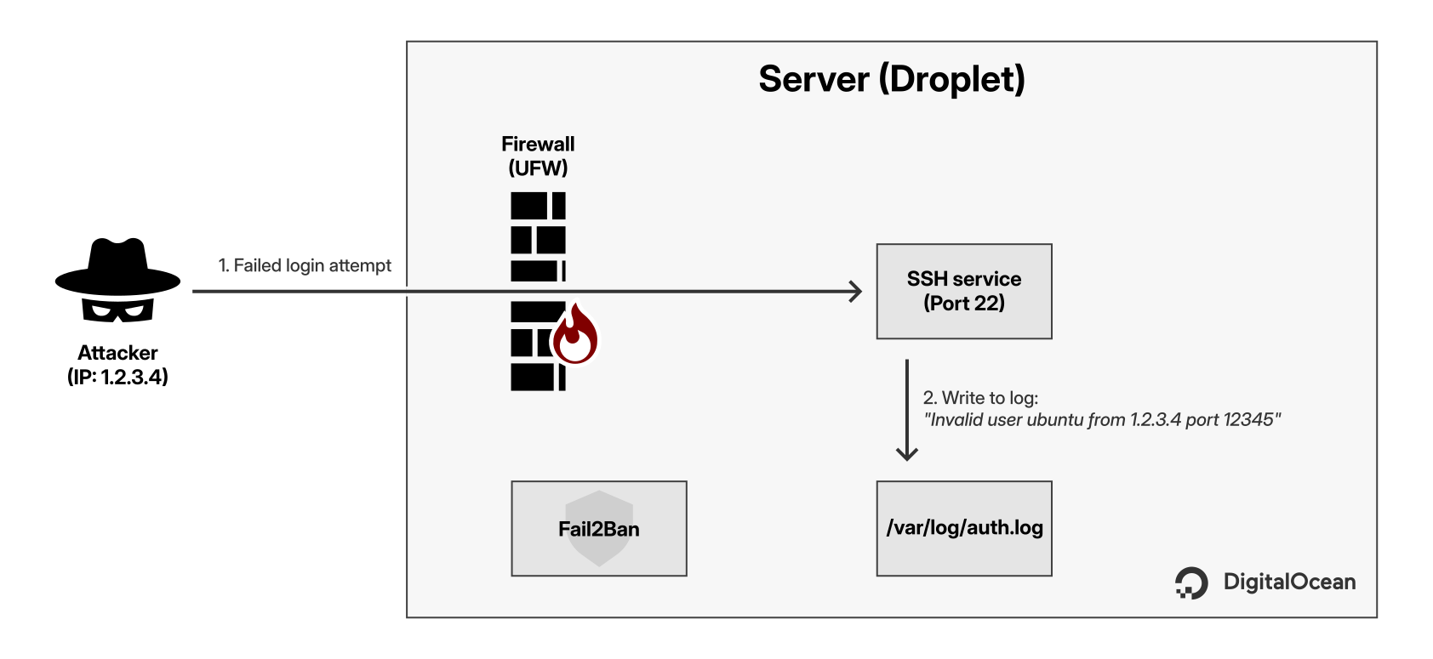
How Fail2Ban works

Slide 15
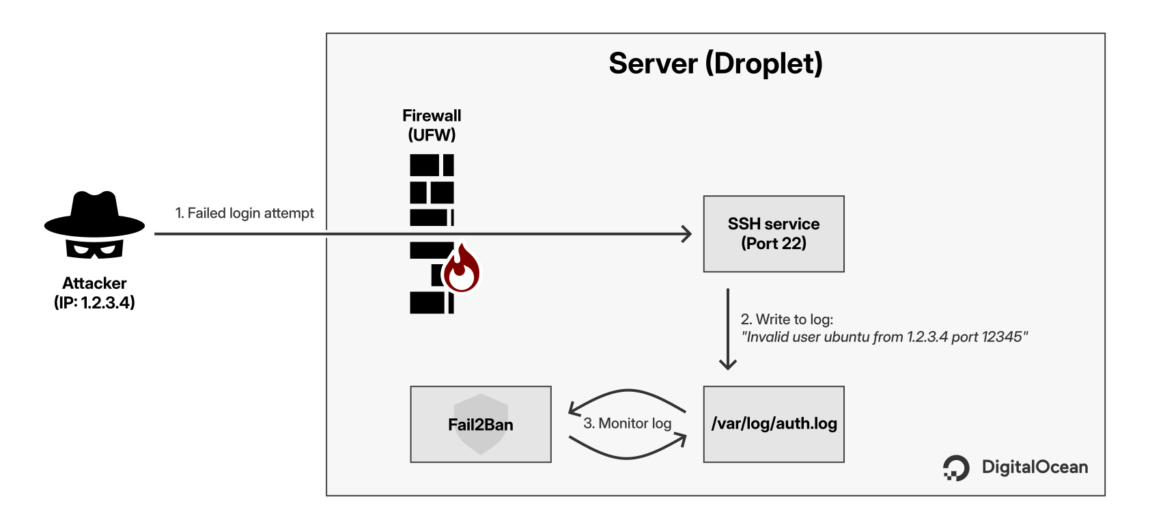
How Fail2Ban works

Slide 16
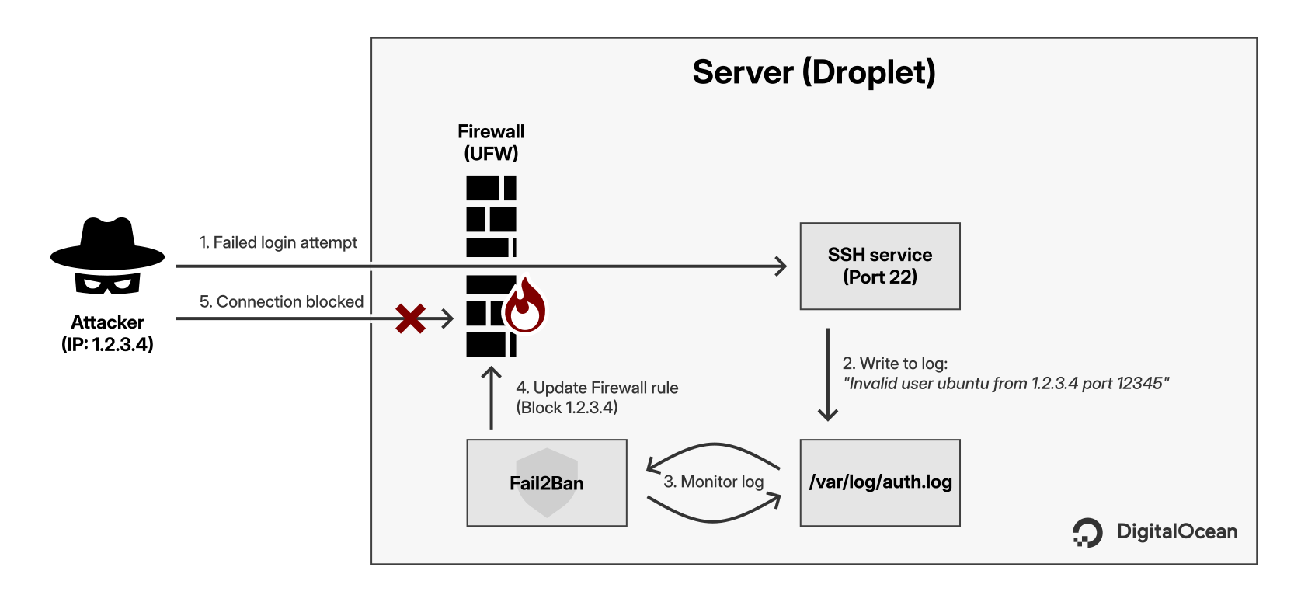
How Fail2Ban works

Slide 17
Module 2: The
application runtime
Manual deployment

Slide 18
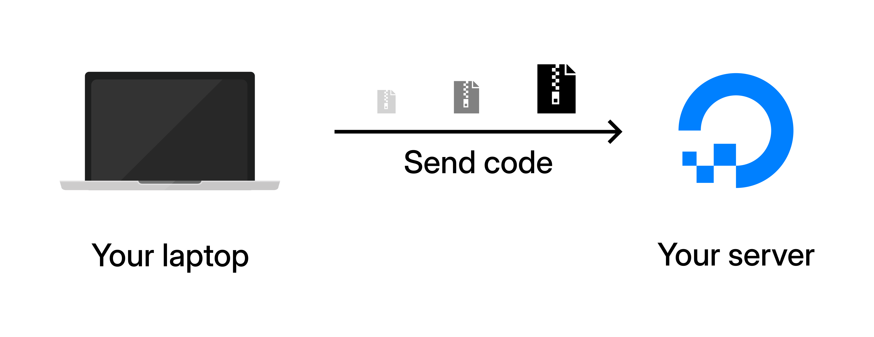
Manual deployment
Move code using scp and organize permissions.

Slide 19
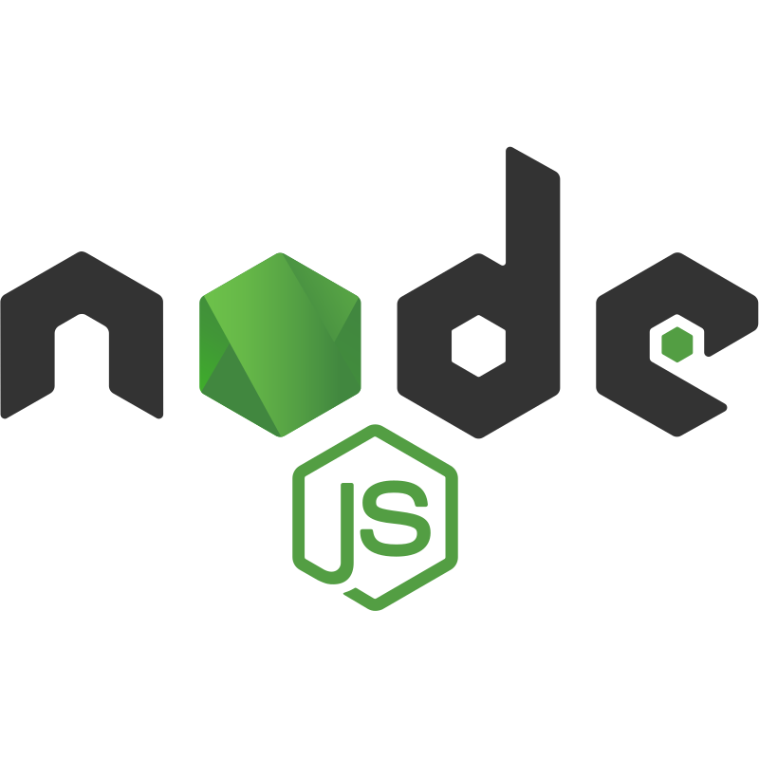

Manual deployment
Move code using scp and organize permissions.
Install Python (Backend) and Node.js (Frontend).
Fix build errors using Swap files.
Use SSH Tunnels to bypass the firewall.

Slide 20

Manual deployment
Move code using scp and organize permissions.
Install Python (Backend) and Node.js (Frontend).
Fix build errors using Swap files.
Use SSH Tunnels to bypass the firewall.
Configure Gunicorn and Supervisor.

Slide 21
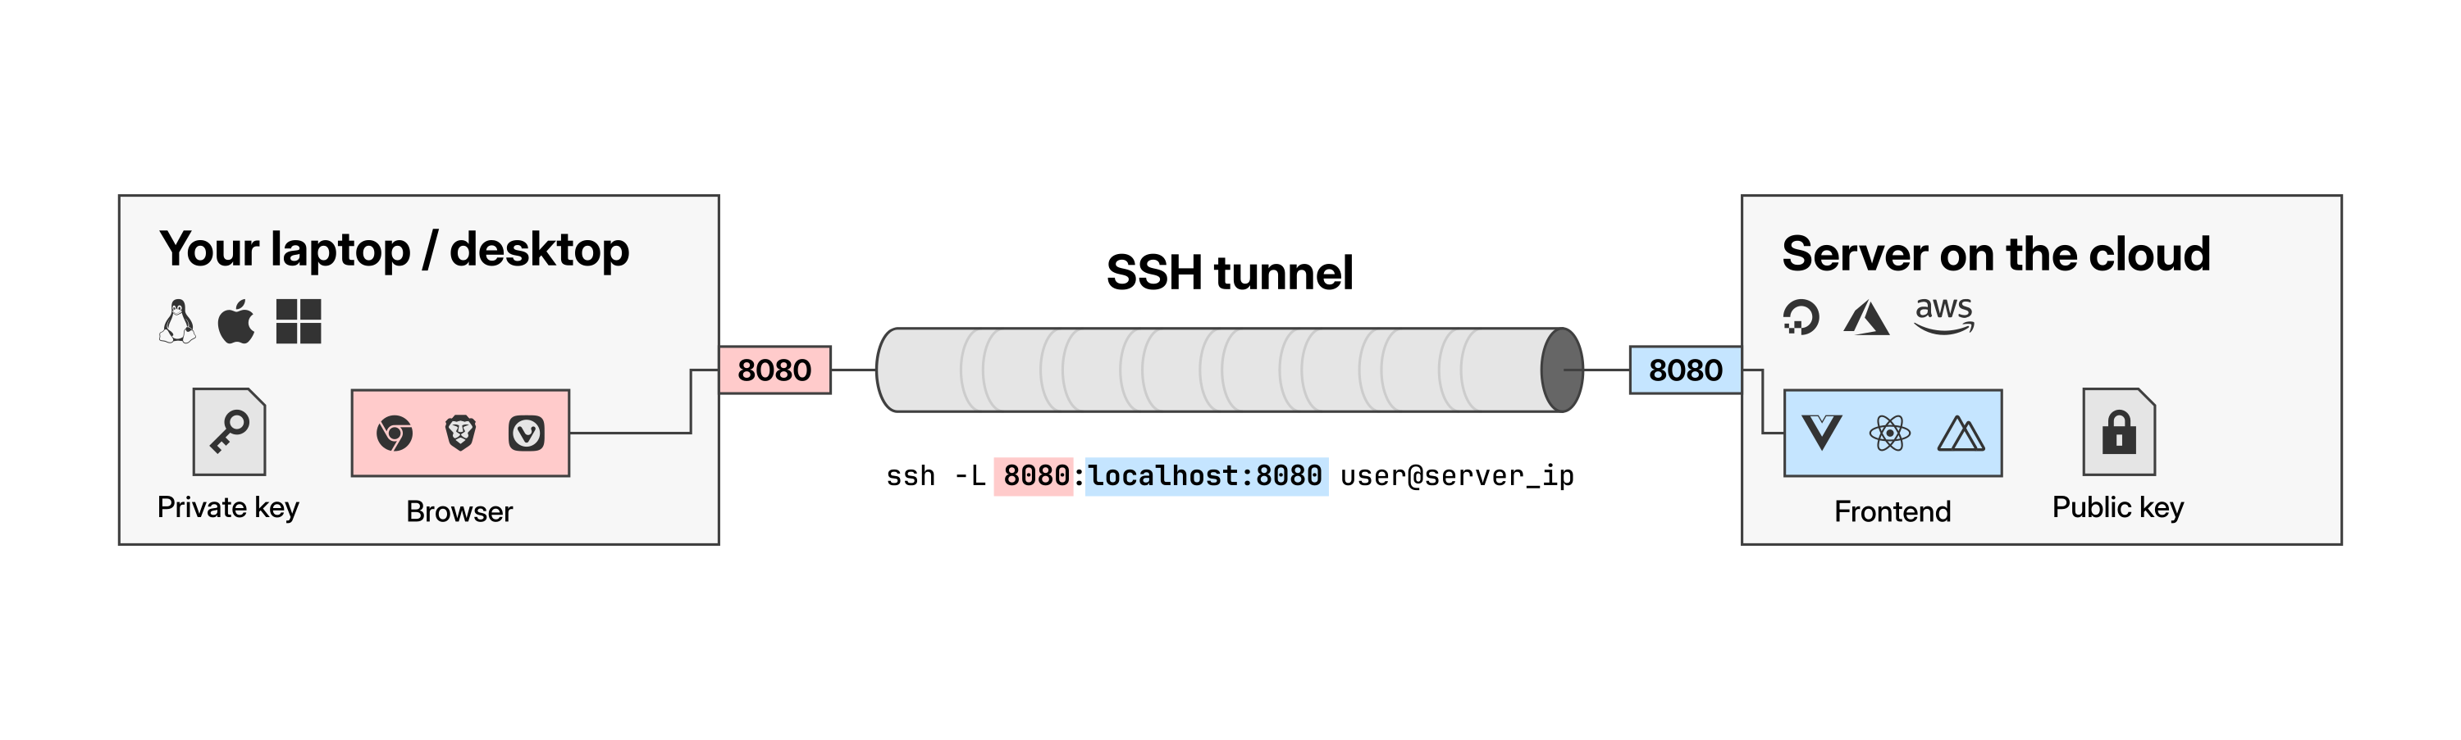
SSH tunneling

Slide 22
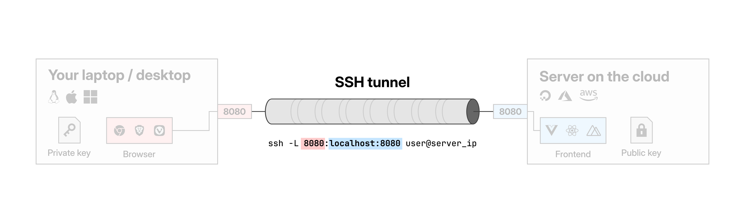
SSH tunneling

Slide 23
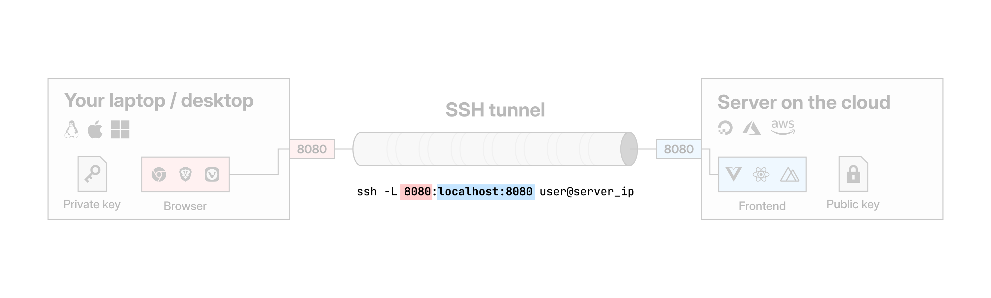
SSH tunneling

Slide 24
SSH tunneling

Slide 25
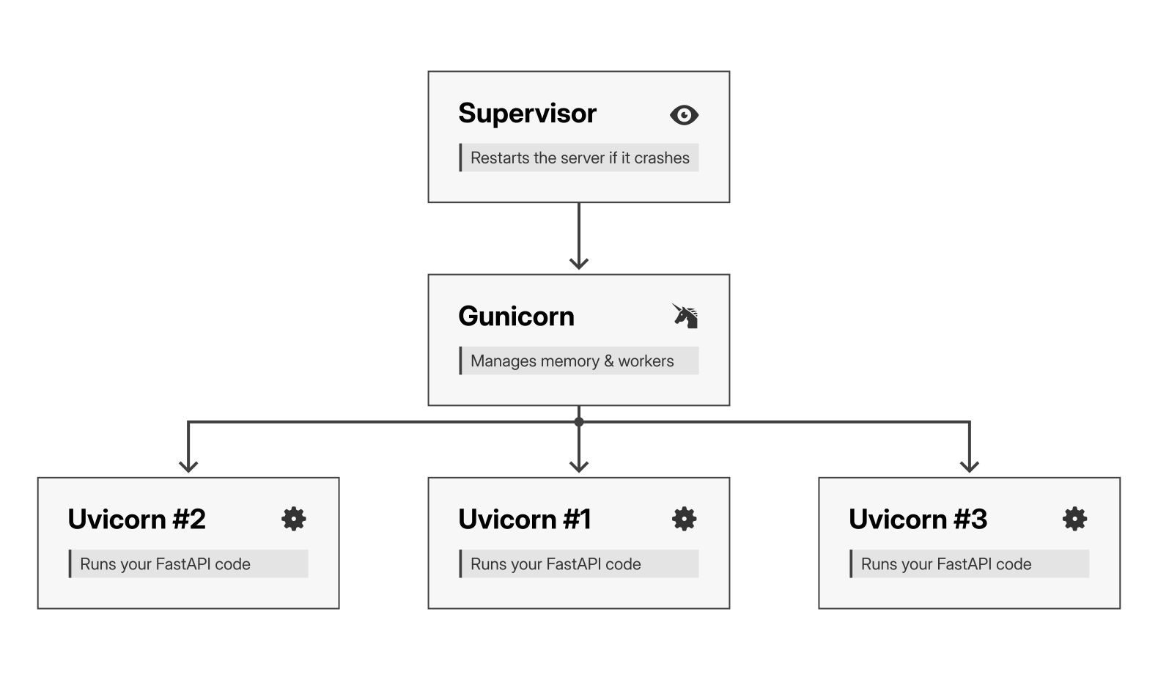
Keeping the app alive

Slide 26
Module 2: The
application runtime
Reverse proxy & security headers

Slide 27

Reverse proxy & Security
Sync frontend and backend URLs.
Install and configure Nginx.

Slide 28
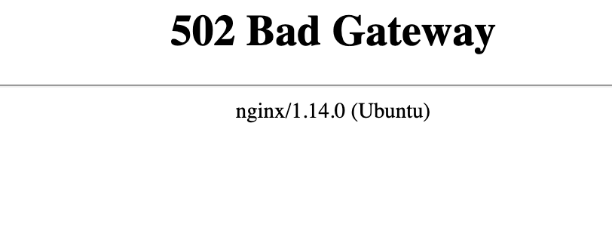
Reverse proxy & Security
Sync frontend and backend URLs.
Install and configure Nginx.
Understand and fix the 502 Bad Gateway error.

Slide 29
Reverse proxy & Security
Sync frontend and backend URLs.
Install and configure Nginx.
Understand and fix the 502 Bad Gateway error.
Protect users with HTTP Security Headers (CSP).

Slide 30
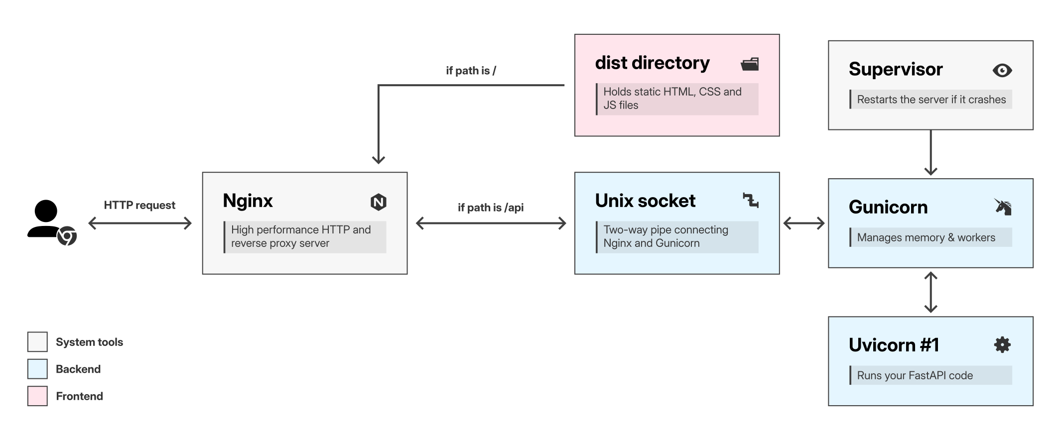
Nginx: The traffic cop

Slide 31
Module 3: Data and search
Self-hosting Meilisearch

Slide 32

Self-hosting a search engine
The engine: Meilisearch (a lightning-fast Rust binary).
Security: Isolate the database using a system user.
Automation: Run it as a background service using systemd.
Maintenance: Schedule automatic snapshot backups.
Management: Use an SSH Tunnel to access a visual dashboard securely.

Slide 33
What is a system user?
Feature | Standard user | System user
Purpose | Human administration | Running background services
Shell | /bin/bash | /bin/false
Login | Yes | No
Home folder | /home/user | /var/lib/meilisearch

Slide 34
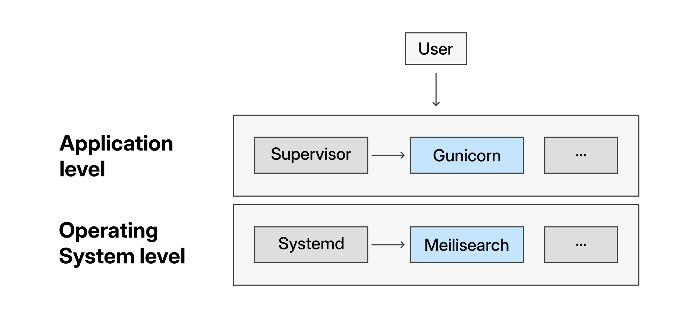
Systemd vs Supervisor

Slide 35
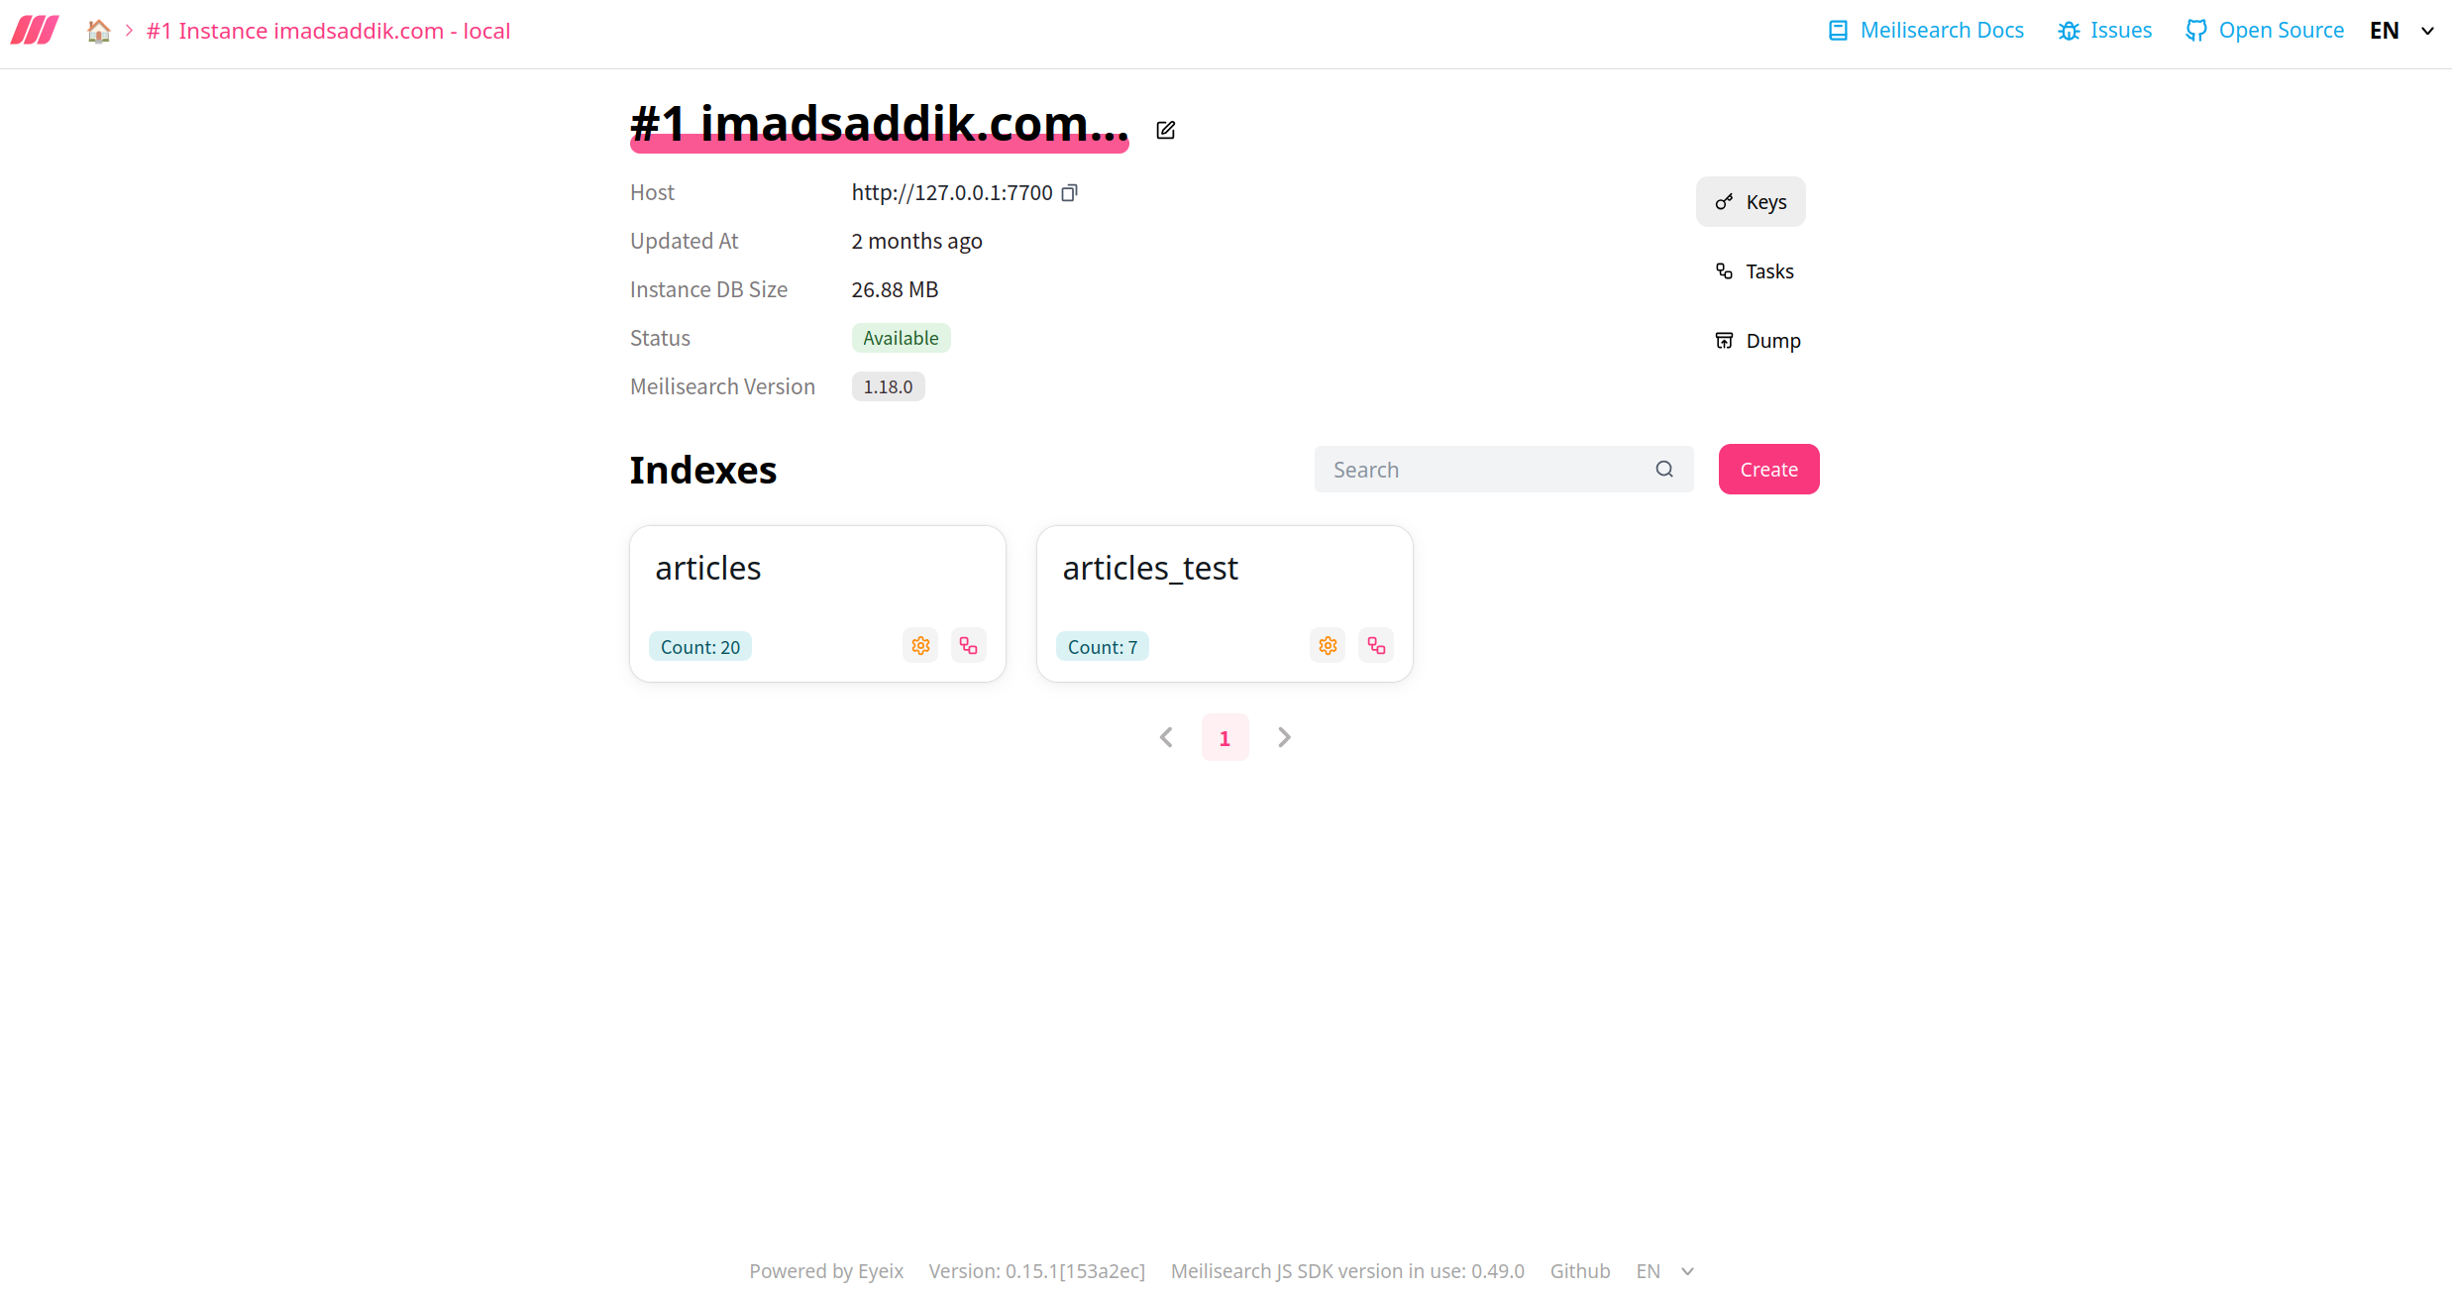
Secure database management
The tool: meilisearch-ui (Open-source web dashboard).
Features: Search, add, and edit documents visually.

Slide 36
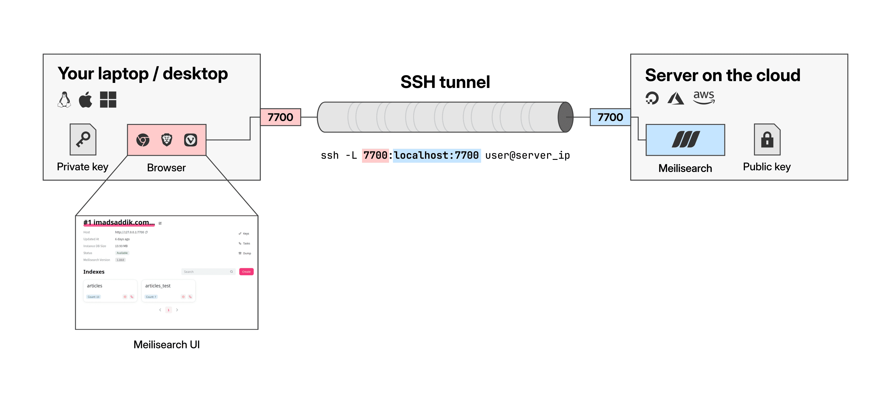
Secure database management
The tool: meilisearch-ui (Open-source web dashboard).
Features: Search, add, and edit documents visually.
The connection: Secure access via SSH Tunneling (no open ports).

Slide 37
Module 4: Global delivery and security
Domains and SSL

Slide 38

Domains & SSL
Purchase a custom domain.
Configure DNS Records (A and CNAME).
Install free SSL certificates via Let's Encrypt.
Automate 90-day renewals using Cron.

Slide 39
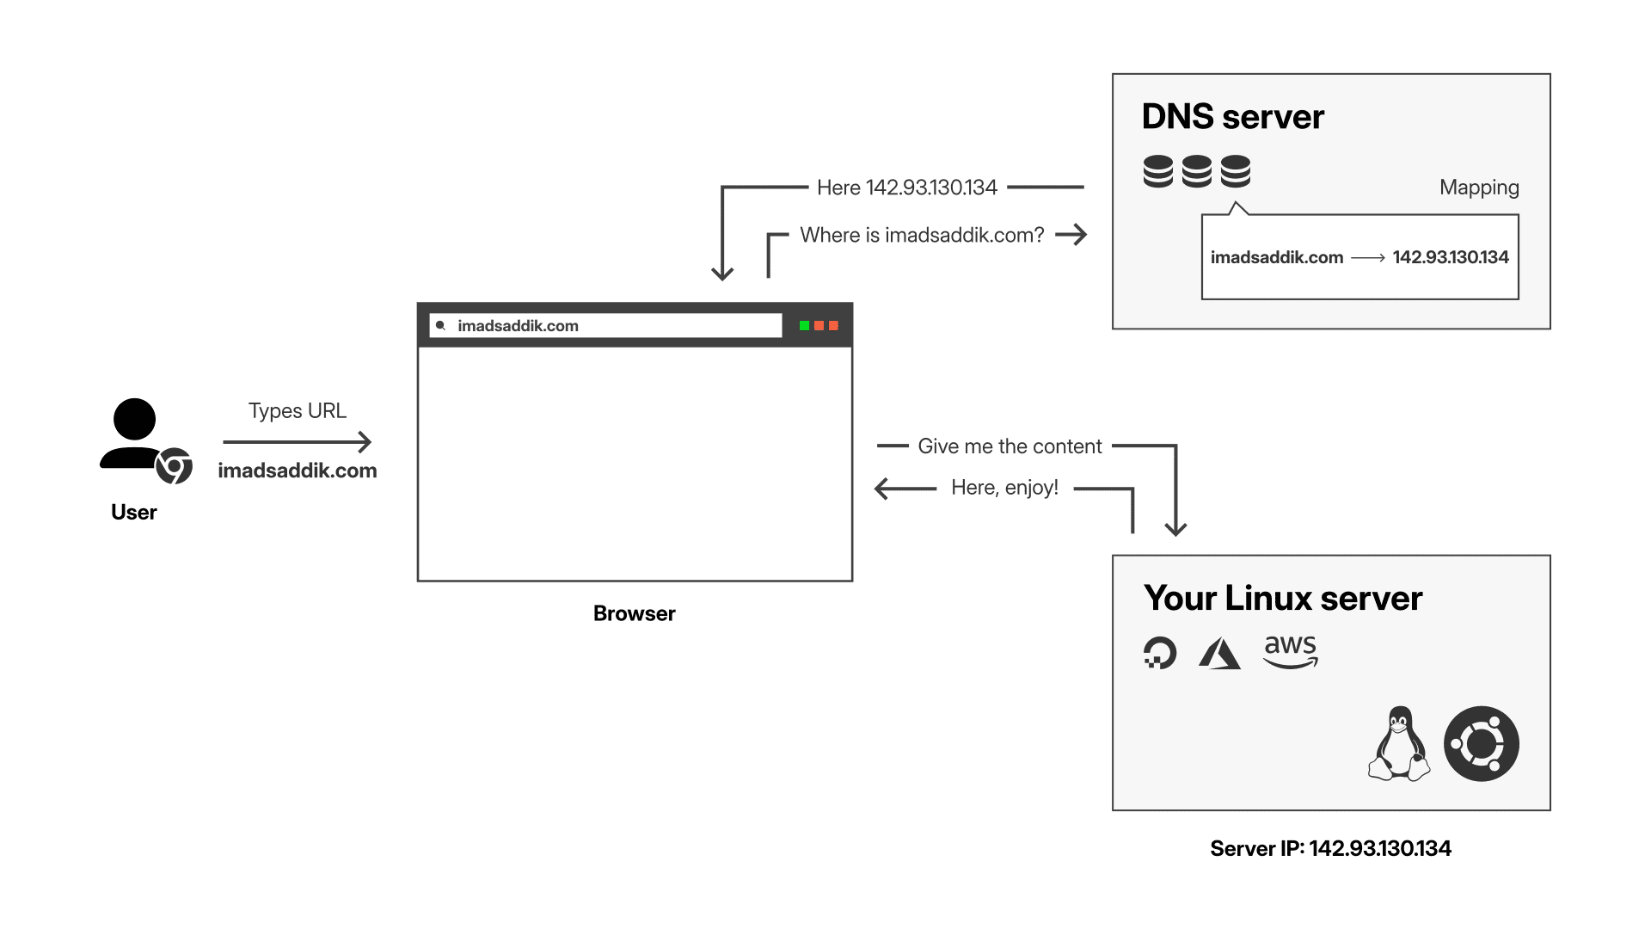
How DNS works

Slide 40
Module 4: Global delivery and security
The CDN layer and caching

Slide 41

Global speed & Caching
Route traffic through a Content Delivery Network (CDN).
Configure strict end-to-end SSL encryption.
Unmask visitor IP addresses in Nginx.
Implement a caching strategy for SPAs.

Slide 42
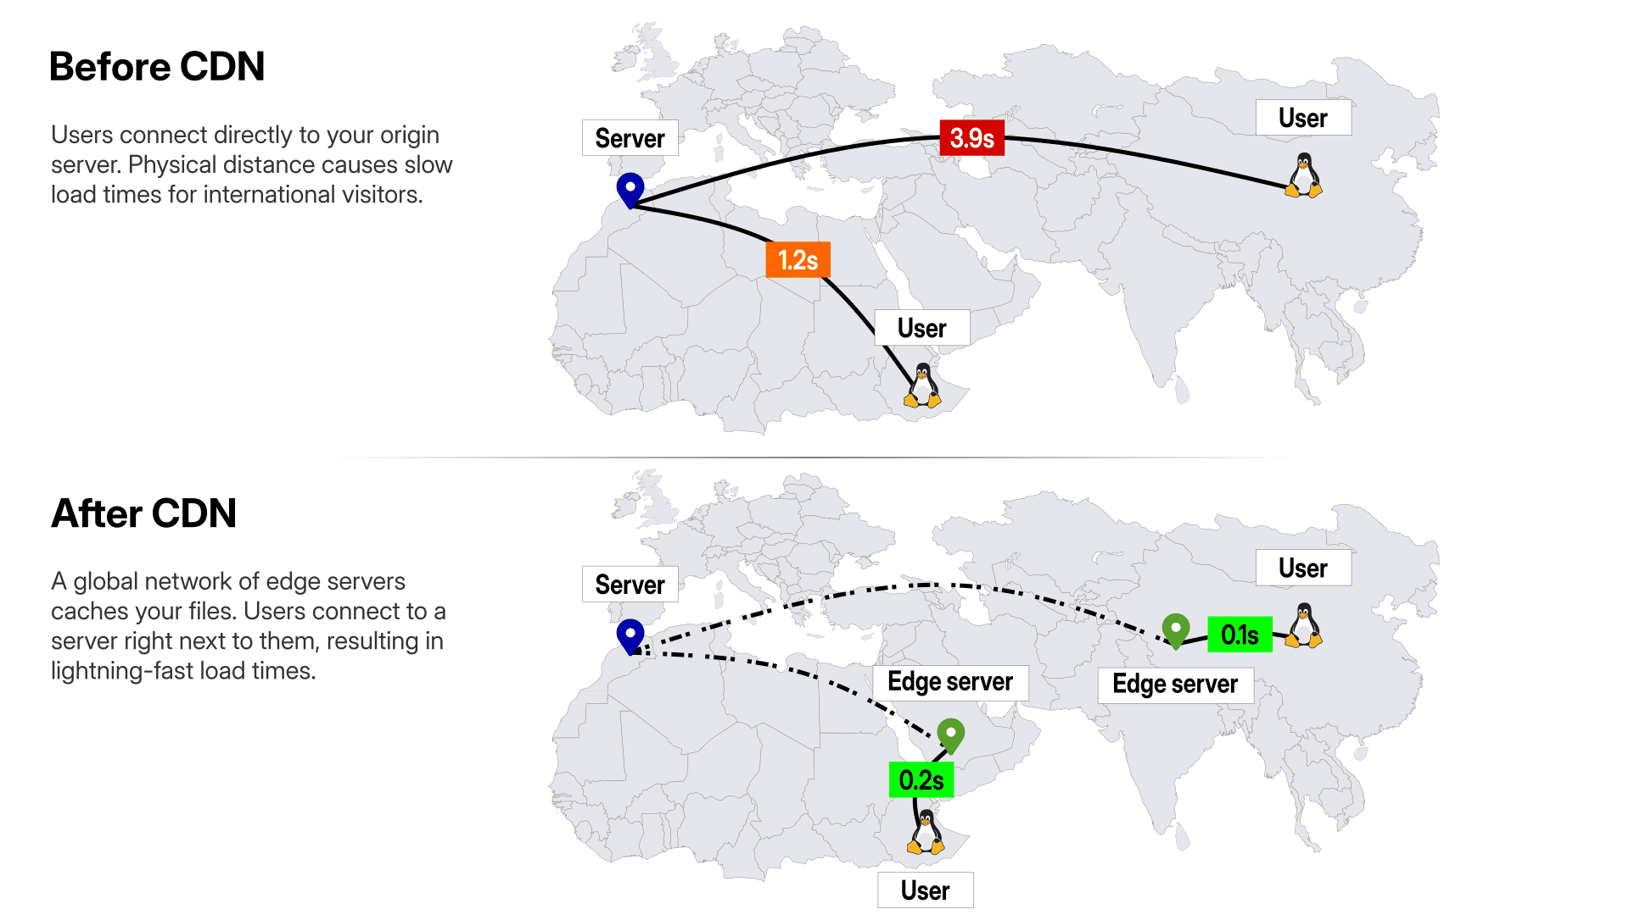
Beating the speed of light

Slide 43
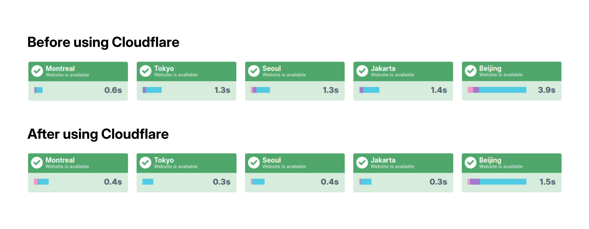
Beating the speed of light

Slide 44
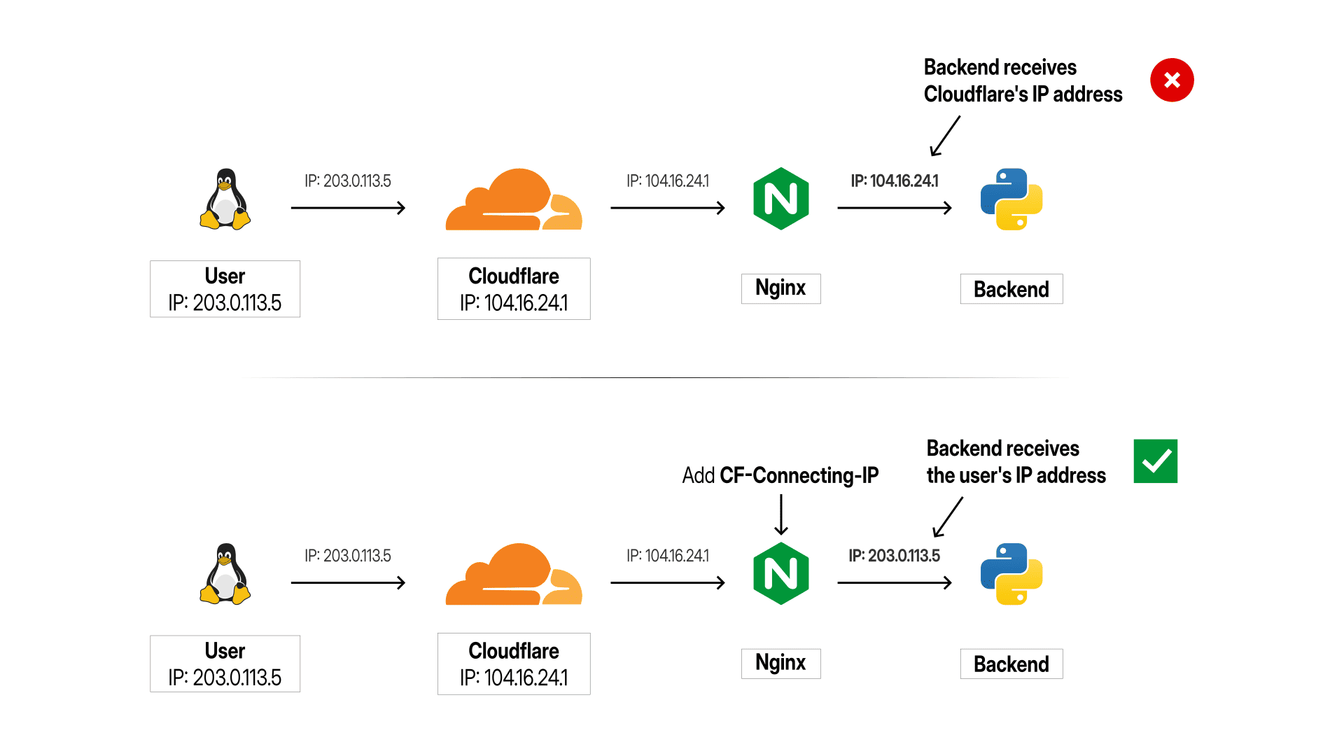
The real IP problem

Slide 45
The real IP problem

Slide 46
Module 4: Global delivery and security
Vulnerability scanning

Slide 47
Testing your defenses
Understand and fix the Soft 404 vulnerability.
Configure Nginx to instantly block malicious bots.
Use nmap to scan your firewall from the outside.

Slide 48
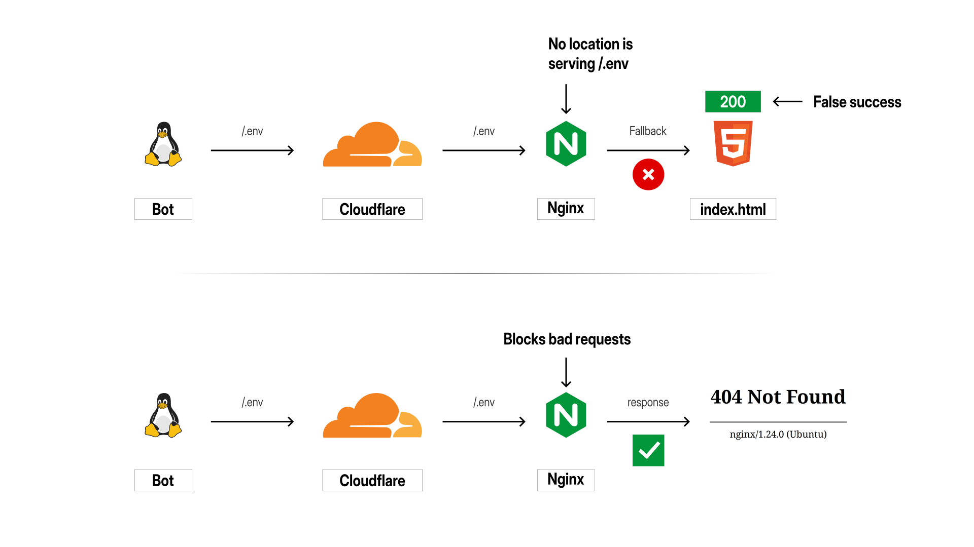
Fixing the SPA trap (Soft 404s)

Slide 49
Fixing the SPA trap (Soft 404s)

Slide 50
Module 5: The automation pipeline
Local hygiene

Slide 51
Securing your local workflow
Protect the main branch using GitHub Rulesets.
Automate local checks with pre-commit.
Lint and format Python using Ruff.
Lint and format Vue.js using ESLint & Prettier.

