Slide 1
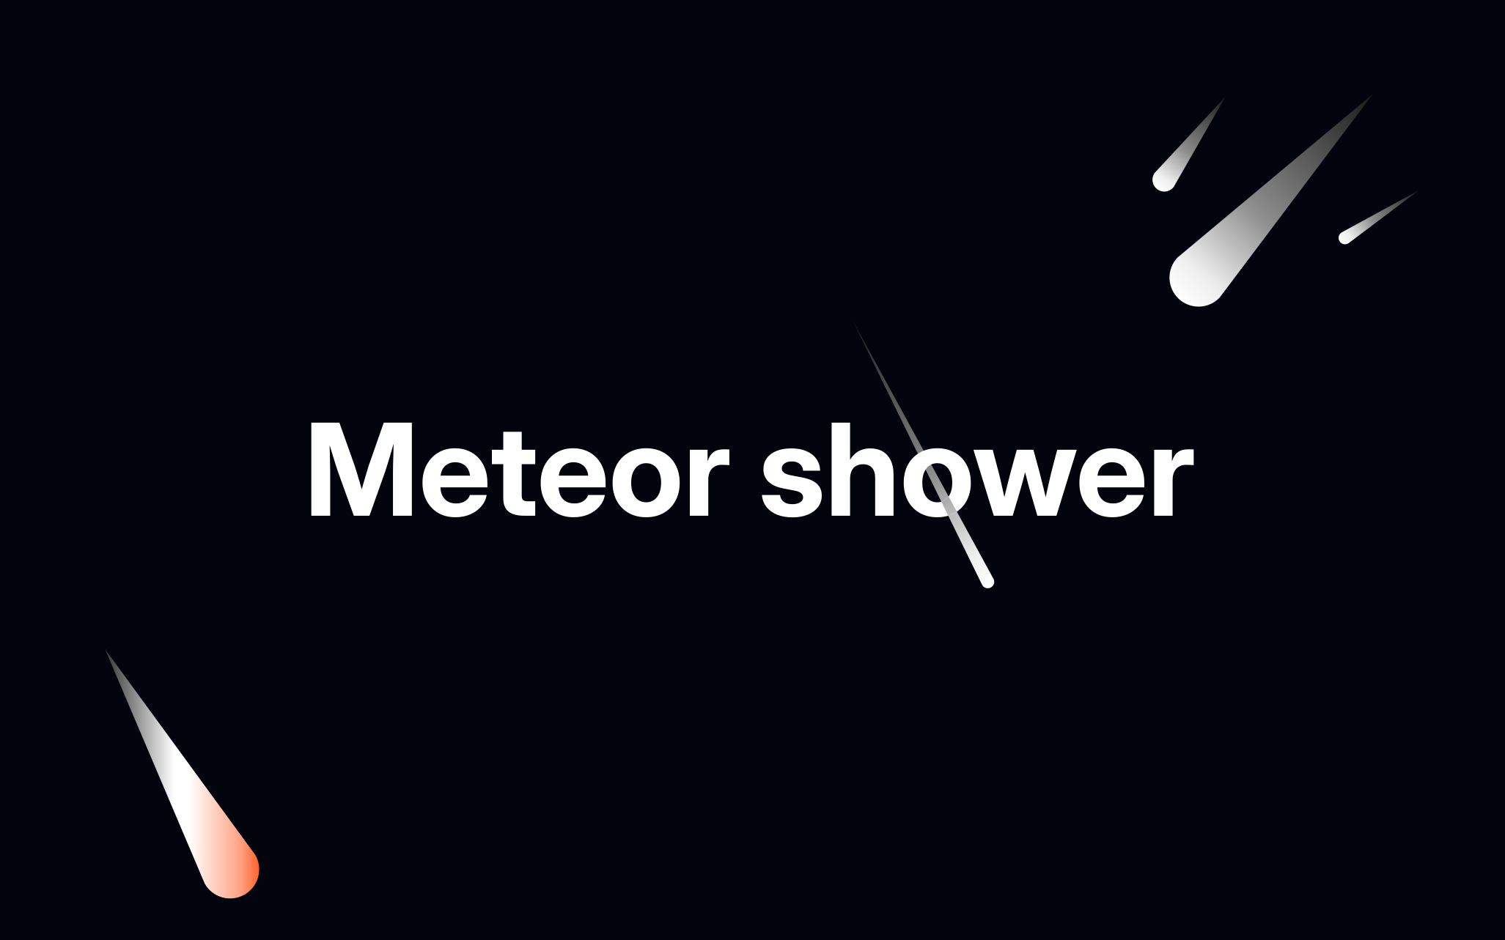

Slide 2
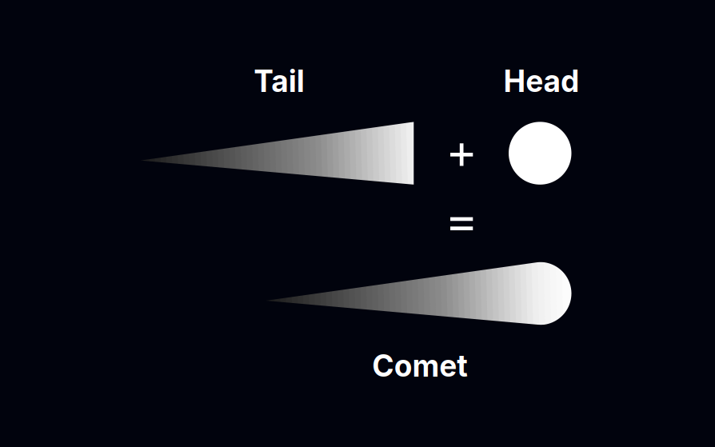
Designing the comet

Slide 3


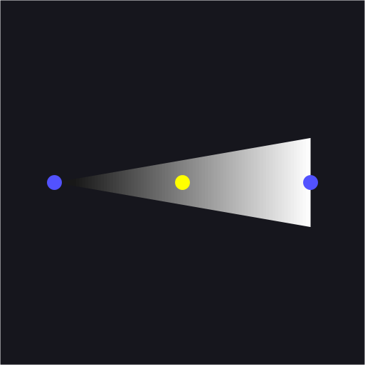
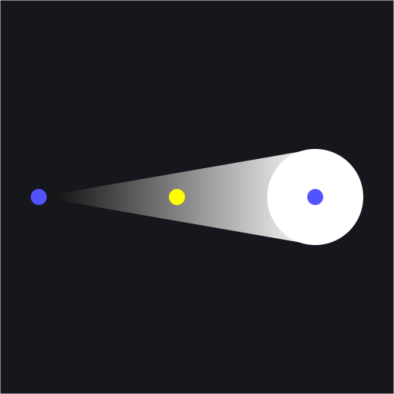
Designing the comet
To draw the comet, we will use the canvas in HTML.
The steps to follow:
Locate the head and tail
Find the center
Draw the tail
Add the head

Slide 4
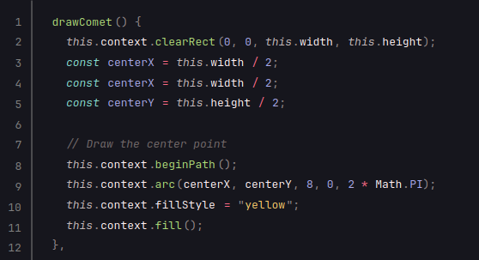
Designing the comet
Find the center

Slide 5
Designing the comet
Find the center

Slide 6
Designing the comet
Find the center

Slide 7
Designing the comet
Find the center

Slide 8
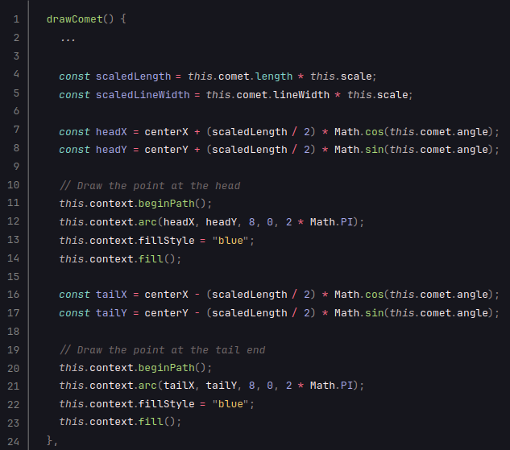
Designing the comet
Locate the head and tail

Slide 9
Designing the comet
Locate the head and tail

Slide 10
Designing the comet
Locate the head and tail

Slide 11
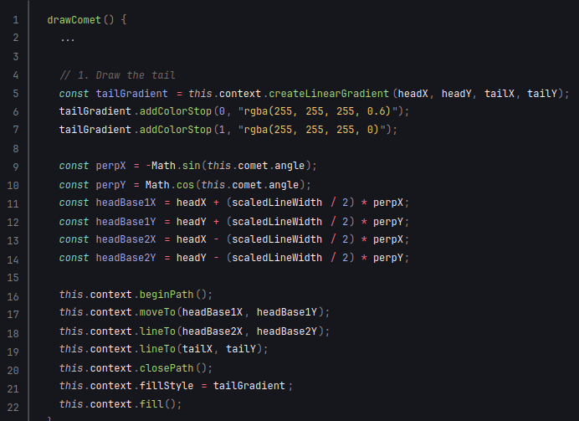
Designing the comet
Draw the tail

Slide 12
Designing the comet
Draw the tail

Slide 13
Designing the comet
Draw the tail
perpX = Sin(0) = 0
perpY = Cos(0) = 1

Slide 14
Designing the comet
Draw the tail
perpX = Sin(0) = 0
perpY = Cos(0) = 1

Slide 15
Designing the comet
Draw the tail
perpX = Sin(0) = 0
perpY = Cos(0) = 1

Slide 16
Designing the comet
Draw the tail

Slide 17
Designing the comet
Draw the tail

Slide 18
Designing the comet
Draw the tail

Slide 19
Designing the comet
Draw the tail

Slide 20
Designing the comet
Draw the tail

Slide 21
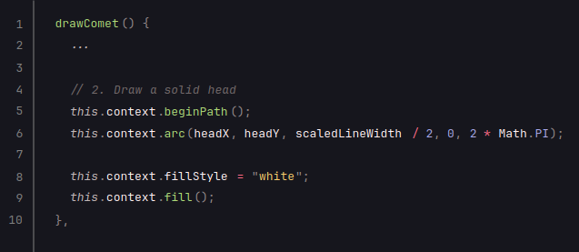
Designing the comet
Draw the head

Slide 22
Designing the comet
Draw the head

Slide 23
Designing the comet
Draw the head

Slide 24


Designing the comet
Final result
Width = 10
Width = 50

Slide 25
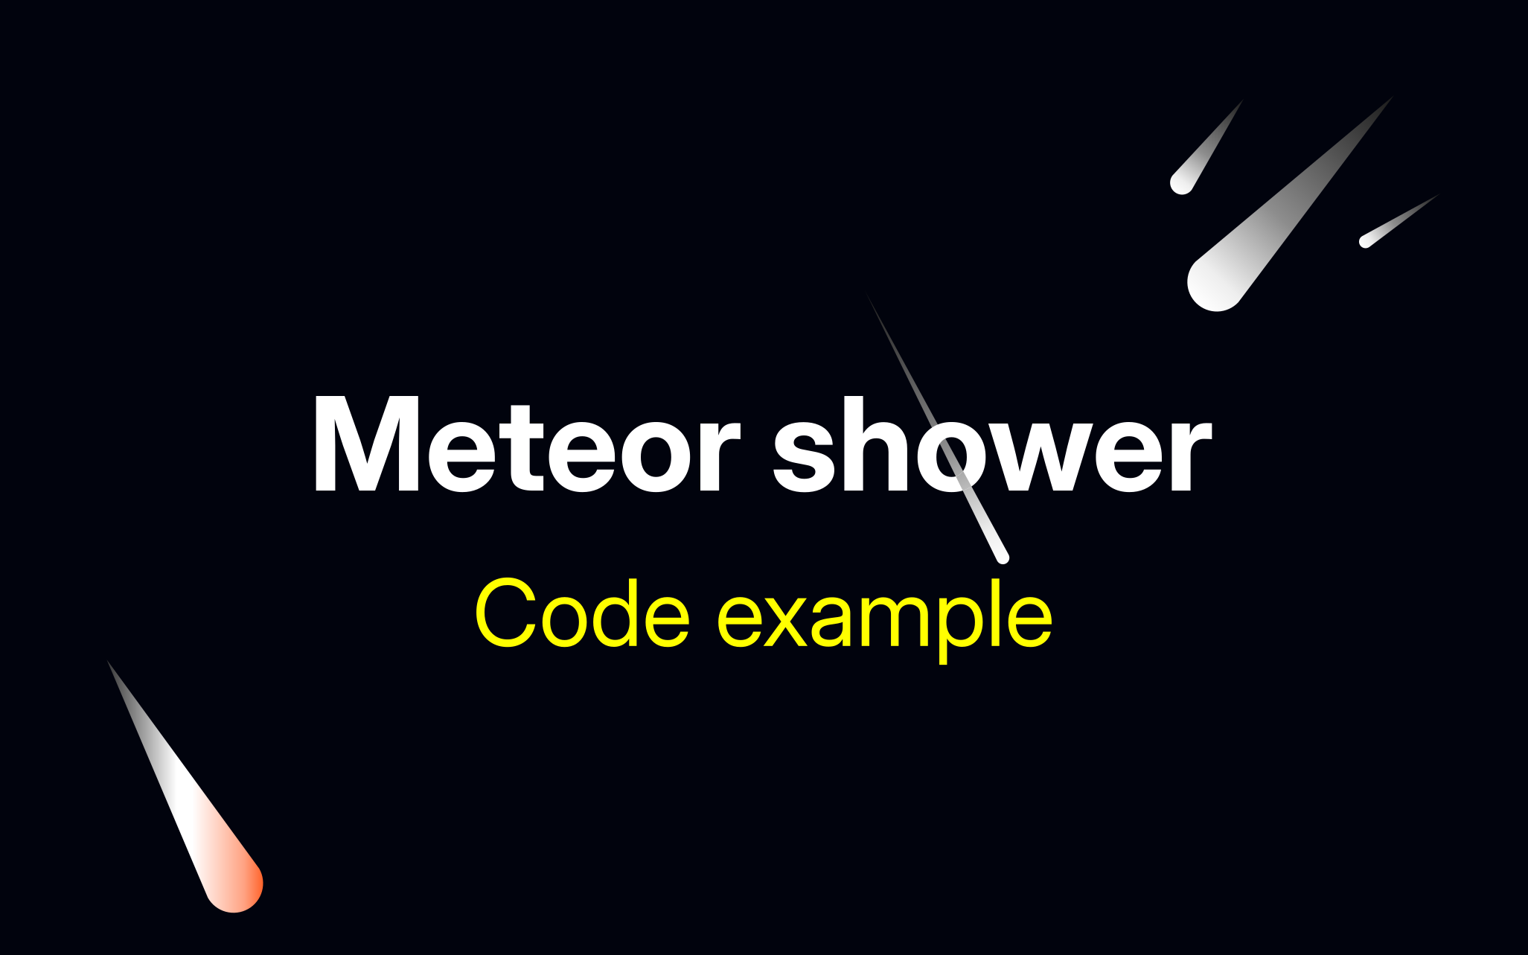

Slide 26




Moving the comet
After spawning a comet, we will move it in steps.
Example:
Step 0
Step 1
Step 2
Step 3

Slide 27
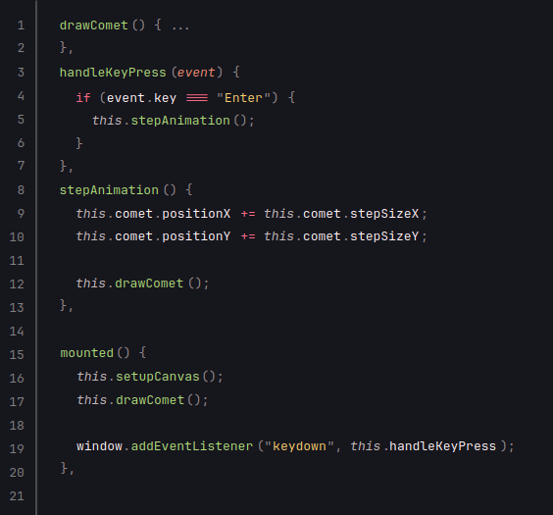
Moving the comet
Code example:

Slide 29

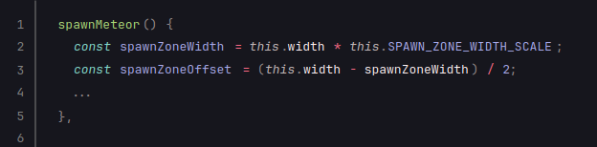
Meteor shower
To simulate a meteor shower, we will spawn multiple comets.
The meteor shower source is called radiant.

Slide 30
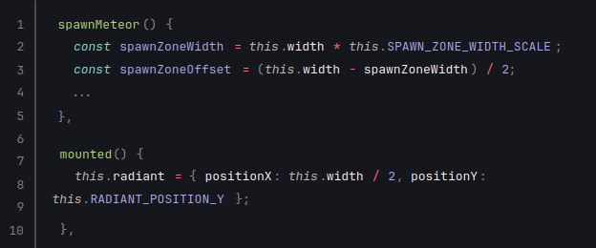
Meteor shower
To simulate a meteor shower, we will spawn multiple comets.
The meteor shower source is called radiant.

Slide 31
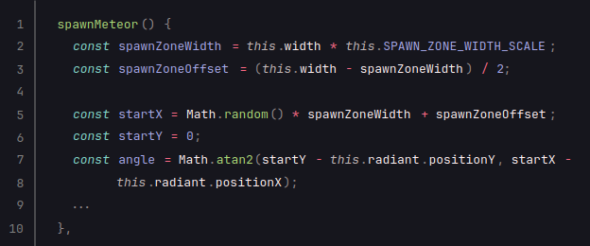
Meteor shower
To simulate a meteor shower, we will spawn multiple comets.
The meteor shower source is called radiant.

Slide 32
Meteor shower
To simulate a meteor shower, we will spawn multiple comets.
The meteor shower source is called radiant.

Slide 33
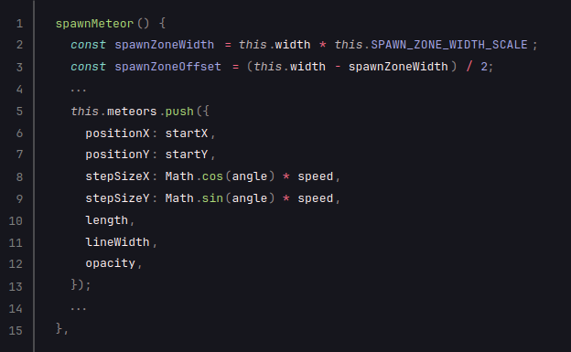
Meteor shower
To simulate a meteor shower, we will spawn multiple comets.
The meteor shower source is called radiant.

Slide 34
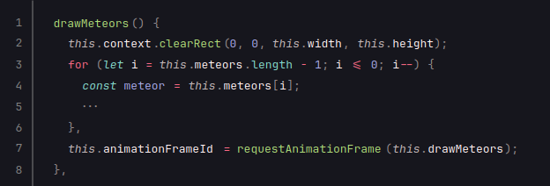
Meteor shower
To simulate a meteor shower, we will spawn multiple comets.
The meteor shower source is called radiant.

