Slide 1


Slide 2
1
OSRM Installation

Slide 3
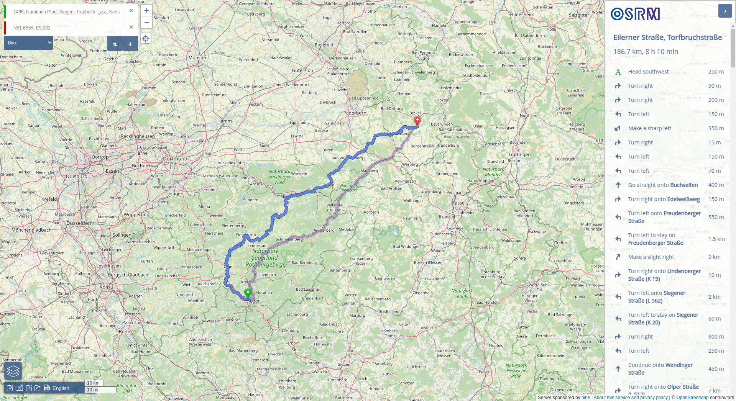
What is OSRM ?
Open Source Routing Machine.
The original OSRM demo website.

Slide 4

What is OSRM ?
Open Source Routing Machine.
High performance routing engine written in C++

Slide 5

What is OSRM ?
Open Source Routing Machine.
High performance routing engine written in C++
It runs on OpenStreetMap data.

Slide 6

What is OSRM ?
Open Source Routing Machine.
High performance routing engine written in C++
It runs on OpenStreetMap data.
Provides multiple services:
  Route: finds the fastest route between coordinates.
  Trip: Solves the TSP using a greedy heuristic.
  And more.

Slide 7

How to use OSRM ?
Use Docker to pull the OSRM image.

Slide 8
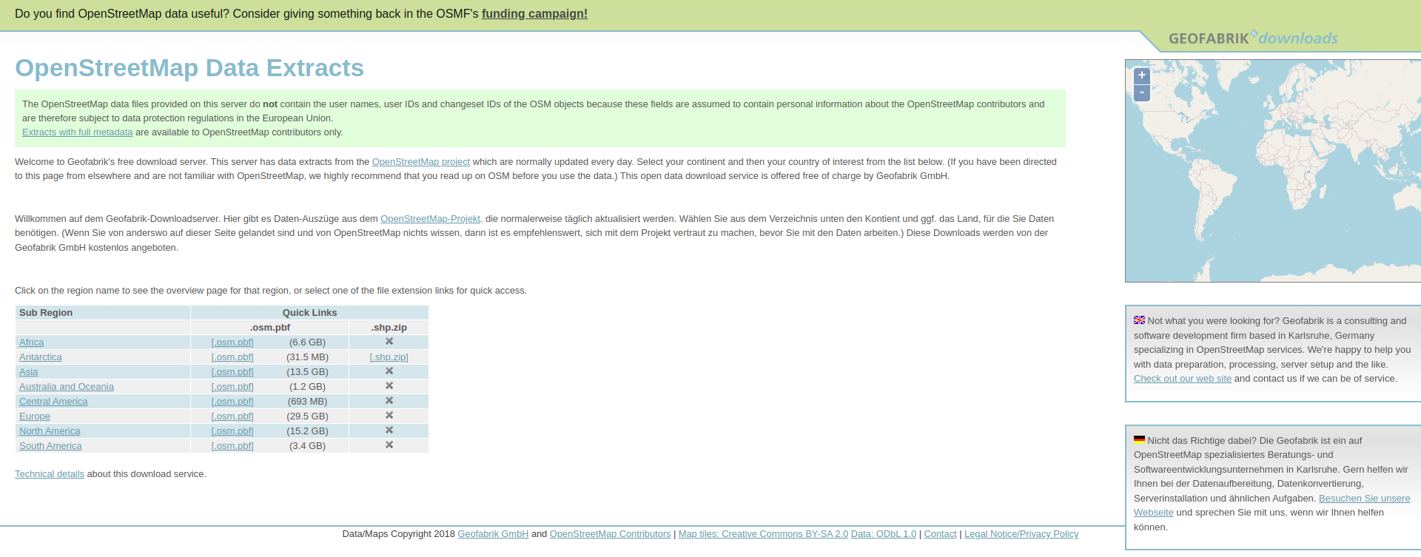
How to use OSRM ?
Use Docker to pull the OSRM image.
Download the map region you are interested in from Geofabrick.
Use pbf format.

Slide 9


Slide 10
2
Route service

Slide 11


Route service
The bearing angle is the angle measured between the direction of the compass needle and true North.
N

Slide 12
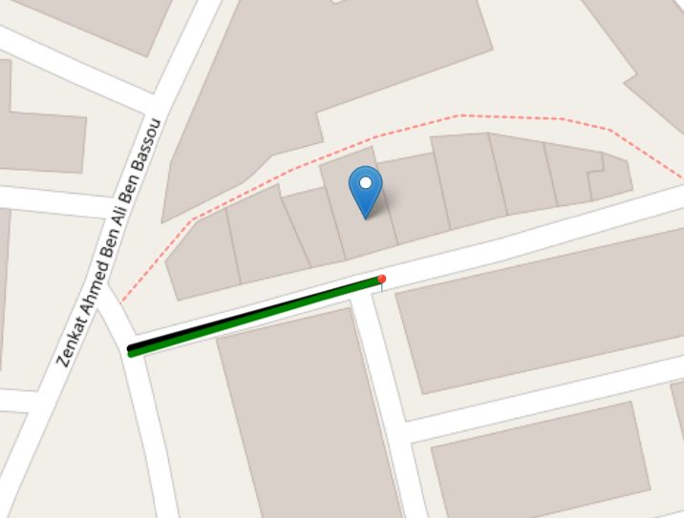
Route service
The bearing angle is the angle measured between the direction of the compass needle and true North.
N
256°
E

Slide 13
4
Table service

Slide 14
Table service
Computes the duration of the fastest route between all pairs of points.
 |  | Destinations
 |  | Point 1 | Point 2 | Point 3
Sources | Point 1 | 0 | x | x
 | Point 2 | x | 0 | x
 | Point 3 | x | x | 0

Slide 15
Table service
Computes the duration of the fastest route between all pairs of points.
Duration is 0 if source = destination.
 |  | Destinations
 |  | Point 1 | Point 2 | Point 3
Sources | Point 1 | 0 | x | x
 | Point 2 | x | 0 | x
 | Point 3 | x | x | 0

Slide 16
Table service
Computes the duration of the fastest route between all pairs of points.
Duration is 0 if source = destination.
You can force some points to be the source by using the sources option.
  If sources = 0,1. The output should be a 2x3 matrix.
 |  | Destinations
 |  | Point 1 | Point 2 | Point 3
Sources | Point 1 | 0 | x | x
 | Point 2 | x | 0 | x

Slide 17
Table service
Computes the duration of the fastest route between all pairs of points.
Duration is 0 if source = destination.
You can force some points to be the source by using the sources option.
  If sources = 0,1. The output should be a 2x3 matrix.
You can force some points to be the destination by using the destinations option.
  If destinations = 2. The output should be a 3x1 matrix.
 |  | Destinations
 |  | Point 3
Sources | Point 1 | x
 | Point 2 | x
 | Point 3 | 0

