Slide 1


Slide 2

Designing the stars
We have 2 types of stars:
Round
Diffraction spikes (JWST style)

Slide 3
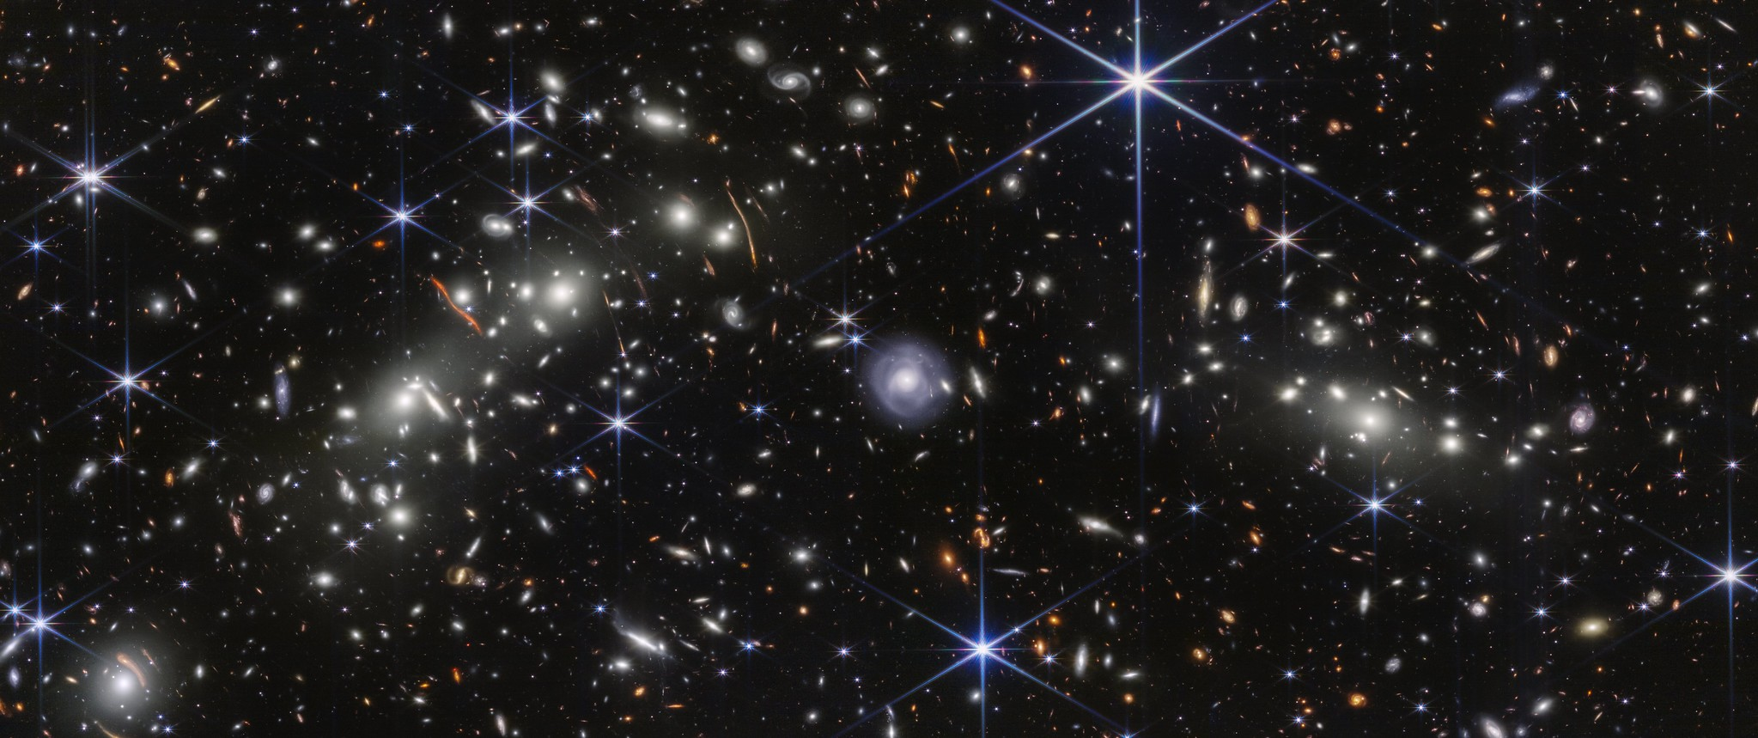
Designing the stars

Slide 4




Designing the stars
To draw the stars, we will use the canvas in HTML.
The steps to follow to draw the stars with diffraction spikes:
Draw the 1st half spike
Draw the 2nd half spike
Draw the last half spike
Draw a circle

Slide 5
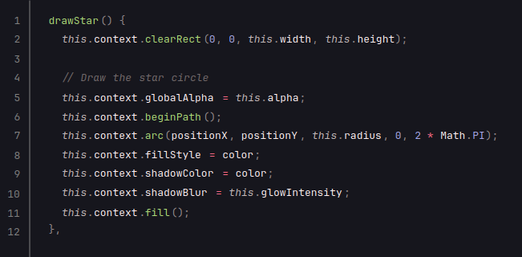
Designing the stars
Draw a circle

Slide 6
Designing the stars
Draw a circle

Slide 7
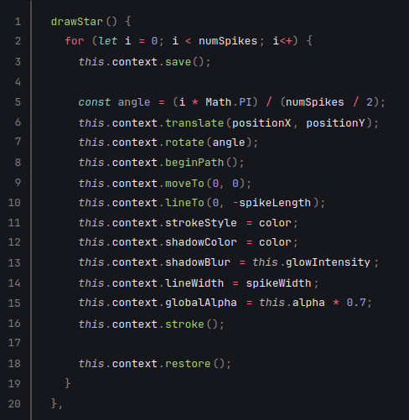
Designing the stars
Draw the spikes

Slide 8
Designing the stars
Draw the spikes
X
Y
i = 0 => angle = 0°

Slide 9
Designing the stars
Draw the spikes
X
Y
X
Y
i = 0 => angle = 0°

Slide 10
Designing the stars
Draw the spikes
X
Y
i = 0 => angle = 0°

Slide 11
Designing the stars
Draw the spikes
X
Y
i = 0 => angle = 0°

Slide 12
Designing the stars
Draw the spikes
Y
X
i = 1 => angle = 60°

Slide 13
Designing the stars
Draw the spikes
Y
X
i = 1 => angle = 60°

Slide 14
Designing the stars
Draw the spikes
X
Y
i = 1 => angle = 60°

Slide 15
Designing the stars
Draw the spikes

Slide 16


