Slide 1
Courier Management System
Under the supervision of
Dr. Sangram Ray
Department of Computer Science and Engineering
Submitted by
Adarsh Srivastava
B180001CS
Pre-Final Year, CSE

Slide 2
Introduction
Application based service
Handles and manages the courier services
Efficiently and smoothly
A solution for Courier & Logistics Tracking Business
Offers a variety of services to its users and contains different modules

Slide 3
Project Details

Slide 4
Cloud Firestore Database
At first, let's talk about Database we have used for the project,
A NOSQL Database .i.e. Not Only SQL
Document-oriented database
Can be imagined as a cloud-hosted JSON tree
Data is stored as JSON objects organized into collections
Each document contains a set of key-value pairs
Primary Key for them are usually document-id which can be either auto-generated or set by user.

Slide 5
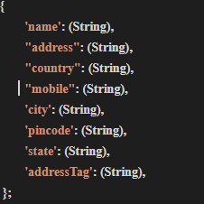
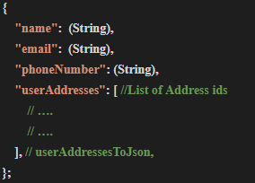
Database Schema
Collections used for the project have following schemas for documents:
userAddresses
customers

Slide 6
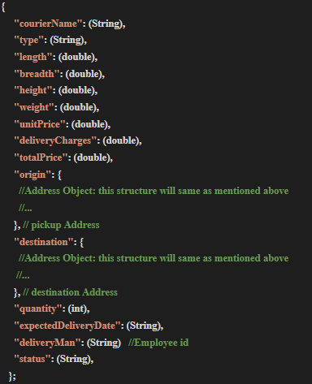
couriers

Slide 7
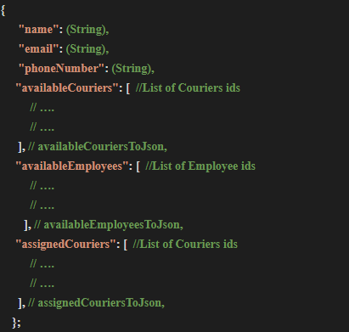
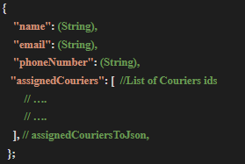
employees
admins

Slide 8
CRUD Operations
CRUD operations used in this project are:
Create Operations:
Account creation of Customer, Employee and Admin
Creation of a Shipment
Adding an Address by a customer
Read Operations:
Checking courier details
Tracking Courier
Checking Employee Details, etc
Update Operations:
Changing status of the courier
Assigning an employee for courier delivery
Setting estimated delivery cost and time
Delete Operations:
Removing an Address from list

Slide 9
Conclusion
Aim of this project: To automate the courier management services.
Objective of the project: To deliver an efficient system whose main functionality is to provide a simple and user friendly interface with all the facilities.
Personalized to fit in any business and can either be used as a complete system or as separate modules.
Can be used for day to day actions such as maintaining employee details, creating a shipment, checking details and tracking the courier and many more things.

Slide 10
THANK YOU

