Slide 1
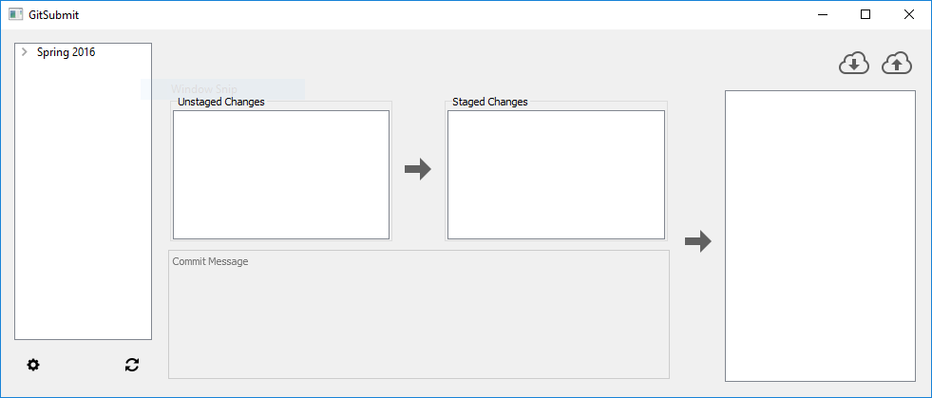


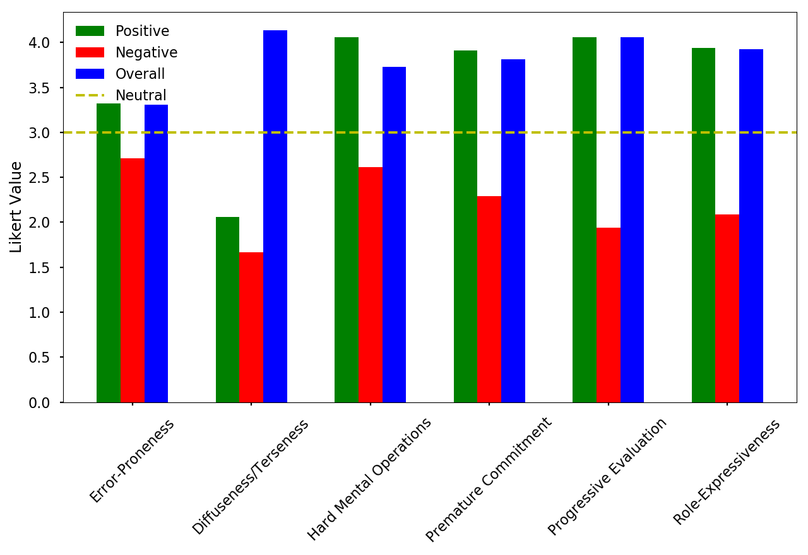
SafeMed: AI-Assisted ADR Reporting With Duplicate Detection and Severity Triage
Imadeddin Ouahidi, Anji Reddy Modugula, Lohitha Vodnala
School of Computer Science and Information Systems, Northwest Missouri State University, Maryville, Missouri, USA | support@safemed.app
Background & Problem
Methodology
Discussion & Conclusion
INTRODUCTION / BACKGROUND
• ADR reporting is often fragmented, slow to review, and hard to prioritize consistently.
• Patients need a simple way to submit side effects across desktop and mobile workflows.
• Clinicians need secure, structured, and searchable reports instead of scattered free-text evidence.
PROBLEM STATEMENT / RESEARCH QUESTION
• How can one cross-platform system collect multimodal ADR evidence and support faster duplicate-aware triage?
• Gap: the project requirements combine secure intake, AI triage, duplicate screening, and role-based review in one workflow.
• Patient submits an ADR report from web or mobile using text, photo, or voice.
• Backend validates input, applies secure auth checks, and stores report data in MongoDB.
• Attachments are uploaded through MinIO-backed storage for shared web/mobile access.
• Duplicate screening compares recent reports in a 72-hour window with a 0.7 similarity threshold.
• RabbitMQ sends the report to an async AI consumer for severity, seriousness, priority, and guidance analysis.
• Clinicians review flagged cases, follow progression, receive notifications, and export reports.
DISCUSSION
• SafeMed demonstrates an end-to-end ADR workflow instead of isolated UI mockups.
• Queue-based AI processing keeps submission responsive while supporting later enrichment.
• Strengths: multimodal input, cross-platform clients, role-aware review, and a containerized service design.
• Limitations: duplicate merging, full multilingual coverage, graphing, urgent alerts, and print layout are still partial.
CONCLUSION
• The project shows a credible CS prototype for AI-assisted ADR reporting across patient and clinician workflows.
• The strongest defensible claim is an implemented prototype with seeded scenarios and async analysis, not a finished production platform.
Objectives & Future Work
Results
OBJECTIVES / CONTRIBUTIONS
• Build a unified ADR reporting system for web and mobile users.
• Support text, image, and audio submission with AI-assisted structuring.
• Add secure authentication, role-based access, notifications, export, and symptom progression tracking.
• Use duplicate detection and severity prioritization to reduce review burden.
FUTURE WORK
• Complete confirmed-duplicate merge workflows and urgent staff escalation.
• Finish multilingual coverage and analytics dashboards.
• Improve printable report layouts and deeper clinician review flows.
• Evaluate the system on larger or de-identified ADR datasets.
• The deployed architecture uses 6 runtime services plus 1 MinIO initialization helper in Docker Compose.
• The backend exposes 7 major API areas: auth, medications, reports, symptom progression, uploads, notifications, and export.
• The repo includes seeded demo accounts for patient and doctor workflows and curated ADR report scenarios.
• Demo reports span mild, moderate, and severe cases with AI risk scores such as 15, 35, 45, and 75.
• Web and mobile clients both support shared uploads, notifications, and role-based navigation.
References
Acknowledgments
Contact Information
Ouahidi, I., Modugula, A. R., & Vodnala, L. (n.d.). Functional requirements list - final - group 5. GDP-Group5 project wiki.
Ouahidi, I., Modugula, A. R., & Vodnala, L. (n.d.). Software requirements specification - group 5. GDP-Group5 project wiki.
Ouahidi, I., Modugula, A. R., & Vodnala, L. (n.d.). Use cases (Iteration 2). GDP-Group5 project wiki.
Ouahidi, I., Modugula, A. R., & Vodnala, L. (n.d.). Client meeting minutes IV. GDP-Group5 project wiki.
• Northwest Missouri State University and the School of Computer Science and Information Systems.
• Group 5 contributors: Imadeddin Ouahidi, Anji Reddy Modugula, and Lohitha Vodnala.
• Project guidance and feedback documented in the SafeMed wiki and client meetings.
Email: support@safemed.app
GitHub: github.com/ImadeddinOuahidi/GDP-Group5
Wiki: github.com/ImadeddinOuahidi/GDP-Group5/wiki

