Slide 1

SafeMed ADR - GDP-I Final Presentation
AI-Powered Adverse Drug Reaction Reporting System
Presented by:
Imadeddin Ouahidi
Lohitha Vodnala
Anji Reddy Modugula

Slide 2
Presentation Overview
01
02
03
Introduction
Problem Statement
Proposed Solution
Understanding ADR challenges in healthcare
SafeMed platform architecture and features
04
05
06
Use Cases
Functional Requirements
Non-Functional Requirements
Core capabilities and user workflows
Performance, security, and compliance standards
07
08
09
System Architecture
Design Patterns & Technologies
Hosting Strategy
10
11
12
Data Management Plan
Prototype Demos - GUI Mockups
What Have Been Accomplished
Data management and system architecture
Live features
13
14
Spring 2026 Plan
References

Slide 3

Introduction: Adverse Drug Reactions Today
Adverse Drug Reactions (ADRs) are harmful or unwanted effects from medications.
Current reporting methods are inconsistent and often delayed.
Healthcare professionals face difficulty processing incomplete reports.
Goal: Build a simple, fast, and secure ADR reporting platform for patients and doctors.
SafeMed addresses these gaps by providing a streamlined, digital-first platform that enables rapid, structured reporting of adverse drug reactions from both patients and healthcare professionals.

Slide 4
Problem Statement
Patients submit ADRs through multiple methods (email, phone, paper).
Reports often lack key details or consistency.
Staff manually verify data and identify duplicates.
Urgent reports are not prioritized effectively.
Privacy risks exist due to sensitive images or personal health information shared insecurely.

Slide 5

Proposed Solution
SafeMed ADR Web Application
Key Features
Secure online ADR form.
A secure web-based system for ADR reporting and management.
Duplicate detection & severity scoring.
Role-based login for patients, and doctors.
Patients: Submit side effects (text, image, or voice).
Doctors: Review, verify, and classify reports.

Slide 6
12 Core Use Cases
#
Use Case
Goal
1
Submit ADR Report (Text)
Patient reports side effect via text
2
Submit Report via Voice
Voice recording submission with transcription
3
Submit Report with Photo
Image-based side effect report and analysis
4
Review ADR Reports
Healthcare staff view and manage reports
5
Validate Submitted Report
System ensures required fields are complete
6
Securely Store ADR Reports
Encrypted database storage of all submissions
7
Healthcare Staff Login
Secure system access with authentication
8
Identify Duplicate Reports
System flags repeated reports automatically
9
Mark Report Severity
AI-based severity assignment and classification
10
Secure Upload of Reports
Encrypted file uploads for all media types
11
Role-Based Access
Permission differentiation by user type
12
Display Error Messages
Meaningful validation feedback to users

Slide 7
Functional Requirements
SafeMed ADR system SHALL (Must Have) the following capabilities:
ID
Requirement
FR-1
Allow patients to submit ADR reports through an online form
FR-2
Validate each submitted report for required fields
FR-3
Store ADR reports securely in encrypted database
FR-4
Allow healthcare staff to view reports through secure login
FR-5
Identify duplicate ADR reports using AI (ChatGPT)
FR-6
Mark reports with AI-assigned severity level
FR-7
Provide secure method for uploading text, images, or voice recordings
FR-8
Restrict unauthorised access to patient reports
FR-9
Track date and time of each report submission
FR-10
NOT store user passwords in plain text (bcrypt hashing)
FR-11
Provide role-based access (patients, doctors, administrators)
FR-12
Provide clear error messages when validation fails
FR-13
Support English language (with multilingual capability)
FR-14
Be cross-platform (web and mobile clients)

Slide 8
Functional Requirements (SHOULD & MAY)
System SHOULD (Important)
SafeMed ADR system SHOULD (important) include the following capabilities:
ID
Requirement
FR-S1
Allow staff to filter reports by severity, date, or drug name
FR-S2
Generate summary statistics for reported ADRs
FR-S3
Notify staff immediately when a new urgent report is submitted
FR-S4
Allow patients to check the status of their submitted report
FR-S5
Provide a printable summary of individual reports for record-keeping
System MAY (Nice-to-Have)
The SafeMed ADR system MAY (nice-to-have) incorporate these enhancements:
Allow exporting reports in standard formats.
Allow visualization of trends with charts and graphs.

Slide 9





Non-Functional Requirements
Security
Performance
TLS 1.3 in transit, AES-256 at rest; MFA and RBAC enforced
Validation under 10 seconds; dashboard load under 3 seconds
Reliability
99.5% uptime SLA; automated backups with disaster recovery
Accessibility
Fully responsive design; supports 500+ concurrent users
Compliance
GDPR and HIPAA certified for patient data protection

Slide 10
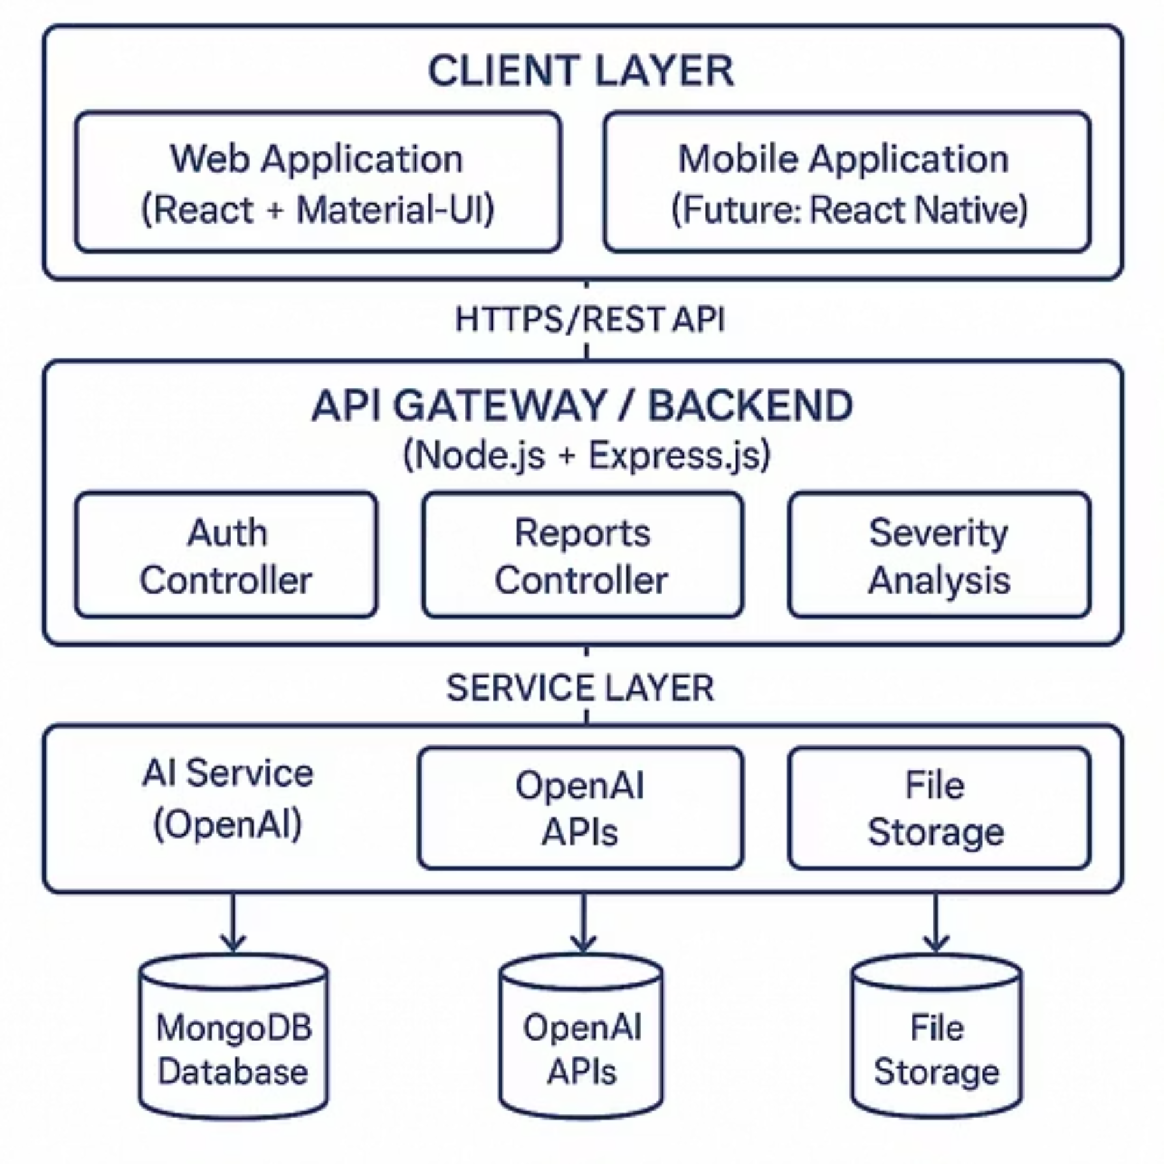
System Architecture

Slide 11



Design Patterns & Technologies
The SafeMed ADR system leverages established design patterns to ensure robustness, scalability, and maintainability across its architecture.
Design Pattern: MVC (Model-View-Controller)
Model
Defines the data structure and core business logic. Implemented with MongoDB and Mongoose, encompassing schemas for User, Medicine, ReportSideEffect, and SymptomProgression.
Controller
Manages user input, orchestrates interactions between the Model and View. Includes dedicated controllers for authentication, report management, medicine data, AI report processing, and severity analysis.
View
Presents data to the user through a rich interface. Developed using React Components, featuring pages for Login, Registration, Dashboard, and various report submission forms.
Additional Patterns
Repository Pattern: Abstracts data access logic, promoting clean separation from business services.
Service Layer Pattern: Encapsulates complex business logic, ensuring modularity and reusability.
Middleware Pattern: Handles cross-cutting concerns like authentication, logging, and error handling efficiently.

Slide 12
Platforms & Technologies
Frontend
React, React- native, Material-UI (MUI), Axios, React Router
Backend
Node.js, Express.js, Mongoose
Database
MongoDB
AI/ML
OpenAI GPT-5 Vision, OpenAI Whisper, Fuse.js

Slide 13
Key Third-Party Libraries
Library
Purpose
bcryptjs
Secure password hashing for user authentication
jsonwebtoken
JSON Web Token (JWT) implementation for secure API access
multer
Middleware for handling multipart/form-data, primarily file uploads
helmet
Helps secure Express apps by setting various HTTP headers
express-validator
Middleware for robust input validation and sanitisation
string-similarity
Calculates similarity between strings for duplicate report detection
natural
Natural Language Processing (NLP) for text analysis and processing
sharp
High-performance Node.js image processing library

Slide 14
Hosting Strategy & Requirements
Deployment Architecture
Component
Hosting Option
Specifications
Frontend
Vercel / Netlify
Static hosting, CDN
Backend API
AWS EC2 / Heroku
Node.js runtime
Database
MongoDB Atlas
Managed cloud database
File Storage
AWS S3
Secure object storage
AI Services
OpenAI API
Cloud-based AI processing
Infrastructure Requirements
Requirement
Specification
Compute
2+ vCPUs, 4GB RAM minimum
Storage
50GB+ for uploads and backups
Network
HTTPS (TLS 1.3), Load Balancer
Monitoring
Real-time status monitoring
Backup
Automated daily backups, secondary DC

Slide 15
Data Management
SafeMed employs a modern, scalable MERN stack with MongoDB for flexible data storage and a RESTful API for seamless integration.
Database Layer
1
MongoDB with collections for Users, Medicines, ADR Reports, and Symptoms
linked relationships enable comprehensive analysis
Security Measures
2
Passwords hashed with bcrypt; TLS 1.3 for data in transit; AES-256 encryption for data at rest; comprehensive audit trails
Access Control
3
JWT-based authentication; role-based data filtering; automatic timestamps for regulatory tracking

Slide 16
Prototype Demos - GUI Mockups
GUI Components Implemented
Login & Registration pages
Patient Dashboard
Doctor Dashboard
Side Effect Report Form
Medicine Management Interface
Report Review Interface

Slide 17

What Has Been Accomplished?
We have successfully delivered on our core development phases, culminating in a robust and feature-rich system for Adverse Drug Reaction reporting.
1
2
Phase 1: Basic Healthcare API
Phase 2: AI-Powered Multimodal Processing
Express.js REST API with MongoDB integration
OpenAI GPT-4 Vision for image analysis
JWT-based authentication with role-based access control
OpenAI Whisper for audio transcription
Complete medicine and user management
Side effect reporting system with validation
Swagger API documentation
3
4
Phase 3: Advanced Fuzzy Search
Documentation & Planning
Multi-algorithm fuzzy search (Fuse.js, Levenshtein, Jaro-Winkler)
12 detailed use case diagrams
Intelligent medicine name matching with typo tolerance
Comprehensive functional/non-functional requirements
Brand name to generic name mapping
Data management plan with security implementation
Smart autocomplete and suggestion system
Performance-optimized search with caching

Slide 18
Spring 2026 Plan
Phase 4: Testing & Quality Assurance
Ensuring the robustness and reliability of SafeMed ADR through thorough testing protocols.
Unit testing (backend API endpoints)
Week 1-2
Integration testing (AI workflows)
Week 3-4
User acceptance testing
Week 5-6
Security and privacy validation
Week 7-8
Phase 5: Deployment
Preparing and launching SafeMed ADR into a production environment.
Cloud infrastructure setup
Week 9-10
CI/CD pipeline configuration
Week 11
Production deployment
Week 12
Performance monitoring setup
Week 13

Slide 19
References (APA Format)
Technologies & Frameworks
Express.js. (2024). Express - Node.js web application framework.
Meta Platforms, Inc. (2024). React - A JavaScript library for building user interfaces.
MongoDB, Inc. (2024). MongoDB documentation.
MUI (Material-UI). (2024). MUI: The React component library.
AI & Machine Learning
OpenAI. (2024). GPT-4 Vision API documentation.
OpenAI. (2024). Whisper API documentation.
Healthcare Standards
U.S. Department of Health & Human Services. (2024). HIPAA for Professionals.
World Health Organization. (2024). WHO-UMC Pharmacovigilance.

Slide 20
Thank You
Q&A

