Slide 1
Automated Cognitive Presence Detection in Online Discussion: An approach using LLMs
Group-5 Instructor- Fengjiao Tu
Imaduddin Ahmed
Srikar Duriseti
Madhan Dadi
Sivanarayana Reddy
Tanvi Kandula
Sandeep Reddy

Slide 2
Automated Cognitive Presence Detection in Online Discussion: An approach using LLMs
- Group 5

Slide 3
Table of Contents
Introduction
Community of Inquiry
Cognitive Presence
Research Design
Research Questions
Data Collection
Data Pre-processing
Data Cleaning
Modelling- LLMs
Evaluation
References

Slide 4
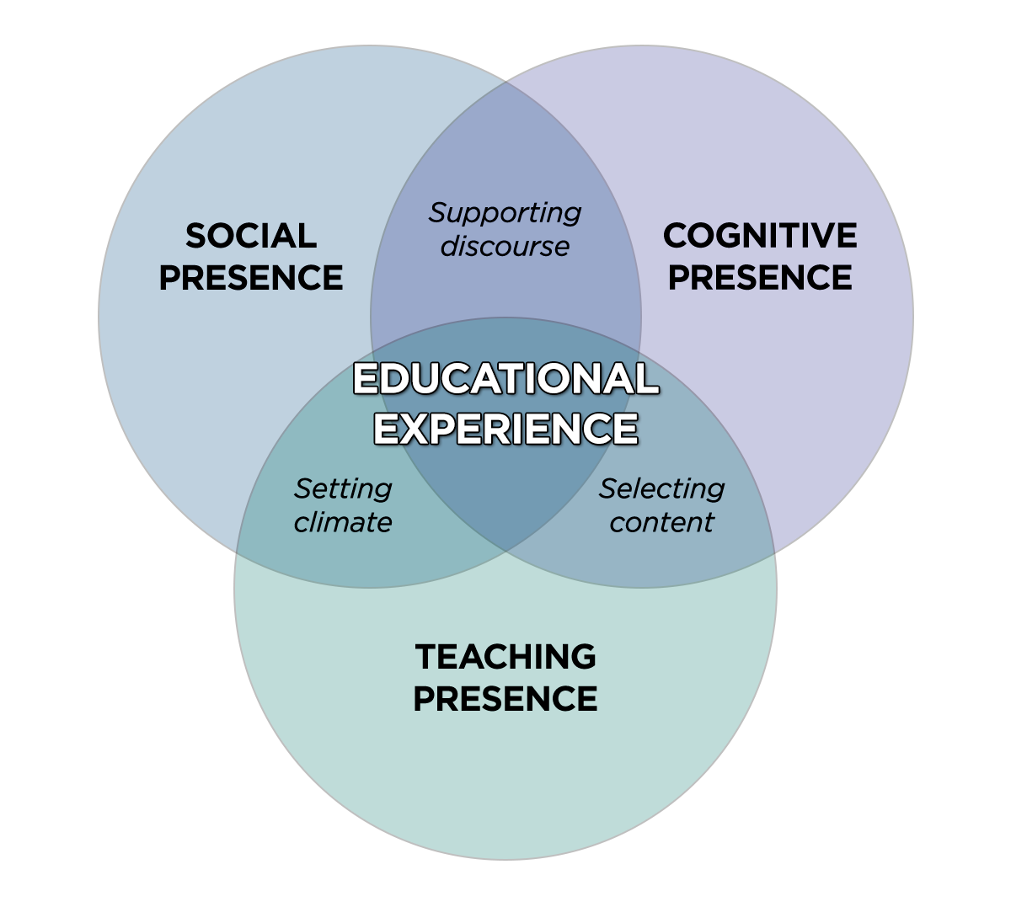
Community of Inquiry
Social Presence
Cognitive Presence
Teaching Presence

Slide 5
Cognitive Presence
Triggering Event
Integration
Sense of Puzzlement.
Recognize problem.
Connecting ideas.
Integrating among the group members.
Exploration
Resolution
Information exchange , Divergence.
Suggestions, Brainstorming.
Exploring within the online community
Applying new Ideas.
Creating Solutions

Slide 6
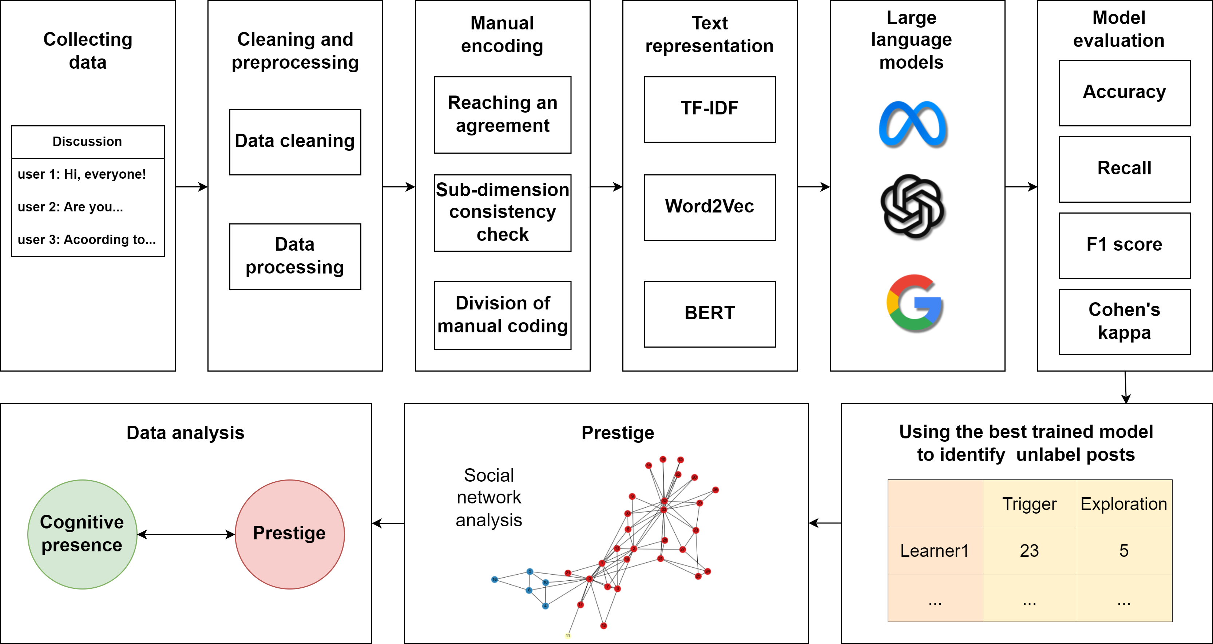
Research Design

Slide 7
Research Questions
RQ1: How to construct a high-quality and large-scale machine learning datasets for automated cognitive presence detection?
RQ2: Can LLMs be used to enhance the performance of automated cognitive presence detection?
RQ3: Can the model trained from online discussion be transferred to other educational contexts?

Slide 8
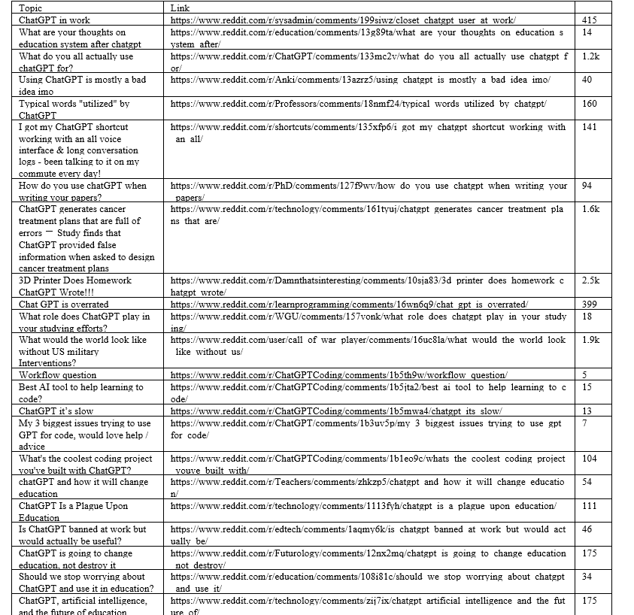
Data Collection
Employed the PRAW library to systematically extract data from Reddit discussions, ensuring methodical data retrieval.
Curated a diverse selection of Reddit posts pertinent to ChatGPT, fostering comprehensive analysis.
Gathered comprehensive post details, encompassing ID, title, score, and URL, for comprehensive contextual understanding.
Methodically recorded pertinent comment attributes, including ID, depth, likes, and textual content, enhancing data richness.
Structured the extracted data meticulously into a well-organized pandas Data Frame, facilitating efficient data manipulation and analysis.
The dataset comprises approximately 17,000 records, providing a substantial foundation for in-depth exploration and analysis.

Slide 9
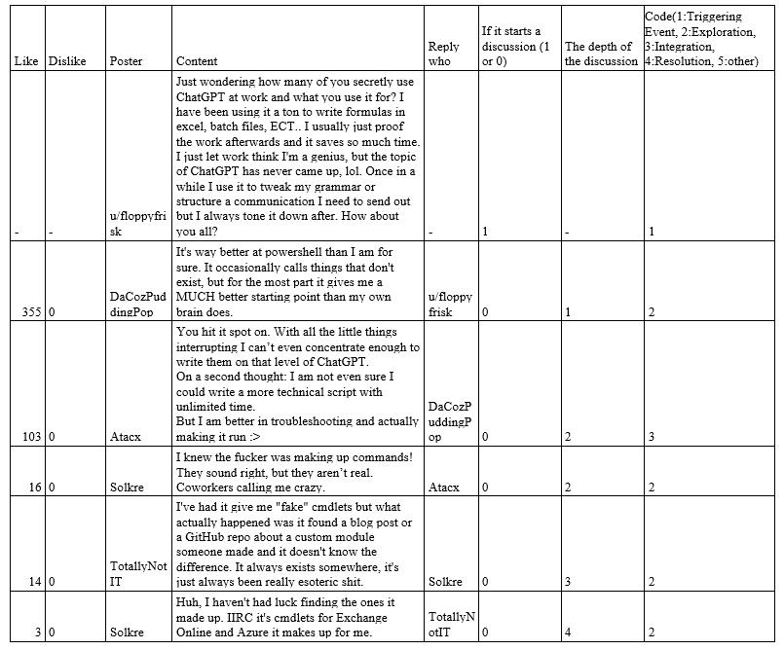
Dataset
Attributes of the dataset
Likes/Dislikes
Poster
Reply
Comment body
Comment depth
Start column
Label (code column)

Slide 10
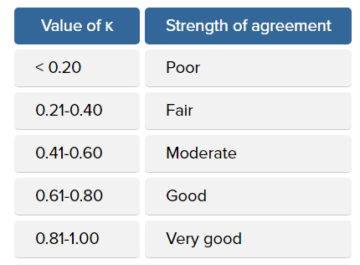
Data Pre-processing
Manual Encoding of Labels- Based on the Community of Inquiry (CoI), a coding scheme is developed that includes the categories such as Triggering Event , Exploration , Integration and Resolution.
Handling missing values.
Fleiss’ Kappa- A statistical measure used to analyze the consistency of agreement among several raters when classifying elements into various categories. It indicates the equity of the data.
Using the IBM SPSS Statistics software we are able to determine the Fleiss’ Kappa value.

Slide 11
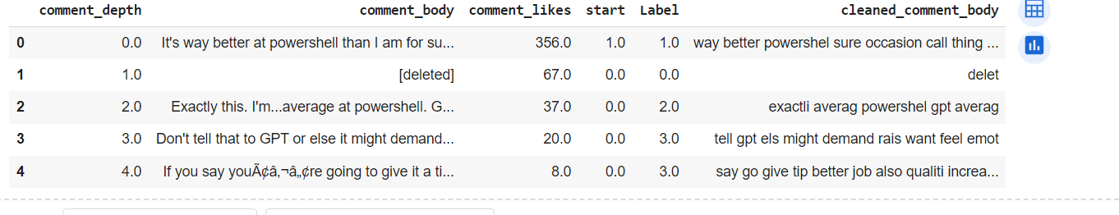
Data pre-processing and cleaning
Developed a custom function to preprocess text data, ensuring uniformity and enhancing analysis quality.
Implemented robust input validation to handle diverse data types gracefully, maintaining processing integrity.
Conducted thorough data cleaning by removing URLs and non-alphabetic characters, focusing solely on textual content.
Standardized text by lowercasing and tokenizing it, laying the foundation for subsequent analysis.
Optimized data relevance by filtering out common English stopwords, enriching the dataset for meaningful insights.
Streamlined dataset dimensions by retaining essential columns ('comment_depth', 'comment_body', 'comment_likes', 'start', 'Label'), aligning with analysis objectives.

Slide 12
Modelling
BERT MODEL:
The BERT language model is an open-source machine learning system for natural language processing (NLP). BERT was created to assist computers in understanding the meaning of unclear phrases in text by establishing context from the surrounding text.
Effective to handle different vocabulary and casual language in comments: Subword tokenization deals with out-of-vocabulary and uncommon phrases.
Pre-trained with a big corpus, including casual text captures context and details in comments : Contextual word embeddings understand word meaning based on the surrounding text. Bidirectional attention gathers context from left to right as well as right to left.
Transferrable information from pre-training: Pre-trained on a big corpus to provide robust text representations. Fine-tuning of the comment dataset enables efficient knowledge transmission.
CHAT GPT 2:
Manages long-term dependencies in comment content: Transformer architecture with attention mechanism captures long-term interactions. Suitable for comprehending and producing coherent comment-like text.
Uses knowledge from large-scale pre-training: Pre-trained on an extensive corpus, including informal and conversational text. Transfer learning enables efficient adaption to the comment dataset.
Large language models, such as GPT-2, have important implications for several domains, including natural language processing, artificial intelligence, and human-computer interaction. They enable advances in language comprehension, interactive agents, content development, and other areas.

Slide 13
Evaluation
Encode the preprocessed data with the GPT-2 tokenizer and prepare the dataset for training and evaluation.
Define training arguments, such as the output directory, number of training epochs, batch sizes, and evaluation strategy.
Set up the Trainer with the model, training arguments, and training assessment datasets.
Using scikit-learn, predict the outputs from the validation set and calculate performance metrics like as accuracy, recall, f1 score and Cohen's Kappa.
Calculate the required performance metrics using the validation set's anticipated outputs and true labels.
Display the generated metrics, such as accuracy , recall, f1 score and Cohen's Kappa, to assess the model's performance.

Slide 14
References
[1] Sun, C., Qiu, X., Xu, Y., & Huang, X. (2019). How to fine-tune bert for text classification?. In Chinese computational linguistics: 18th China national conference, CCL 2019, Kunming, China, October 18–20, 2019, proceedings 18 (pp. 194-206). Springer International Publishing.
[2] Liu, S., Liu, S., Liu, Z., Peng, X., & Yang, Z. (2022). Automated detection of emotional and cognitive engagement in MOOC discussions to predict learning achievement. Computers & Education, 181, 104461.
[3] https://statistics.laerd.com/spss-tutorials/fleiss-kappa-in-spss-statistics.php
[4] https://llama.meta.com/docs/model-cards-and-prompt-formats/meta-llama-3/
[5] https://www.cu.edu/blog/online-teaching-blog/strategies-promoting-cognitive-presence-your-online-course

Slide 15
Contribution | Author’s
Data Collection | Srikar, Tanvi, Siva
Data Preprocessing | Imaduddin, Madhan,Sandeep,Tanvi
Data Cleaning | Siva, Sandeep, Imaduddin, Srikar
Modelling | Imaduddin, Madhan,Siva, Sandeep
Documentation | Tanvi, Srikar, Madhan, Imaduddin

Slide 16
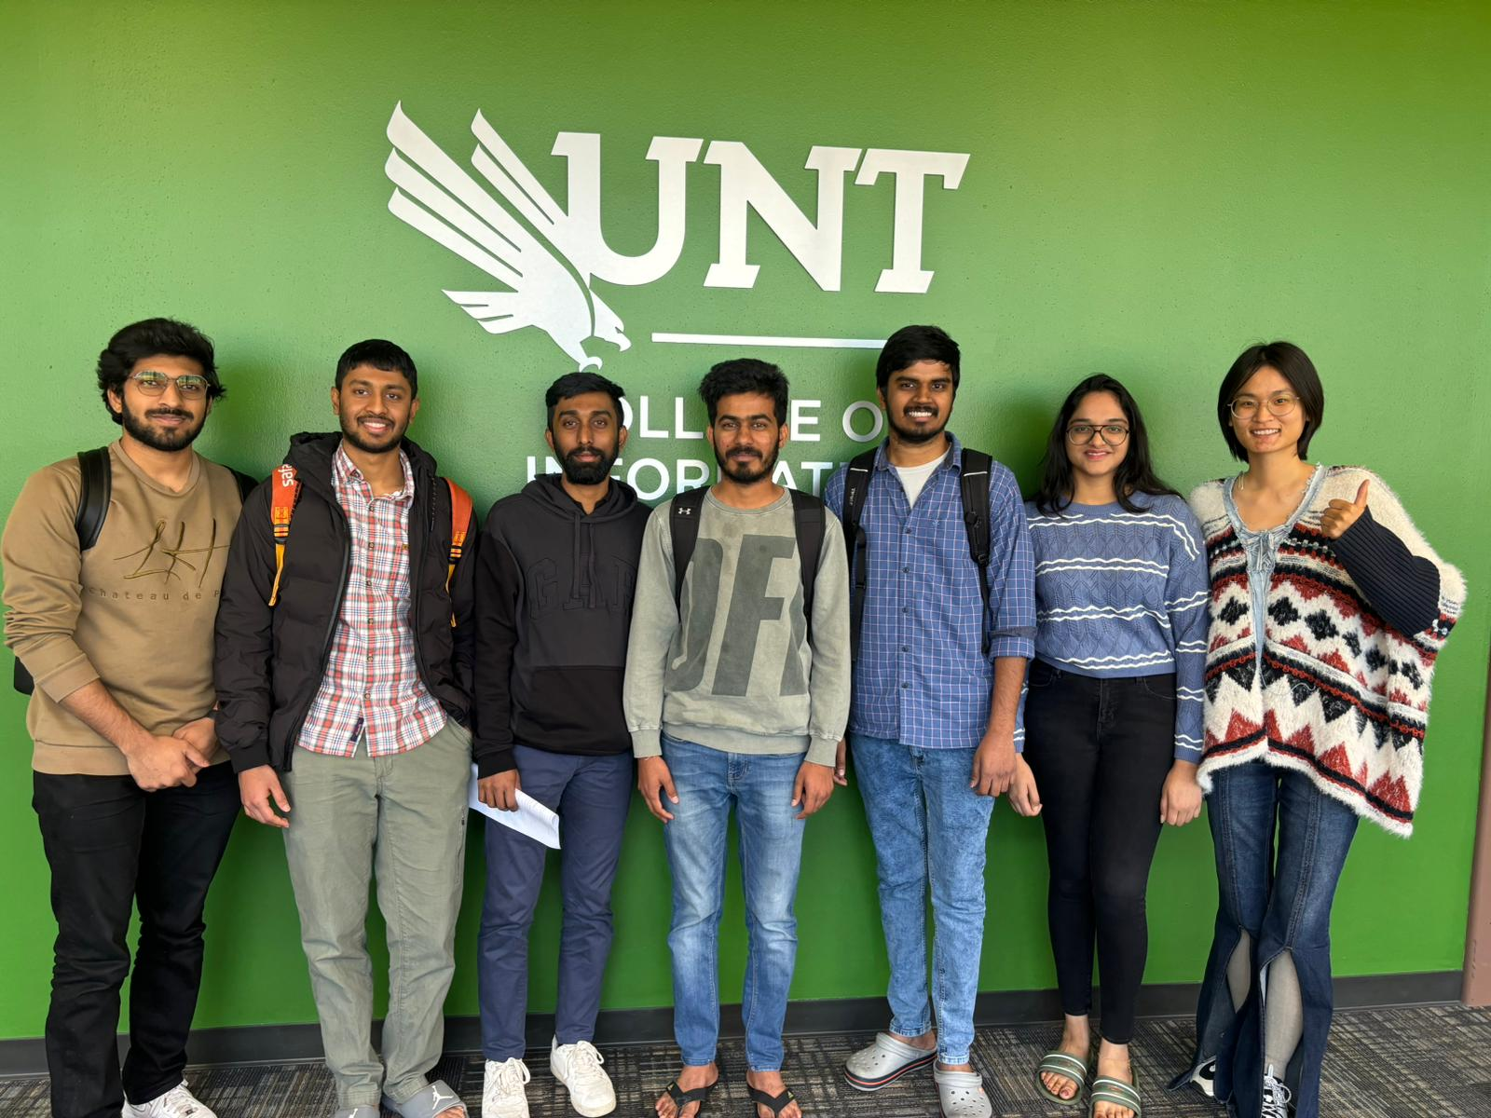
Thank you
Github Link- https://github.com/ImaduddinAhmedMohammed/INFO5731_Project_LLM.git

