Slide 1
DEPARTMENT OF CSE-AIML (CSM)
Project Title: Image Forgery Detection System
Team Members:
21BQ1A42A3(TL)-M. Swapna Sri
21BQ1A42B8- N.Nagendra
21BQ1A4268-J. Tarun
22BQ5A4208-K.Sampath
Project Guide:
Mr. A.Janardhan Rao

Slide 2

DEPARTMENT OF CSE-AIML (CSM)
Problem Statement
In today's digital era, the rapid dissemination of images across social media, news platforms, and online communities has increased the prevalence of image manipulation and forgery, leading to misinformation and trust issues. To address this challenge, we propose a Real-Time Forgery Detection System that leverages advanced machine learning and image processing techniques to detect manipulated images in real time. The system is designed to identify common types of image forgeries, including copy-move forgery, splicing, and retouching, and can be extended to video forgery detection, including deepfakes.
Digital images are being used in many fields like military, medical diagnosis, art pieces, photography
The process of creating fake images has been tremendously simple with the introduction of new and powerful computer graphics editing software which is freely available as Photoshop, GIMP, and Corel Paint Shop
While performing digital image forgery, it is a usual practice to combine multiple images (some region/regions of one image are replaced with the other) for example, when compositing one person’s head onto another person’s body

Slide 3
DEPARTMENT OF CSE-AIML (CSM)
Context
The Image Forgery Detection System leverages Artificial Intelligence (AI), particularly Deep Learning (DL) techniques and Convolutional Neural Networks (CNN), to analyze digital images and authenticate their integrity. This system examines images to identify potential manipulations and classifies them into three categories:
Forged: Images that have been digitally tampered with.
Authentic: Original and untampered images.
Suspicious: Images with uncertain or unclear authenticity.
Using advanced image analysis techniques, the system detects common forgery methods, such as copy-move forgeries, splicing, or region tampering, to ensure the authenticity of visual content. This technology plays a critical role in digital forensics, journalism, law enforcement, and industries where image authenticity is crucial.

Slide 4
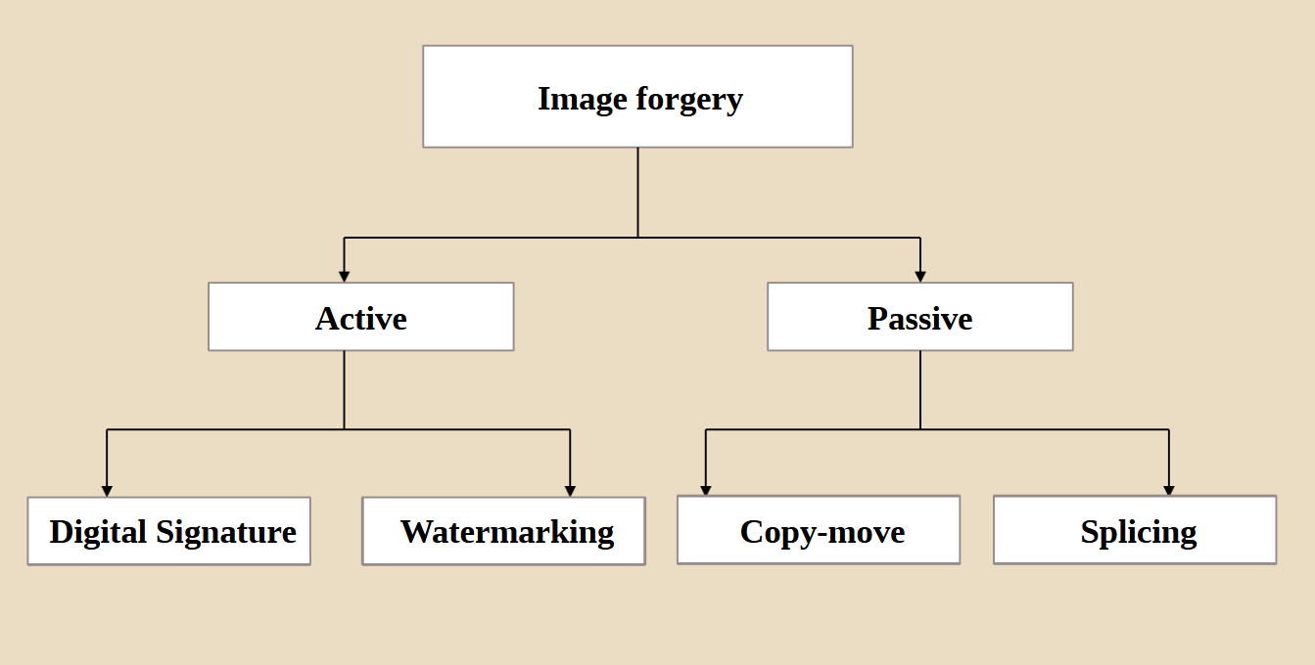
DEPARTMENT OF CSE-AIML (CSM)
Types of image forgery

Slide 5
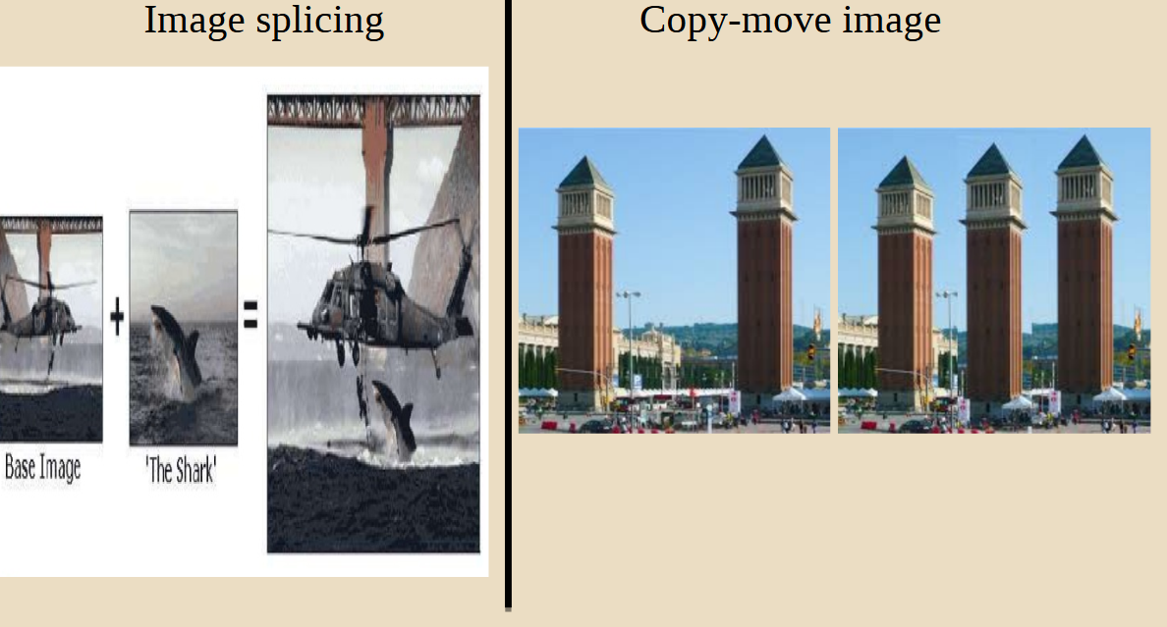
DEPARTMENT OF CSE-AIML (CSM)

Slide 6
DEPARTMENT OF CSE-AIML (CSM)
Proposed Solution for Image Forgery Detection System
To address challenges such as copy-move forgery, compression artifacts, noise variance, forged documents, and signature verification, an AI-driven Image Forgery Detection System will utilize a combination of Deep Learning (DL) techniques and Convolutional Neural Networks (CNN). The solution is broken down into key modules, each targeting a specific forgery problem. The system aims to provide a scalable solution that enhances trust and reliability in visual data by automating the process of image verification.
Key Features:
User Interface
Forgery Heatmap Visualization
Image comparison
Forgery confidence score
Region-specific Analysis
Dashboard
Meta Data Analysis
Document Verification
User Authentication
History and Logs
cloud Storage
Textual Forgery Detection

Slide 7
DEPARTMENT OF CSE-AIML (CSM)
Project Development Tools and Technologies
Front-End Development: HTML, CSS, JavaScript, React.js/Angular
Back-End Development: Python (Flask/Django), Node.js/Express.js Machine Learning & Deep Learning: TensorFlow, PyTorch, OpenCV, Flask, FastAPI, NumPy, Pandas.
Databases: MongoDB, SQL.
Cloud Infrastructure: AWS, Docker Security & Compliance: SSL/TLS, OAuth 2.0 Testing & Version Control: GitHub, Postman

Slide 8
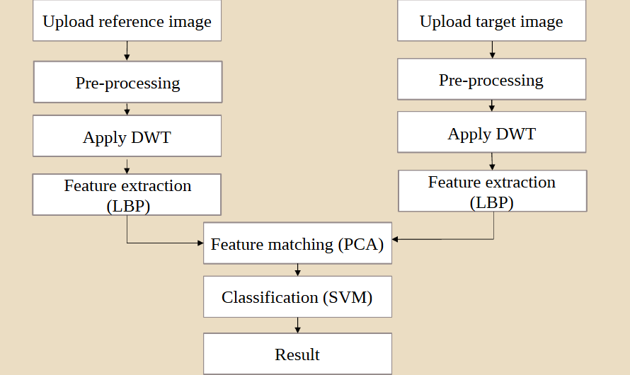
DEPARTMENT OF CSE-AIML (CSM)
System Architecture

Slide 9
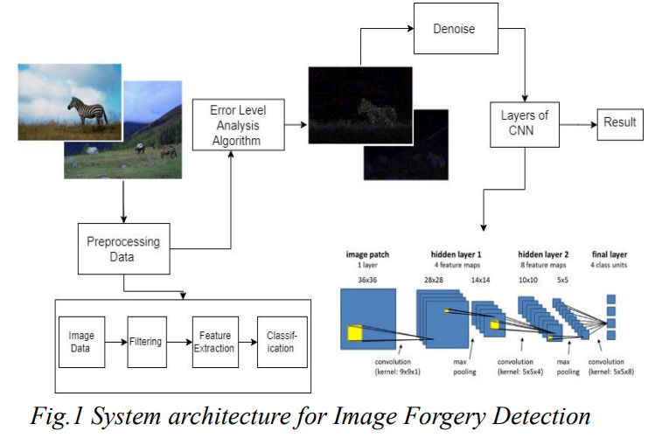
DEPARTMENT OF CSE-AIML (CSM)

Slide 10
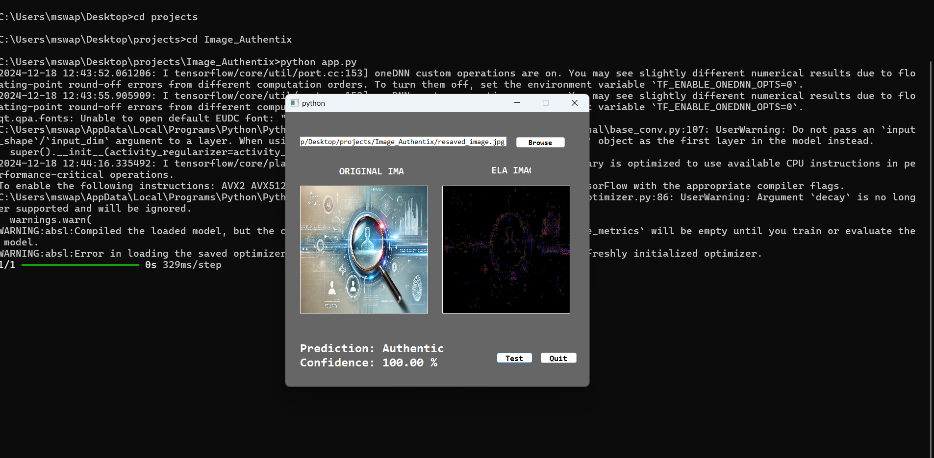
DEPARTMENT OF CSE-AIML (CSM)
Sample predicted model

Slide 11
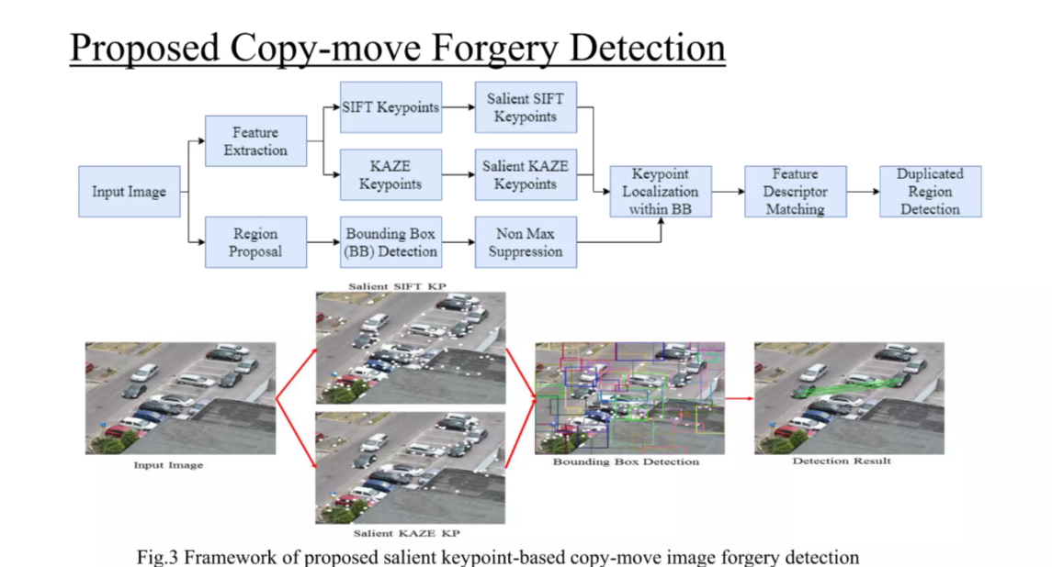
DEPARTMENT OF CSE-AIML (CSM)

Slide 12

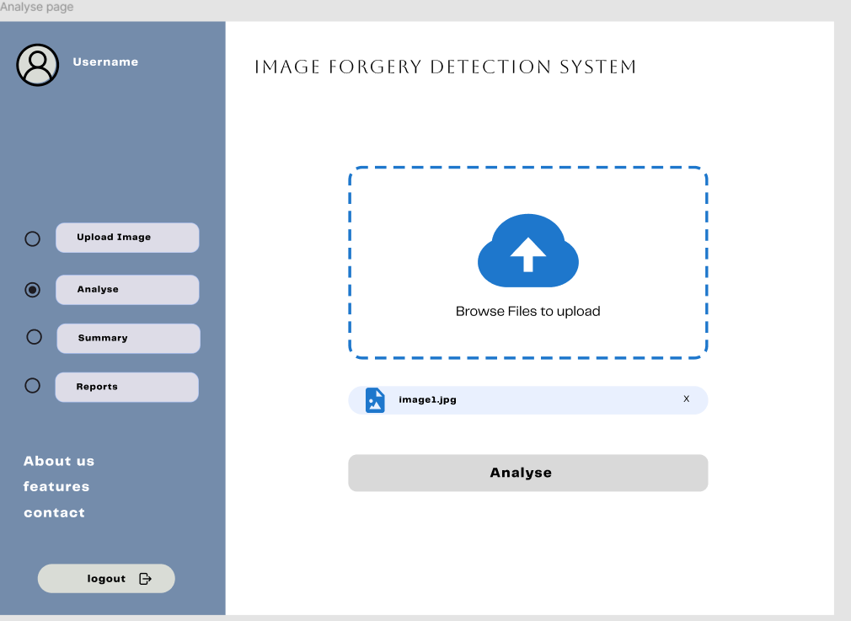
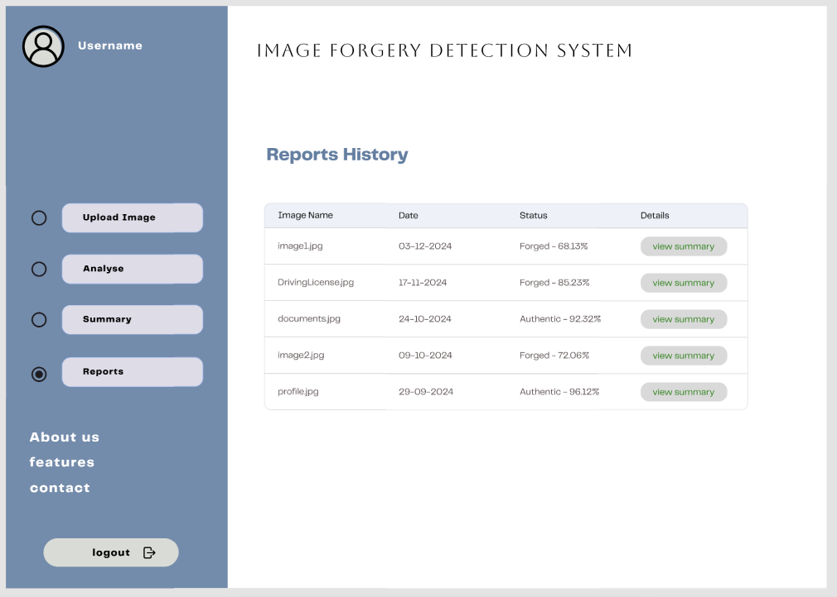
DEPARTMENT OF CSE-AIML (CSM)
Prototype

