Slide 1
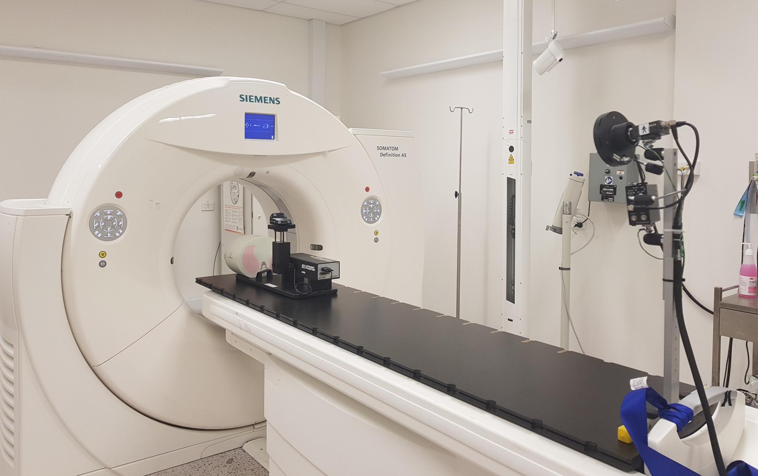

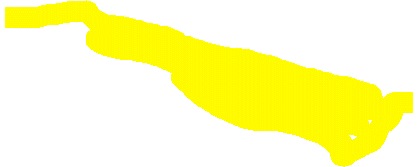

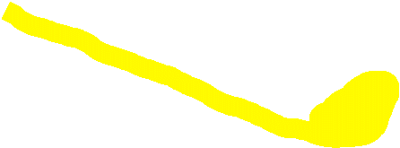


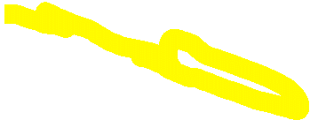
A CT scan was taken of the Blacktown CT couch and should be used for more accurate modelling although it should be noted that the couch itself is longer than the scanning field of view coverage.
The images from this scan can be found on the Image X share drive at:
Z:\GRP-RPL\2RESEARCH\2_ProjectData\REACT\Experiments\2019_Prototype CT couch Measurements_NM\Thorax 1.0 HD_FoV_Series0002
Farah created some cad files for a full couch top model that can be found on the image X share drive at:
Z:\GRP-RPL\2RESEARCH\2_ProjectData\REACT\Experiments\2019_CT couch Measurements_NM\V3 Full top.SLDPRT
Z:\GRP-RPL\2RESEARCH\2_ProjectData\REACT\Experiments\2019_CT couch Measurements_NM\V3Full Basw.SLDPRT
During the scan the black couch top as well as the RPM camera all move together (all parts highlighted in yellow) and the white base remains in place

Slide 2
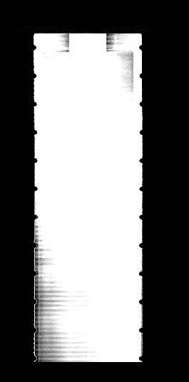
The couch within the imaging region: from above
529
1640

Slide 3
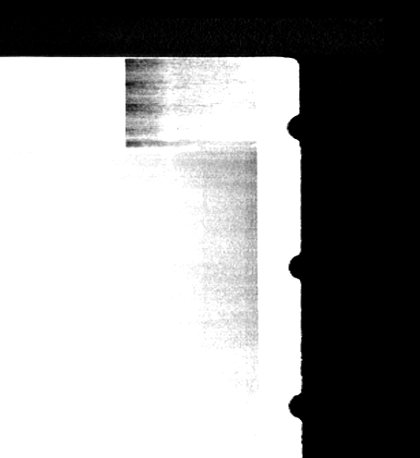
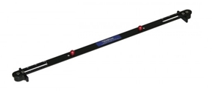
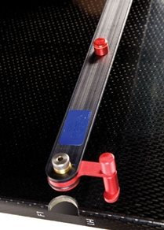
The couch within the imaging region: from above → close up of end of couch closest the CT ring.
The notches are for Lok-Bars that in turn ‘lock’ patient positioning devices to the couch in reproducible manner
58
72
113
139
13mm????
26
26

Slide 4
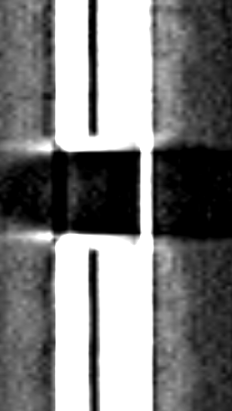
The couch from the side (close up of notch)
26
27
23.5
3.5

