Slide 1
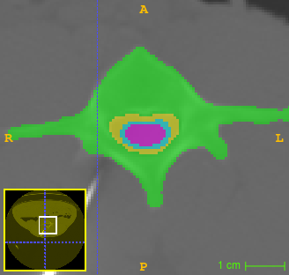
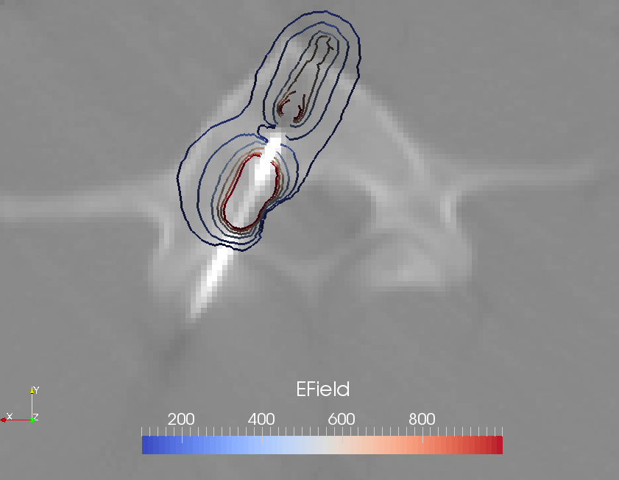
muscle
bone
cord/csf/fat
applicator

Slide 2
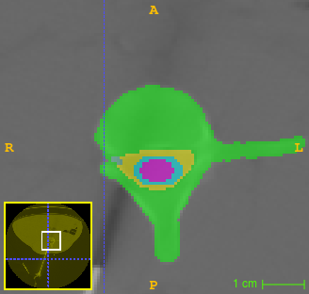
muscle
bone
root
cord/csf/fat
applicator

Slide 3
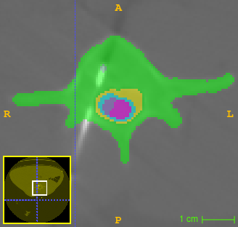
muscle
bone
cord/csf/fat
applicator

