Slide 1
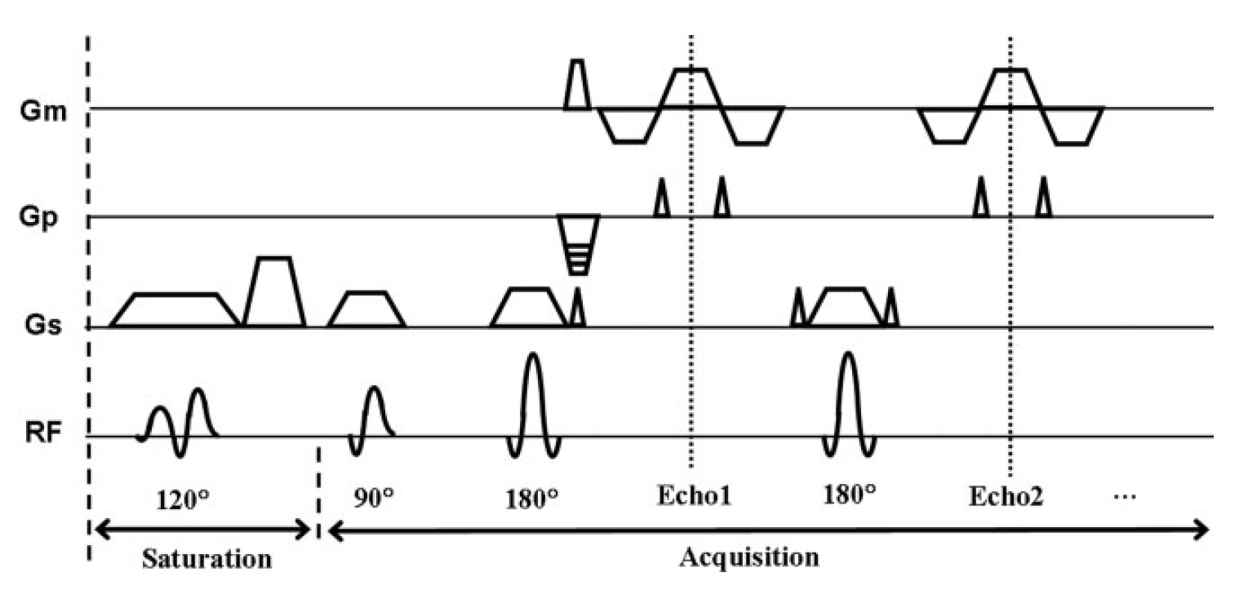
θ = saturation FA
α = local FA
Delay Time = TD
Echo Time = TE
Echo Spacing = ESP
Repetition Time = TR

