Slide 1
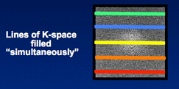
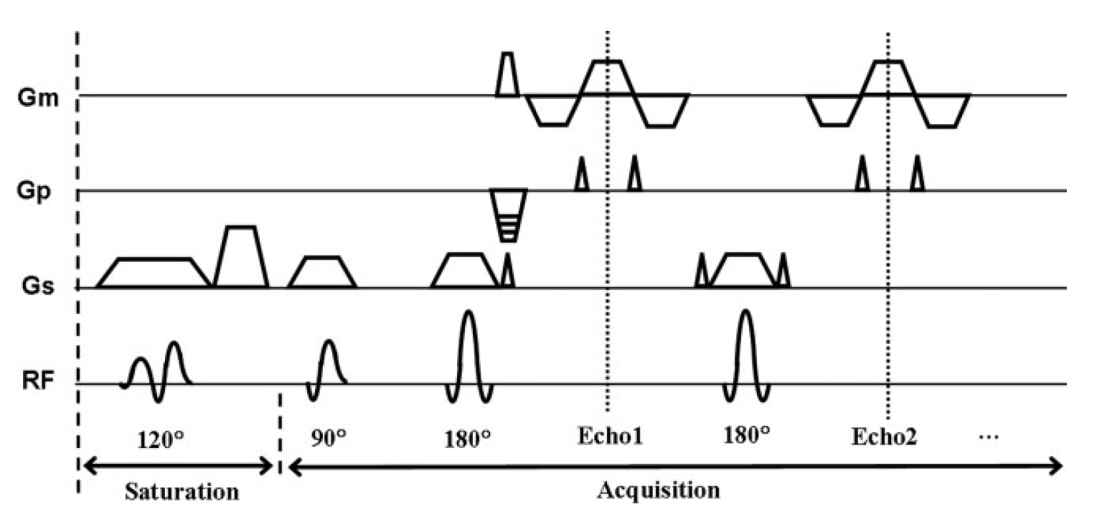
Repetition Time = TR
Echo Spacing = ESP
θ = saturation FA
α = local FA
Echo 2
Echo 3
Echo 4-7
Echo 8
Delay Time = TD
Echo Time = TE1 = effective TE = Time readout crosses k-space 0 on first image
Echo Time = TE2 = effective TE = Time readout crosses k-space 0 on second image

Slide 2
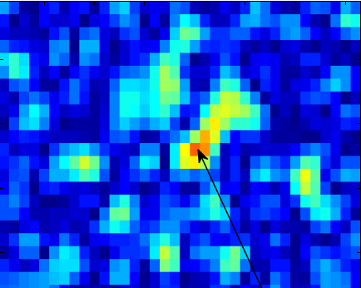
TD
Current Acquisition
Optimal Acquisition
TE

