Slide 1
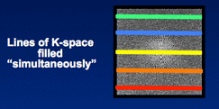
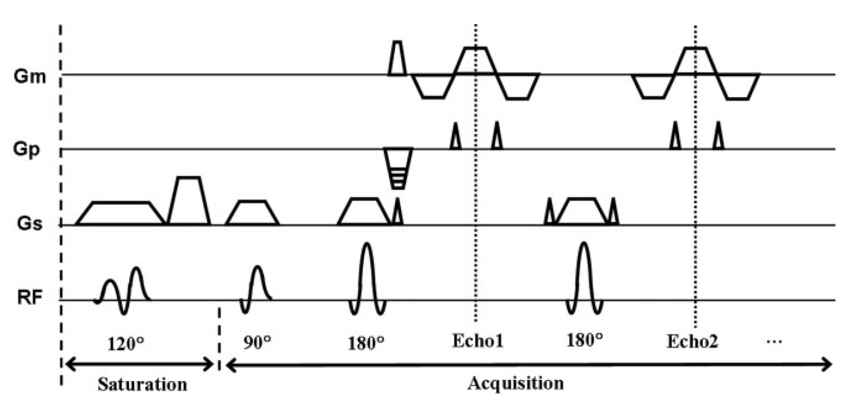
Echo Spacing = ESP
θ = saturation FA
α = local FA
Echo 2
Echo 3
Echo 8
Delay Time = TD
Echo Time = TE1 = effective TE = Time readout crosses k-space 0
Repetition Time = TR

